Slide 1
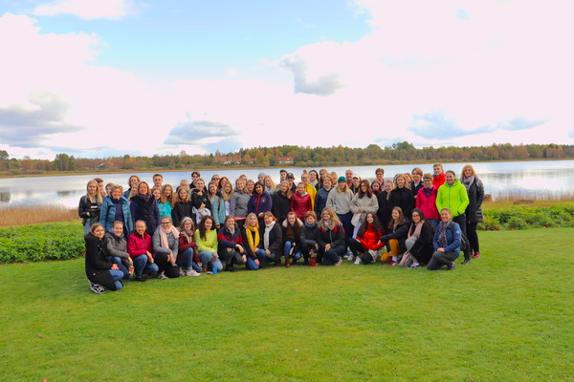
Erasmus + project

Slide 2
“This is the real reason why they let Amazonas burn - Insiders declare about new palm tree plantations”
“Trump shows his support - offers to negotiate with EU about allowing Brexit”
“Alabama passes bill banning abortion”

Slide 3
When you hear the word “fake news” what do you think of?

Slide 4
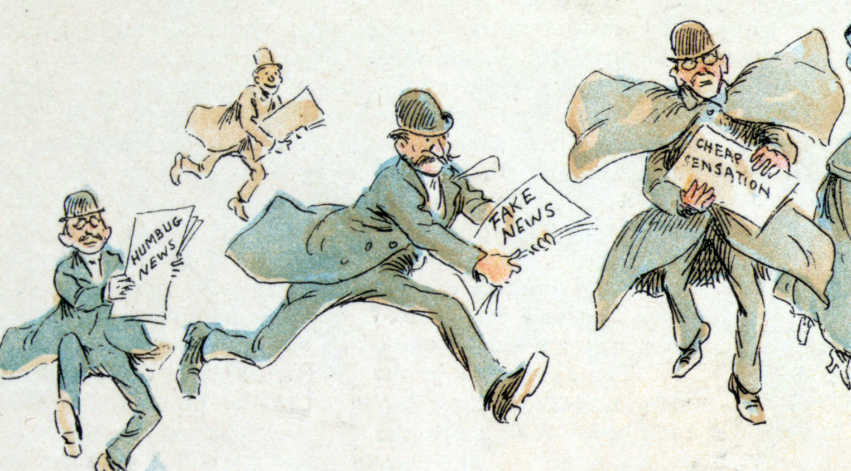
How do you know if something is a fake new? And what can you do to find out if it is or not?

Slide 5
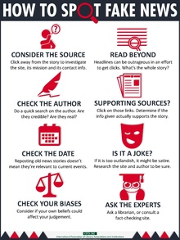
How to identify fake news
Check the source
Read more than just the headline
Look into the writer and when the article was published
Are there any other sources recited?
Do your own opinions agree with the ones in the article?

Slide 6
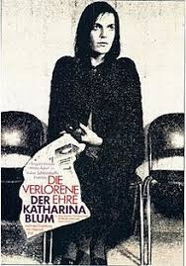
The book: The Lost Honor of Katharina Blum
Heinrich Böll
Published in 1974
Take place in 1970’s
Mistress of a criminal
Normal girl turns into a face off the newspapers
Center of attention

Slide 7
Headline
“Katharina Blum, outlaw’s sweetheart, refuses information on male visitors”
Notes:
What do you think happened here?
If you saw this on a newspaper what would you think about her?
But is it true or false..?
Hand out the paper…..
Questions on the paper:
Now what do you think about her after reading the hole article?
How did the article present her, like how did they make her look like?
Have your opinion of her changed?

Slide 8
Young
Eloquent
Impeccable maid
Well Behaved/Prude
Beautiful
Proud
Innocent
Faithful
Sweet
Loyal
Orderly economy

Slide 9
What impact has the article on Katharina?
paste the text in your language
page 113
article about the death of her mother

Slide 10
What kind of person is Katharina?

Slide 11
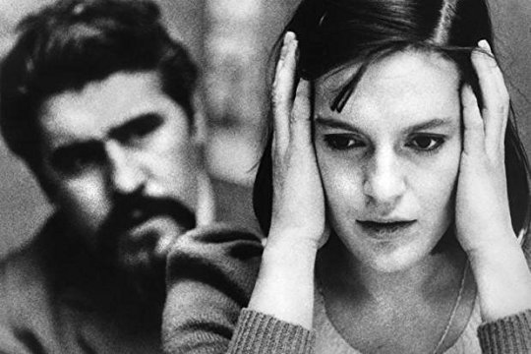
How does she escape the situation?

Slide 12
What would you do if you were her?

Slide 13
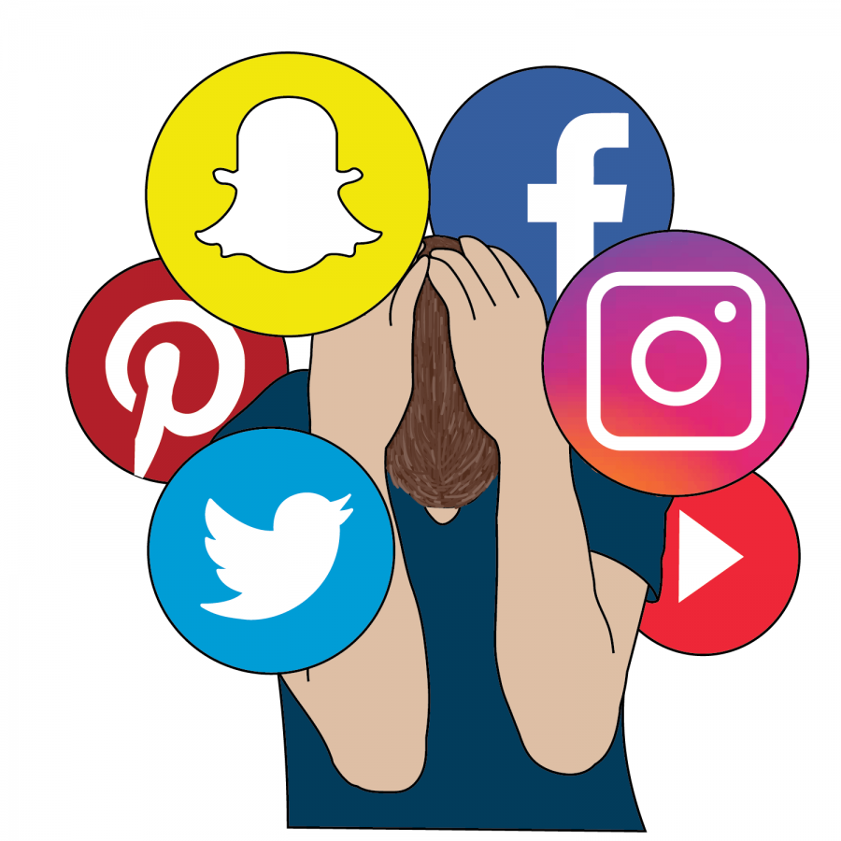
How does the social media effect us today?

