Slide 1
Christmas
In Year 6 (2014)

Slide 2
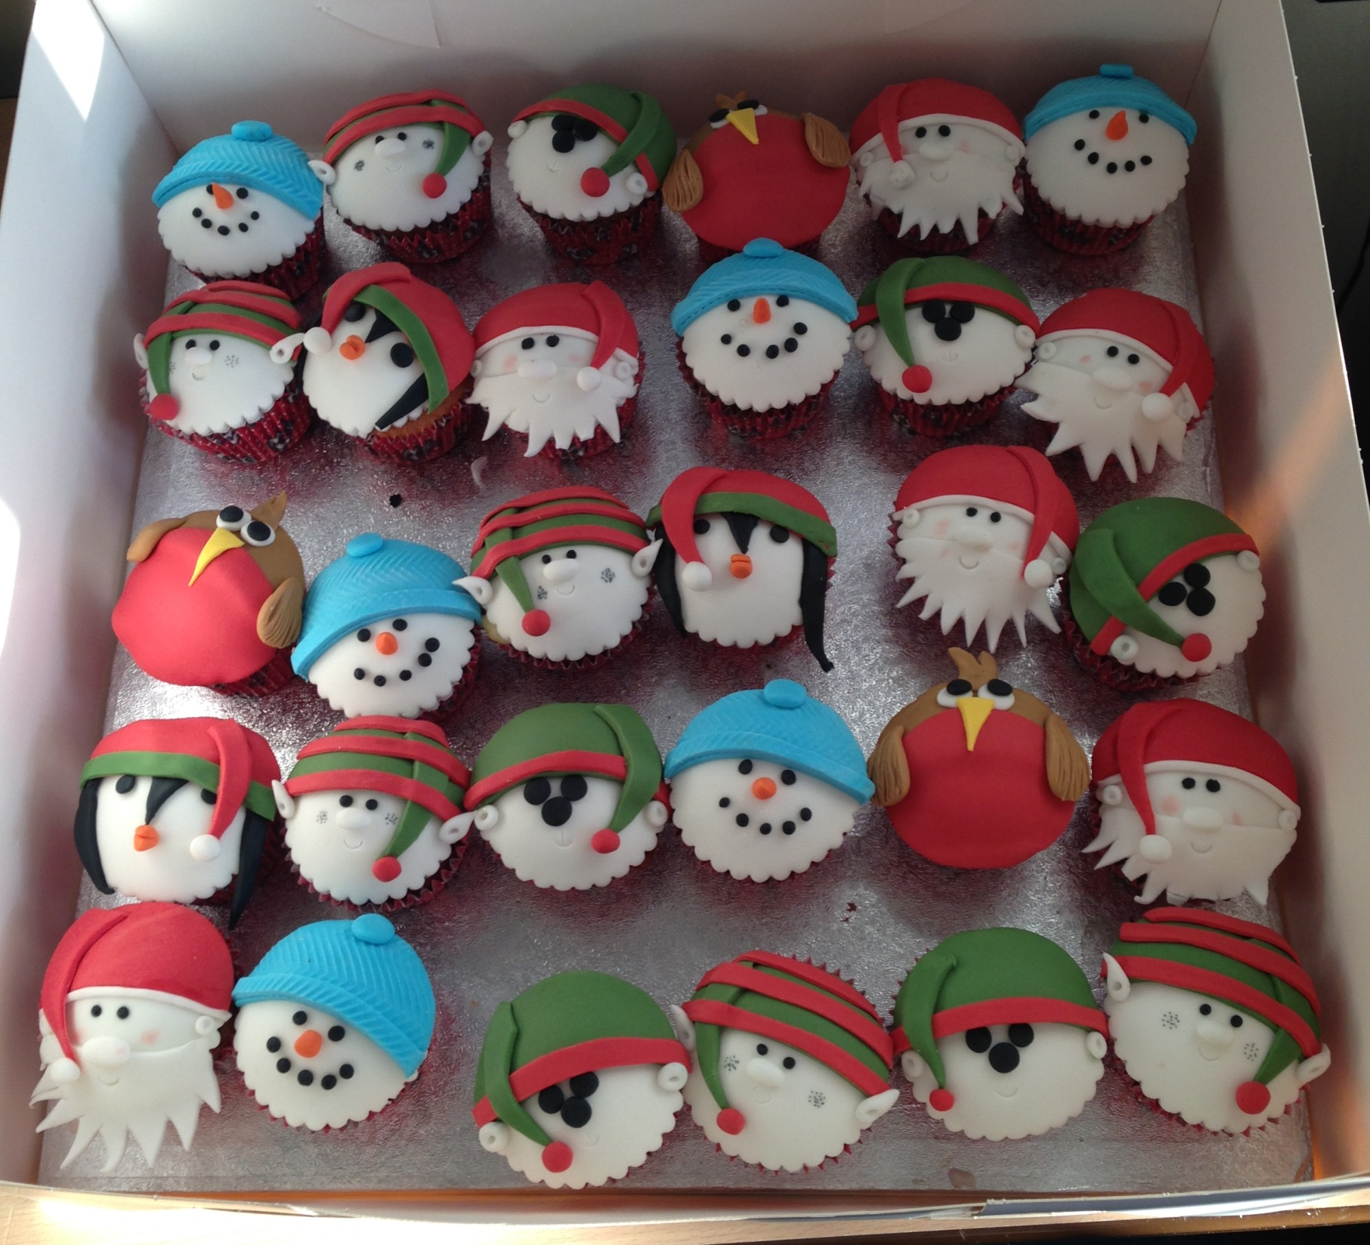
Yum! Our Christmas cupcakes from Lexie – they were very tasty!

Slide 3
Take a look at the next slide,
we made Christmas cards as
part of our Erasmus project!

Slide 4
