Slide 1
INSTRUCTIVE TEXT
FOUR-YEAR-OLD CHILDREN

Slide 2
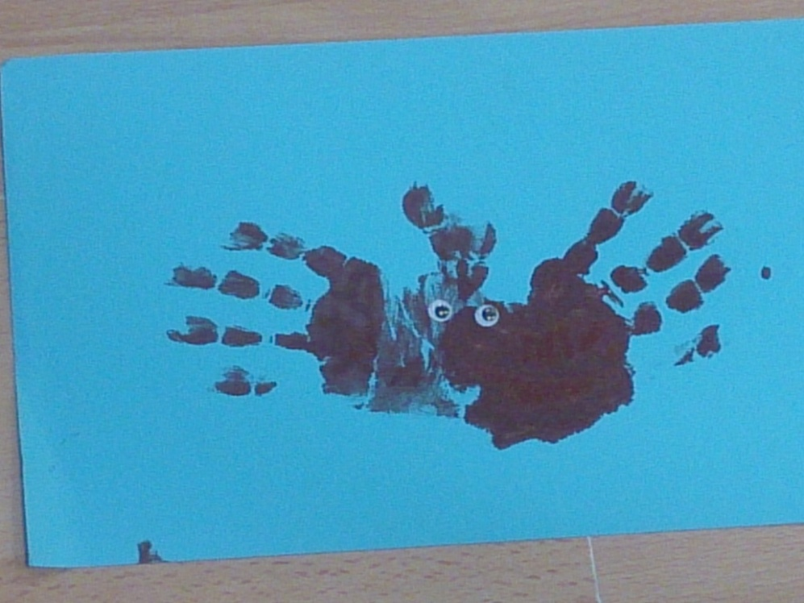
INSTRUCTIVE TEXT
An instructive text explains how to do something.
Four-year-old children made a SPIDER-HAND by using this type of text for Halloween

Slide 3
INTRODUCTION
First of all… the teacher introduced the activity.
“We are going to make a SPIDER-HAND!”

Slide 4
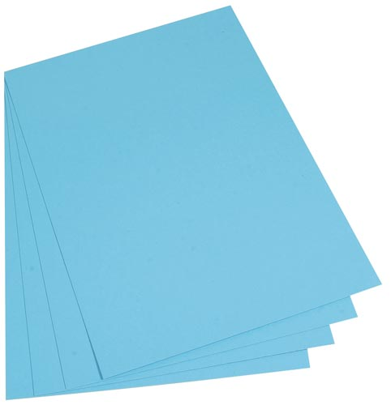
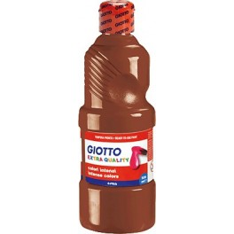
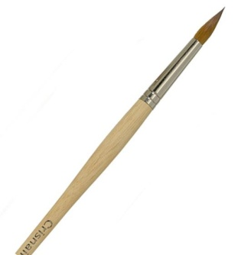
MATERIALS
What materials we will use?
1. Blue cardboard
2. Brown paint
3. A brush

Slide 5
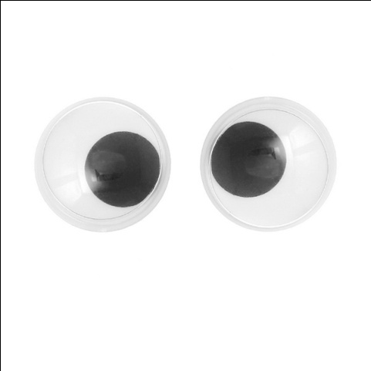
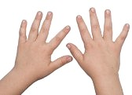
MATERIALS
4. Eyes
5. Our hands

Slide 6
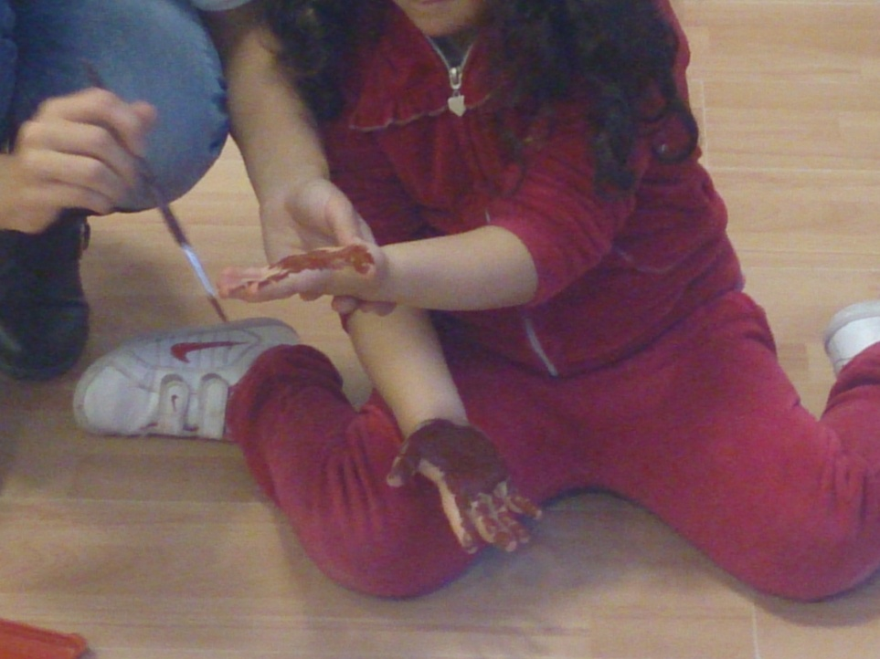
THE ACTIVITY
The teacher gives the children a demonstration and explains how to do the activity
1. We paint our hands by using the brush and the brown paint.

Slide 7
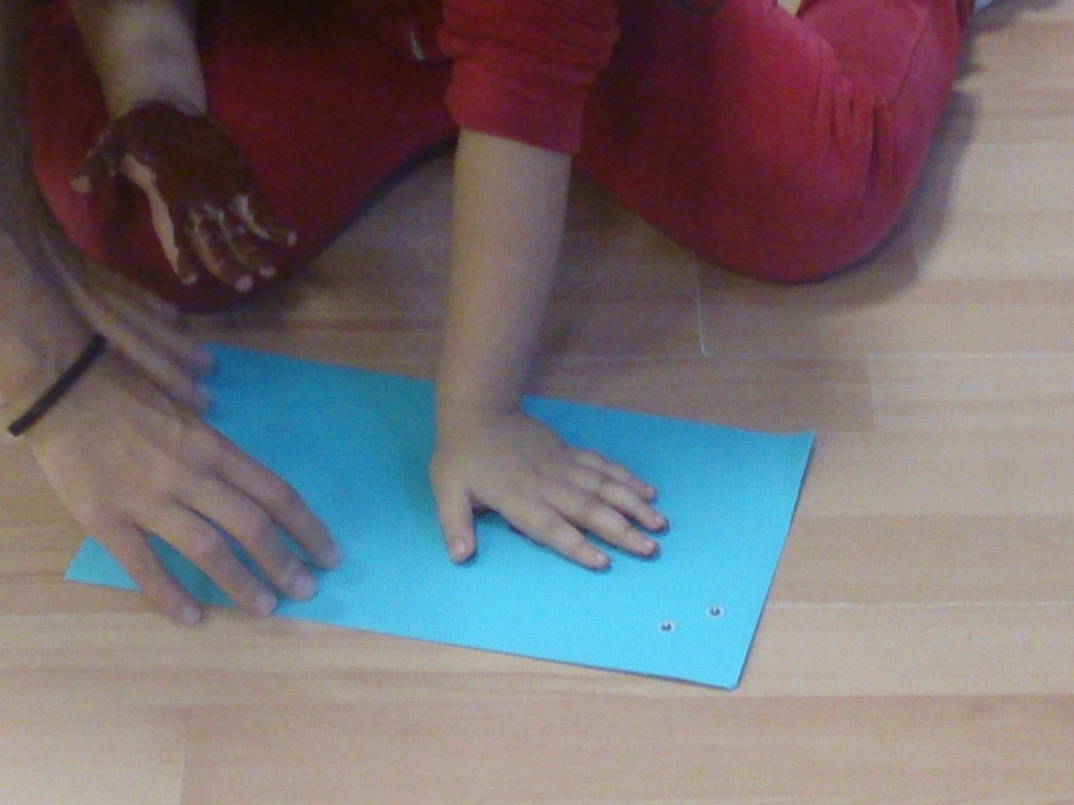
THE ACTIVITY
2. We put our left hand horizontally on the paper.

Slide 8
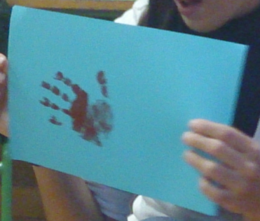
THE ACTIVITY
3. We raise our left hand

Slide 9
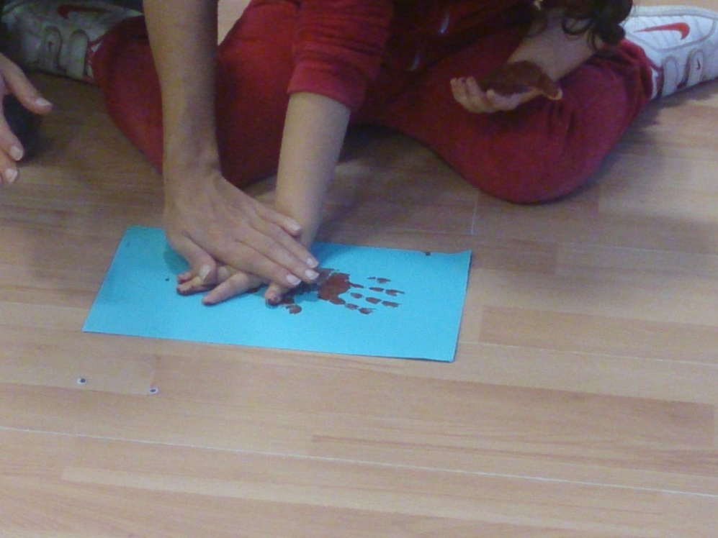
THE ACTIVITY
4. We put our right hand horizontally on the paper, in the contrary direction to the right hand.

Slide 10
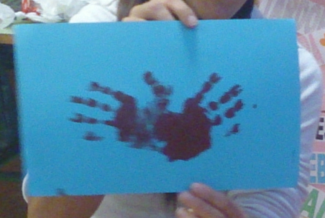
THE ACTIVITY
5. We raise our right hand.

Slide 11
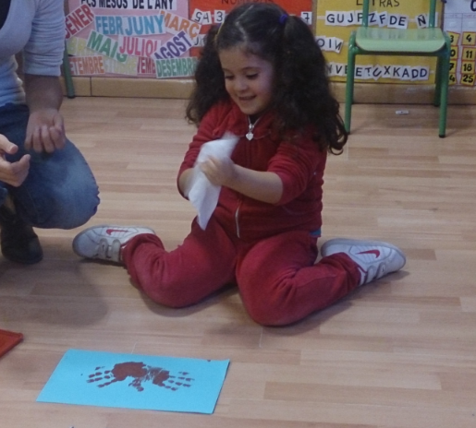
THE ACTIVITY
6. We almost have our SPIDER-HAND. Now, we have to clean our hands.

Slide 12
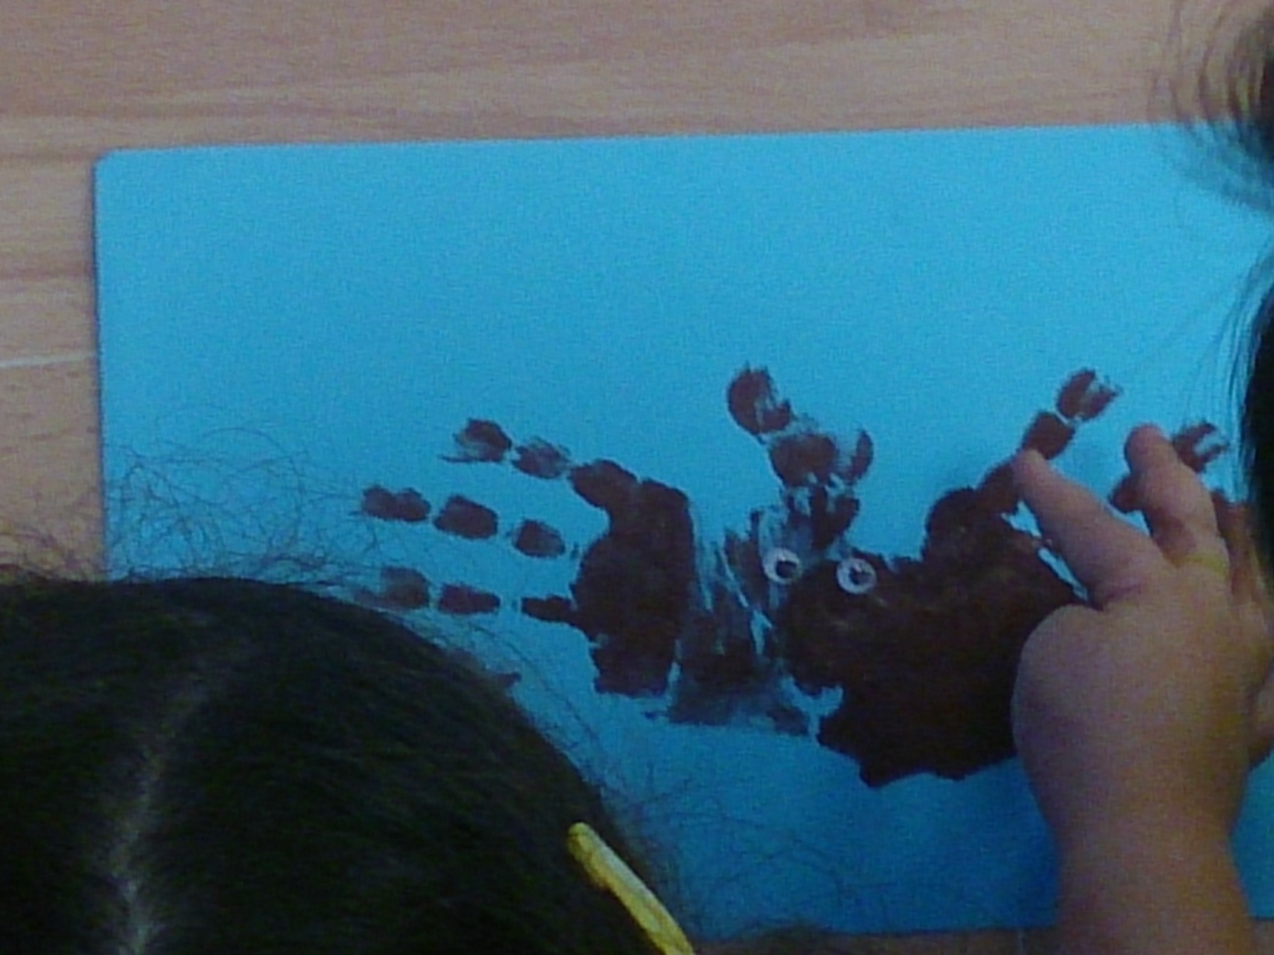
THE ACTIVITY
7. Finally, we paste the eyes on the SPIDER-HAND.

Slide 13
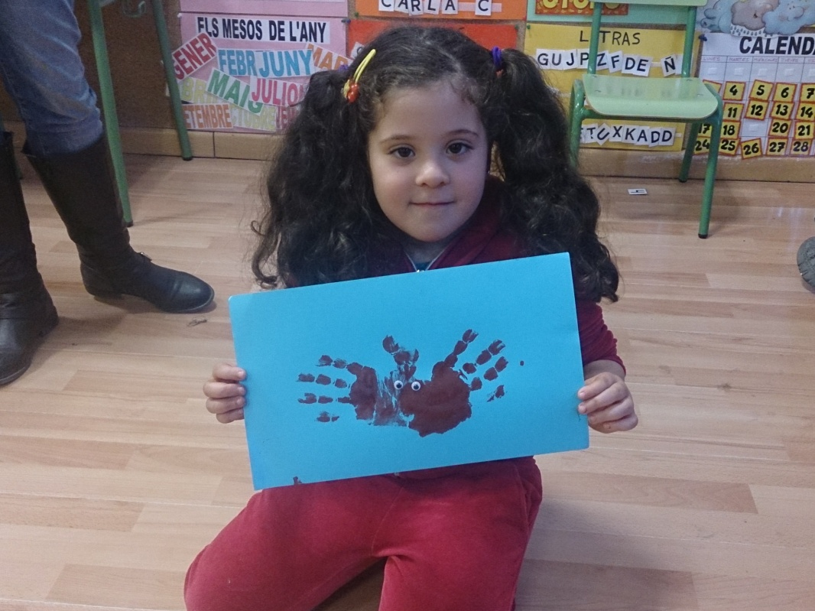
THE SPIDER-HAND IS DONE!
This is the result! A fun spider made with our hands

