Slide 1
Magic pumpKIN
P3
"CEIP SAN JOSÉ DE CALASANZ “
SPAIN

Slide 2
MAGIC PUMPKIN
Our instructive text is based on how can my pupils get Orange from red and yellow crayons.
For that, they need different materials, such as liquid crayons, some sheet of papers with a pumpkin on it and brushes, although they need to go step by step and pay too much attention.
With this PowerPoint we would like to show our project, and how pupils with three years old can work individual and in big groups on their own.

Slide 3
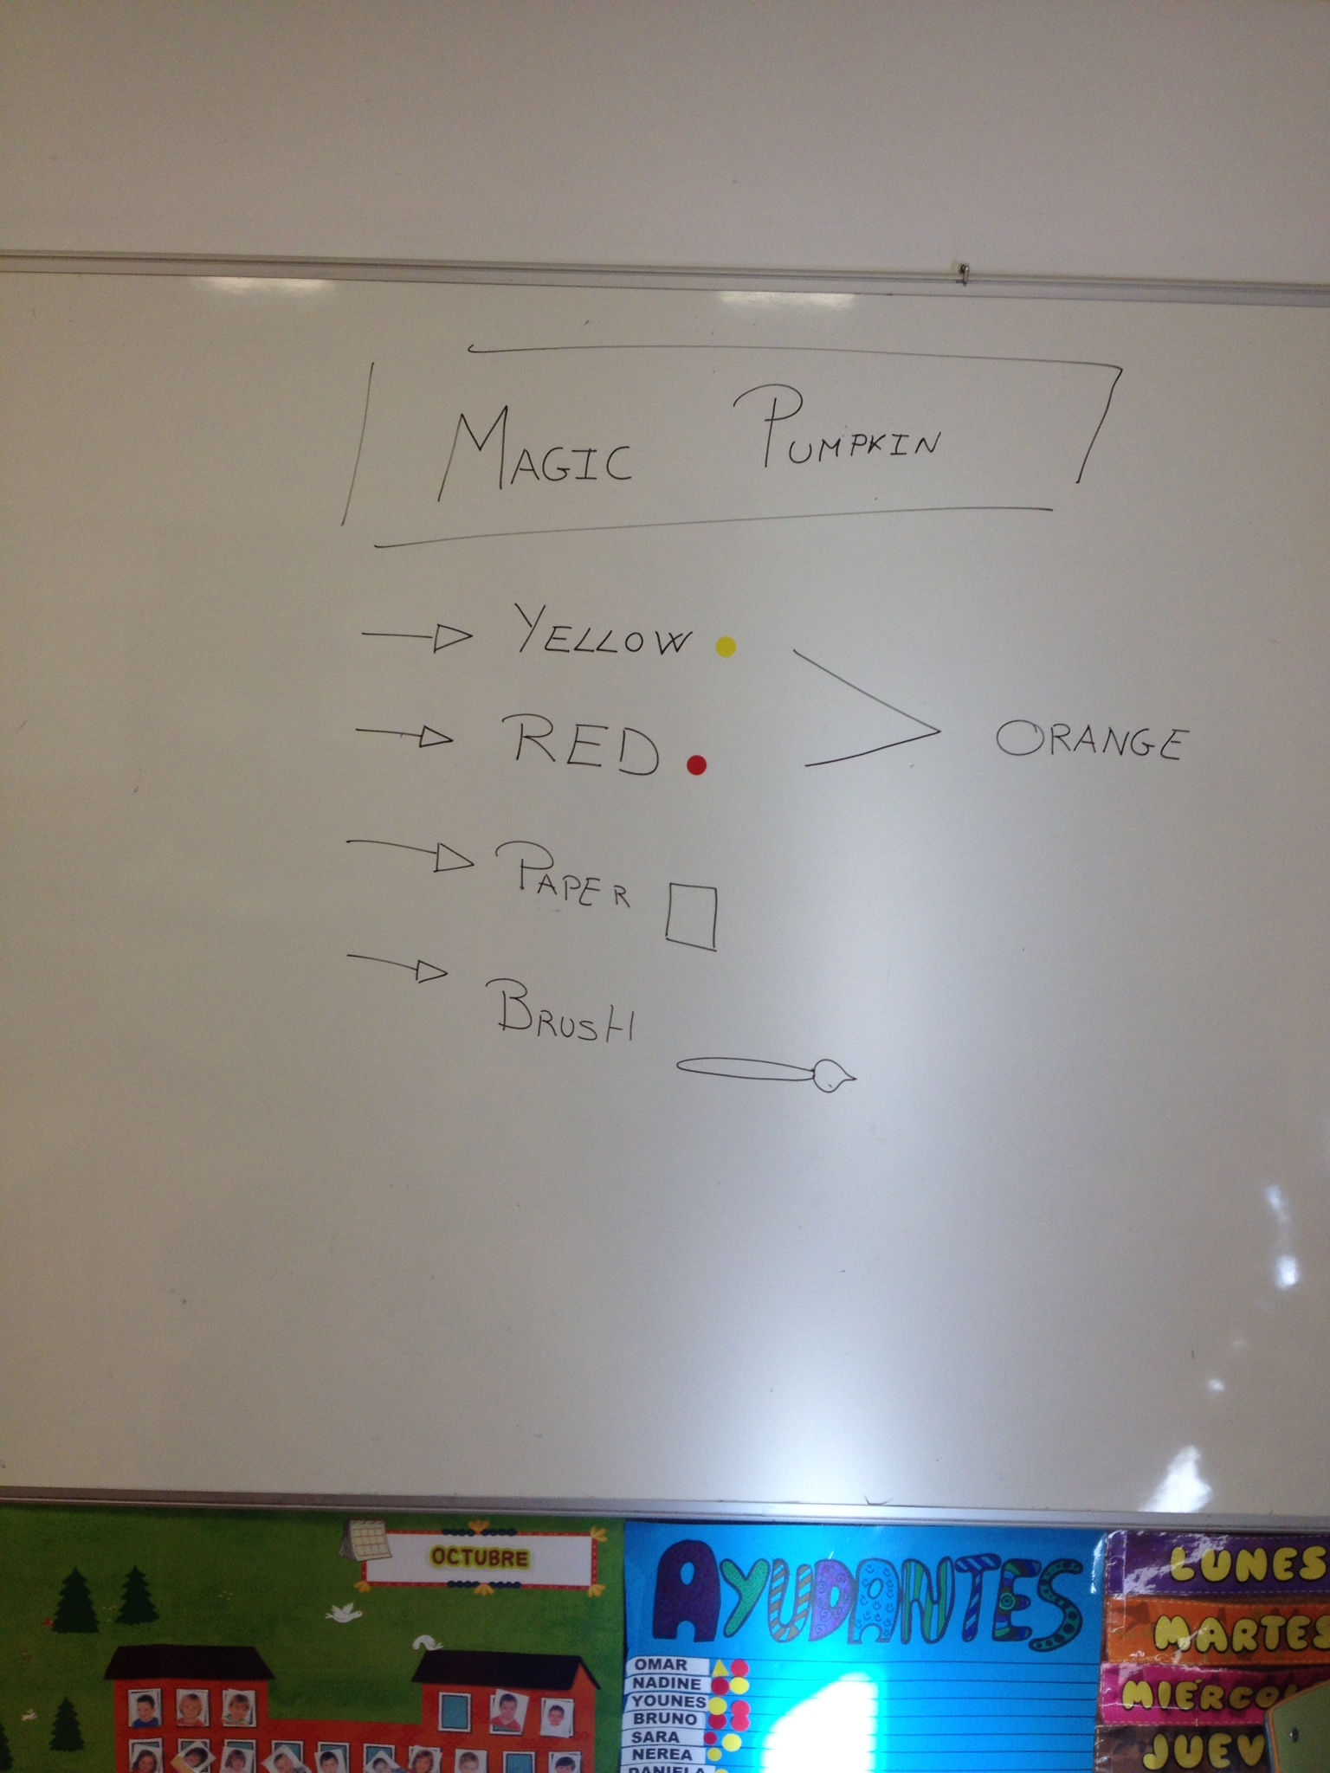
First of all... What do we need?

Slide 4
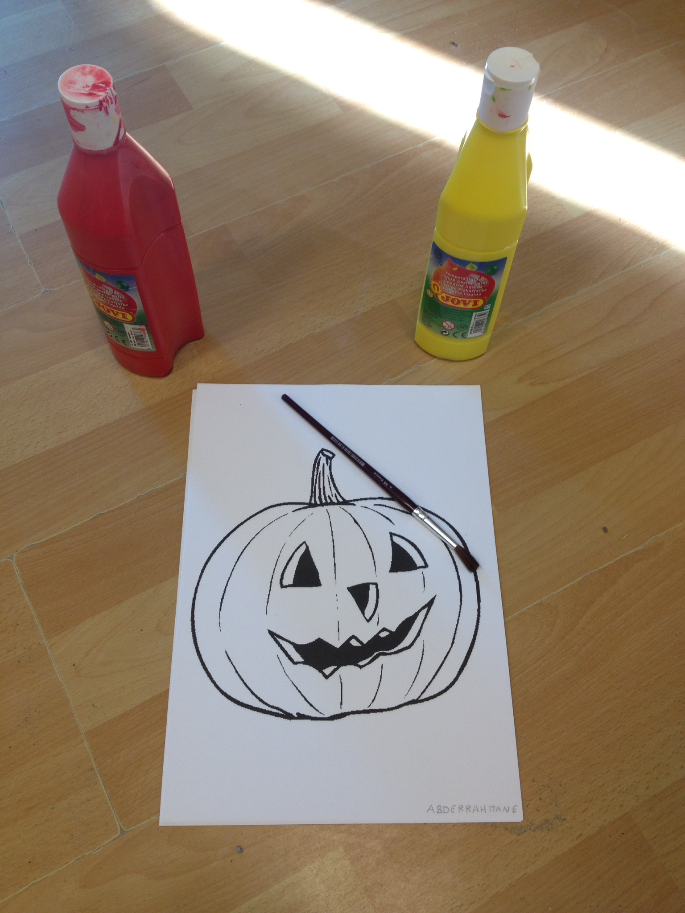
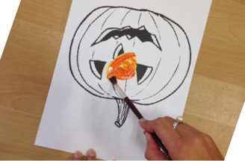
Once we have in mind all what we need it's time to start.
We need red and yellow crayons. Later with some help we will put some red and yellow on the pumpkin. Now is time to mix the colours with a brush or with your finger to get …

Slide 5
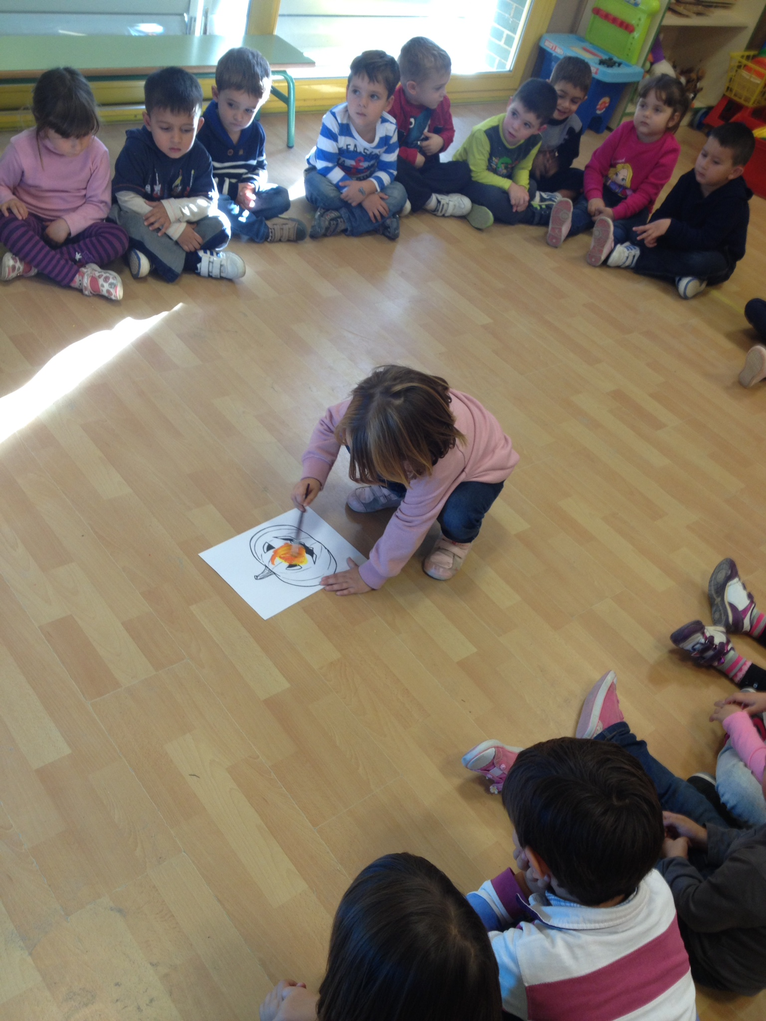
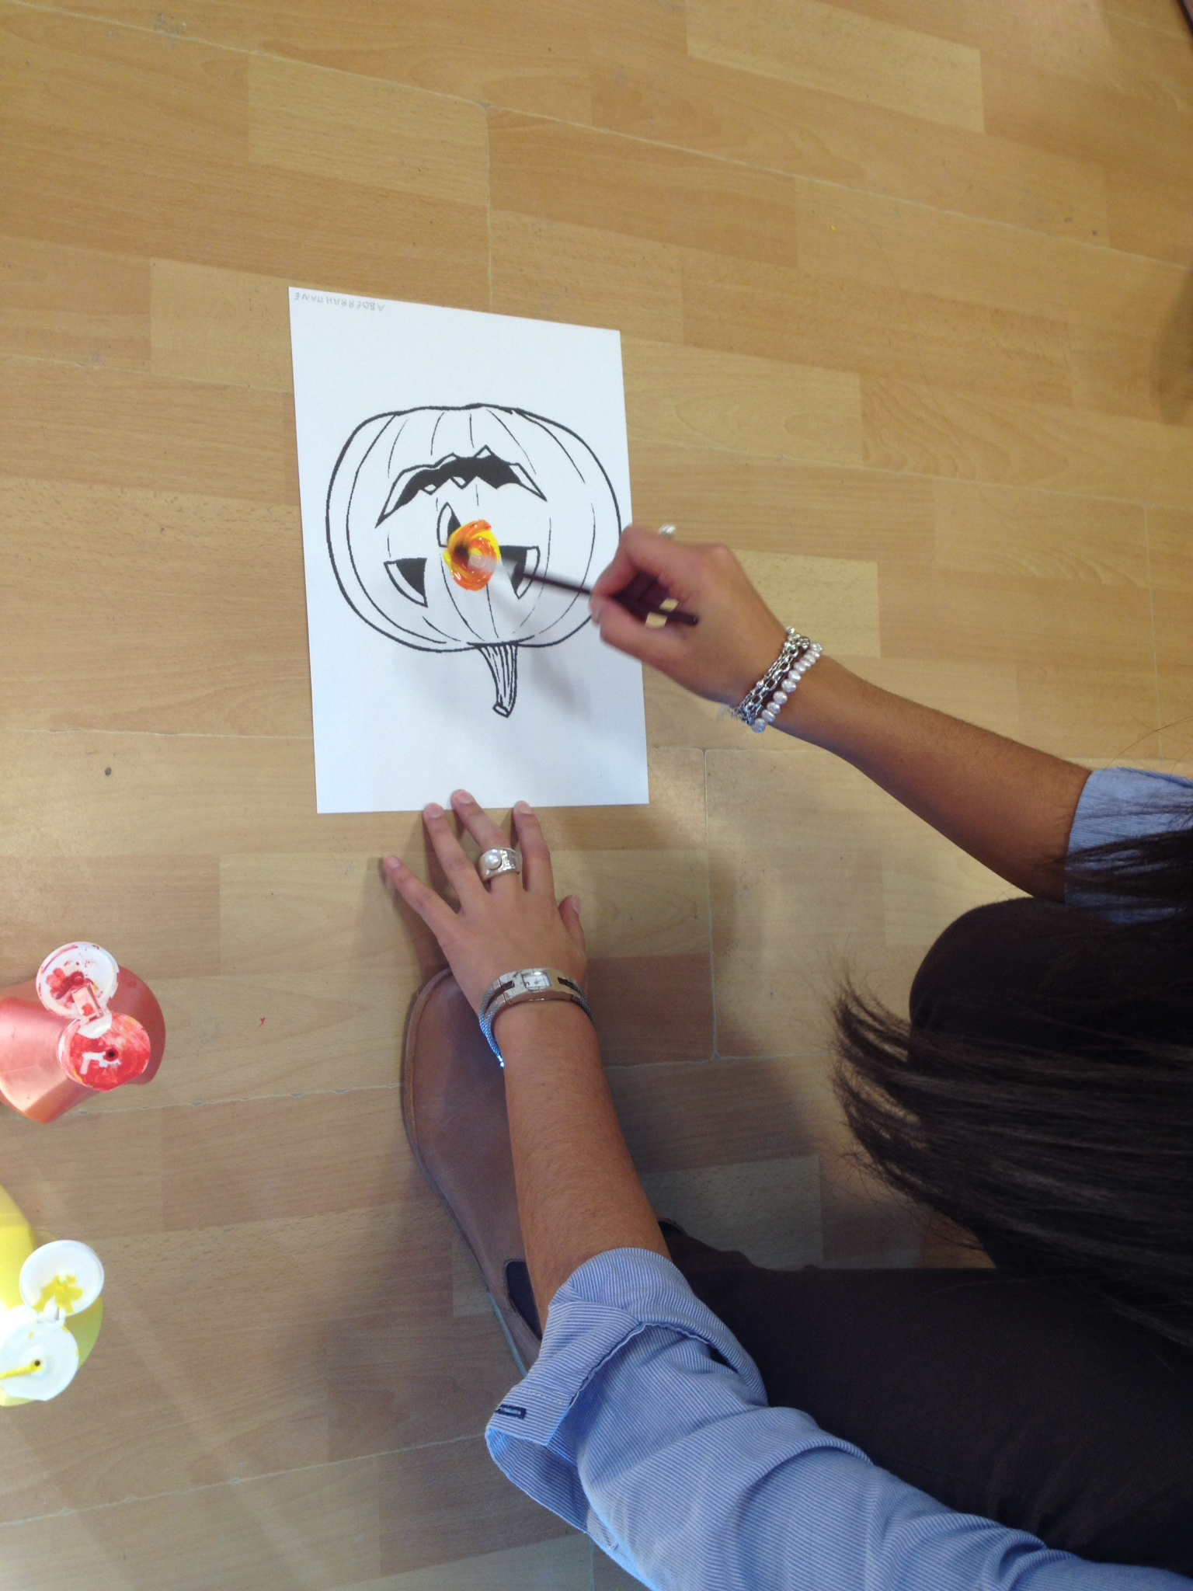
We need to show them how to do it and then….

Slide 6
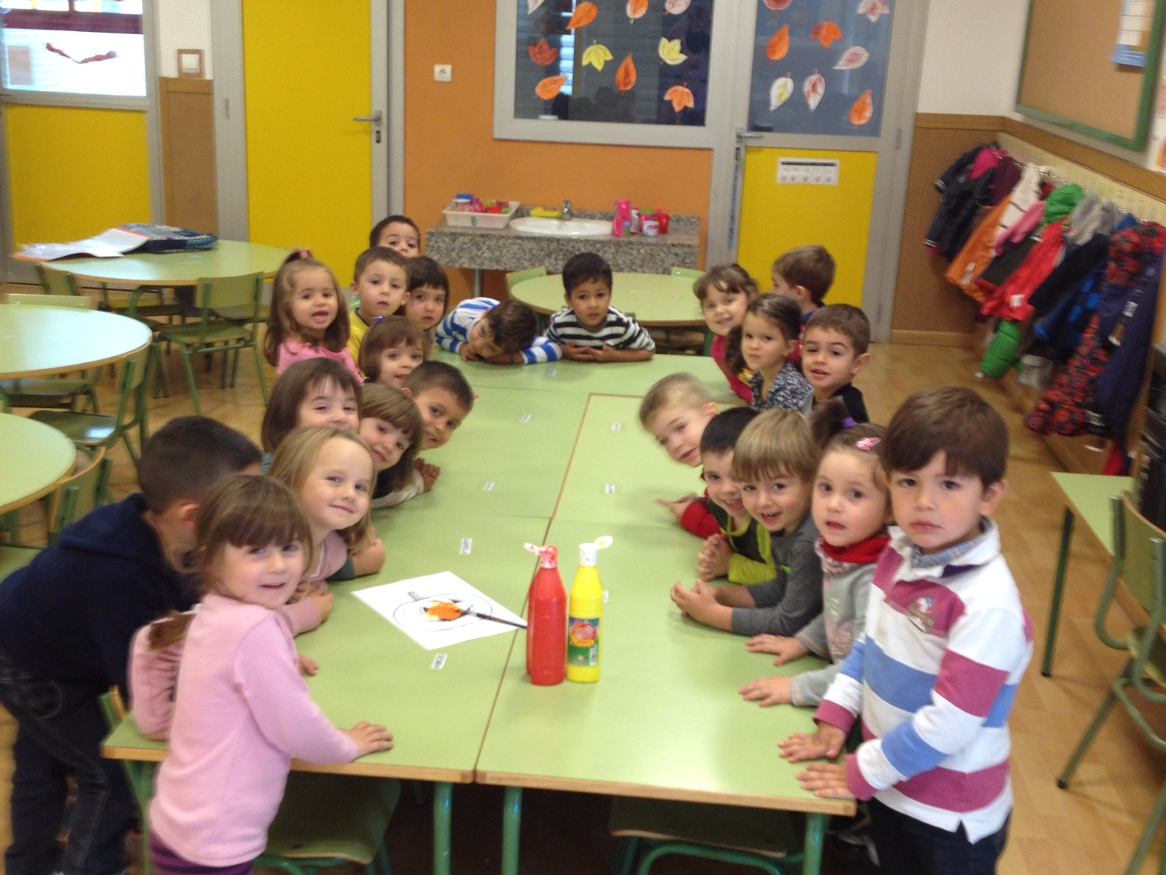
Ready to start….

Slide 7
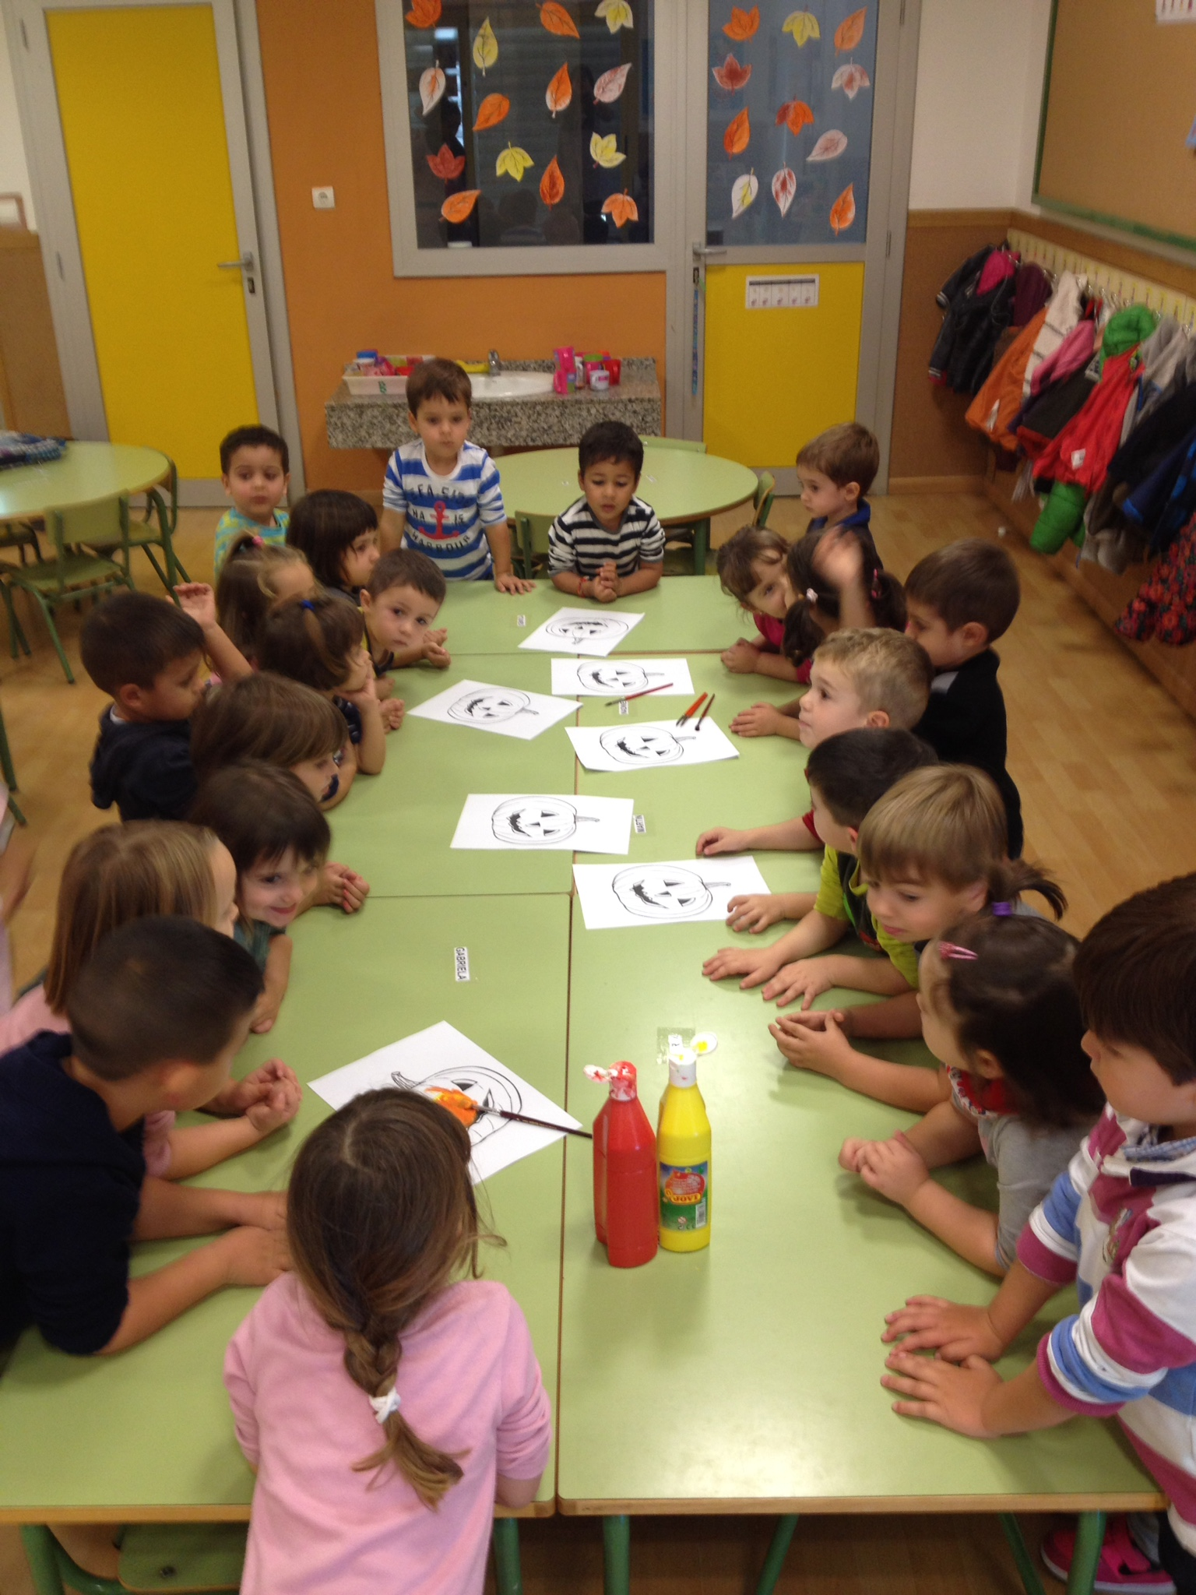

Slide 8
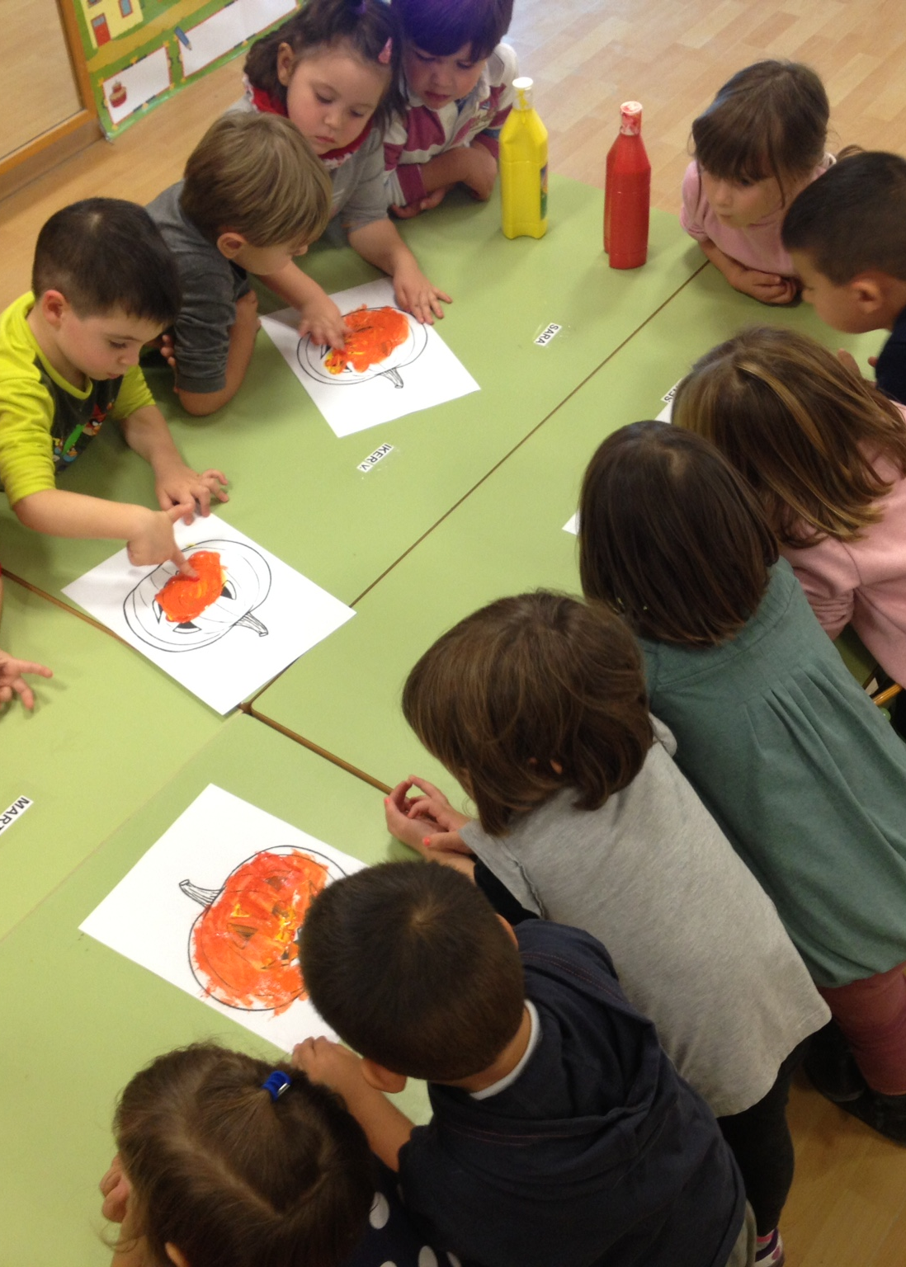
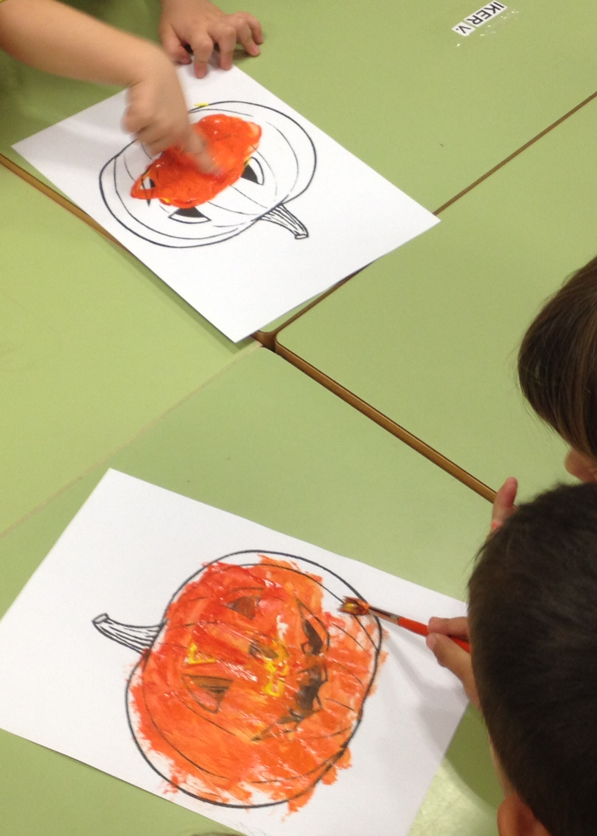

Slide 9
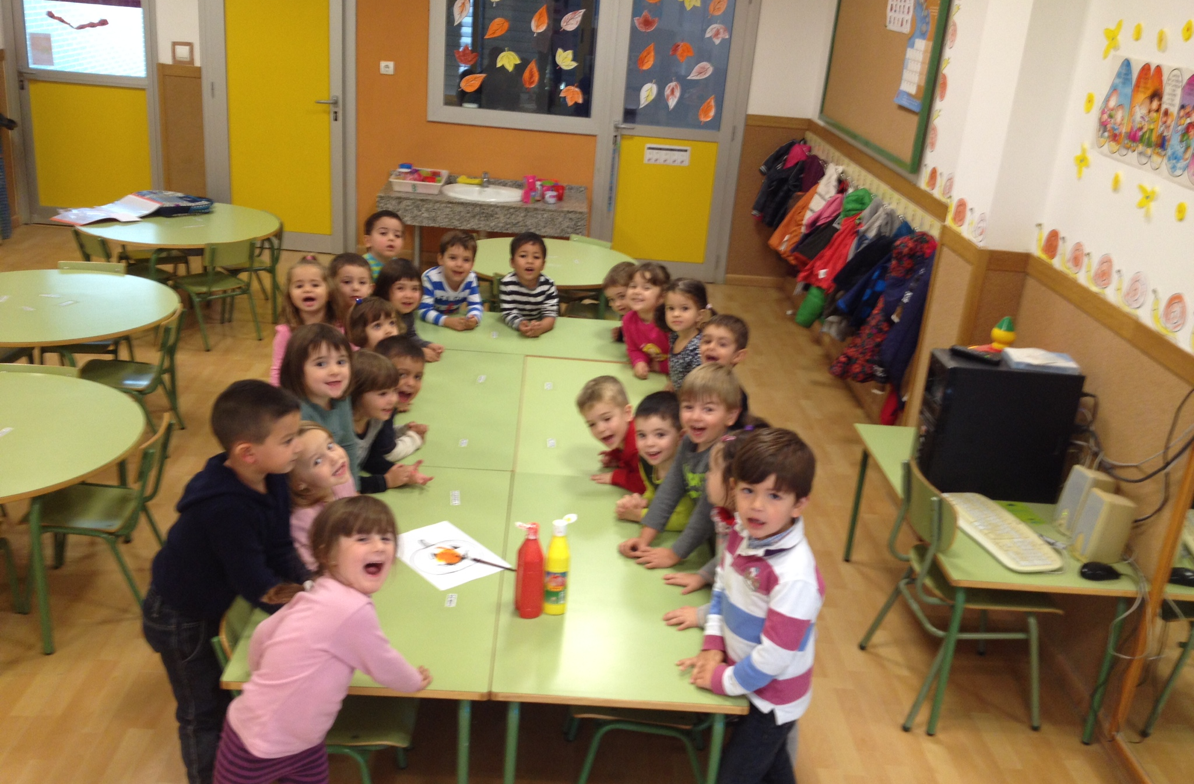
And finally we got some orange pumkins for our class!!!

