Slide 1
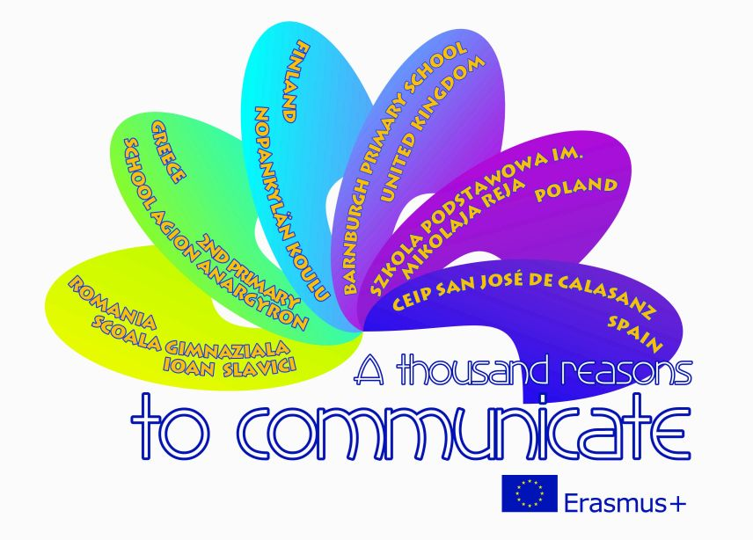

The most popular places in Poland!
Erasmus
Wiktoria Mirczuk Class: I B

Slide 2
Kraków: Wawel Cathedral:
The construction of the cathedral began Bolesław Chrobry in 1020. The patron of the cathedral is Saint Wacław. It has survived decades and was destroyed by fire. In 1320 in the ruins of the cathedral was crowned Władysław Łokietek. And later it was rebuilt in gothic style.

Slide 3
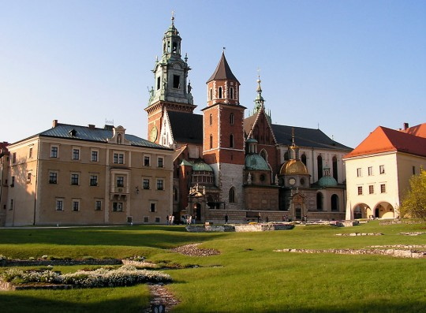

Slide 4
Wieliczka: Historic underground salt mine:
Entering underground mine we see customary greeting and salutations with the words "God Bless". During the tour we will see antique tools, treadmills or structures of carpentry. Attraction is also a series of sculptures made of salt created by self-taught artists and miners and featured in many places. The grandest is the Chapel of Saint Kinga.

Slide 5
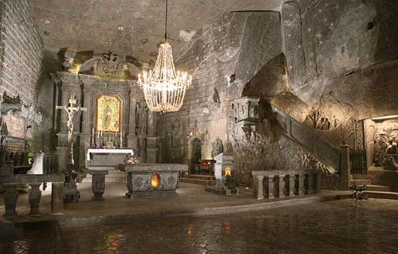

Slide 6
Oświęcim: German Nazi Concentration and Extermination Camp ( 1940-1945):
A place created by the Nazis; till 1942 it served as a place of slow extermination of prisoners, not due to human existence but due to hard work and hunger. From spring 1942 to autumn of 1944 it became an additional place of immediate and mass extermination of Jews from all over Europe.

Slide 7
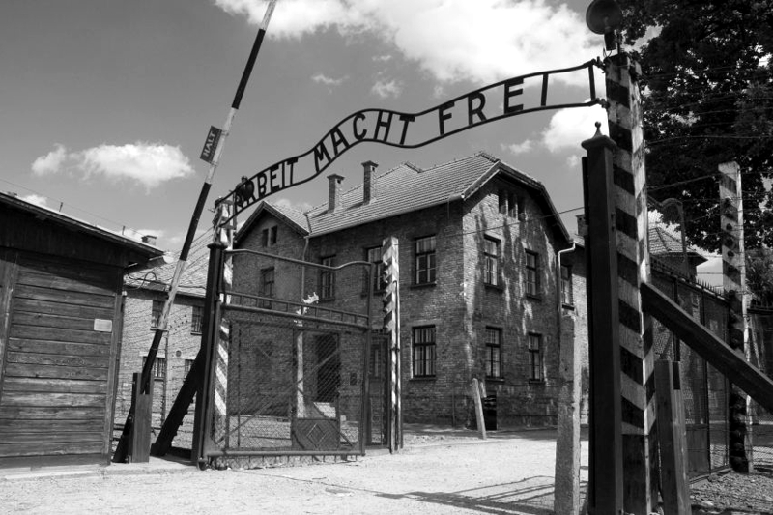

Slide 8
Warszawa: Square castle:
Until the eighteenth century, the most important square of the city, where life concentrated in Warsaw. In the square active spcial life took place. Alongside square are the Zygmunt's Column, Royal Castle and Coper-Roof Palace.

Slide 9
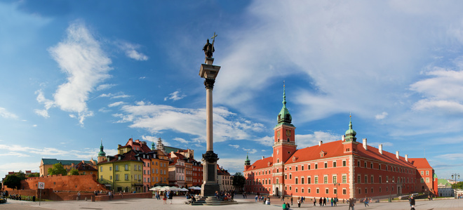

Slide 10
Zamość: Town hall:
The main bulding in Zamość Old City. It has a 52-meter high clock tower and wide, fan-shaped staircase. At the town hall tower every day (in season) at 12.00 is played a bugle called zamojski.

Slide 11
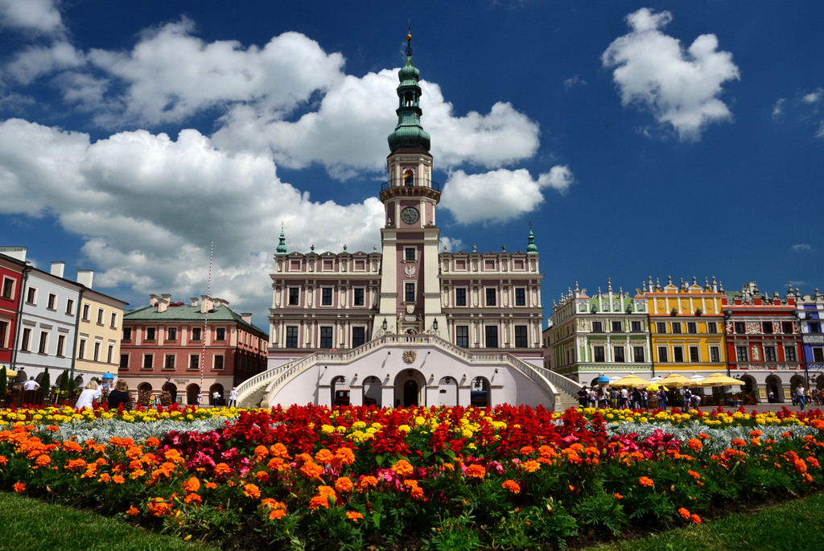

Slide 12
Toruń: Nicolaus Copernicus Monument:
Monument shows Nicolas Copernicus dressed in a professor toga and in his left hand he holds an astrolabe; a finger of this right hand indicates the sky, which indicates Copernican astronomy links and research of the sky.

Slide 13
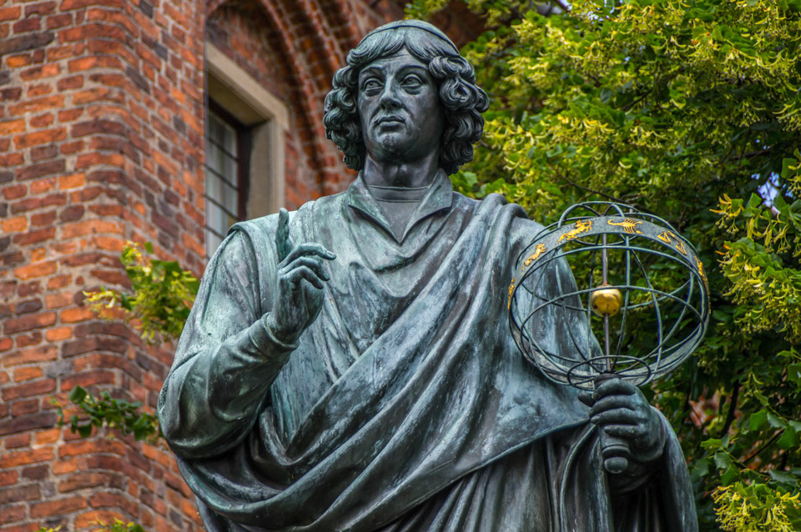

Slide 14
Malbork: Teutonic castle:
The castle was built by the Knights of the Order of St. Mary's Hospital German House in Jerusalem, popularly known as the Teutonic Knights. It was one of the three largest, next to the Knights and the Knights Templar, Teutonic Orders.

Slide 15
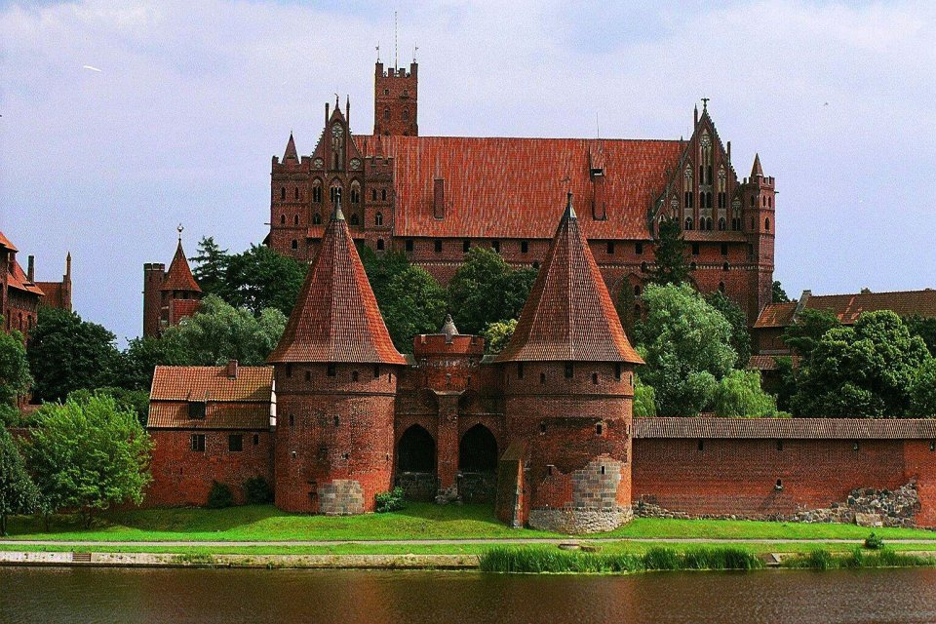

Slide 16
Świdnica: Church Peace:
At the beginning of the eighteenth century, the church bell tower was founded by the evangelical school and built. In 1989, the church became a symbol of peace and reconciliation in Europe today.

Slide 17
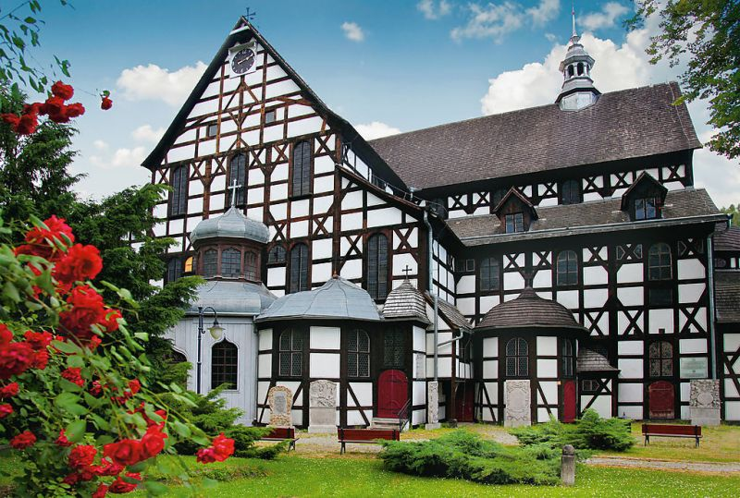

Slide 18
Wrocław: Centennial Hall
Currently, Hall serves as a sports and entertainment facility. The property held sports competitions, fairs, congresses and monumental opera performances.

Slide 19
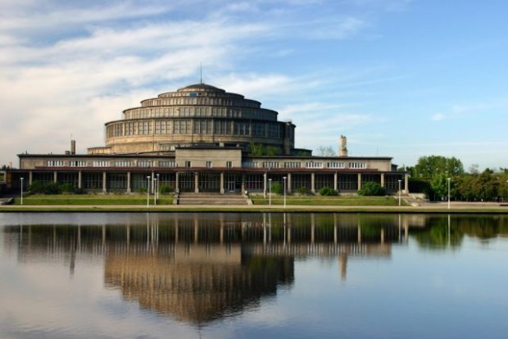

Slide 20
Puszcza Białowieska:
Sightseeing strictly protected area is carried out only with a guide. In the valley of Narewka river a tower was built to observe the animals. The park includes the Museum of Natural History and Forestry.

Slide 21
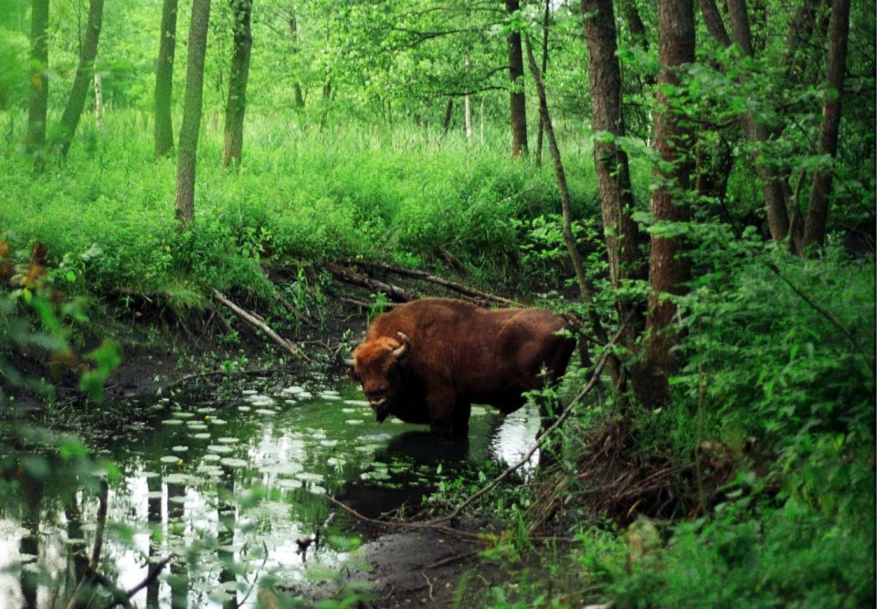

Slide 22
Sources:
Book UNESCO World Heritage Sites in Poland
Google Images
Wikipedia

Slide 23
Thanks for your attention!
Wiktoria Mirczuk Class: I B

