Slide 1
How to become a witch
Celia Andrés – Soraya Ordás

Slide 2
Instructional text
YEAR 1

Slide 3
We have worked the book Room on the Broom in this unit.
Children have done a spell to work the instructional text.

Slide 4
Ingredients

Slide 5
A hat

Slide 6
A twig

Slide 7
A broomstick

Slide 8
Ten bones

Slide 9
Steps

Slide 10
First …

Slide 11
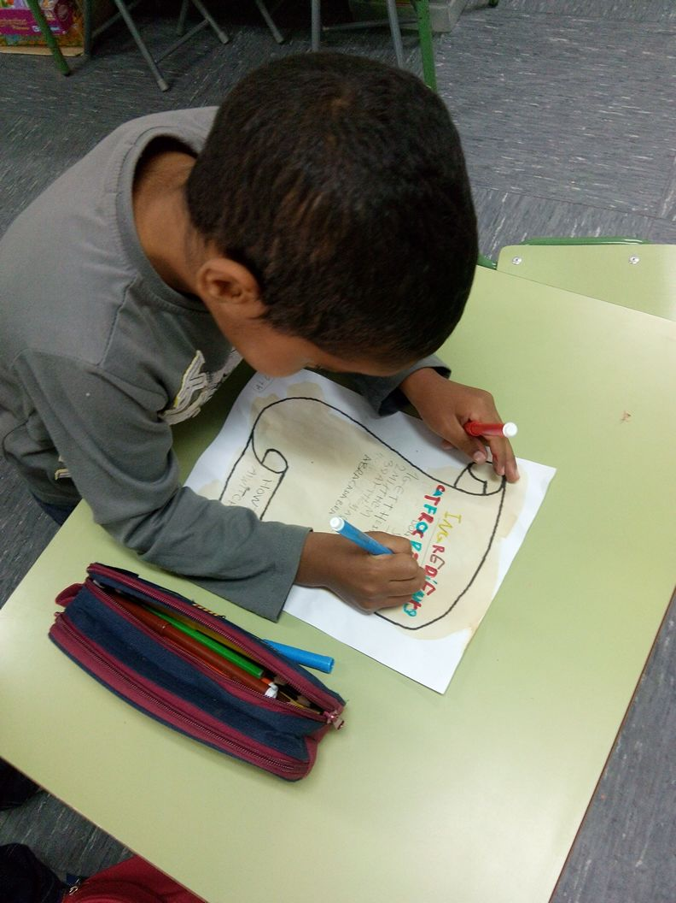
Second …

Slide 12
then …

Slide 13
Finally…

