Slide 1
Instructive texts
Recipes
Our potions

Slide 2
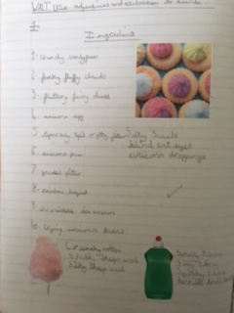

Slide 3
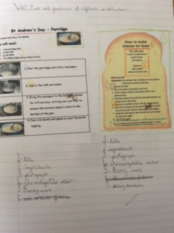

Slide 4
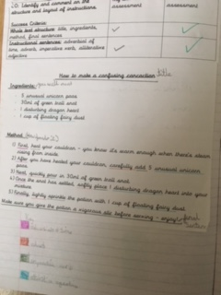

Slide 5
