Slide 1
Visit my town ☺
Visit Rejowiec Fabryczny

Slide 2
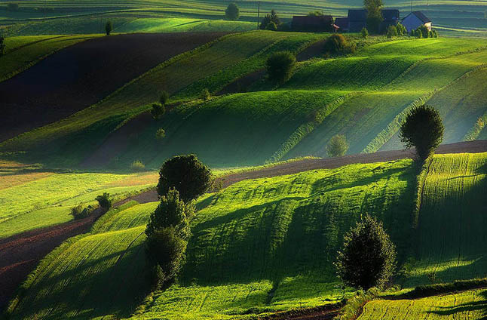
Welcome to Lubelskie Region
& Rejowiec Fabryczny ☺

Slide 3
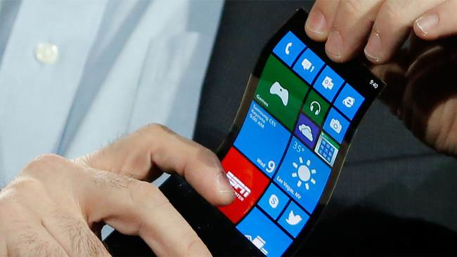
If you want to see something new….

Slide 4
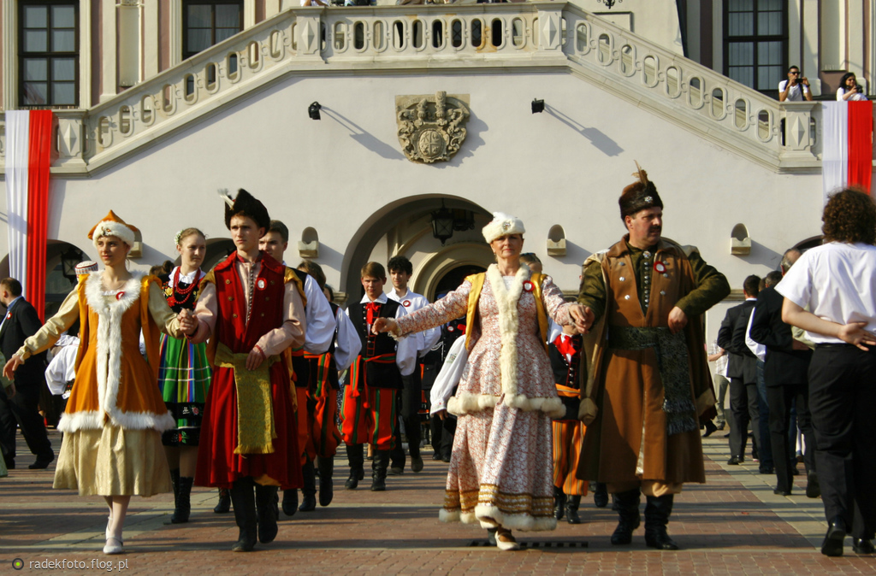
To discover another culture…

Slide 5
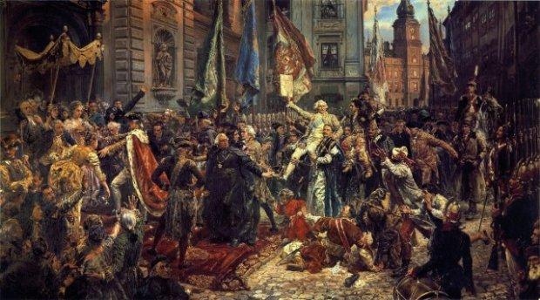
To learn about the history…

Slide 6
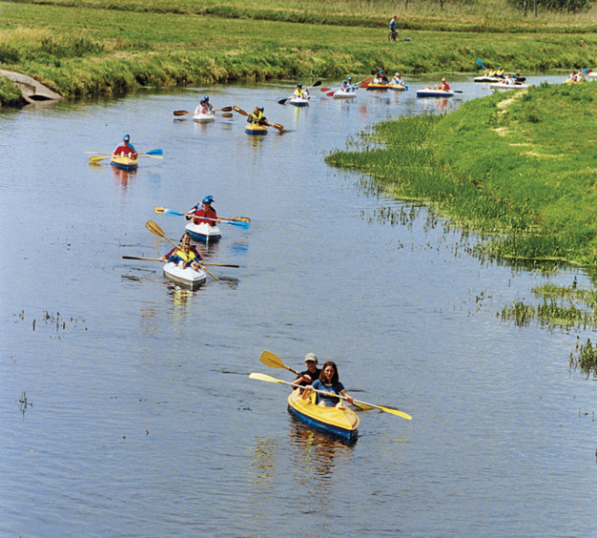
Or just to relax…

Slide 7
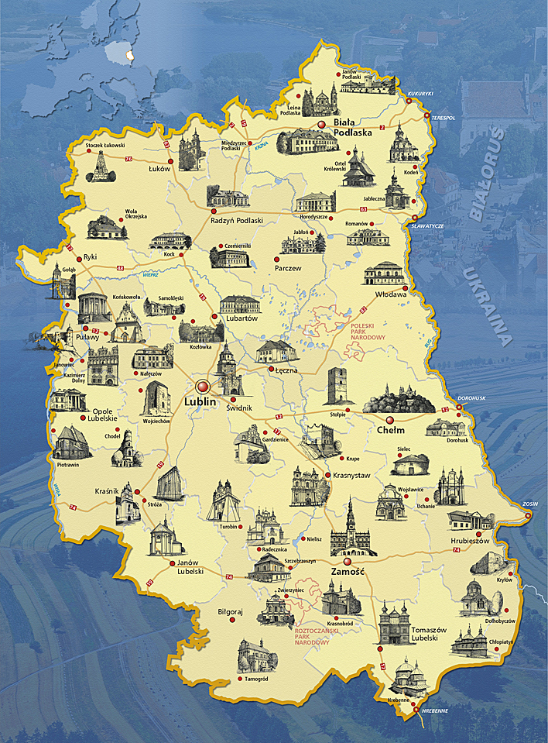
Come and visit my town and the neighbourhood….

Slide 8
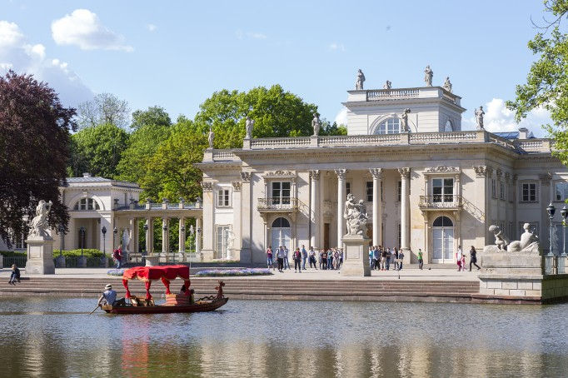
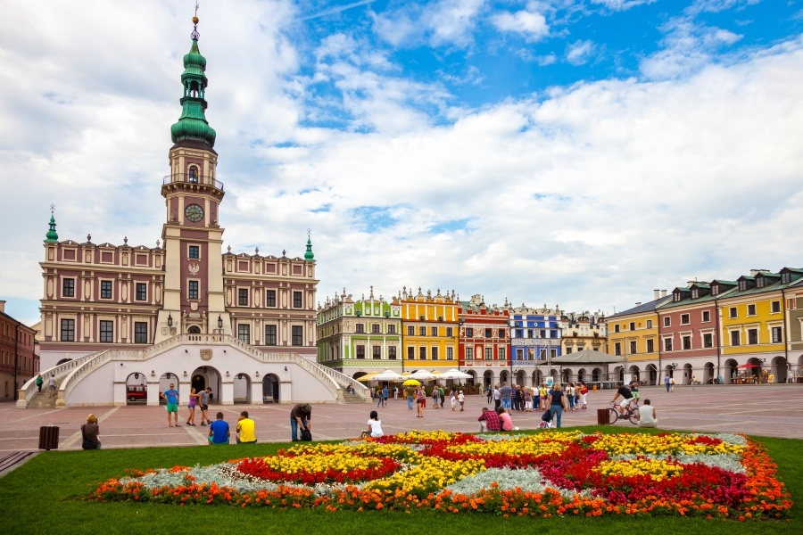
Discover the culture and history while visiting Lublin, Zamość or Warsaw…

Slide 9
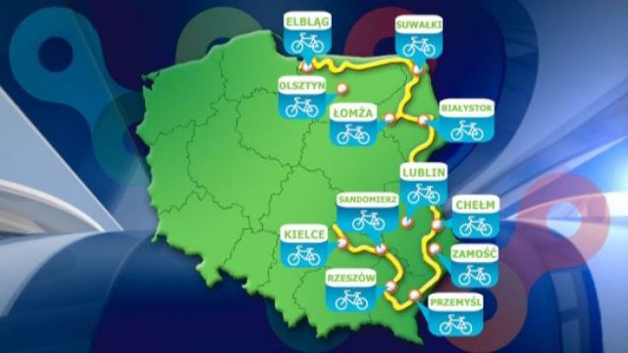
Try cycling on one of the longest routes in Europe (ca. 2000 km)…

Slide 10
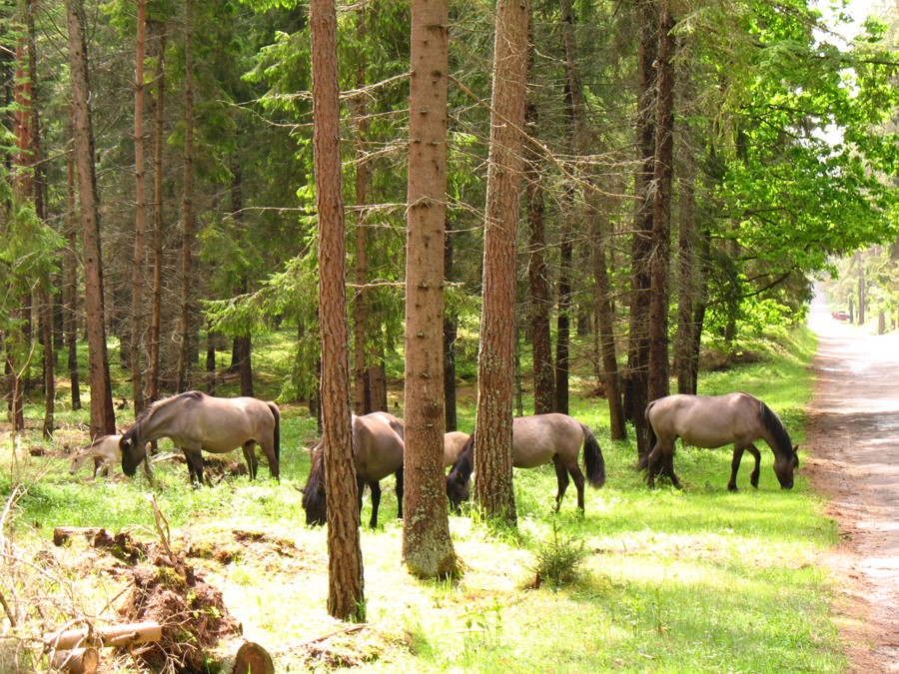
Try kayaking or hiking in Roztocze….

Slide 11
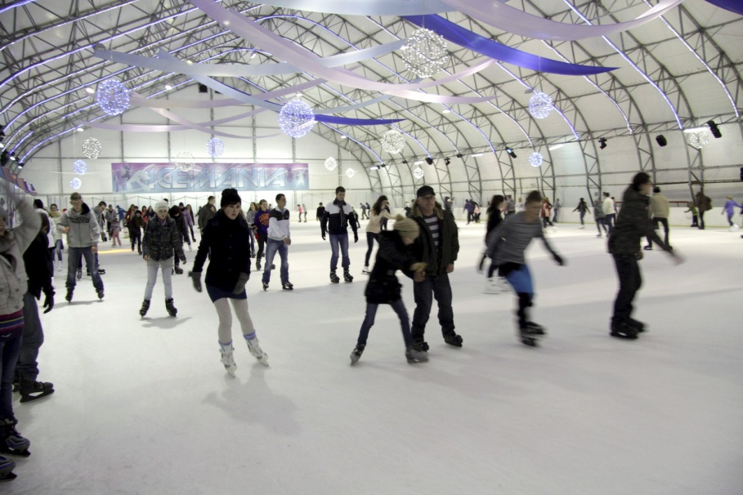
Polish you skiing skills in Bobliwo or go ice-skating in Lublin…

Slide 12
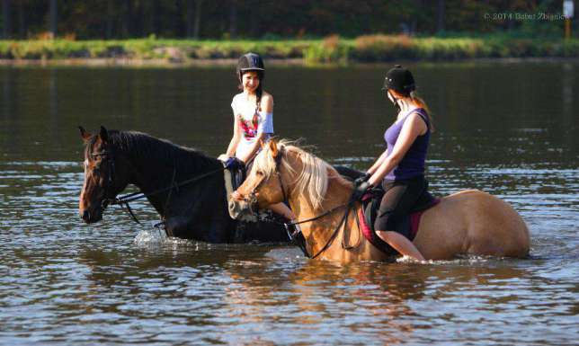
Learn horse riding in Siennica or Janów…

Slide 13
Or just play tennis in Rejowiec Fabryczny…

Slide 14
The member of the famous CittaSlow Society…

Slide 15
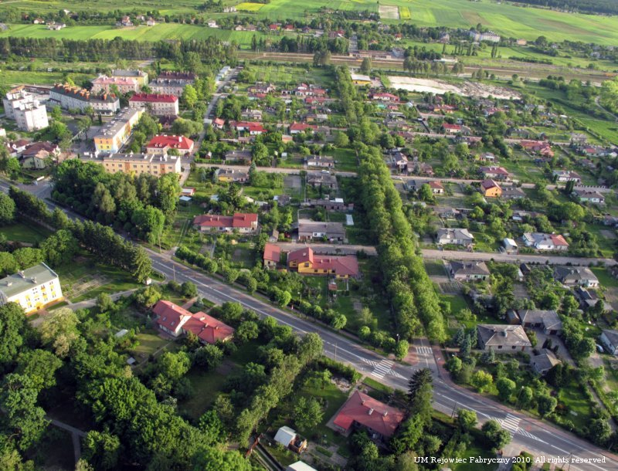
So come and visit my town….
… and enjoy your time here!!!!
Prepared by:
Mikołaj Krzywicki (IV b)

