Slide 1
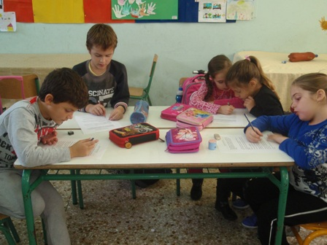
INSTRUCTIVE TEXT RICE SALAD B2

Slide 2
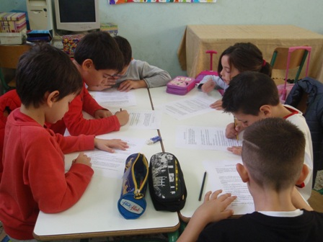
INSTRUCTIVE TEXT RICE SALAD B2

Slide 3
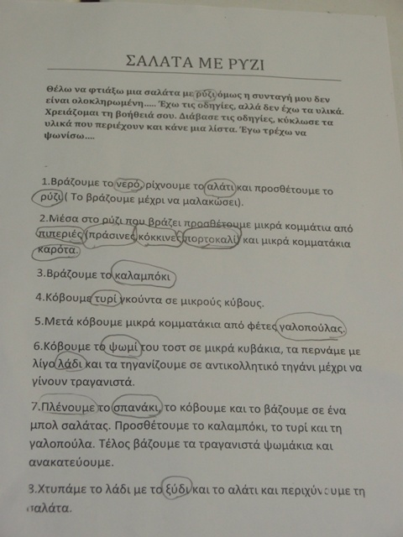
INSTRUCTIVE TEXT RICE SALAD B2

Slide 4
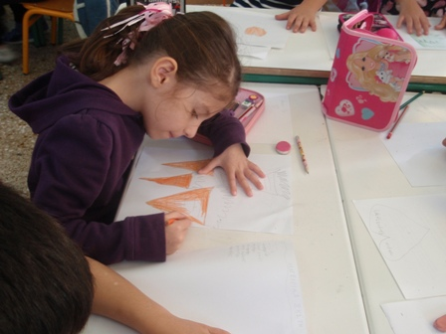
INSTRUCTIVE TEXT RICE SALAD B2

Slide 5
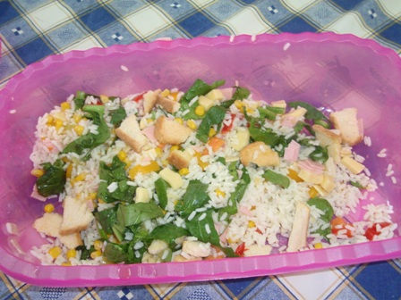
INSTRUCTIVE TEXT RICE SALAD B2

Slide 6
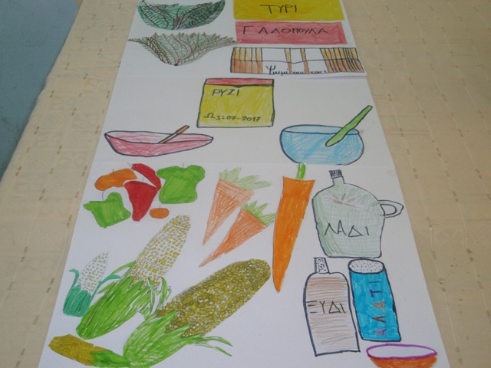
INSTRUCTIVE TEXT RICE SALAD B2

Slide 7
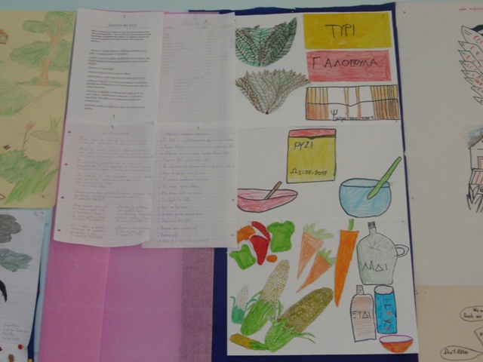
INSTRUCTIVE TEXT RICE SALAD B2

Slide 8
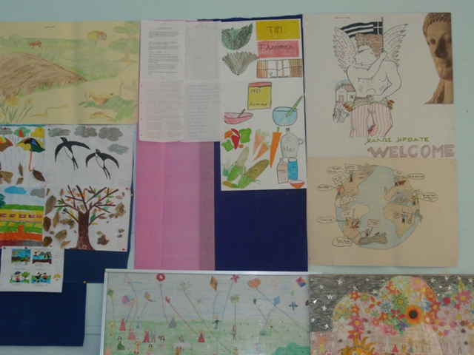
INSTRUCTIVE TEXT RICE SALAD B2

