Slide 1
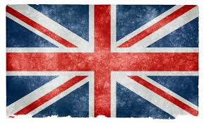
Welcome to England
Our most famous land marks are held in London, Yorkshire and Blackpool.

Slide 2
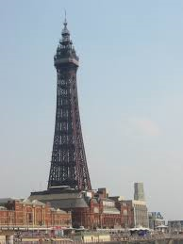
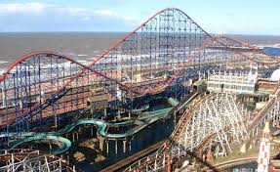
BLAKPOOL
Blackpool tower
Blackpool has a lot of fun things to do. You can go into the Dungeon, up to the top of the Blackpool Tower or go into the wax works. At the top of the tower you can see down to the floor.
Blackpool Pleasure Beach has one of the first rollercoasters to do a loop the loop and is still running today. The Pepsi Max is one of the highest rollercoasters in the world.

Slide 3
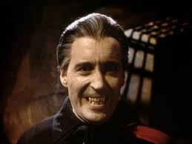
Whitby
Whitby is on the coast of Britain and has a very famous Abbey. This is Whitby Abbey and it is said that Dracula lived here. Dracula is said to have originated from Transylvania.

Slide 4
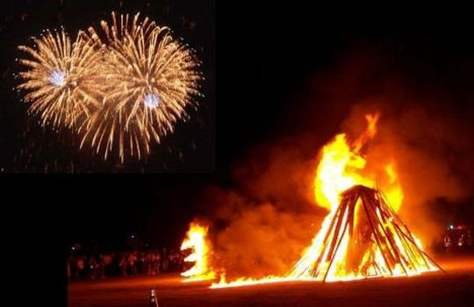
Bonfire night
Guy Fawkes Night is annually held on November the 5th
It is sometimes known as Bonfire Night and marks the anniversary of the discovery of a plot organized by plotters to blow up the Houses of Parliament in London in 1605. Many people light bonfires and set off fireworks to celebrate the fact that the plot was discovered.

Slide 5
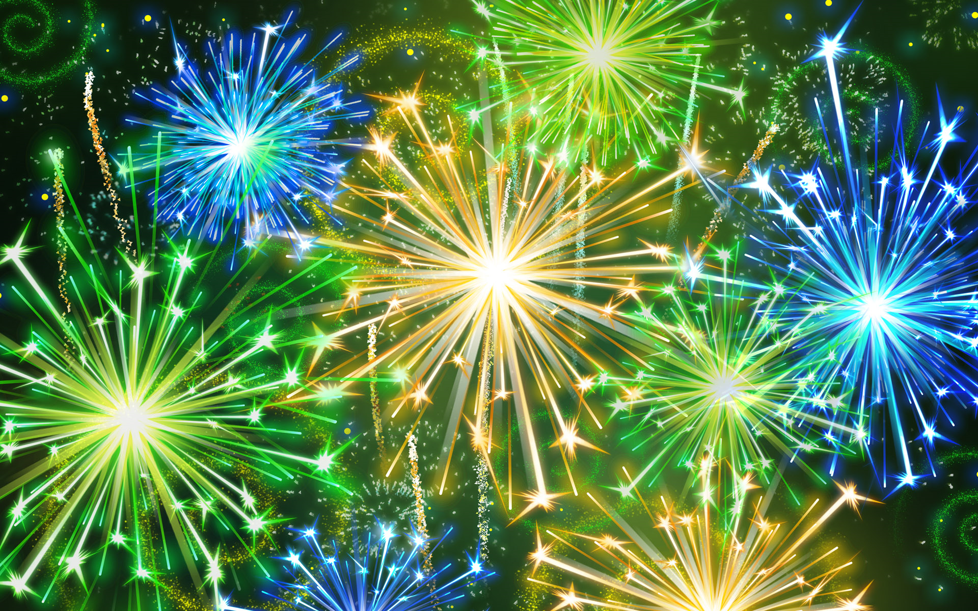
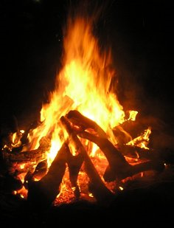
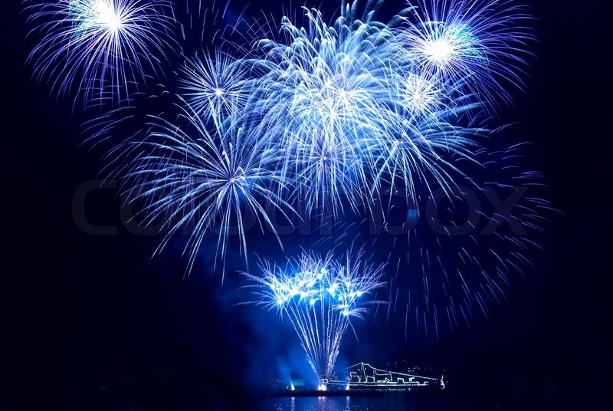
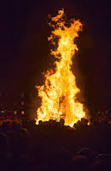
PITURES OF FIREWORKS AND BONFIRES
fireworks
bonfires

Slide 6
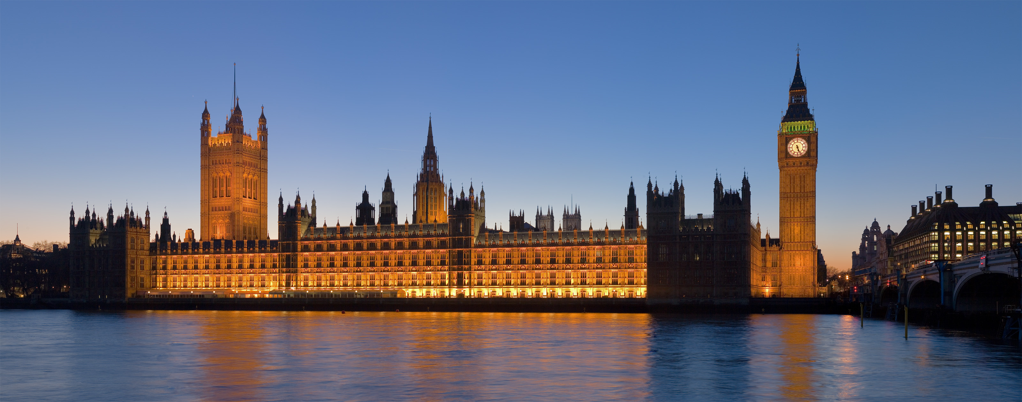
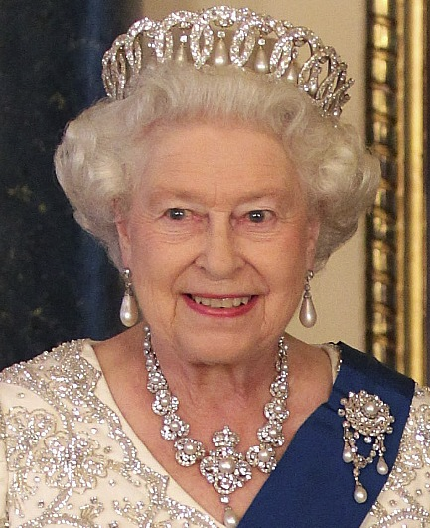
London
London, England’s capital, is set on the River Thames. It is a 21st-century city with history stretching back to Roman times. At its centre stands the Houses of Parliament. Our Queen (Elizabeth II) lives in Buckingham Palace and is the longest raining heir to the throne.

Slide 7
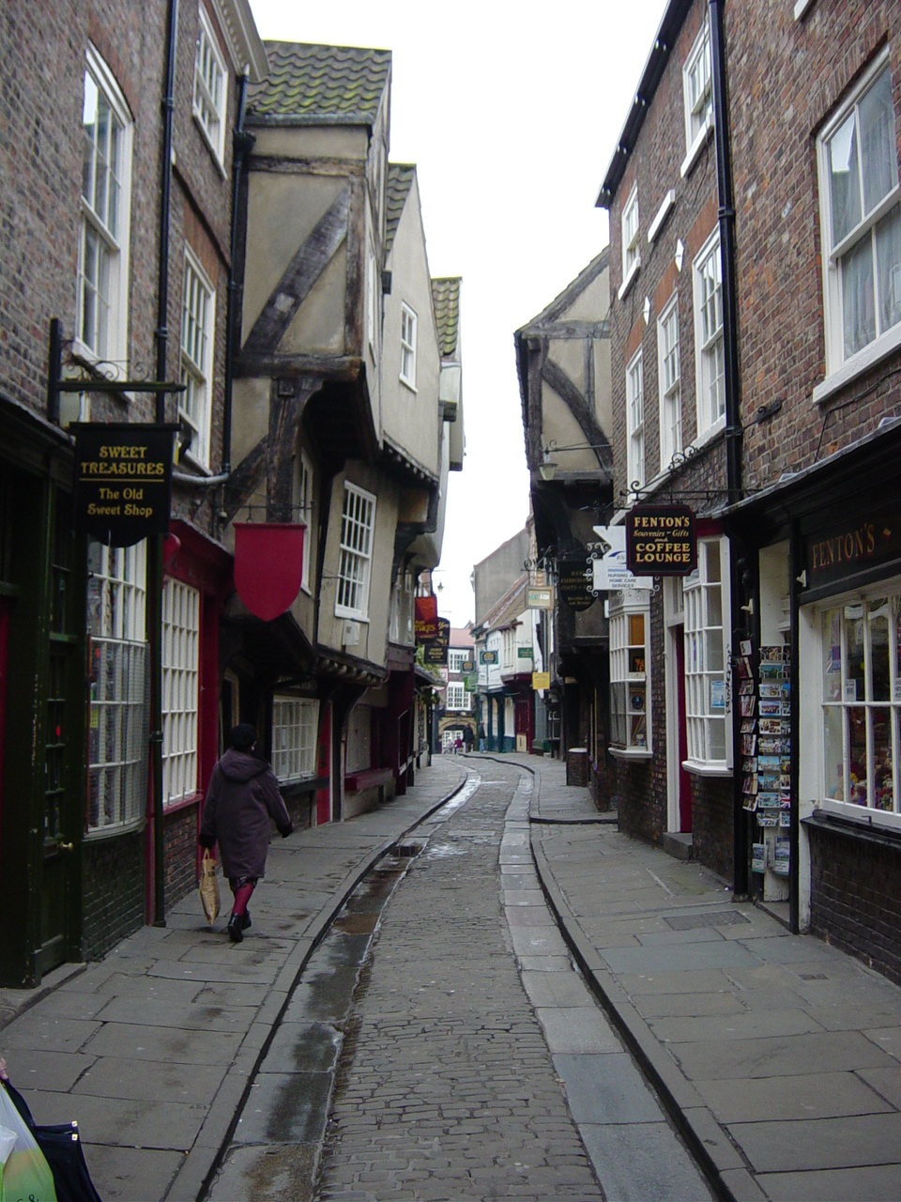
YORK
York is a walled city in Yorkshire that was founded by the Ancient Romans.
The City Walls form a walkway on both sides of the River Ouse.
The Monk Bar gate houses an exhibition tracing the life of 15th-century King Richard III.

Slide 8
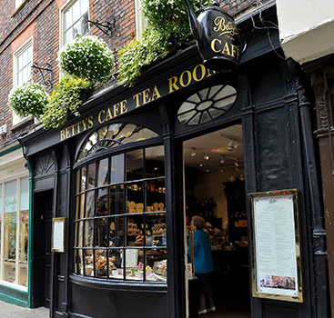
Bettys Tea Room
This is a famous tea room that is visited by people from all around the world. The story of Bettys Tea Rooms began in 1919 when the founder, Frederick Belmont, opened his first Bettys Café Tea Room. If you visit York it is definitely worth a visit!

Slide 9
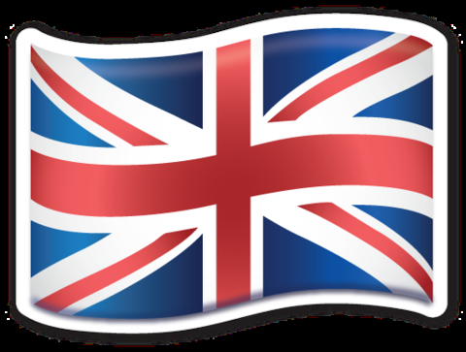
THANKYOU FOR LISTENING TO OUR PRENTATION ABOUT ENGLAND.
We hope you enjoy your stay here!

