Slide 1
FRAGA
By: Alba Lauroba, Alejandra Martinez, Inés Mayora,
Maria Navarro, Maria Reyes and Andrea Rios.

Slide 2
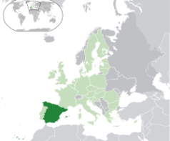
Where is it located?
3.852,6km

Slide 3
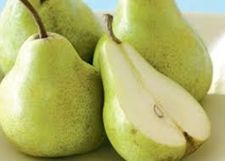
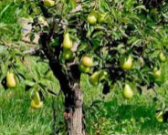
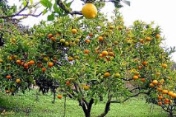
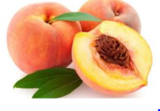
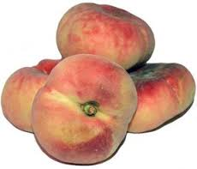
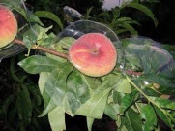
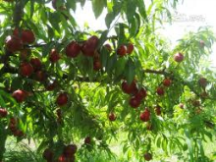
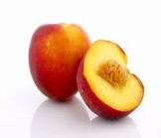
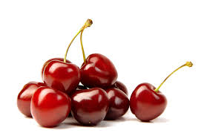
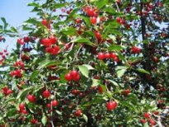
agriculture
Fraga is very rich in agriculture.
The most of the fruits are:
Pears
Peaches
Paraguayans
Nectarines
Cherries
…

Slide 4
TRADITIONAL FOODS

Slide 5
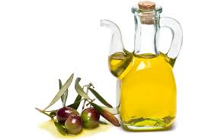
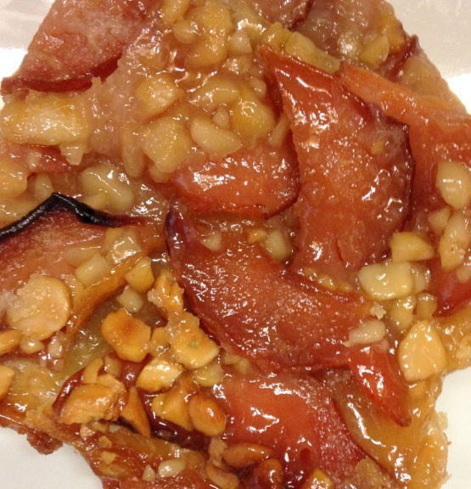
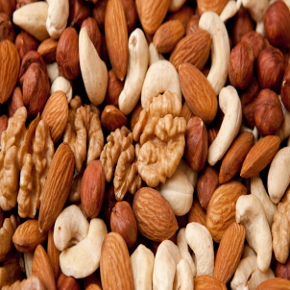
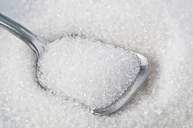
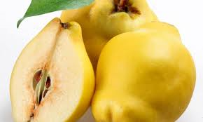
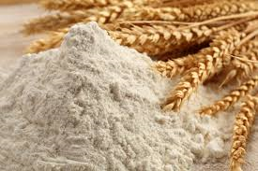
COC DE FRAGA
“ Coc de Fraga”---- It’s composed by a puff pastry, oil, clean nuts, sugar, flour and quince.

Slide 6
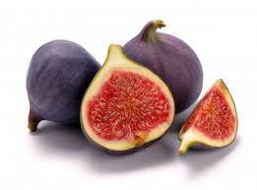
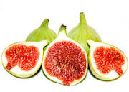
figs
Figs ---- We can make many recipes with two different types of figs, such us: dried figs with walnuts, figs cake with nuts and almonds, chocolate figs and lots of more recipes.

Slide 7
Annual and traditional festivals

Slide 8
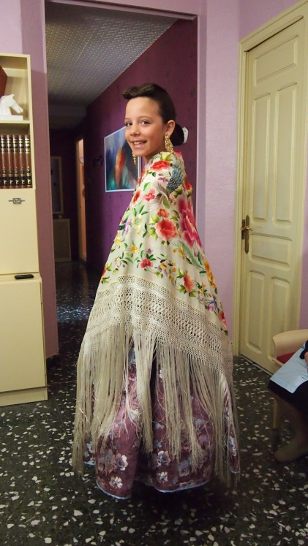
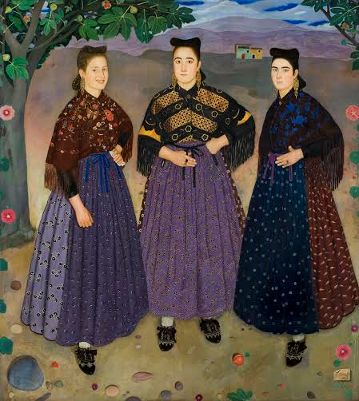
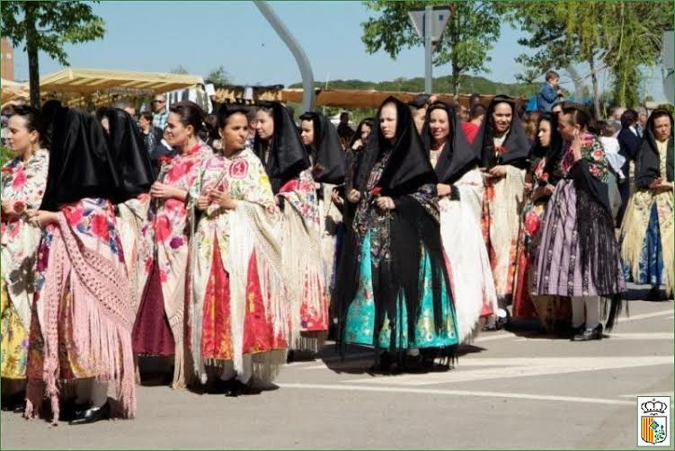
One of the most traditional festivals in Fraga is the day of the Faldeta in which we remember our ancestors.
These are the traditional dresses:

Slide 9
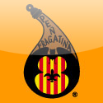
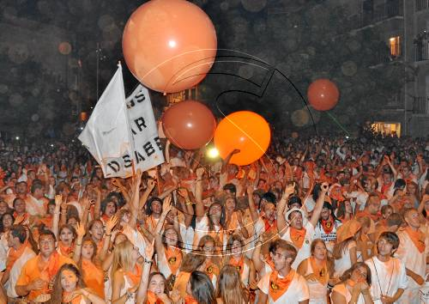
Also a famous festival is the fiestas del pilar, in which we dress with white clothes and an orange handkerchief.

Slide 10
Important places in Fraga

Slide 11
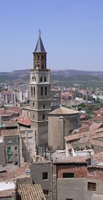
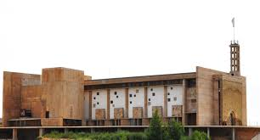
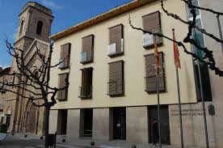
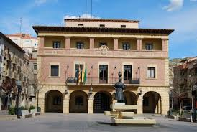
One of the nicest places of Fraga
is the bell tower which is located in
the historic center of Fraga.
Another of the places located
in the historic center of Fraga is the castle.
Also the town hall where the mayor
and his aides work.
Bell tower
Castle
New townhall
Old townhall

Slide 12
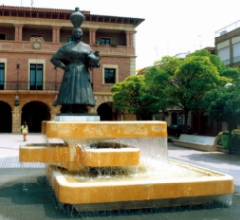
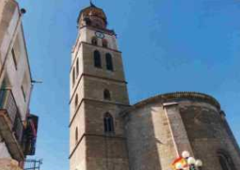
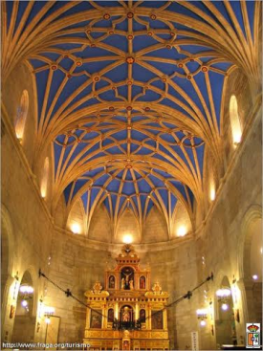
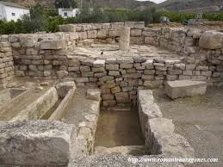
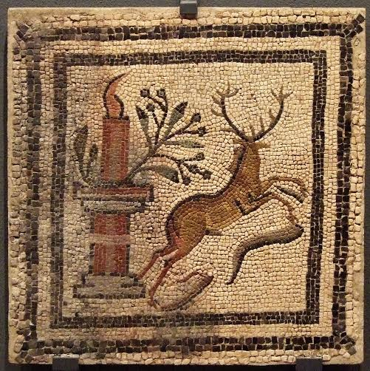
In front of the townhall the people
that work in ceramics Arellano, built
a woman with faldetas (skirts).
In Fraga we have two churches
one in the historic center and another
in the new part of Fraga.
Villa Fortunatus is a Roman villa that
Fraga conserves.

Slide 13
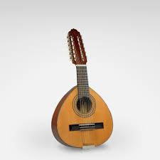
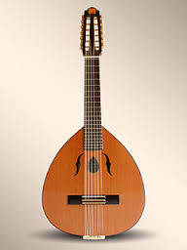
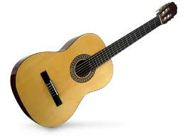
The traditional folklore
The traditional folklore is the Jota also the same folklore in Aragon.
The instruments that we use are guitars, “bandurrias” and “lauds”.
Know we are going to sing you a jota that we have prepared.

Slide 14
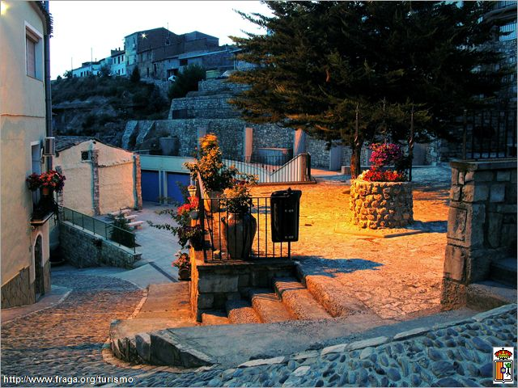
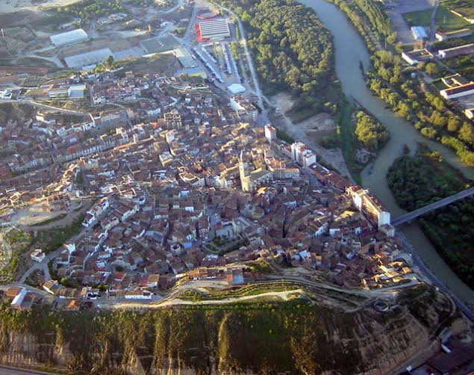
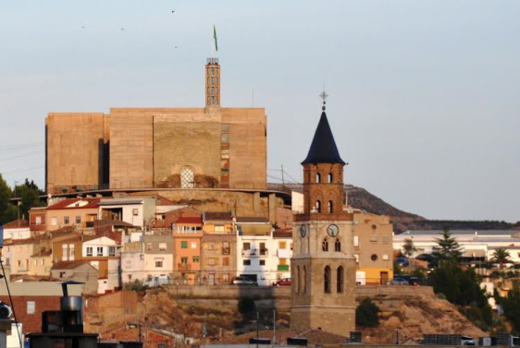
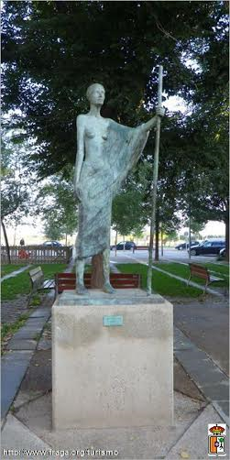
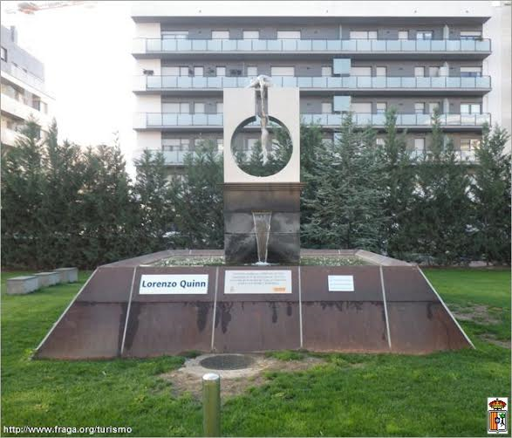
PHOTOS!!!

Slide 15
The end
We hope that you like it.

