Slide 1
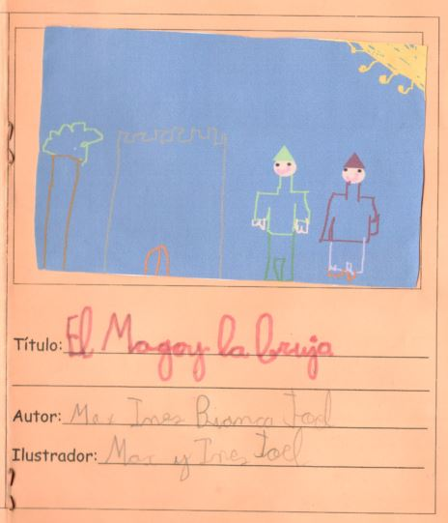
The Wizard and the Witch.

Slide 2
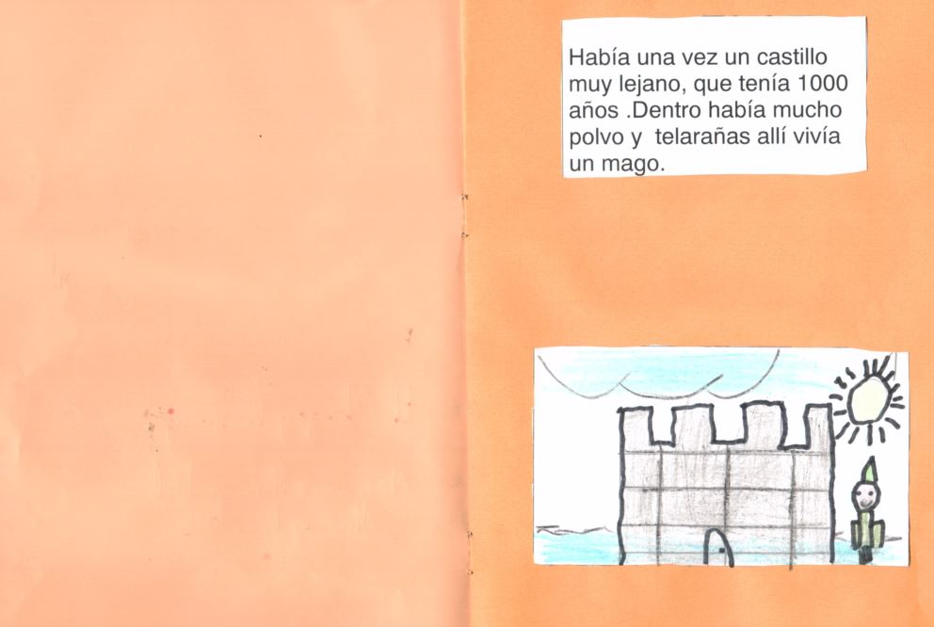
Once upon a time there was a castle, far, far away, which had 1000 years. Inside the castle there was a lot of dust and cobwebs. In the castle lived a magician.

Slide 3
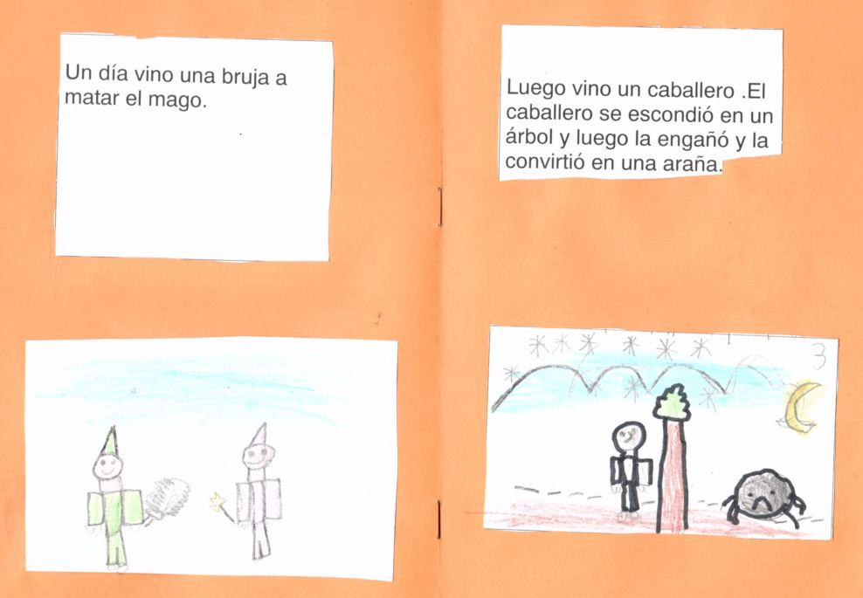
One day a witch comes to kill the wizard.
Later a knight came and hid behind a tree. After that, he tricked the witch and transforms her into a spider.

Slide 4
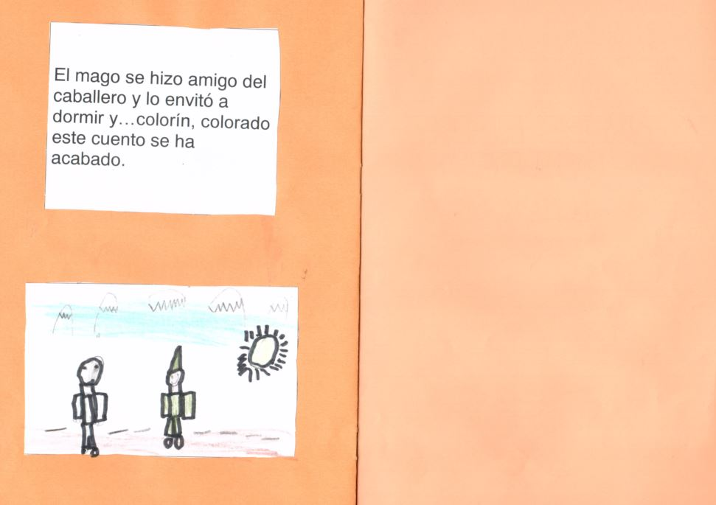
The wizard and the knight became friends and the wizard invited the knight to sleep…and they lived happily ever after.

Slide 5
