Slide 1
CHOOSE A LOGO FOR A PROJECT
Made by: Renata Dimnik

Slide 2
Discuse about the project, what is the topic.
It is only a picture.
It isn‘t show the contents of a project.

Slide 3
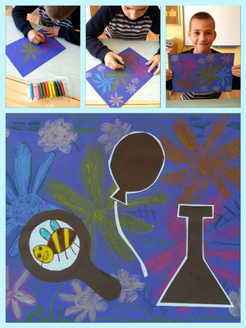
Be creative.
We have to discusse with students how we are going to create a Logo.
a picture with computer

Slide 4
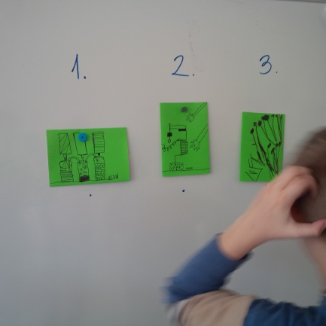
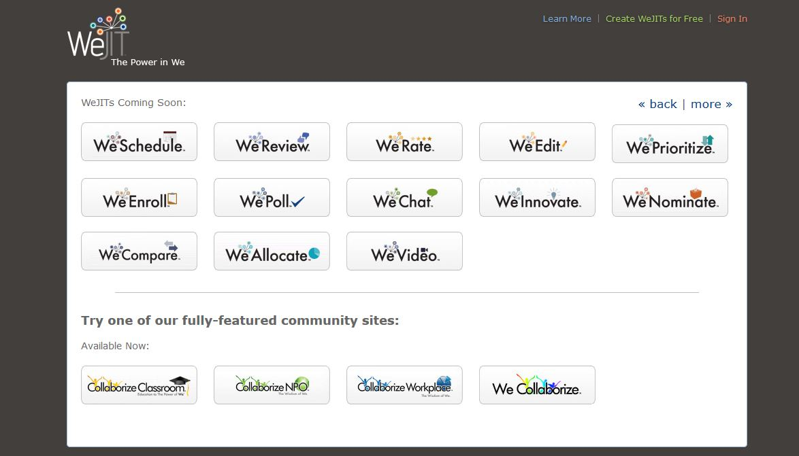
We have to decide how you are going to choose a Logo.
In school among the children at national level - Tricider
at international level -

Slide 5
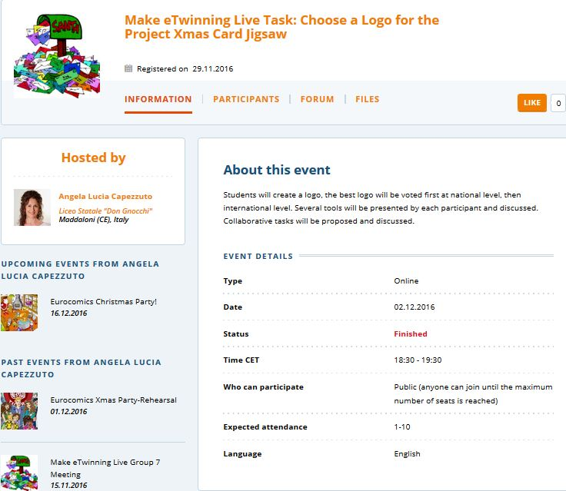
First there was a beginning.
Bruna has a problem with camera - her picture was black.
Luigi had a problem with microphone but we solve it so that he tipped on chat section.
Also me - Renata disappeared several time and had a black picture, but I solve the problem - I switch on and off camera button and button switch camera several times.

Slide 6
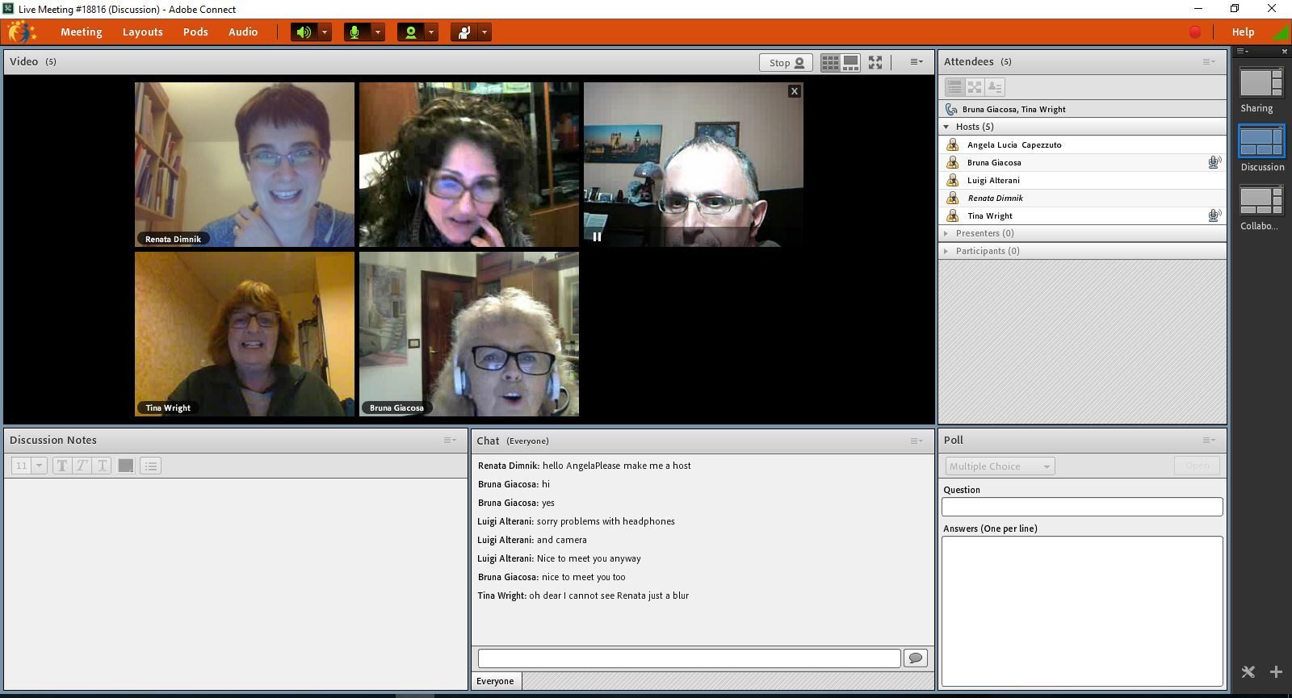
The screenshots with cameras on
Renata Dimnik from Slovenija
Angela Lucia Capezzuto from Italy
Bruna Giacosa from Italy
Tina Wright from UK
Luigi Alterani from Italy

Slide 7
The screenshots - Presentation
Renata Dimnik

Slide 8
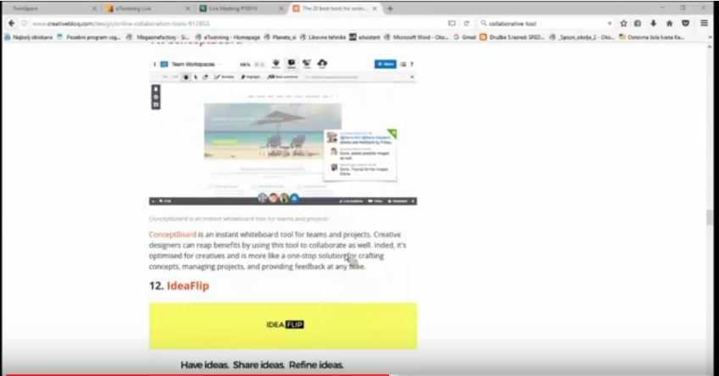
The screenshots
I missed it:))
I am going to do in when Angela
is going
to send
me a link to
the recorded
event.

Slide 9
The screenshots - Presentation
Angela Lucia Capezzuto

Slide 10
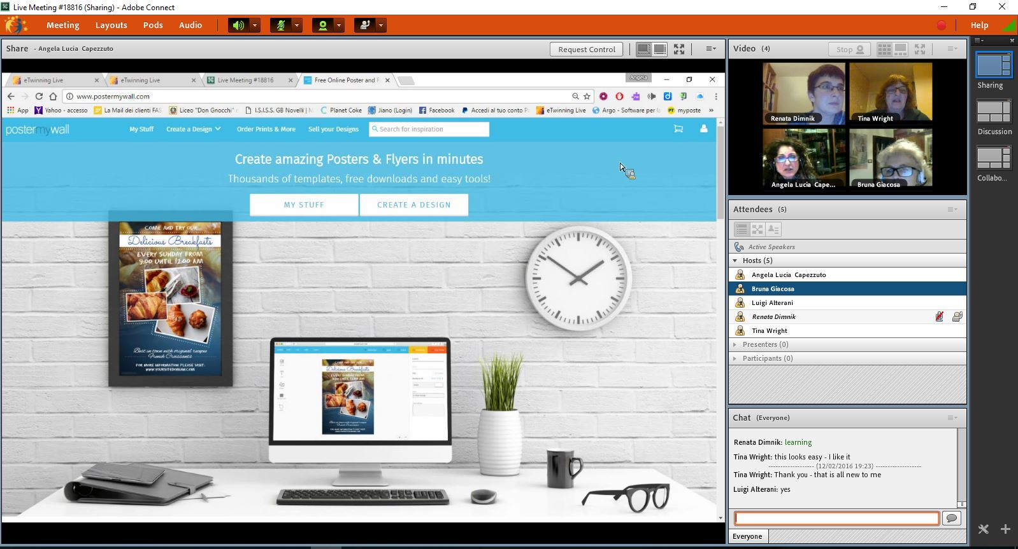
The screenshots

Slide 11
The screenshots - Presentation
Bruna Giacosa
She present the idea for Logo on Screen sharing.

Slide 12
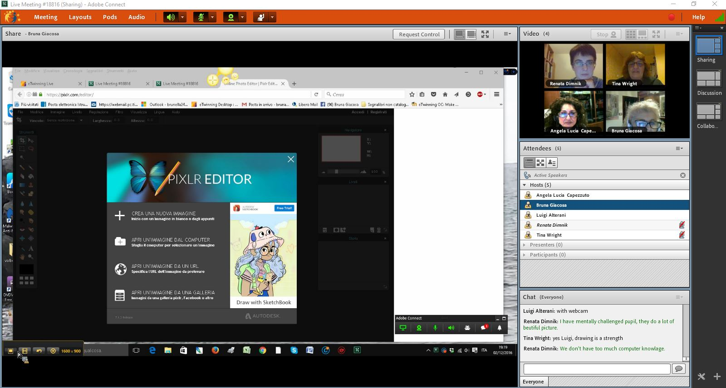
The screenshots

Slide 13
The screenshots - Presentation
Tina Wright

Slide 14
The screenshots

Slide 15
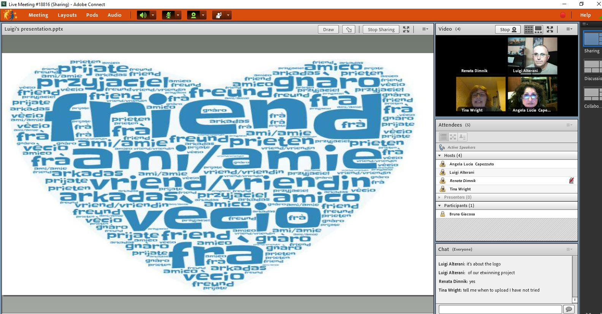
The screenshots - Presentation
Luigi Alterani

Slide 16
The screenshots
Luigi had problem with computer.

Slide 17
The discussion notes

Slide 18
The screenshot from poll
We had some problems with poll. We have click it on the answer and edit it but nothing happened. Only one have succeeded at the time.

Slide 19
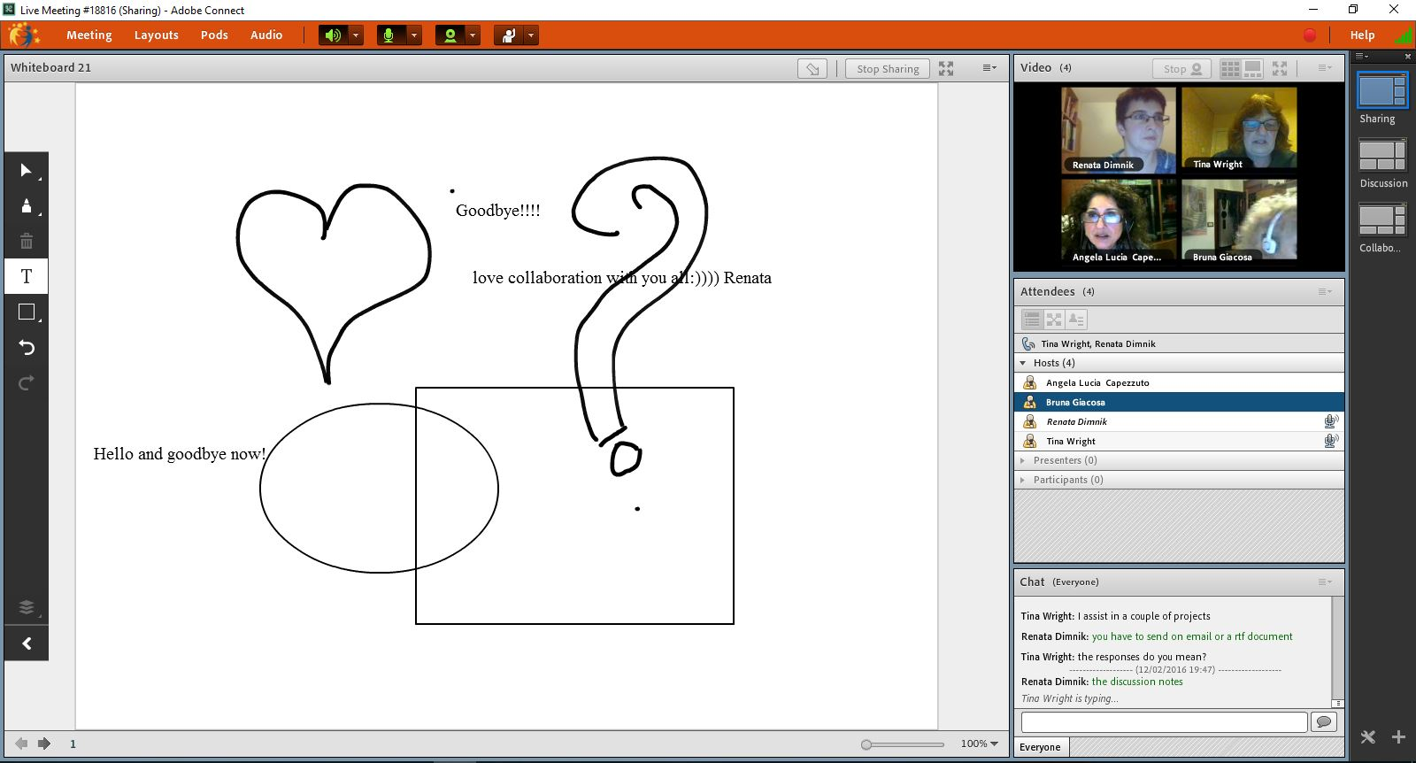
The Whiteboard image

Slide 20
She had a little time for us. She prepared very well. She gave us some information and interesting tools for work. She knew what she was doing with technology and she gave us useful instruction.
Luigi was positive person, who asked also personal questions about from where we are. He encourage us with positive words like interesting, great with capital letters…:)) He gave us an instruction about new eTwinning platform.

Slide 21
Tina is a positive person, who is the listener. For me very positive and valuable quality. She gave comments - feedback what is working and what not. She gave me a useful information about special need students - use answergarden.
Bruna has a problem with computer I make here a host all the time. She was fun. She told us that is not necessary to do the presentation she can do the Screen sharing and she do it a great job because she gave us an instruction about Photo editor.

