Slide 2
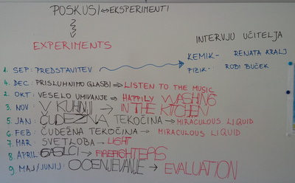
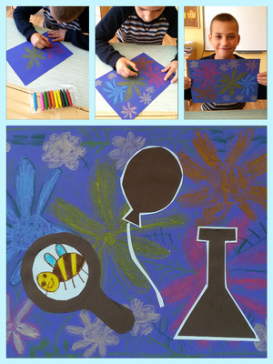
1. Pedagogical innovation or creativity.
2. Students have to do everything their selves.

Slide 3
3. Partners have to decide everything together.
All participance.
Administration.

Slide 4
Please look for new things.
? ------ Contact me.

Slide 5
4. Communication and collaboration:
Very important is that communication is timely manner.
You also have to give the feedback to other members because is very important to be the part of the project,
be motivator,
be positive,
be adaptable and
be active.
Make project fun.

Slide 6
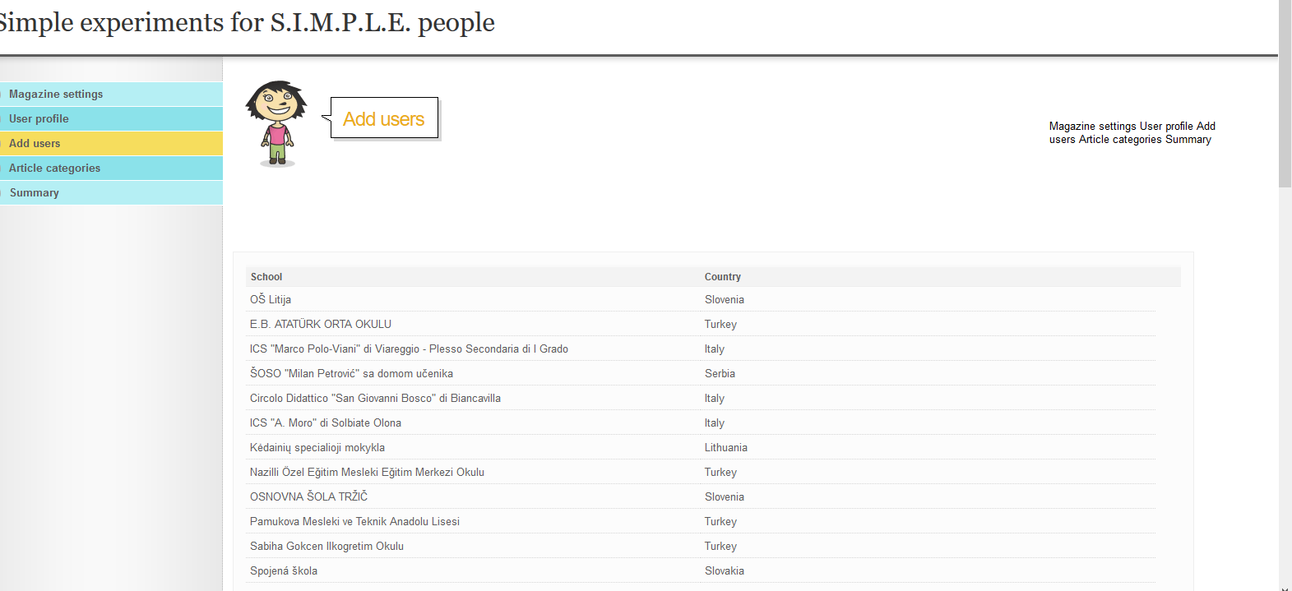
5. Curricular Integration
6. Dissemination.

Slide 7
7. Evaluation.
Go on project - We are able to - on mine Twinspace.
Students evaluation
https://twinspace.etwinning.net/14228/pages/page/122938
Teachers evaluation
https://twinspace.etwinning.net/14228/pages/page/129071
http://new-twinspace.etwinning.net/c/portal/layout?p_l_id=20402469
Irene Petarki:
Evaluation is really important in a project to identify what worked well and what not, what the students liked more and what less, how it improved your skills and what impact had in the wider community.

