Slide 1
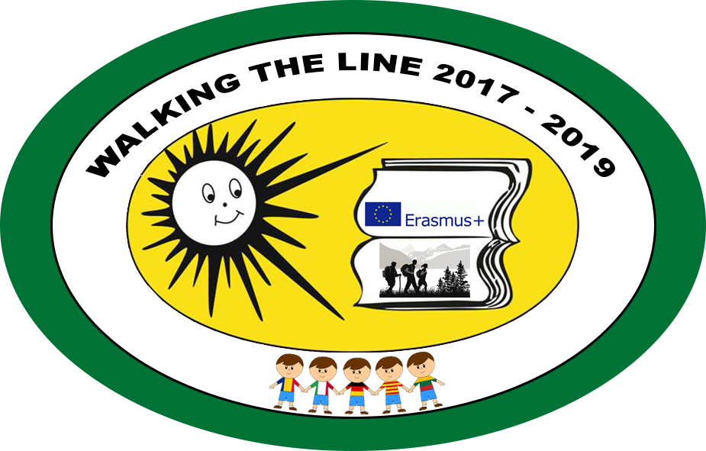
“Walking the line” National Heroes
2017-2019

Slide 2
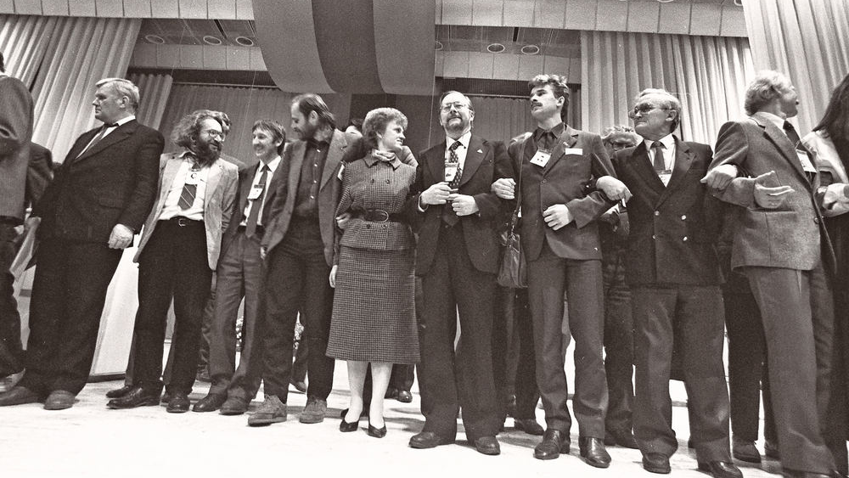
Sąjūdis

Slide 3
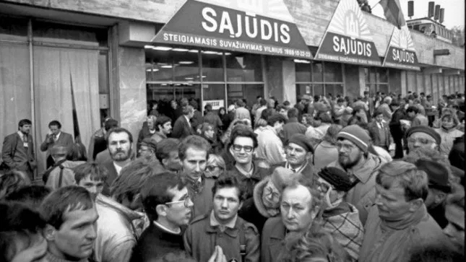
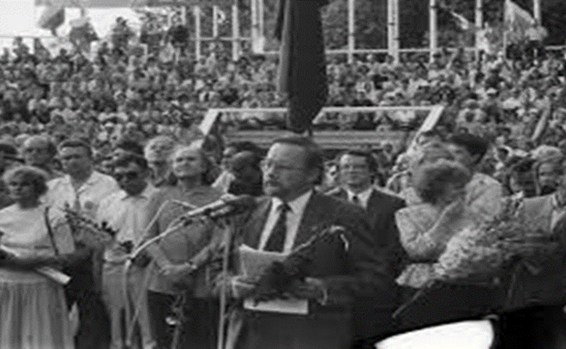
What is Sąjūdis?
Sąjūdis at the beginning known as the Reform Movement of Lithuania. It is a political organisation which led the struggle for Lithuanian independence in the late 1980s and early 1990s. It was established on 3rd of June in 1988, and was led by Vytautas Landsbergis. Its goal was to seek the return of independent status for Lithuania.

Slide 4
THE BALTIC WAY

Slide 5
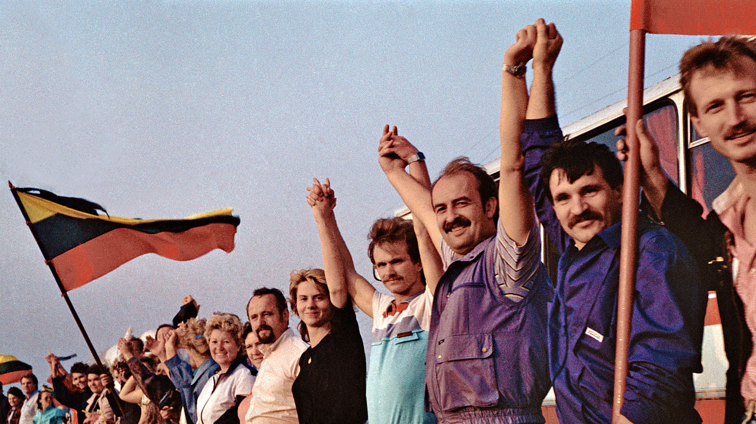
What is the Baltic Way?
On that fateful day in 1989, more than two million people joined hands in a human chain that began in Tallinn, Estonia, stretched about 675 kilometres across Latvia, to Vilnius, Lithuania. The date was chosen to focus the world’s attention on the day in 1939, exactly 50 years prior, when Nazi Germany and the Soviet Union signed the Molotov-Ribbentrop Pact. This secret agreement was created during the early years of World War II, when Germany and the Soviet Union were allies.

Slide 6
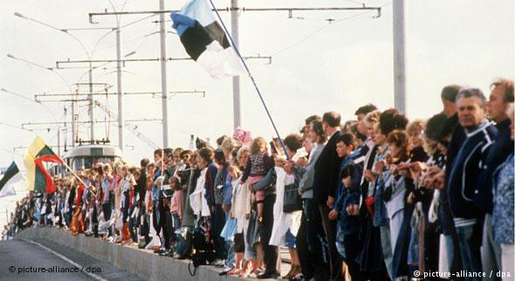
Meaning of the Baltic Way
This peaceful event symbolized the unity of all Baltic States and the same goal – to regain the rightful independence. There were only 5.34 million Balts living in the Soviet Union in 1989, meaning that almost half of them were holding hands in the streets on that iconic day. In fact, everyone from the smallest kid to the wisest old man took part in the Baltic Way. It was a matter of dignity, unity, and complete freedom. The Baltic Way was a clear sign that the Soviet Union had no more power to control the Baltic States, so it was only a matter of time until Estonia, Latvia, and Lithuania became independent again.

Slide 7
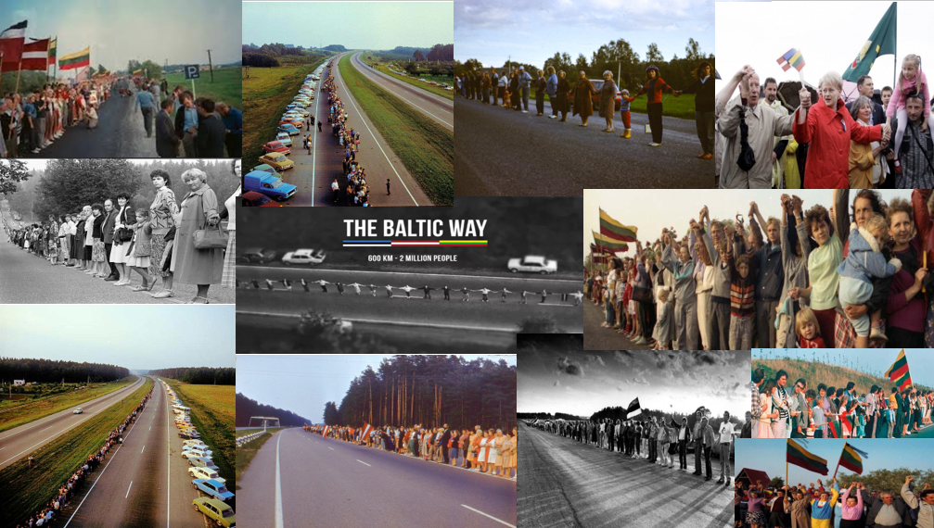

Slide 8
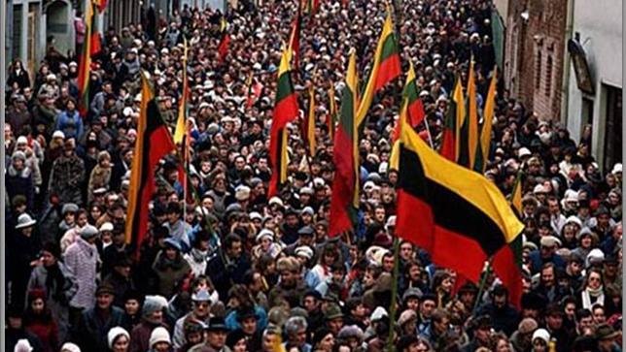
March 11th

Slide 9
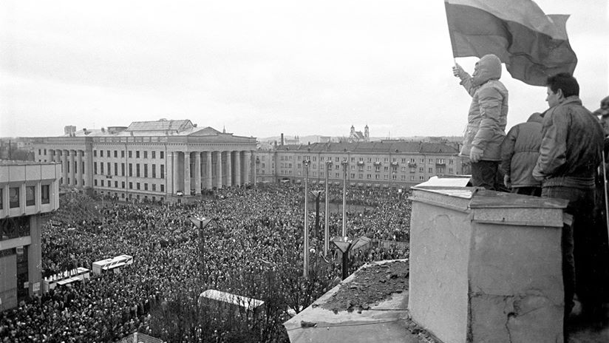
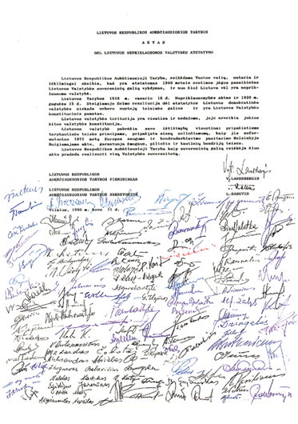
March 11th 1990 in Lithuania
It is National holiday to commemorate the day of Independence. On the 11th of March in 1990 the Highest Council of Lithuania signed the act of Re-Establishment of independence. Lithuania broke away from the Soviet Union. The act confirmed restoration and legal continuity of the interwar period Lithuania, which was occupied by the USSR (Union of Soviet Socialist Republics) and lost independence in June 1940. It was the first time that a Union Republic declared independence from the dissolving Soviet Union.

