Slide 1
NATUPARK
Alba Jiménez
Ana Paula Iriarte
Nuria González
Hugo Ponce
Izan Jiménez

Slide 2
Alba Jiménez: It was fun and entertaining, only gave me time to make three circuits, the most I liked the Blues, the funniest thing was when I slipped in a one part and a girl then come to rescue me, but first a partner intents help me, the next day had many stiffs.
Ana Paula : For me this experience has been fun and interesting. In some obstacles, such as zip lines or “lianas”, I recived help from my colleagues. One obstacle that I didn’t like was the climbing and the “lianas”. But overall, I like this trip.
Nuria González: I really liked this experience because it seemed so fun. The easiest circuit I did seemed very simple but the hardest I did seemed more fun and adventurous. I loved visiting the Natupark.
Hugo Ponce: I liked this tour for several reasons, one of them is that it’s outdoors and that you want or not is a benefit, another reason why I liked it’s because moving from curd to curd is much fun for the variety of tests.
To follow an anecdote to comment is when a partner is stuck in a zip line, and a girl had to come to rescue she.
Izan Jiménez: Going to the Natupark I liked a lot, especially because I had never been to a park of this type, and I knew I would like it a lot. I had a great times seeing how people feel and trying to pass some tests that cost me a lot.

Slide 3
Alba

Slide 4
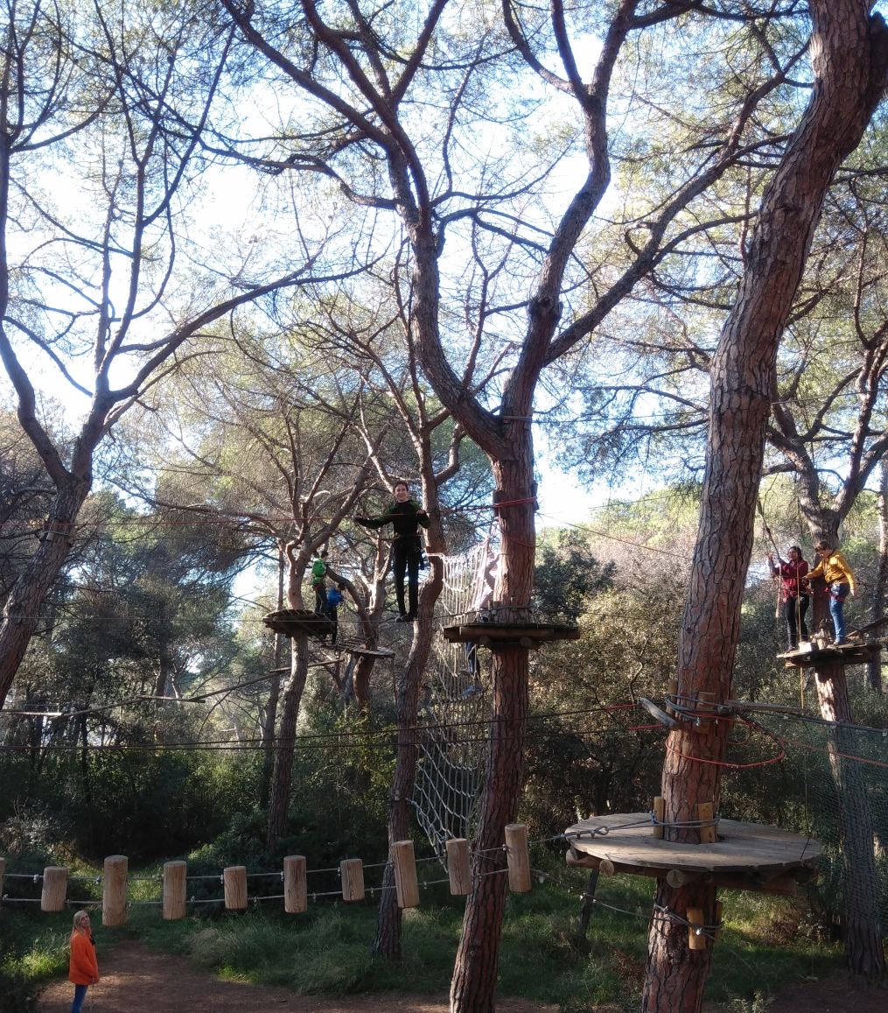
Hugo
Izan
Ana Paula
Nuria

