Slide 1
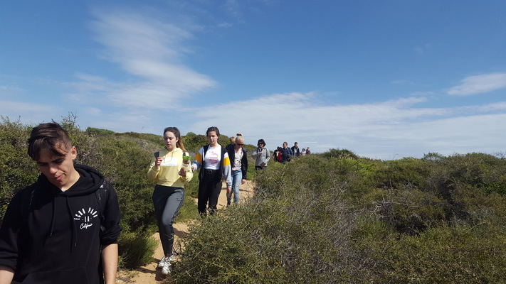
Feedback,,Walking the line“ . QUESTIONNAIRE FOR STUDENTS'

Slide 2
These are the students who created the survey questionnaire

Slide 3
Some information and data of this survey
This questionnaire was created by the students -project team and by their project coordinator at school Ramune Jukneliene .
It was shared with every student participating in the implementation of the ERASMUS PLUS KA2 Project ,,Walking the line“. It was filled by 100 students and it was meant to collect a feedback and information on the activities carried out during the 2 school year of the project.
The results look encouraging as can be seen by the data shown in the following slides.

Slide 4
What were your main motivation participate in the project “ Walking the line“?
Improve a foreign language
Interesting learning
experience different learning practices
to meet new people

Slide 5
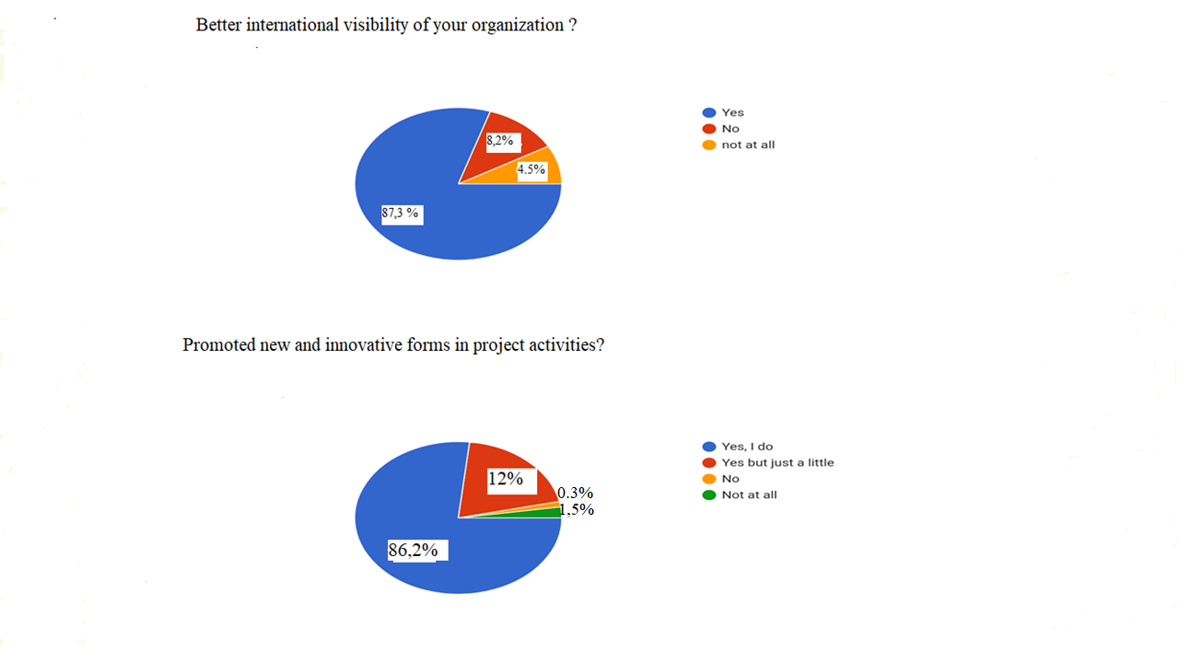

Slide 7
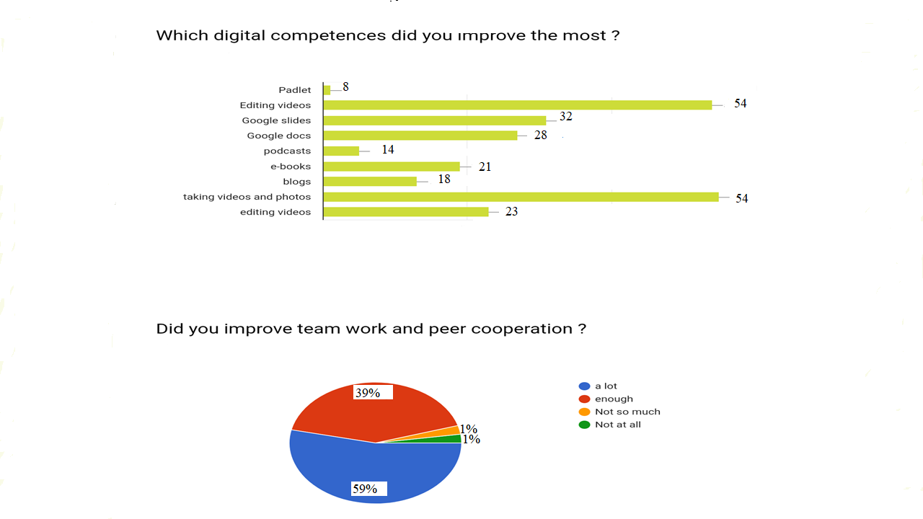

Slide 8
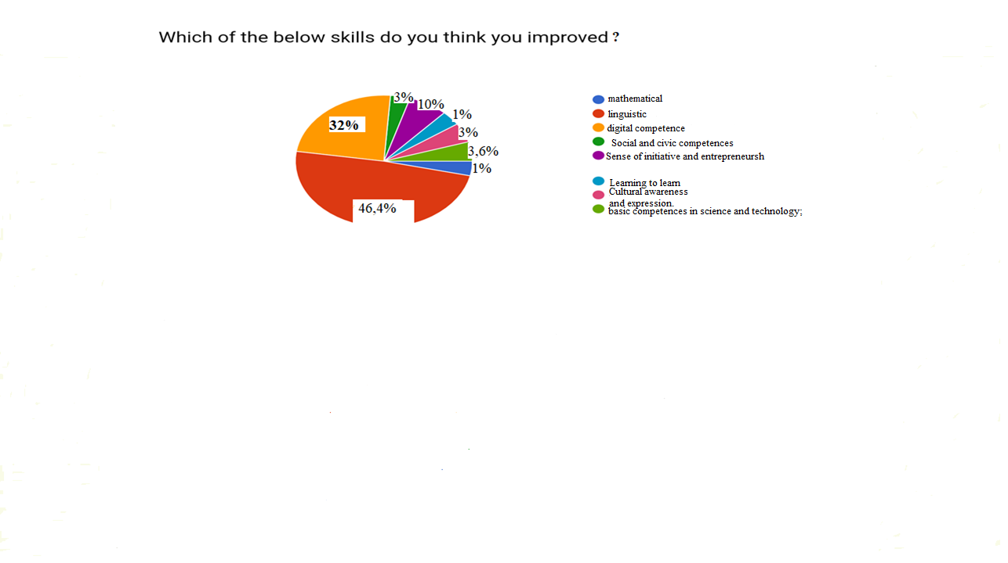
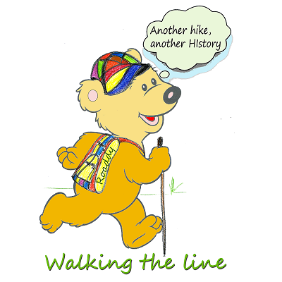

Slide 9
IMPACT FOR PUPILS
1. Self-confidence checked through Survey.
2. Knowledge of the European Union the cultural environment of the partners’ countries.
3. Concern about health through number or students activities from start of the project.
4. Key competences through subjects related to the project.
5. Tolerance to different cultures through questionnaires and attitudes.

Slide 10
IMPACT FOR THE SCHOOL
1. Interdisciplinary teamwork among teachers.
2. Internationalsation of the school( Networks created ).
3. New teaching systems and new content. Curriculum programme.
4. Involvement of other local and regional authorities, parents’ associations.

Slide 11
IMPACT FOR TEACHERS
1. Knowledge of European institutions and Educational systems of European Union.
2. New subjects/knowledge and different teaching methods.
3. Motivation to work.

Slide 12
Thanks for your attention

