Slide 1
NATUPARK
Enrique Atance
Joan Sánchez
Jan Alloza
Simran Kumar
Daniel Valverde

Slide 2
Enrique Atance
The excursion we did in Natupark was great and I enjoyed it a lot.
What I liked most were the zip lines, where you had to throw yourself by a long cable that went from one tree to another. That was very exciting!
However, there were some tests that were quite difficult to do, as one where you have to jump and grab a rope to arrive to another tree. If you don’t grab the rope, you can fall down and stay hanging from the lifecable (a cable to which you are always bound by harnesses, for security).

Slide 3
Joan Sánchez
In my opinion the activity of the NATUPARK is a very fun activity but at the same time a bit complicated because we are at a certain height.
For me a very good activity to do it with family or friends.
To begin with they gave us an internship and then they let us go for free. We started doing the blue, following the red and ending with the black somewhat difficult

Slide 4
Jan Alloza
I really liked the excursion and it was very fun, what I didn’t like was that we had to do the blue / orange then the red one to finally do the black one, I would have liked it more if it was free that we could go for free . But in spite of that I liked a lot especially the zip lines.
And I also liked that the trip was by coach because it goes much more comfortable than public transport as we normally do.

Slide 5
Simran Kumar
I really liked the excursion we did in Natupark. Before we went, I thought I would only do a circuit because I would be afraid to fall from the height. But when we arrived and did the first test where you did three basic things and a little knowledge about safety. After that I already wanted to do almost all the circuits. The truth is that some were easy and some were difficult. What I was most afraid of was pulling me out of the zip line since you just grabbed the harness and went very fast but it was a lot more fun. And the best thing was that if you got on a circuit you had to go you could not turn back.

Slide 6
Dani Valverde
The another day we went to natupark and I enjoyed it a lot.
I liked the excursion because there were many activities with different color circuits each with a different difficulty.
What I liked most were the zip lines because they gave a lot of adrenaline. Although some circuits were very high and were a bit scary.
I would like to go back because some of us could not go to the bigger circuits because of the time. But in conclusion it was very cool.

Slide 7
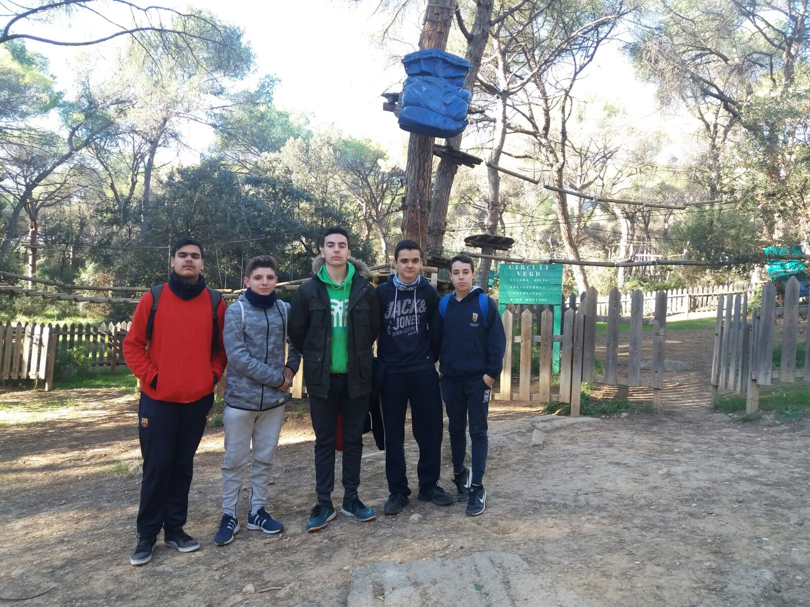
Photos (group)

Slide 8
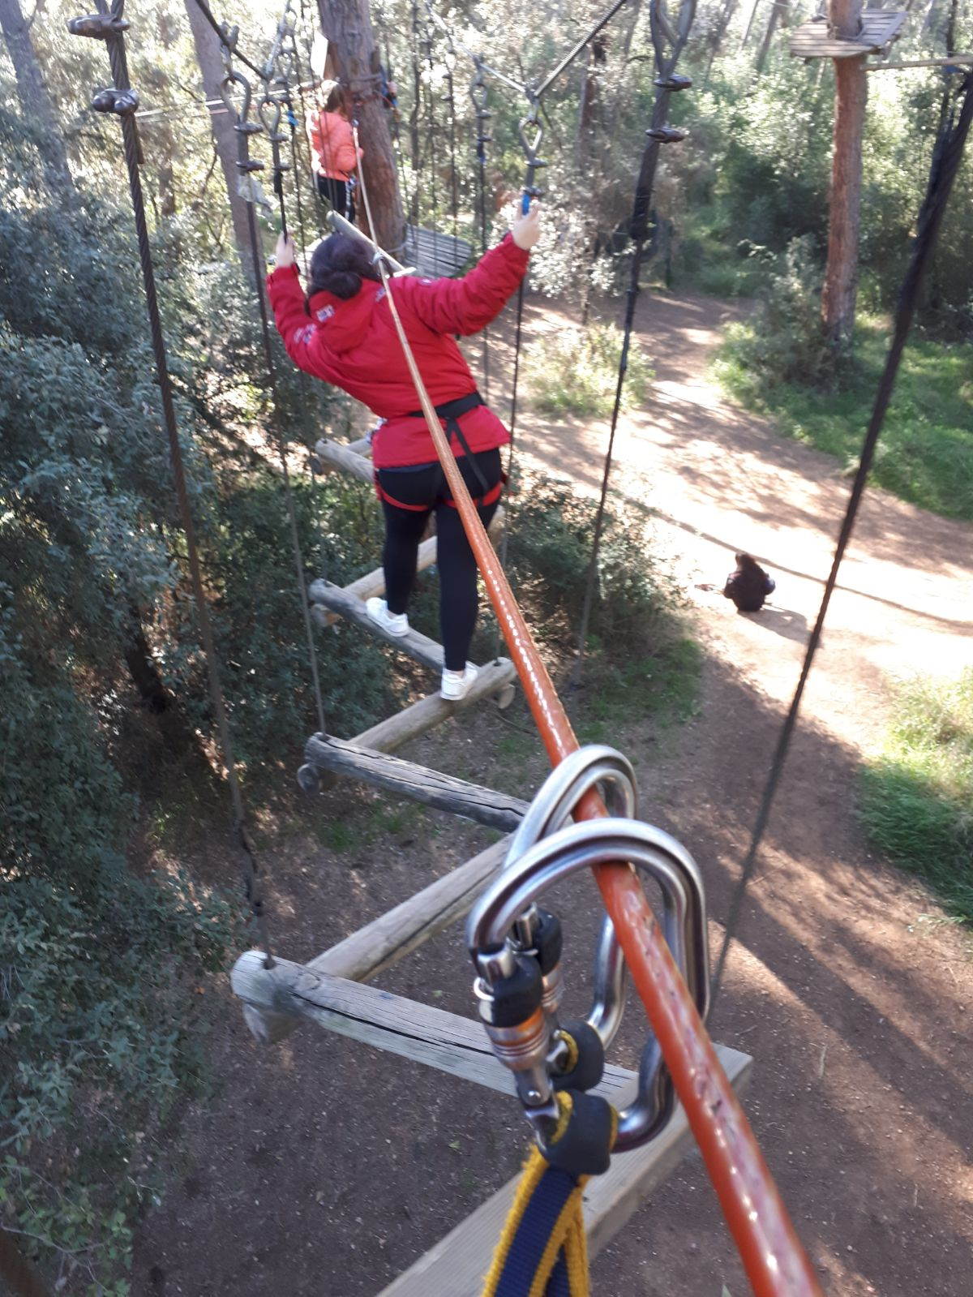
Photos (activities)

Slide 9
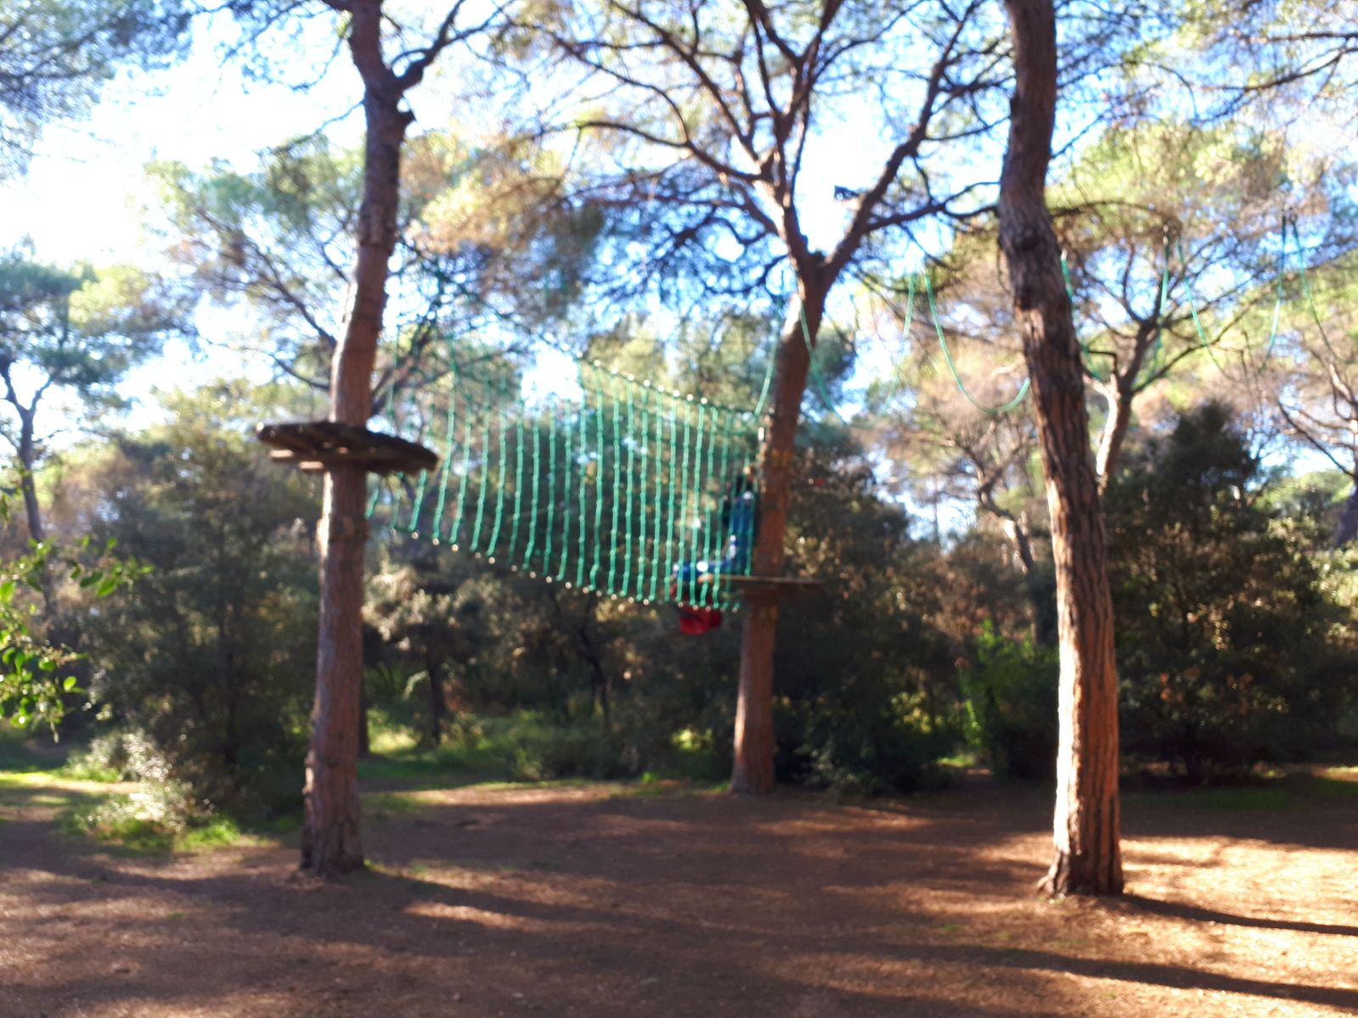
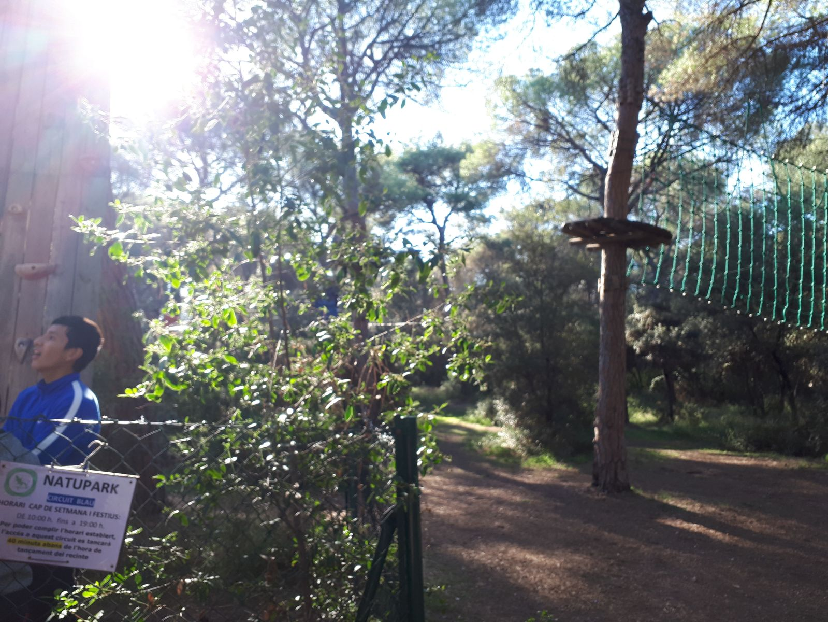
Photos (activities)

