Slide 1
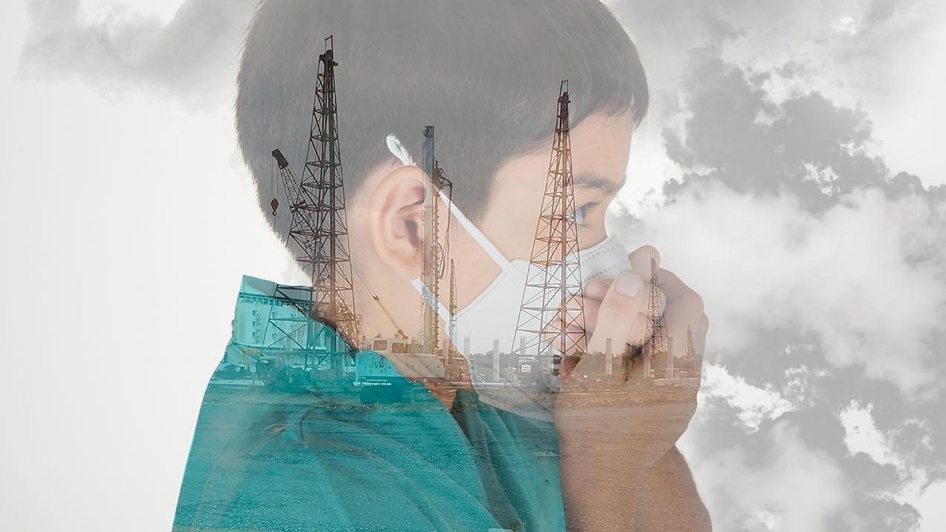
Problems in my city Sfax
Aîcha GARGOURI – La coupole Private School

Slide 2
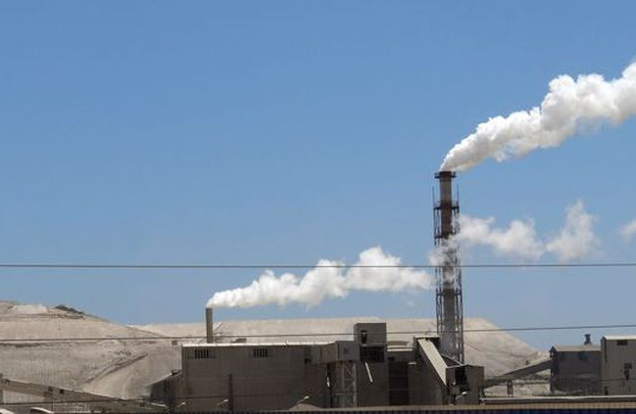
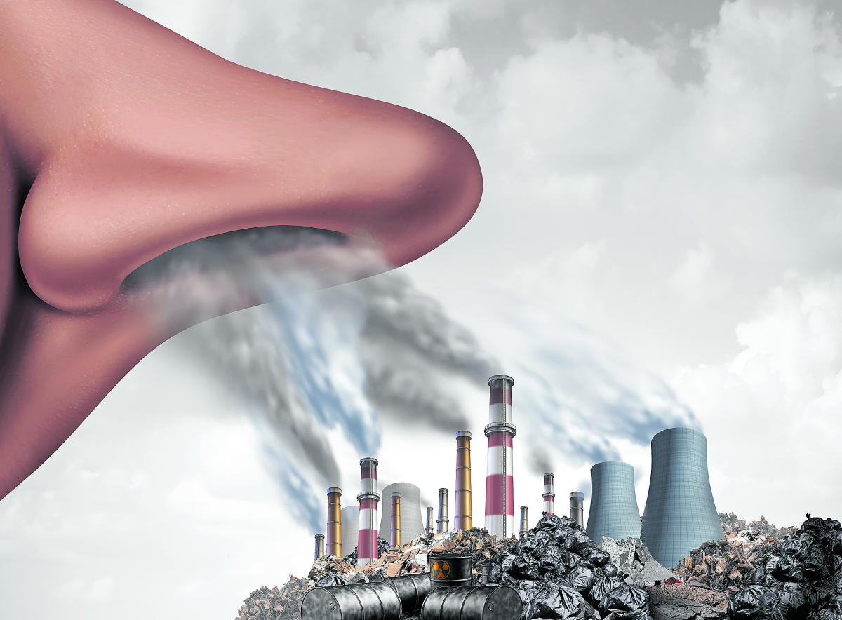
Problems in my city « Sfax »
Tunisia in the Top 10 most polluted African countries.
Sfax is one of the African cities where it is difficult to breathe healthy air.

Slide 3
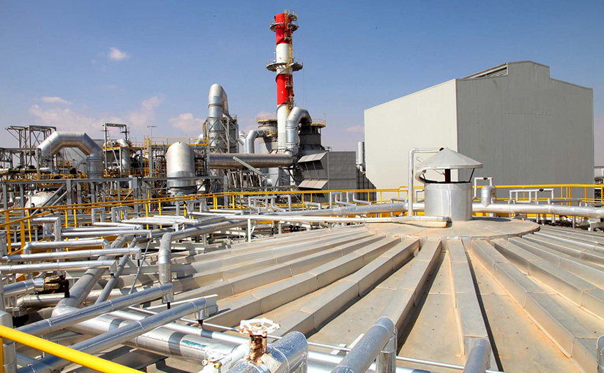
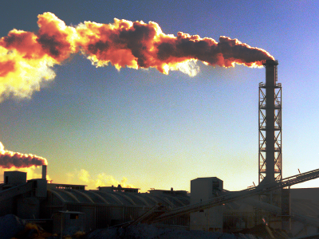
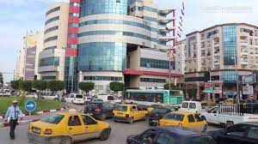
Multiple sources of pollution
Sfax : an Industrial Center
SIAPE : polluting industry
Means of transport

Slide 4
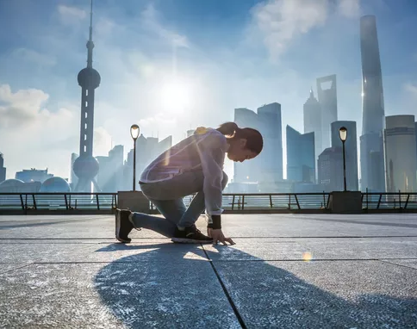
How to do sports in a polluted city ?
It is better to stay at home than to go running along the polluted avenues.

Slide 5
In addition, we have no green space to play sports.
We need real solutions to breathe better and above all to recharge our batteries.

