Slide 1
Solutions for my city « Sfax »
Aîcha GARGOURI
La coupole Private School

Slide 2
Solutions for my city « Sfax »
Solution 1 :
Create coordinated green spaces with recycling accessories.

Slide 3
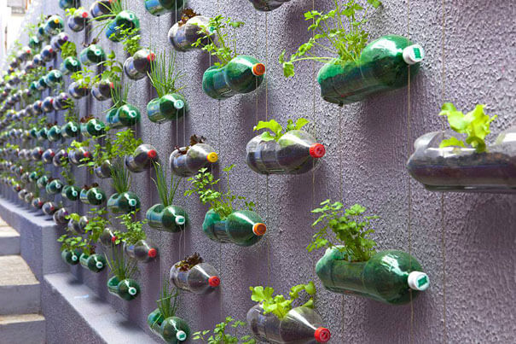
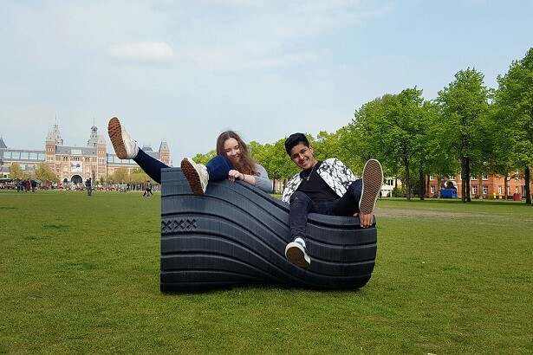
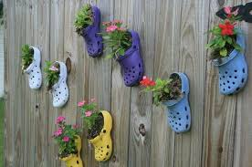

Slide 4
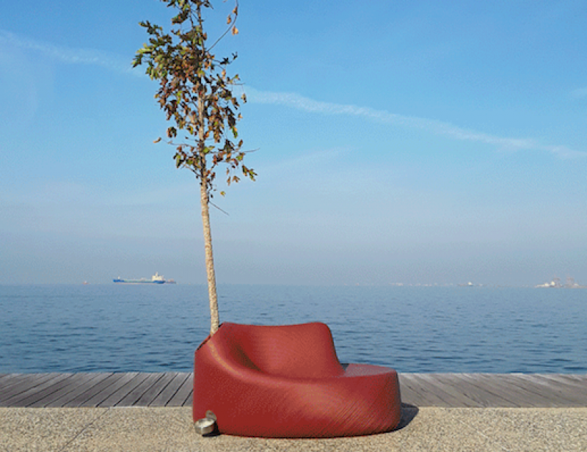
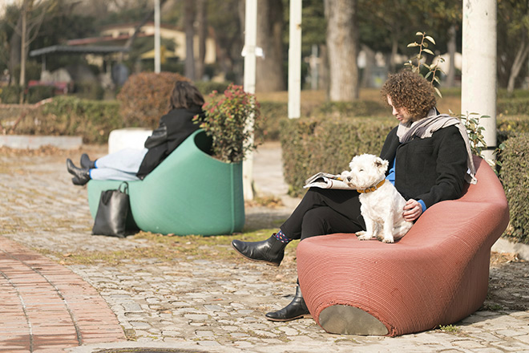
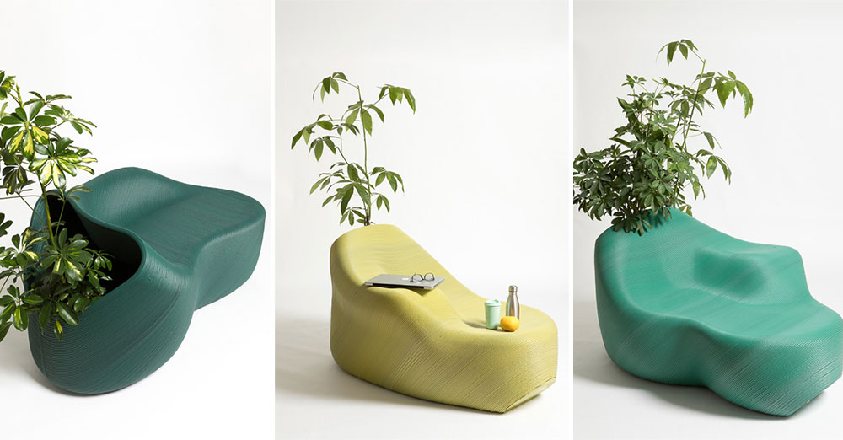

Slide 5
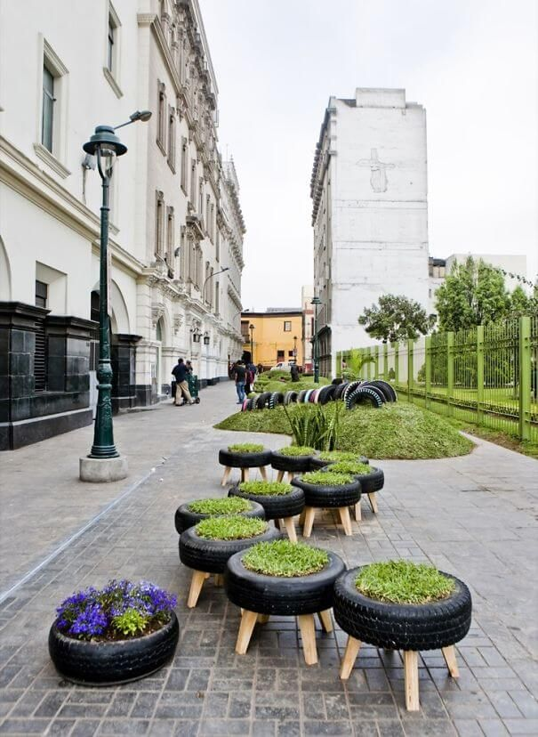
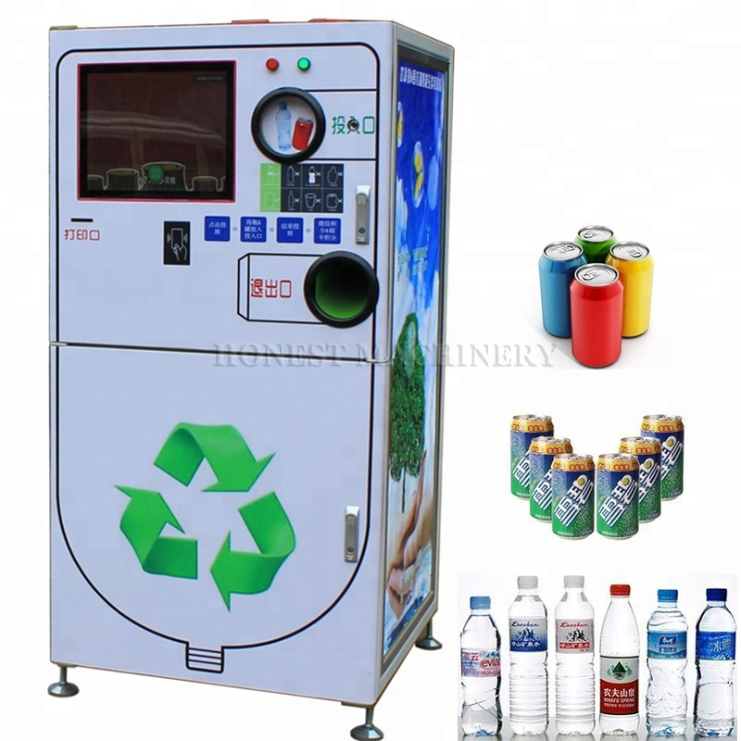

Slide 6
Solutions for my city « Sfax »
Solution 2 :
Take advantage of solar energy to power spaces and make them smart.

Slide 7
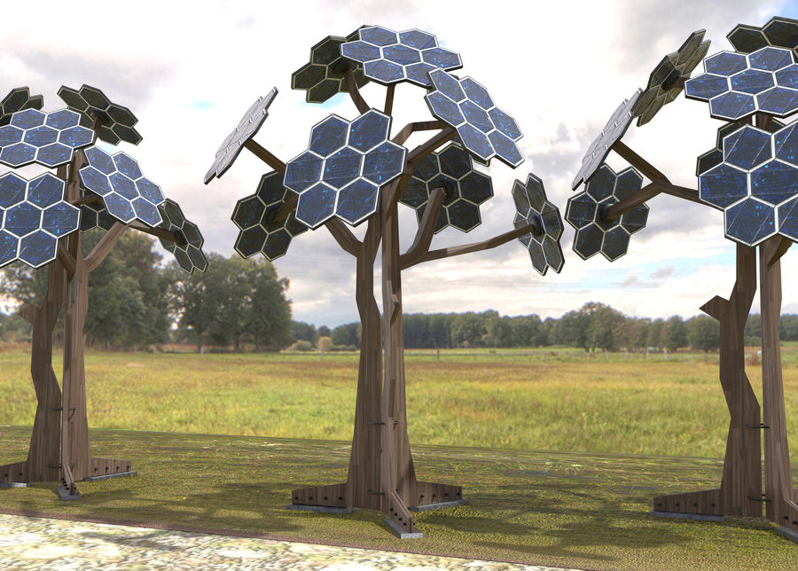

Slide 8
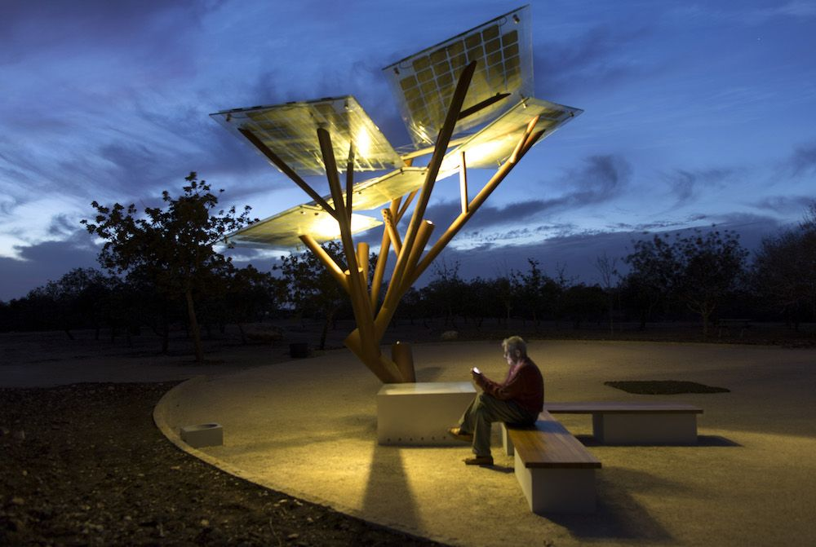

Slide 9
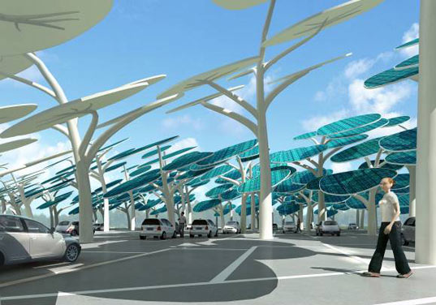

Slide 10
I hope you liked my ideas

