Slide 1
Curso Técnico de Cozinha e Pastelaria Curso Técnico de Gestão
One Fits All (Waltesquita Beverages)
Generational Marketing: Generation X
Trabalho realizado por:
Camila Raposeira
Margarida Raposeira
Rodrigo Henriques

Slide 2
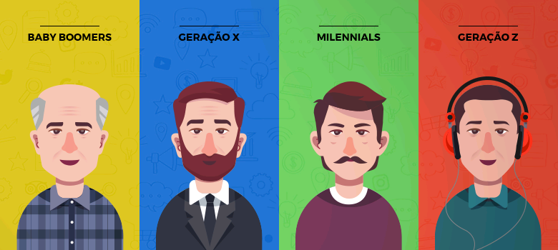
Who is Gen X?
Generation X is one of the smallest generations in the U.S., but they make up a large portion of the purchasing power. They are born sometime between the years of 1965–1980, and are effectively a technological conduit between Baby Boomers and Millennials. To better understand this generation, it’s important to recognize the generations they are sandwiched in between.
Gen X can understand the points of view from both generations. They enjoy learning the new tech of the century, spending time with their families and having independence. We also have to keep in mind, Generation X has borne witness to some significant events, including civil rights movements, several wars across the Atlantic and the Y2K crisis, to name a few.

Slide 3
What to Know About Gen X
Gen X can be the hardest age group to understand and nail down for even the most savvy marketers. You essentially have two types of Gen Xers:
Those born earlier in the generation who have some of the characteristics of Baby Boomers.
Younger members of Gen X who have some Millennial-type buying habits.
From a marketer’s perspective, it’s interesting how different each end of the generation can be when it comes to their savviness with technology. Earlier members of the generation may still have trouble with technology, such as computers and phones, while the later members have no trouble at all and are usually enthusiastic early adopters.
The more tech-dependant marketing techniques may appeal more to those that were born closer to 1980 and miss altogether those that were born closer to 1965.

Slide 4
Despite their differences, there are still commonalities across this diverse generation. Below are a few things to keep in mind when you are marketing to Gen Xers:
They are financially stable;
They care about security;
They’ve seen a lot;
They use the internet to research businesses;
They prefer marketing that is more personal and authentic.

Slide 5
Stats on Gen X
Unlike some of the Baby Boomer generation, Gen X has embraced the internet.
This educated age group enjoys spending time searching online and connecting with friends on their favorite social media platform, Facebook. They’re also known to be very loyal customers — just another reason to focus your marketing efforts on this generation!

Slide 6
Which Channels Reach Gen X?
With 58.2 million Gen Xers using the internet every day, they are the hardest generation in the U.S. to pin down. Generation X is the closest generation to retirement and are at the peak of their buying power. However, they are not as wealthy as the previous generation, the Baby Boomers, and often have more debt.
Gen Xers remember the world before the internet, but don’t let that steer your perception of this generation — many of them are well-versed with technology. It’s important to recognize that this group does have a tendency to develop brand loyalty and is also more likely to spend more on brands that contribute to social causes.
However, there are key channels to include in your marketing strategy to catch Gen X’s attention and influence them to make a purchase on your website.

Slide 7
However, there are key channels to include in your marketing strategy to catch Gen X’s attention and influence them to make a purchase on your website.
Popular Directories;
Facebook;
Direct mail;
Email marketing;
Video marketing;
Your website.

Slide 8
How to Tailor Your Ecommerce Marketing to Gen X
Now that we know who Gen Xers are and which channels are most effective at capturing their attention, let’s explore some of the marketing tactics to turn this discount-loving generation into repeat, loyal customers.
Provide discounts;
Create a loyalty program;
Have written reviews;
Appeal to security;
Keep it personal;
Use traditional and social ads;
Have great customer service;
Incorporate nostalgia;
Optimize your website for mobile;
Use videos.

Slide 9
Conclusion
Generation X has a lot of spending power and shouldn’t be an afterthought when you’re building an effective marketing strategy. If you meet this well-educated age group where they search and purchase, you’ll build a loyal customer base for the years to come.
This in-between generation encompasses traits from Baby Boomers and Millennials, so be sure to include a combination of different channels in your strategy, such as social media, direct mail and email, to drive them to your website.

Slide 10
Webgraphy
https://www.bigcommerce.com/blog/gen-x-marketing/#conclusion
https://www.google.com/search?q=gera%C3%A7%C3%A3o+x&tbm=isch&ved=2ahUKEwjk9pjPmPznAhUa-hoKHYbLB5QQ2-cCegQIABAA&oq=gera%C3%A7%C3%A3o+x&gs_l=img.3..0i67l4j0j0i67j0l2j0i67l2.15839.26872..27012...1.0..0.161.858.6j3......0....1..gws-wiz-img.....0.52lR81kRLiw&ei=2TFdXqSmI5r0a4aXn6AJ&bih=881&biw=1280

