Slide 1
Marcellin Mesquita Secondary School of Cartaxo Professor: Ana Joaquim
Eight P's from Marketing-Mix
Work done by: Ana Jesus nº1, Elisa Mota nº5 and Carina Rodrigues nº2

Slide 2
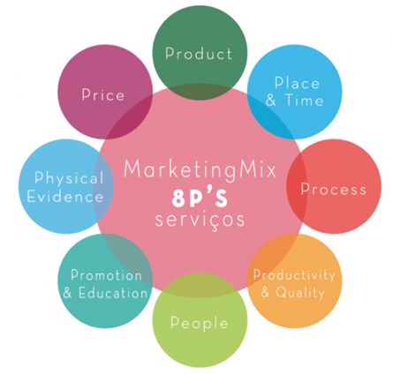
What is Marketing-Mix?
The Marketing Mix 8 P's, is a set of actions or tactics that a company uses to promote the brand, service or product in the market. The 8P's were developed and studied originally thought in the Marketing services.

Slide 3
Product Elements
The company must take into account all the components of the service performance. The characteristics of the main service and the package of complementary services involving it must be selected, taking into account the benefits and the degree of performance of competing services.

Slide 4
Place & Time
It is necessary to define when (delivery time), where (place) and how (means) the service will be delivered/rendered to Customers. This definition may involve physical and/or electronic distribution channels, depending on the nature of the service being provided.

Slide 5
Process
The set of necessary procedures and processes that are necessary for the effectiveness of the service. These procedures are defined by the company and must be strictly followed.

Slide 6
Productivity & Quality
Ability that the company has to provide services in a timely manner and with the minimum possible costs while maintaining the quality characteristics required and perceived by customers. Quality - The degree to which a service satisfies the needs, desires and expectations of Customers.

Slide 7
People
Any person directly or indirectly involved in the production/delivery of the service. It is important to understand what the Client is looking for, but it is equally important to know how to interact with the Clients and take into account the individual needs of each one. The Customer is increasingly looking for a personalized service.

Slide 8
Promotion & Education
Communication has a fundamental role, no marketing plan is successful without a good communication strategy, which promotes the benefits of the service but also educates the clients about it.

Slide 9
Physical Evidence
Visual or other tangible characteristics that provide evidence of service quality, anything that may influence the Customer's perception of the quality of service.

Slide 10
Price
The company not only defines a retail price and purchase conditions, it is also necessary to take into account other costs that Clients may incur to obtain benefits from the service, such as time, physical and intellectual effort, among others.

