Slide 1
Migration of people in Croatia

Slide 2
Croatian national minorities abroad
Austria about 50 000
Czech Republic about 800
Italy about 3 000
Kosovo about 350
Hungary about 50 000
Macedonia is about 4 000
Romania about 7 500
Slovakia about 4 000
Slovenia from 35 000 to 54 000
Serbia from 150 000 to 200 000
Montenegro about 7 000 to 10 000

Slide 3
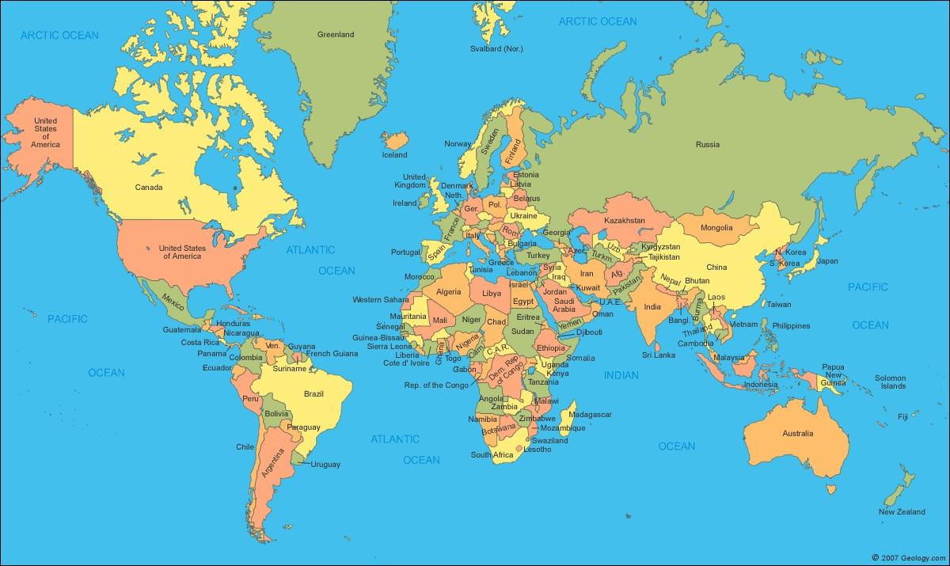
Croatian emigrants and their descendants abroad
Argentina about 250 000
Australia about 250 000
Austria about 90 000
Brazil about 20 000
Chile about 200 000
France about 40 000
Italy about 60 000
Canada about 250 000
New Zealand about 40,000
Germany about 350 000
USA about 1 200 000
Sweden about 35 000
Switzerland is about 80 000

Slide 4
The period of emigration
1st period - from the 15th to the 18th century (old diaspora)
Burgenland Croats
Molise Croats
Croats in Romania
Croats in Slovakia
Bunjevci and Šokci

Slide 5
Second period- from 1880 to the First World War
USA, Latin American countries, South Africa, Australia, New Zealand
3rd period - between the two world wars
Germany, France, Belgium
4th period- from 1940 to 1948
Argentina and other Latin American countries, North America
5th period- from 1965 to 1990
Western Europe, Australia, New Zealand and Canada
6th period - from 1991 to present
Germany, Switzerland, Austria, Canada, USA, Australia and New Zealand

Slide 6
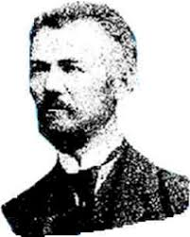
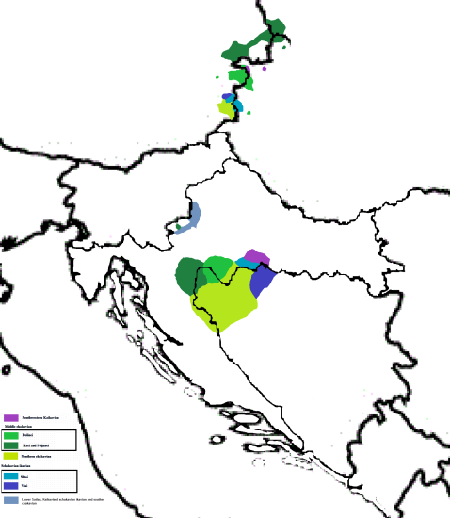
Burgenland Croats (Austria)
Ottoman penetrations-emigration of Croats (Lika, Krbava, Banovina, Slavonia, Bosnia, Posavina, Pounje, Croatian littoral and the ends south of Senj).
In the 16th century, they inhabited Western Hungary, the East Austria, western Slovakia and southern Moravian.
Since 1868 6 years of compulsory teaching are being introduced in the Croatian language.
1878, Mihovil Naković - Declaration on the unique Croatian spelling and literary language of Burgenland Croats.

Slide 7
Croats in Hungary
The linguistic and cultural - most diverse and most complex Croatian minority outside the mother tongue country.
They range from the 15th to the 18th centuries with virtually the entire Croatian ethnic space.
After the Second World War - a new school system; the Croatian Teacher's School in Pécs is founded; teaching in Croatian language.

Slide 8
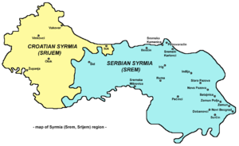
Croats in Vojvodina (Serbia)
Croats in Bačka, Srijem and in a smaller number in Banat - the edge of the Croatian ethnic space; today 56.546
Bunjevci originate from Western Herzegovina; settled in the late 17th century north of Bačka (Subotica and Sombor with its surroundings). Today is the largest community.
Due to the reconstruction of the Military Border, Croats are mostly inhabited in Banat by the 18th century.

Slide 9
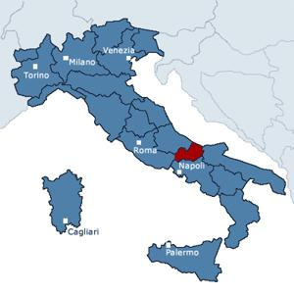
Molise Croats (Italy)
The Italian province of Molise, the "gang zone"
Croats settle in the late 15th and early 16th centuries in the area of ​​Dalmatia (between Cetina and Neretva)
Today there are about 4 500 inhabitants.

Slide 10
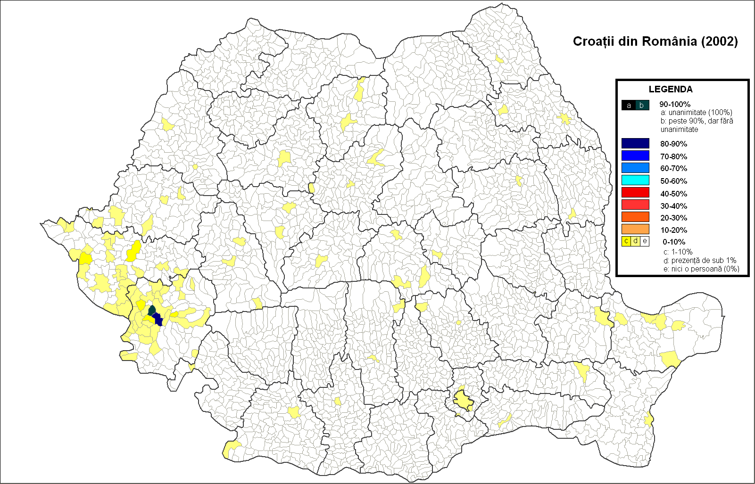
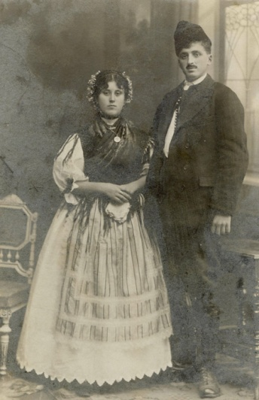
Croats in Romania
The oldest Croatian minority; well-linguistically and ethnographically preserved.
The largest number, 6,500, lives in the Karachi Severin County (Karaševci, Krašovani, Karaševski Croats).
At the beginning of the 20th century, Rekaš became the center of the social and economic life of the region.

Slide 11
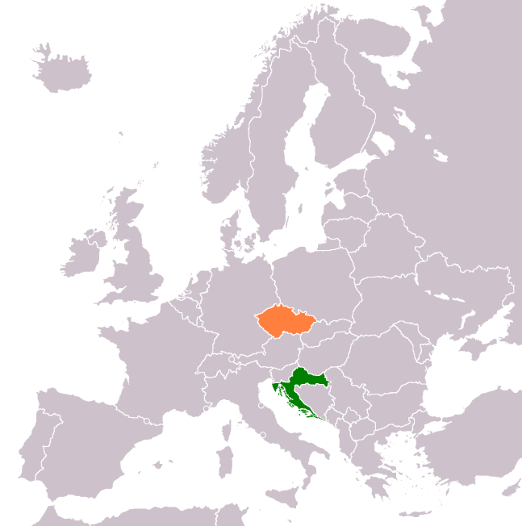
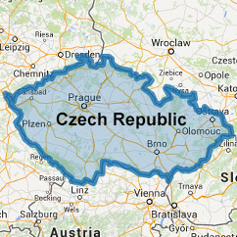
Croats in the Czech Republic
Although originally similar to Burgenland Croats, Croats in southern Moravia are considered to be a separate community.
They come from the Banovina and Kordun in the 16th and 17th centuries.
Today Croatians have around 850 and are organized into the Croatian Cultural Association.

Slide 12
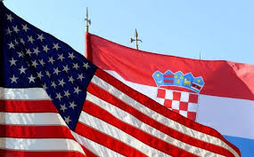
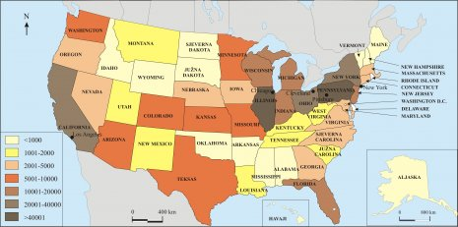
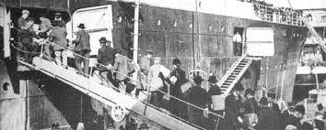
Croats in the United States
Legends about immigration to America; today 401,208 Croats
The larger emigrants began in about 1880 from the Croatian coast, Lika, Jaske, Dalmatia and the islands.
The causes of emigration - mainly of economic nature.
By the end of the First World War, about 350,000 people left.

