Slide 1
Erasmus +
EMIGRATION Presentation

Slide 2
HISTORY OF POLISH EMIGRATION
All emigration processes in Poland were caused by tough economic situations, political and religious, which dominated in the country.

Slide 3
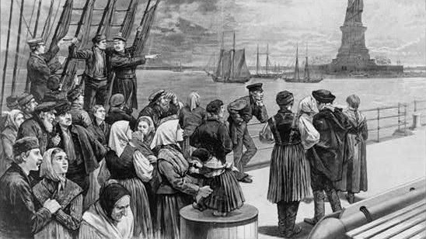
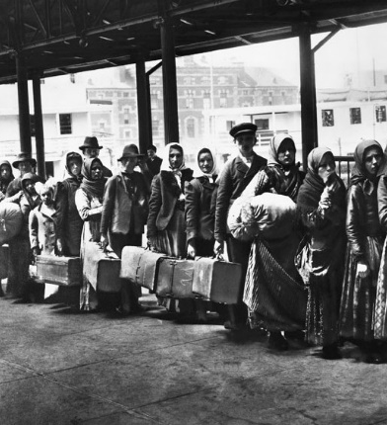
HISTORY OF POLISH EMIGRATION
In 1831 after the failure of the November Uprising nearly 10 000 civilians, soldiers etc. were forced to emigrate. We call it Great Emigration.
In the years from 1864 through 1914 occurred so-called New Emigration, about 3,5 million people left the country.
Over the period 1918 – 1939 about 2 million Poles ran away. Most of them (1,25 mln) to France, Belgium, Germany, and the United States.
In 1939 – 1941 almost 800 000 of Poles were forced to leave their country and work in Germany.

Slide 4
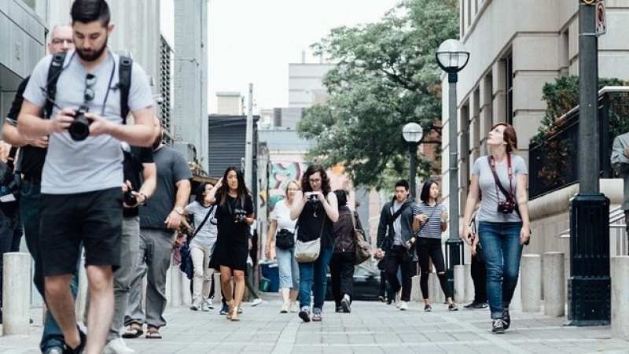
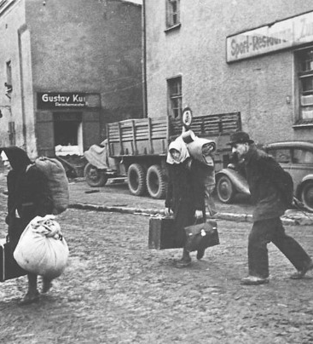
HISTORY OF POLISH EMIGRATION
In the years from 1945 through 1947 about 800 000 Poles came back to their native country.
Over the period 1980 – 1988 almost 1 mln people left Poland because of communism .
In 2004 Poland enters the European Union. As a result, nearly 1 mln of young Poles emigrate and more people start to visit Poland.

Slide 5
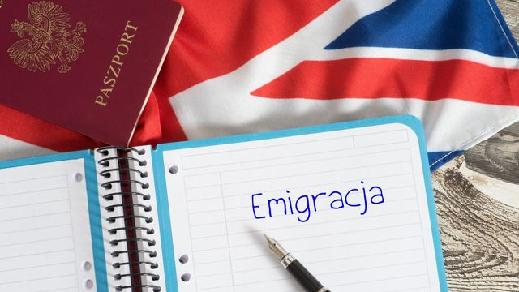
HISTORY OF POLISH EMIGRATION
The most important directions of Polish emigrations:
Germany
Great Britain
Ireland
Italy
the Netherlands
Spain
Austria
Norway
Sweden
Island
Denmark.

Slide 6
Statistic data

Slide 7
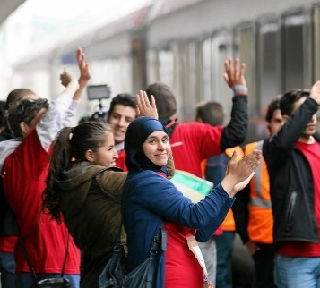
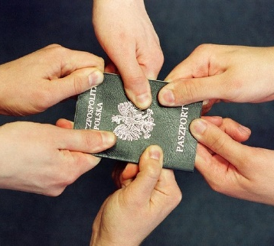
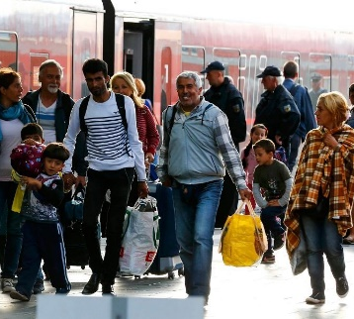
Statistic data
PRESENT - DAY STATISTICS ON THE SUBJECTS OF EMIGRATION IN POLAND BASED ON THE REPORT OF POLISH OFFICE FOR FOREIGNERS
In 2017 applications about international protection applied: 671 Ukraine citizens, 3550 Russian Federation, 154 Tajikistan, 40 Armenia, 44 Syria, 56 Turkey, 28 Pakistan, 12 Libya, 41 Iraq, 16 Iran, 25 Afghanistan, 14 Egypt and 11 of Algeria.
From January to April in 2018, 1069 applications have been applied. The most from Russian and Ukraine citizens.

Slide 8
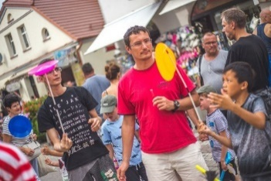
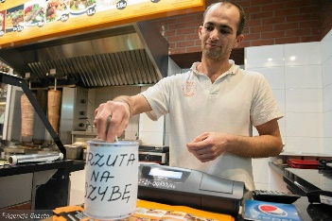
Statistic data
IMMIGRANTS IN USTKA BASED ON TOWN HALL DATABASE
Currently, in Ustka reside about 257 immigrants from Ukraine, Belarus, and Nepal.
Those immigrants are employees of hotels, stores, fish processing and private multi-branch companies.
They work as waiters, maids, salesmen, SPA workers, catering assistants, builders, fish processing workers.

Slide 9
IMMIGRANTS AT OUR SCHOOL

Slide 10
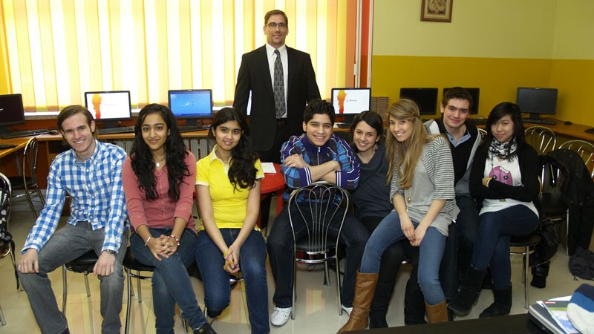
IMMIGRANTS AT OUR SCHOOL
Two foreigners from Ukraine learn at our school.
The school gives them optional Polish classes they can speak Polish fluently and have interpersonal skills. As well as extra Polish lessons, they attend the ones which are supposed to introduce them the history and culture of Poland. Due to our openness, tolerance, and care, they have a sense of security and they are happy.

Slide 11
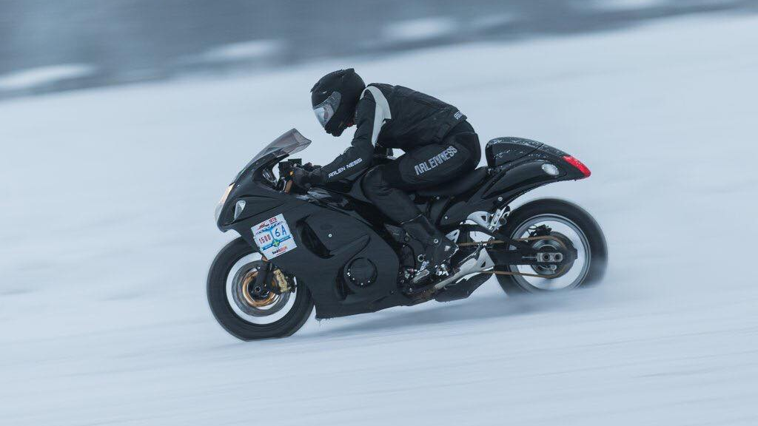
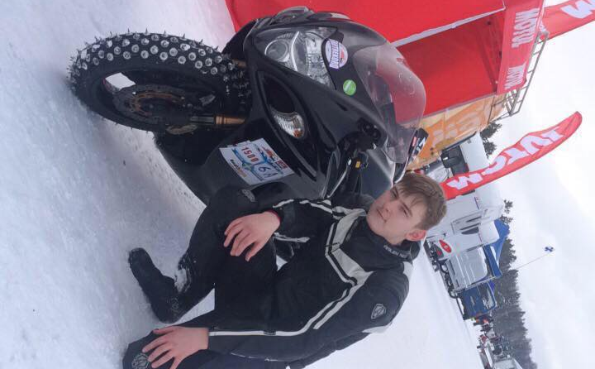
IMMIGRANTS AT OUR SCHOOL
Story of one of the students
Hi im Jakub I'm a 16 year old from Poland. At the age 2 my dad died and my mum was having a really hard time looking after me and working at the same time so she left me with my grandparents and went to England. After a couple of months she came for me and took me to England. I was in England 8 years and i enjoyed being there but it didn't feel like the place for me then at the age then.

Slide 12
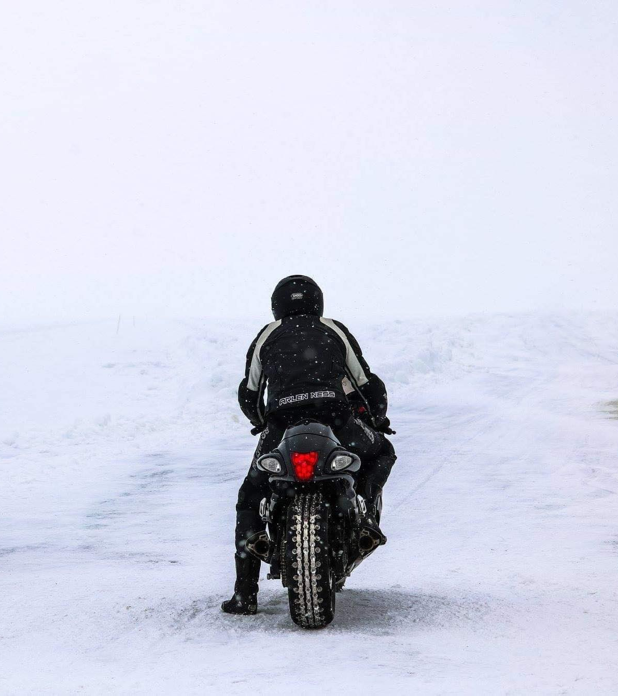
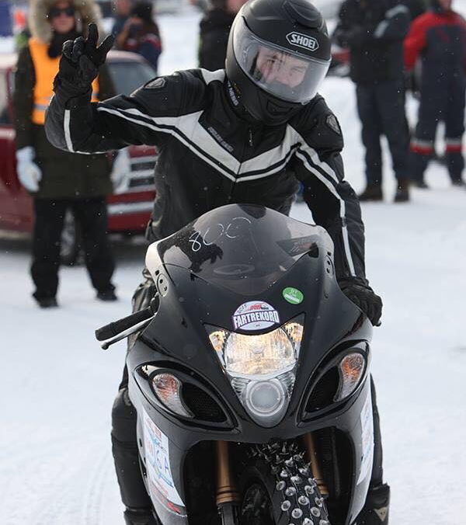
IMMIGRANTS AT OUR SCHOOL
When i was 10 we moved to Norway we also had a hard time but i met lots of new friends that i really like until today, and i had a great time there i really enjoyed it . I lived there for 3 years but because of my mum's financial problems we had to go back to Poland. I was scared that i wont know polish well enough and i wont get along with people at school but it all turned out well. I really like that we are back because i'm back with my family and i don't have to travel so far to see them. I also started my Drag Racing career . I really enjoyed living in other countries but when your away from your family i just doesn't feel like the right place.

Slide 13
Thank you for your attention!
Primary School No. 3 in Ustka

Slide 14
Presentation made by:
Text:
Translation: Wiktoria Różycka, Mrs Aleksandra Łącka
Photo: Szymon Moraczyński, Jakub Ratajczak
Design and Presentation: Tomasz Sawczuk

