Slide 1
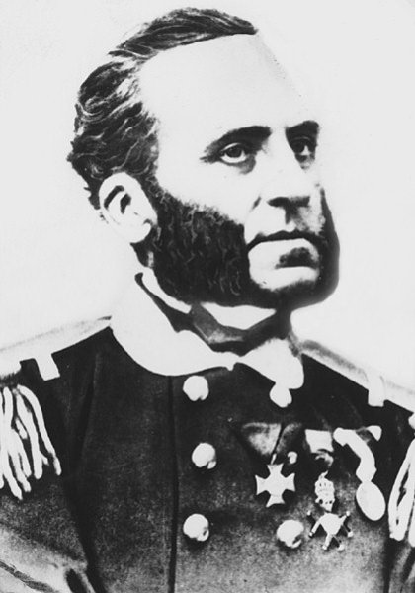
Ivan Lupis
Osnovna škola Petra Preradovića
Jakov Jure Vedrić 6.B
2019/2020

Slide 2
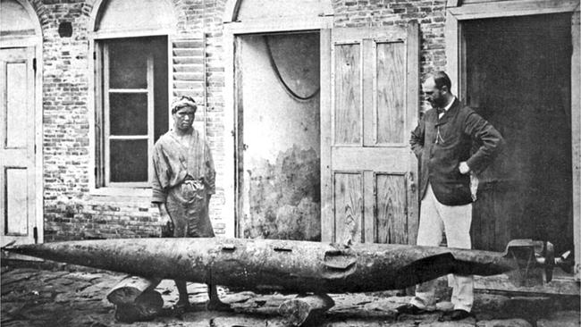
Content
Biography
Inventions

Slide 3
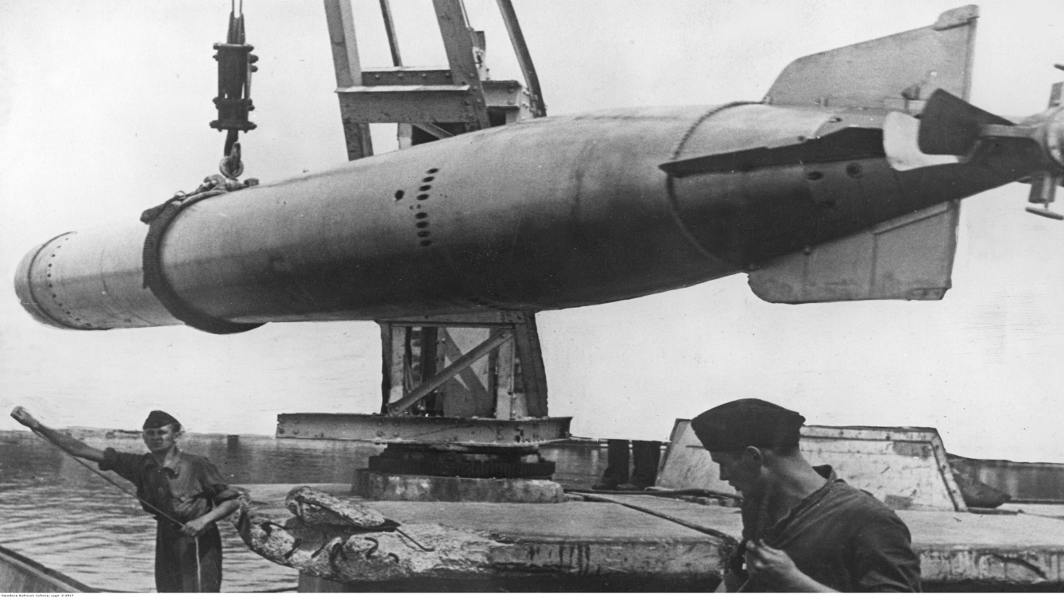
Introduction
This presentation is about the great inventor of the torpedo, Ivan Lupis.

Slide 4
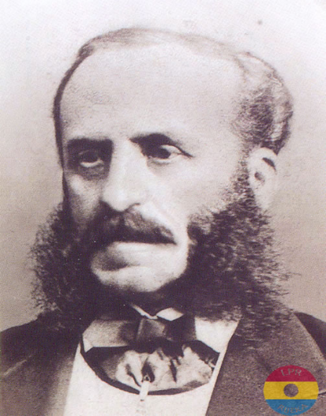
Biography
Born in Rijeka, Croatia on the 27th of August 1813
Died in Trogir on the 11th of January 1875
Ivan Vukić, loannem Blasium Ignatium Lupis, Giovanni Biagio Luppis
The son of Ferdinand and Ivana Lupis maiden name Perić

Slide 5
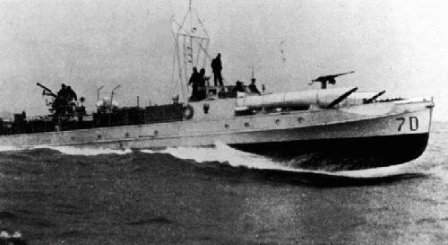
Education
Descended from a family of sailors from Pelješac, he was educated in Rijeka and Venice
He was an officer on the ships of the Austro-Hungarian Navy
He reached the rank of captain

Slide 6
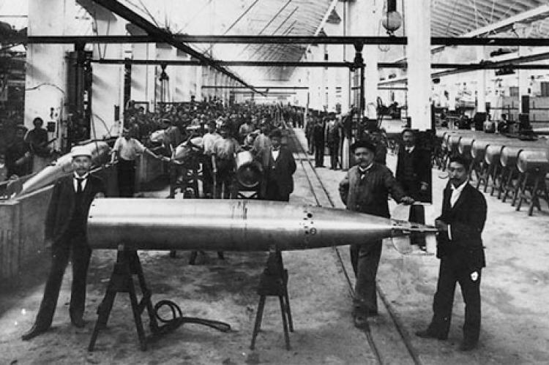
retirement
After his retirement in 1861 he returned to Rijeka to work on the idea of ​​an unmanned boat that attacks an enemy ship over long distances.
He envisioned a floating device for destroying ships that would be unmanned and controlled from land, while the explosive charges would detonate at the moment of impact.

Slide 7
Torpedo
In 1860. godine he built a torpedo, which he later developed with British machine engineer Robert Whitehead, manager of the local factory "Stabilimento Tecnico Fiumano“.
https://youtu.be/O-6a9ruVyxk

Slide 8
production
On the 21st of December 1866 the first automobile torpedo, now named Minenschiff, was officially demonstrated in front of the Austro-Hungarian State Naval Commission for evaluation.
This model was 355 mm in diameter and 3.35 m in length, weighing 136 kg with 8 kg of explosives.
The naval commission accepted it, and subsequently on 6th of March 1867 the government contracted the inventors for a test production and agreed to pay all the production costs.
Whitehead retained the copyrights and even negotiated a new contract with Luppis. This however gave Whitehead full control of all future sales.

Slide 9
what is a torpedo?
A torpedo is an underwater vehicle designed to destroy ships and other vessels.
It is fired from ships, submarines, aircraft, coastal forts, or helicopters.

Slide 10
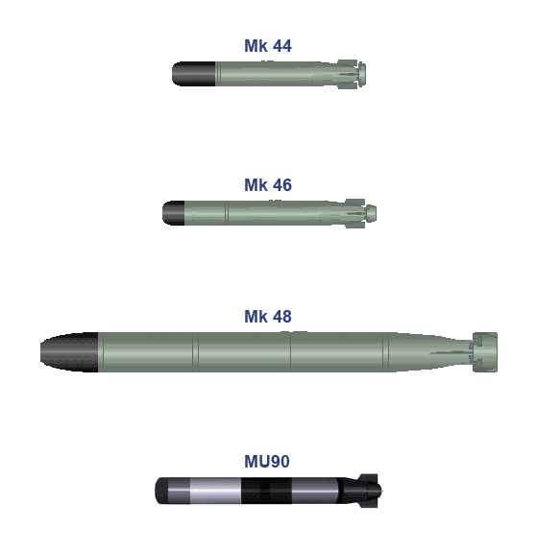
Types of torpedo
1. Compressed air torpedo
2. Torpedo on heated compressed air
3. Combined propulsion torpedo (heated air and steam)
4. Compressed oxygen torpedo
5. Electric-powered torpedo
6. Jet-powered torpedo (hydrogen)

Slide 11
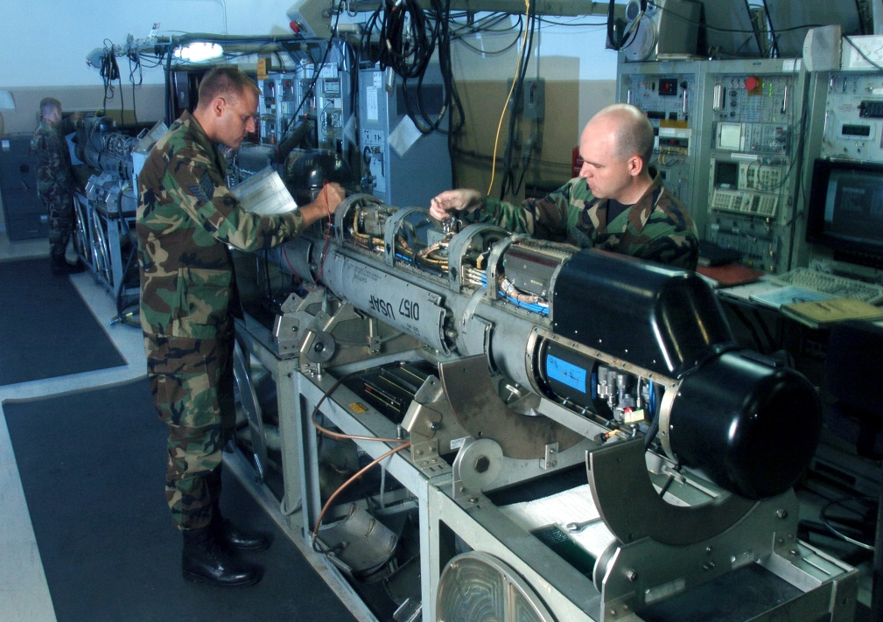
conclusion
By the end of the 19th century, most of the world's navies started to acquire the Rijeka-made torpedoes and warfare at sea became unthinkable without the use of this weapon, at least until the end of the second world war.

Slide 12
sources
http://ivanlupis.blogspot.com/
https://povijest.hr/nadanasnjidan/ivan-lupis-izumitelj-torpeda-1813/
https://www.total-croatia-news.com/lifestyle/35011-croatian
http://www.edubilla.com/invention/torpedo/
https://en.wikipedia.org/wiki/List_of_Croatian_inventions_and_discoveries

Slide 13
