Slide 1
OŠ Petra Preradovića Robert Paleka 6.c 2019./2020.
ANTUN LUČIĆ

Slide 2
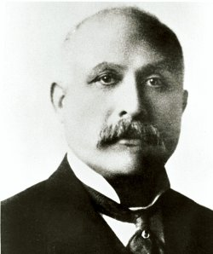
Anthony Francis Lucas was an American Croatian-born oil explorer.
With Pattillo Higgins he organized the drilling of an oil well near Beaumont, Texas that became known as Spindletop.
This led to the widespread exploitation of oil and the start of the petroleum age.

Slide 3
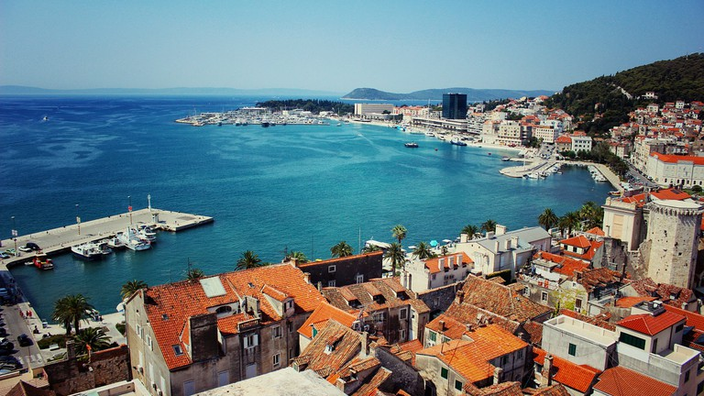
Lucas was born into a Croatian family of shipbuilders and owners in the city of Split, Croatia in 1855.

Slide 4
At the age of 20, Lucas completed studies at the Polytechnical Institute in Graz, Austria and became a mechanical engineer. After entering the Austrian Naval Academy, Lučić served in Pula and Rijeka and rose to the rank of second lieutenant.
In 1879, Lucas visited his uncle in Saginaw, Michigan. There he settled and changed his name to Anthony Francis Lucas.

Slide 5
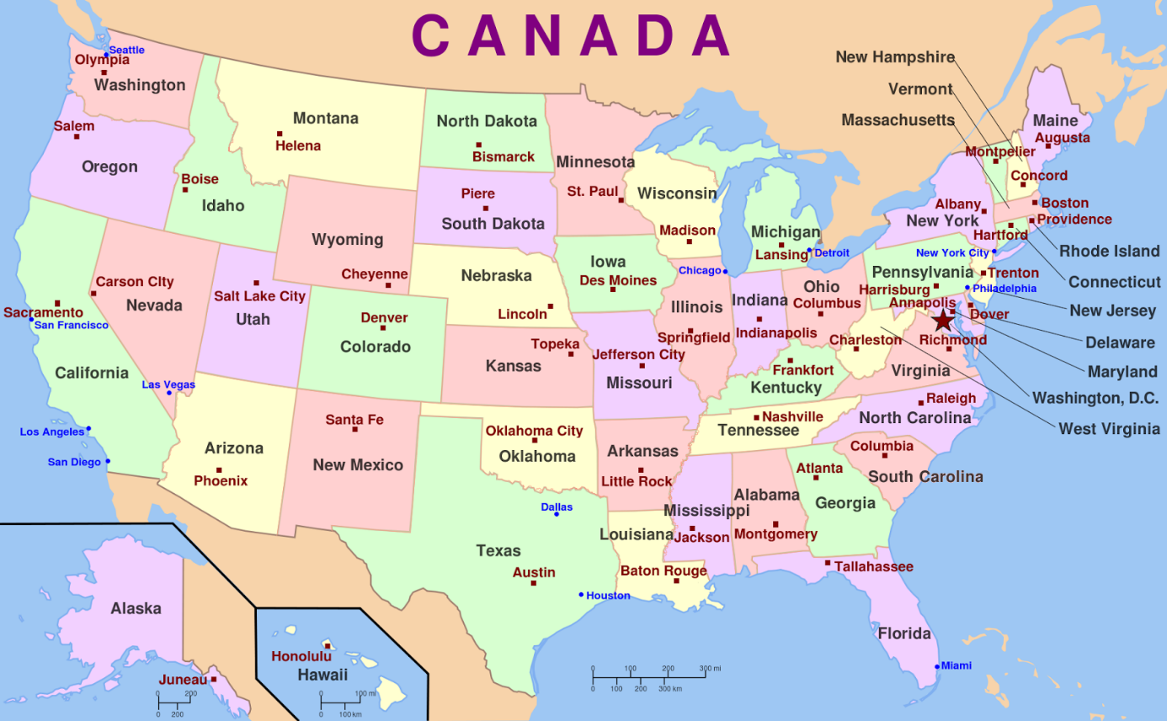
In 1879, Lucas visited his uncle in Saginaw, Michigan. There he settled and changed his name to Anthony Francis Lucas.

Slide 6
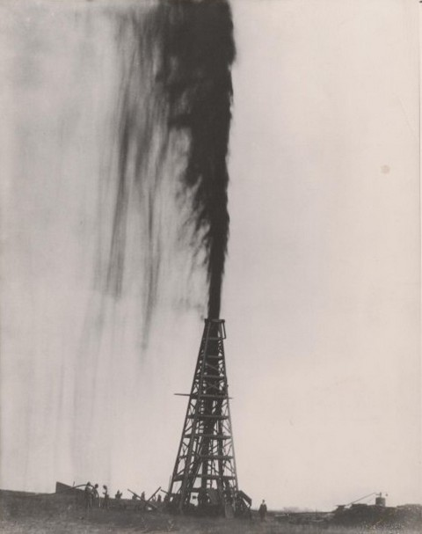
With Pattillo Higgins he organized the drilling of an oil well near Beaumont, Texas that became known as Spindletop.
This led to the widespread exploitation of oil and the start of the petroleum age.

Slide 7
The Lucas Gusher helped revolutionize world fuel use and transformed the economy of southeast Texas.
It helped further the development of the combustion engine automobile since significant amounts of energy were needed for fuel.
The city of Houston become the national center of the oil industry, with the United States surpassing Russia as the world's leading producer.

Slide 8
In 1936, the American Institute for Geological and Metallurgical Investigations founded the Anthony F. Lucas Gold Medal prize for development in the area of oil exploration.
A museum with a granite obelisk was built to honor the explorer about which is inscribed:
"On this spot on the tenth day of the twentieth century a new era in civilization began."

Slide 9
