Slide 1
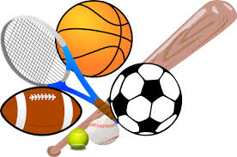
How being active influences the brain

Slide 2
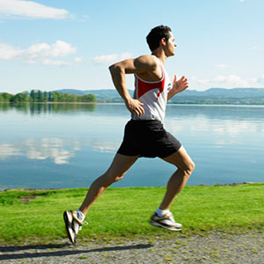
During physical activity, increases circulation, nourishes the brain with nutrients

Slide 3
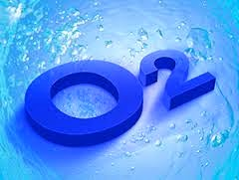
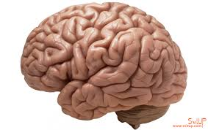
Increased and active respiration supplies the oxygen to the brain

Slide 4
Sport and physical activity help to weaken intense intellectual load

Slide 5
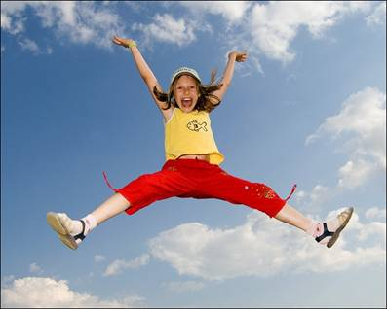
Nice physical activity causes positive emotions

Slide 6
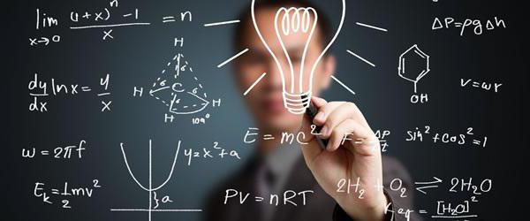
Physical activity stimulates the development and growth of neural processes, which is a prerequisite for high-quality intellectual development

Slide 7
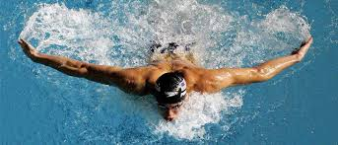
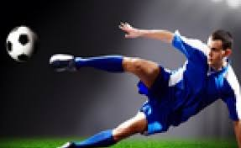
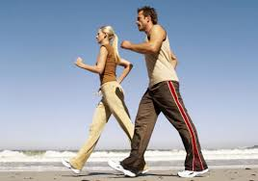
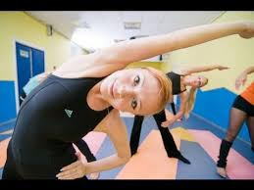
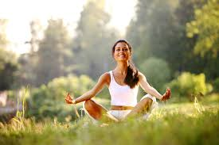
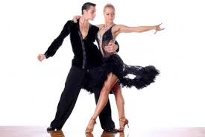
Appropriate types of physical activity:

Slide 8
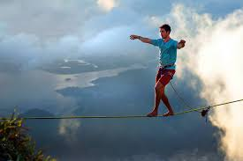
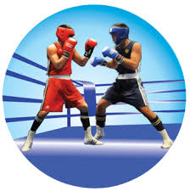
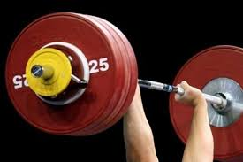
You should avoid!
Extreme sports
Traumatic sports
Tedious sports

Slide 10
*UKRAINE* (KALUSH SPECIALIZED ENGLISH SCHOOL #2)

