Slide 1
How does being active influence the brain?

Slide 2
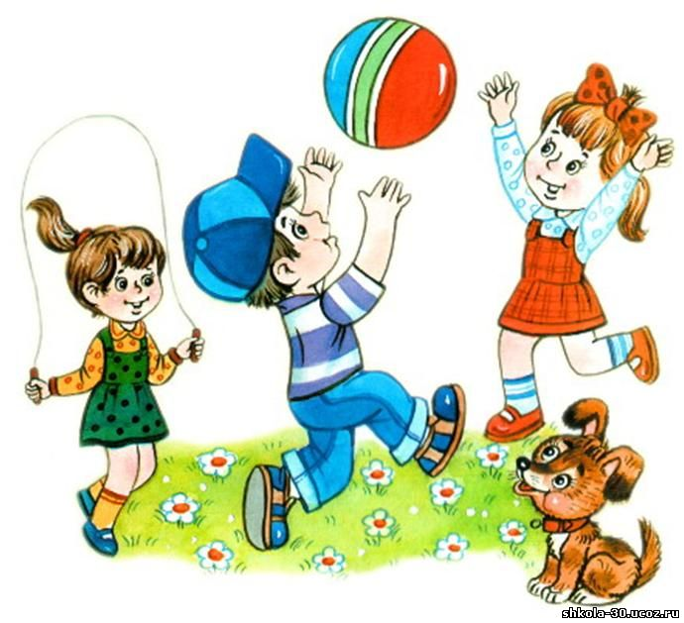
Exercise is good for human health.
This statement is known to all.
But we do not even imagine, as sports and exercise can affect the human brain.
Sports Activities positive effect on the human brain.

Slide 3
Scientists confirm, that people who have a habit to perform a number of sports exercise and physical activity, have higher intellectual abilities.

Slide 4
Sports exercise and physical activity stimulates the metabolic processes in the body, so that nutrients and oxygen reach the brain in sufficient quantity.
Our brain with good blood circulation powered oxygen, which stimulates higher brain activity.

Slide 5
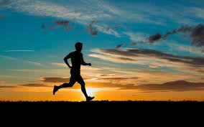
Running relieves depression,
overcomes laziness and fatigue.

Slide 6
Power load
increases concentration.

Slide 7
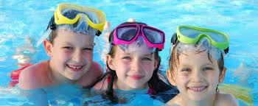
Swimming in the morning
gives us courage.
In the evening, calms nerves.

Slide 8
Train your brain!
Go in for sports!
Stay healthy !

Slide 9
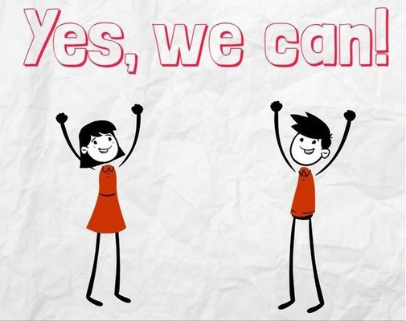
*UKRAINE* (KALUSH SPECIALIZED ENGLISH SCHOOL #2)

