Slide 1
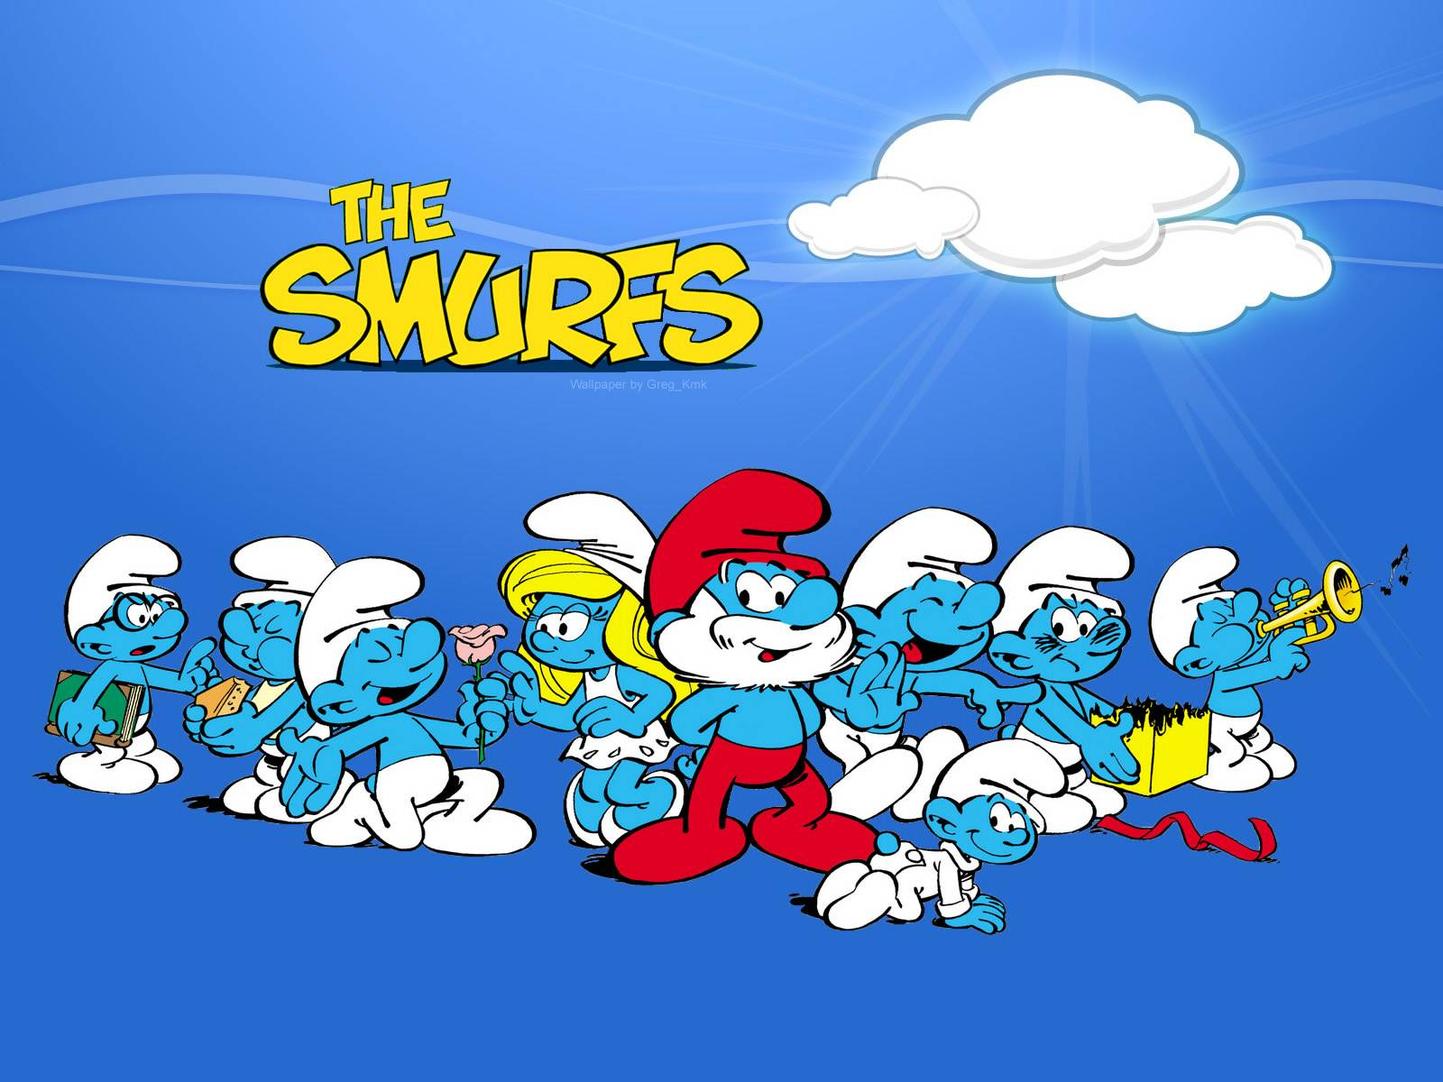
Our Brainfood Smurfstory
Larissa team, Greece

