Slide 1
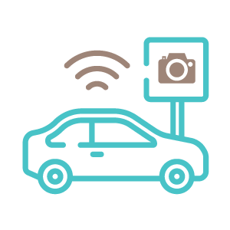
The autonomous car
Dangers ? Company ?
Benefits ? Future ?
What is it ? Opinion ?

Slide 2
When can we consider a car like an autonomous car ?
LEVEL OF DRIVING AUTOMATION
By the SAE
The human monitors the driving environnement
The autonomous system monitors the driving environnement

Slide 3
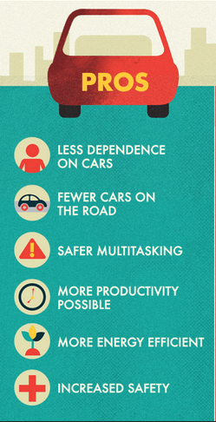
benefits of the Autonomous cars
Cars will ”go” faster because all the cars will be synchronously.
Reduce traffic congestion
Reduce CO₂ emissions
Improvement in fuel economy
The computer that controls the car can’t fall asleep ( the main cause of accident in the United States)
Reduce accident → reduce price of car's insurance

Slide 4
The dangers of the autonomous cars
Like any computerized system, it is open to hacking and possible digital threats
It will displace many public transit sectors.
→Economical consequences?
Cars will not understand police’ movement ( for the circulation …)

Slide 5
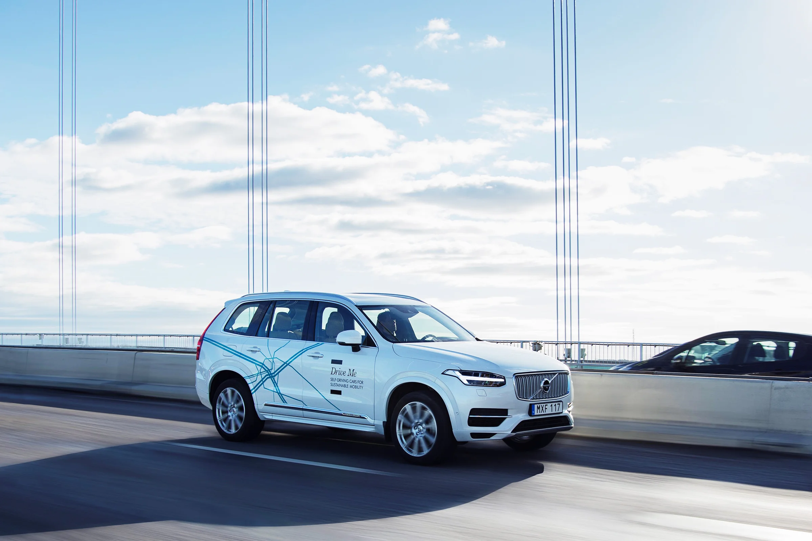
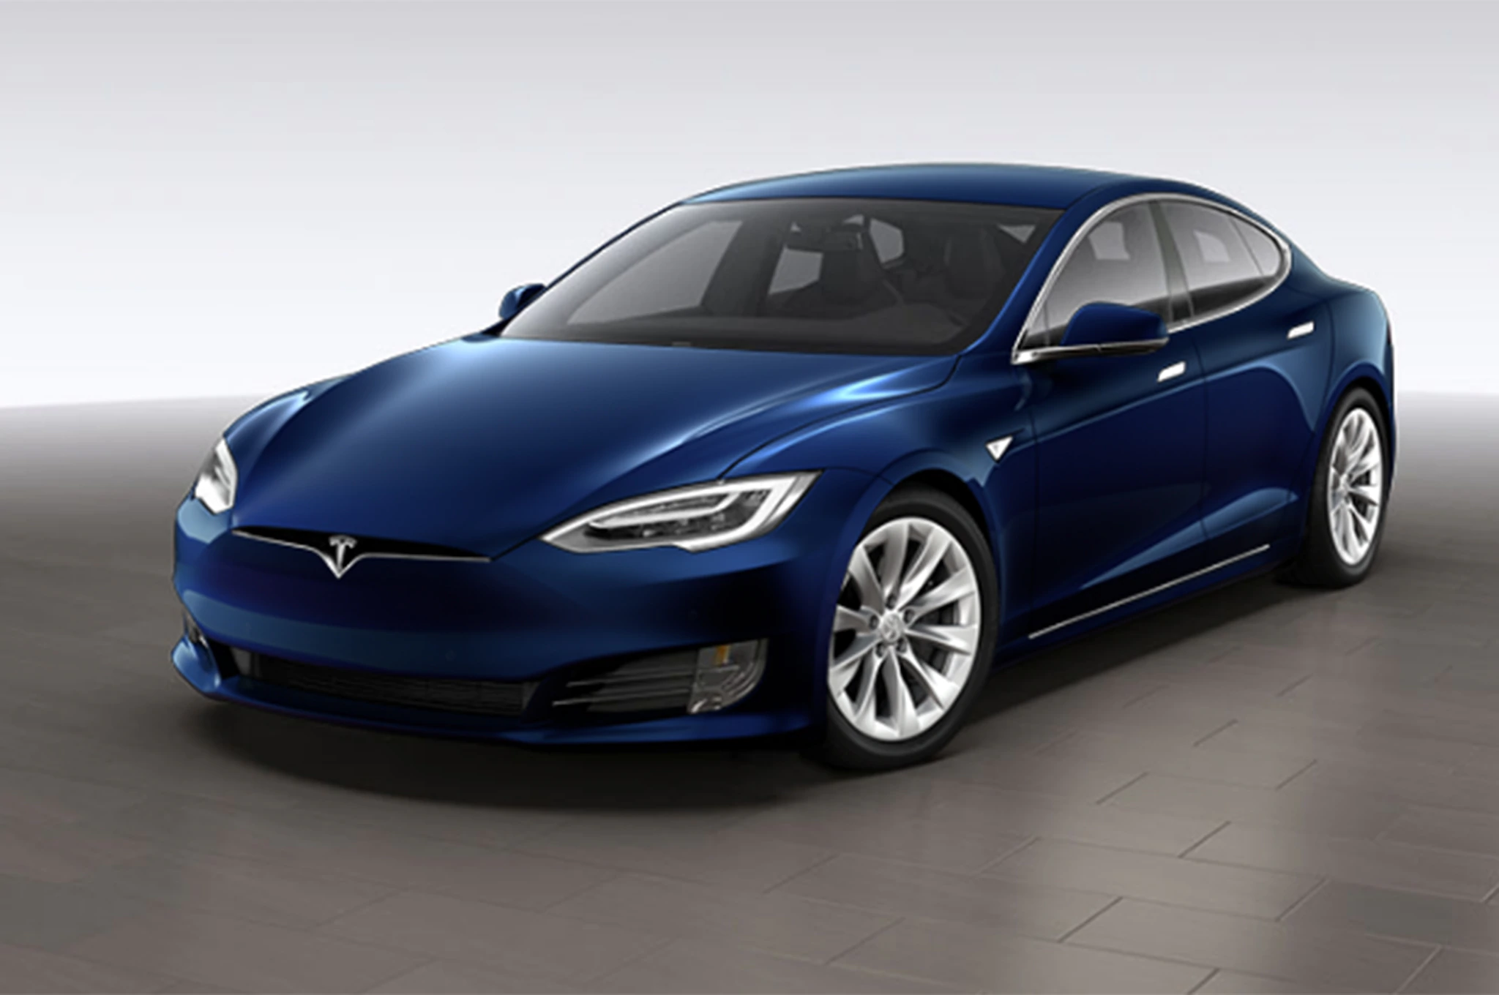
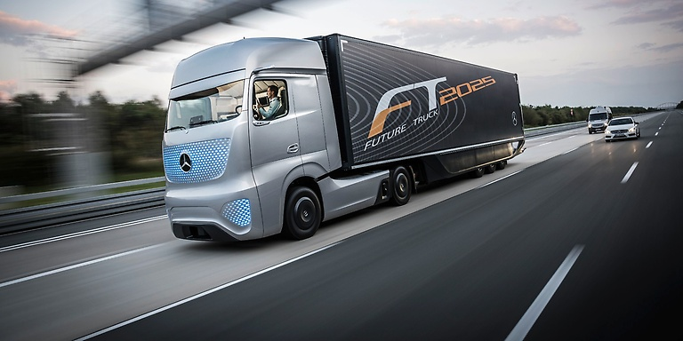
Company
A lot of companies work on the project :
Google with the "google car"
Daimler with the "autonomous lorry"
Volvo with "Drive me"
Tesla with the model S

Slide 6
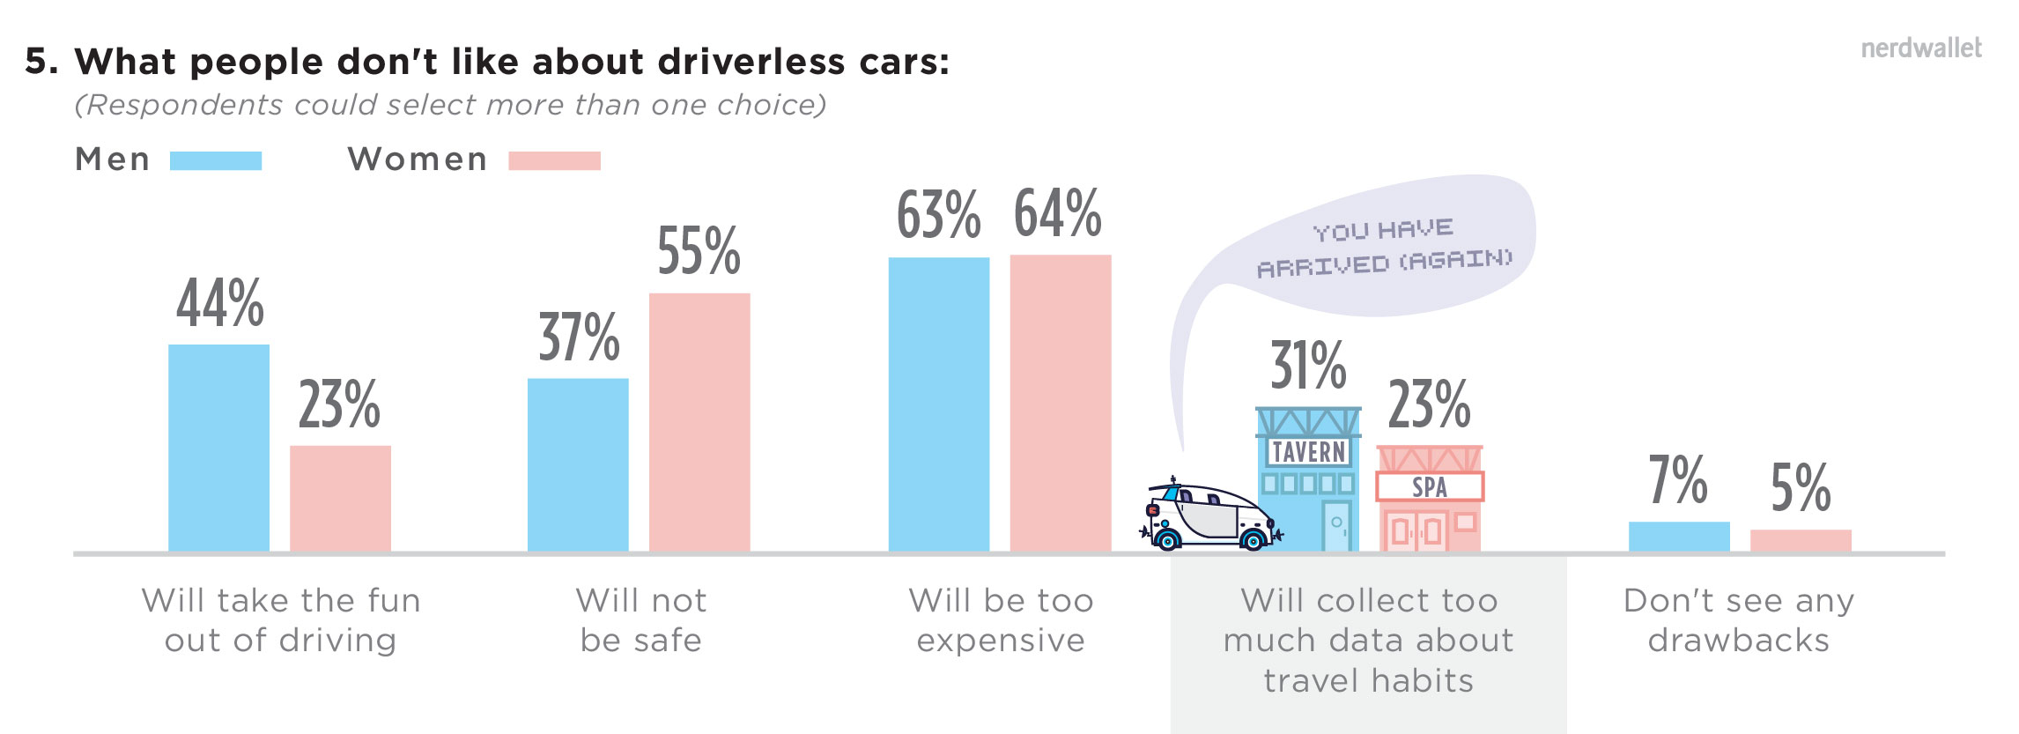
Opinion
What people don't like about driverless cars
Men
Women
3%
21%
When people think they would buy an autonomous car
As soon as possible
3-4 years after they become available
Never
18%
30%
In 1-2 years after they become available
5 or more years after they become available
When ?

Slide 7
Sources :
Thank you for your attention !
https://www.synopsys.com/automotive/what-is-autonomous-car.html
https://www.nerdwallet.com/blog/insurance/auto/survey-consumer-fears-self-driving-cars/
https://www.objetconnecte.com/voitures-autonomes-top-5-entreprises-0812/
https://autonomouscar108.wordpress.com/2016/03/28/the-advantages-and-disadvantages/
Manon and Amélie

