Slide 1
Industry revolutions and big data in sports
-> Industry revolutions
-> Big data in sports

Slide 2
Industry revolution
The first industrial revolution dates from1780s
Coal, Iron, Textiles, Transport and Pottery contributed to the out break

Slide 3
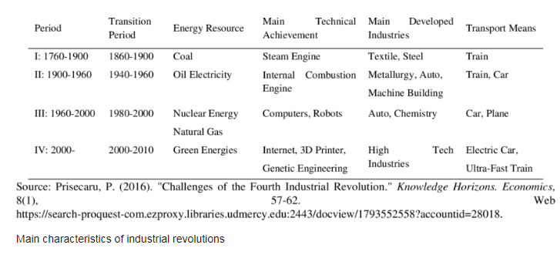
Industry Revolutions

Slide 4
the important inventors of the Industrial
James Watt | First reliable steam engine | 1775
Samuel F.B. Morse | Telegraph | 1836
Alexander Graham Bell | Telephone | 1876
Thomas Edison | Phonograph Incandescent light bulb | 1877 1879
Rudolf Diesel | Diesel engine | 1892
Orville and Wilbur Wright | First airplane | 1903

Slide 5
The industrial revolution changes economies
By the transition from a stable agricultural and commercial society
To a modern industrial society relying on complex machinery rather than tools and human force (industrialization and rural exodus)
Factories produce goods in greater quantities at a cheaper price

Slide 6
Big data in sports
3 companies which are specialized to design/manufacture cloud technology based items.
3 in-ear wearable devices which are used by endurance athletes.
Cloud technology helps non-pro athletes.
Cloud technology democratised sports broadcasting
Sport gadgets.
The effect on sport, using these new cloud gadgets.

Slide 7
3 companies which are specialized to design/manufacture cloud technology based items.
The start-up company FEETME has designed a revolutionary connected sole that measures the efficiency of the stride in real time.
EXSENS, thanks to its Body Scan 3D cabin, generates the double animated digital image of an individual's body. It is thus possible, to show the evolution of one's body following a training program and to plan the appropriate program.
The Parisian startup MOJJO, makes it possible to analyze tennis matches through video analysis. It also allows to calculate statistics and automatically generates match summaries.

Slide 8
3 in-ear wearable devices which are used by endurance athletes.
Company | Sampling of products | Product type | Product functionnality
BioSensive Technologies Inc. | Joule | Earrings | Heart rate, calories burned, steps taken, overall activity level
Starkey Hearing Technologies | Livio AI Hearing Aid | Hearing aid | Translates foreign languages, contains a pedometer, tracks physical activity (wellness score)
Jabra | Sports Pulse Wireless Headphone | Headphone | Accelerometer and heart rate monitoring

Slide 9
technology helps non-pro athletes.
Like a smartphone applications which have step counter.
Videos of musculation on YouTube for example.
An e-coach or somethings like that.

Slide 10
cloud technology democratised sports broadcasting.
A French startup, "VOGO SPORT", allows fans to access, in real time, via their smartphone, the various cameras filming the event. The spectator can then, from his , choose the angle of view of his choice to see or review an action.
It provides real added value for certain sporting events such as golf competitions or skiing events that take place over vast expanses of land, not always visible to the spectator.

Slide 11
sport gadgets.
Mobil app on smartphone
connected wristband (watch)
wireless headphones

Slide 12
the effect on sport, by those new cloud gadgets.
They are popularizing sport. People are more motivated to practice sports, even alone. You can have challenges if you belong to a group.
They can also compare their results and want improve them. Some tips and positive feed-back are received from the user.

Slide 13
SoURCES for the industry revolution
https://en.wikipedia.org/wiki/Industrial_Revolution
https://www.answers.com/Q/Describe_five_factors_that_contributed_to_the_industrial_revolution_in_britain.
https://www.thoughtco.com/industrial-revolution-inventors-chart-4059637
https://schoolworkhelper.net/economic-changes-during-industrial-revolution/

Slide 14
Sources for the big data in sports
https://www.ncbi.nlm.nih.gov/pmc/articles/PMC6662809/
https://usineasite.parisandco.com/Le-Tremplin/A-la-une/Tendances-Sport-Innovation/La-France-pionniere-d-innovations-technologiques-en-matiere-de-sport
Slideshow by: TANNEAU Manon, LANGEVIN Isaline, MAHE Nina, PERRAUD Lise, REDOR Gabin, ROUSSEL Hugo

