Slide 1
Artificial intelligence

Slide 2
Artificial intelligence
Artificial Intelligence (AI) is a scientific and technological discipline aimed at the execution by machines (computers and computer programs) of cognitive processes previously reserved for human brain capabilities

Slide 3
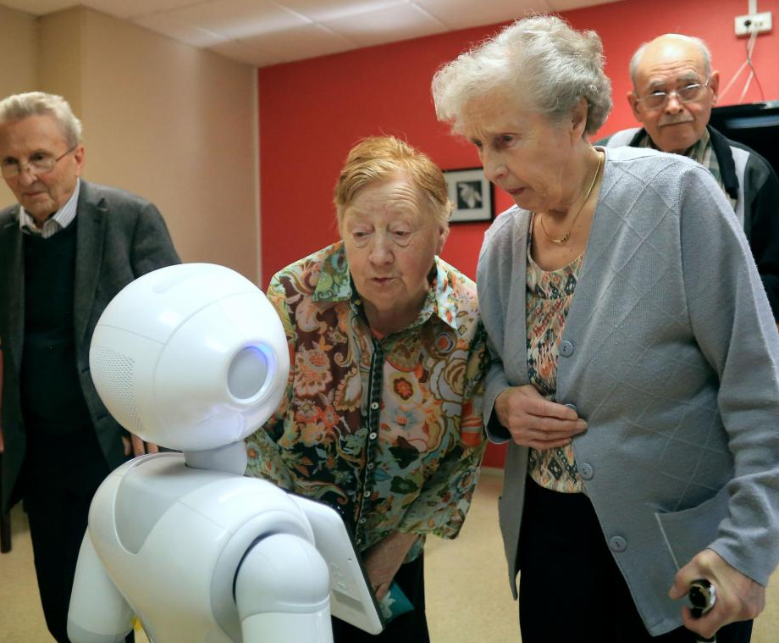
Helping the elderly
Today many robots are created with the aim of helping or bringing company to the elderly. For example MERA.

Slide 4
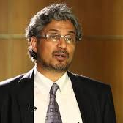
The evolution of robots
The evolution of robots by a need. For example Guruduth Banavar has created an AI to find cancers.

Slide 5
The evolution of robots
The evolution of robots does not come from nowhere. Some people had ideas unachievable in their time as Asinov but from which we are inspired today to create robots.

Slide 6
What's next ?
Robots gradually replaced humans in the most dangerous jobs thanks to AI and one day they will probably replace us totally in all the work but: is this beneficial for us?

