Slide 1
data in sports
BIG

Slide 5
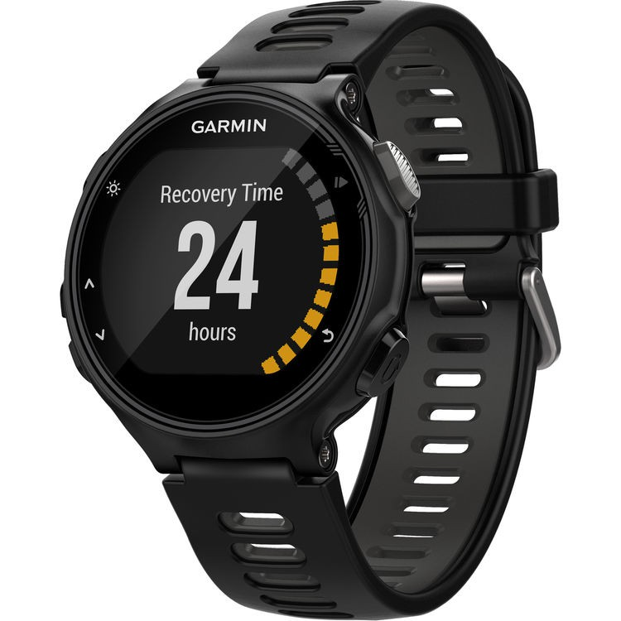

Slide 6
