Slide 1
Future Architecture

Slide 2
MATERIALS

Slide 3
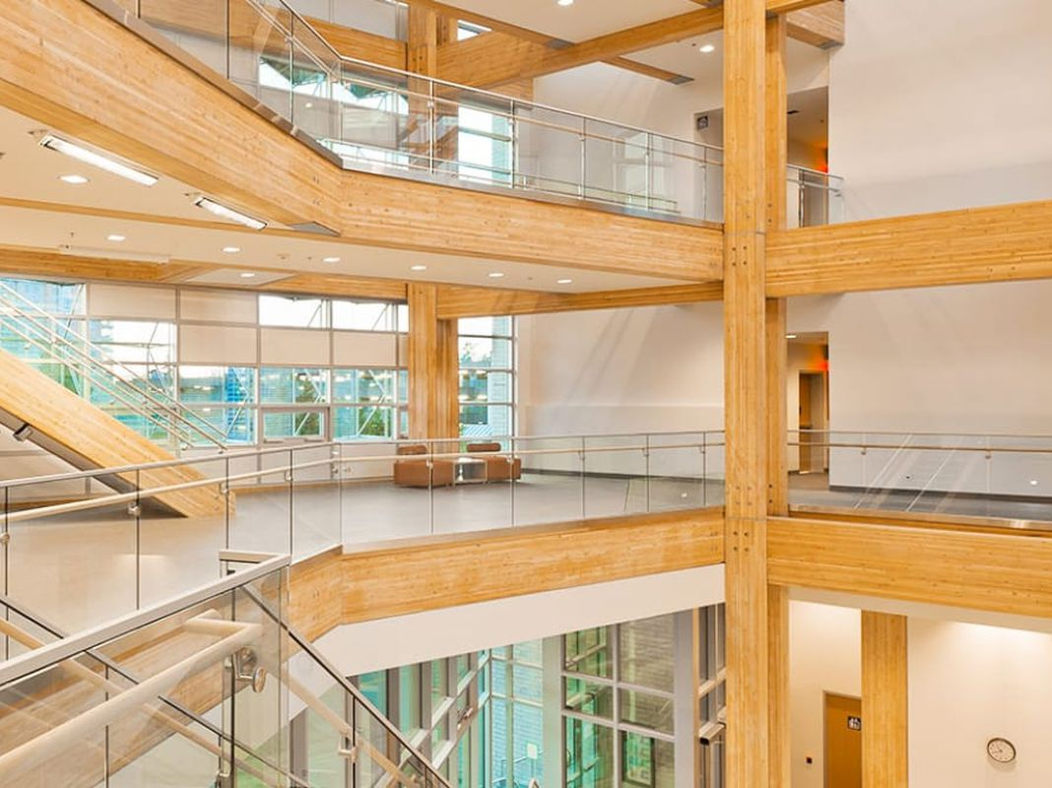
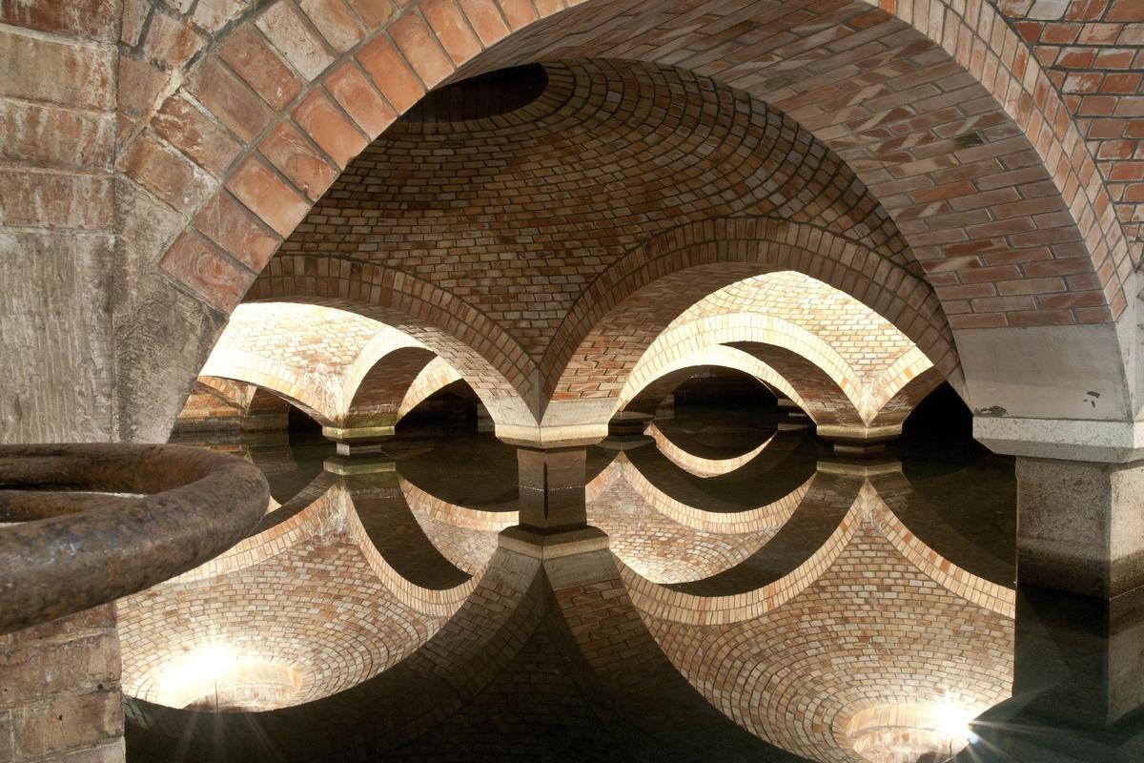
WOOD
BRICS

Slide 4
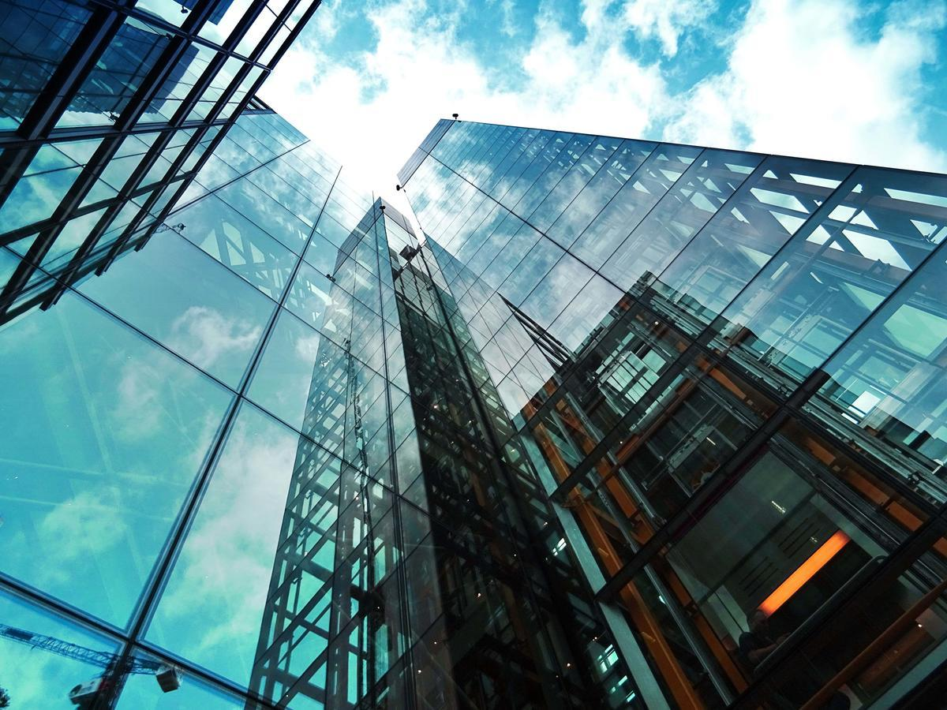
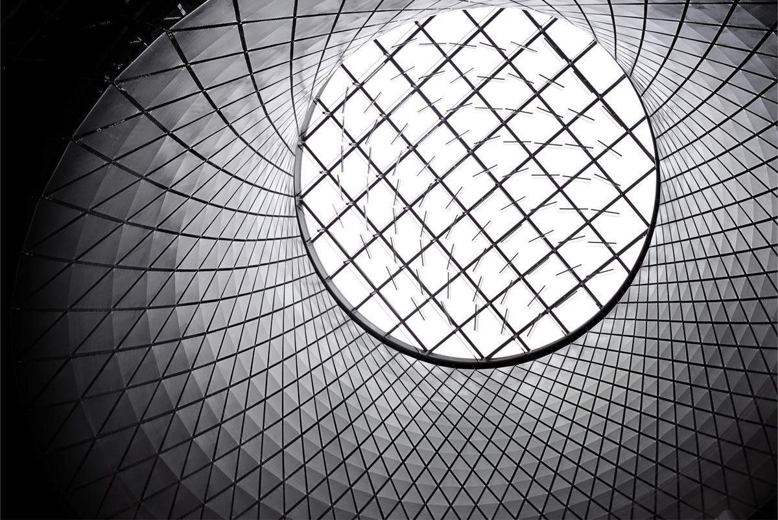
GLASS
ALUMINIUM

Slide 5
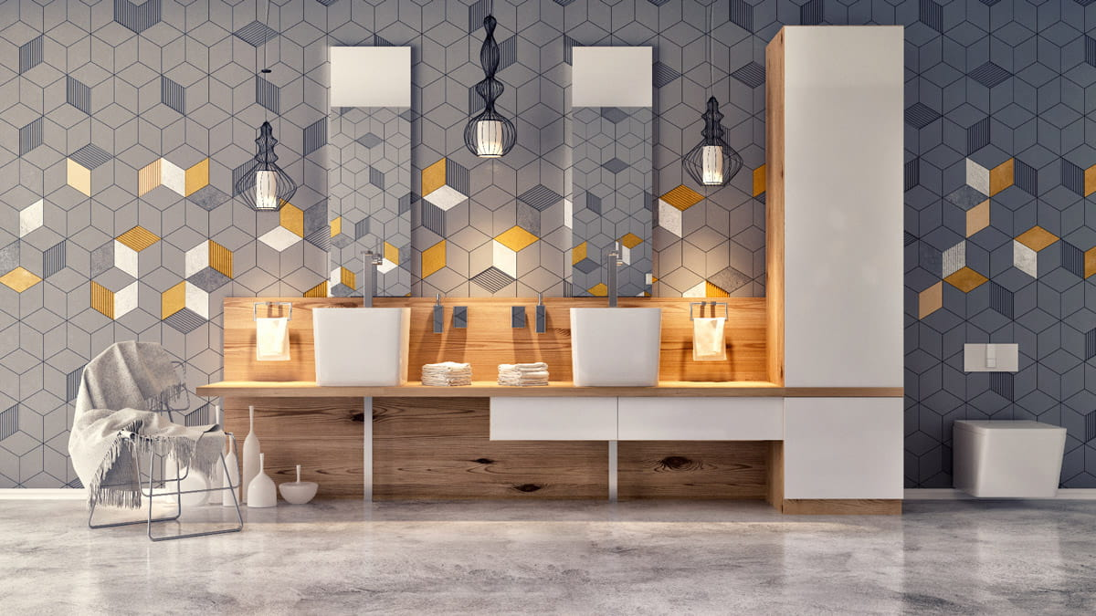
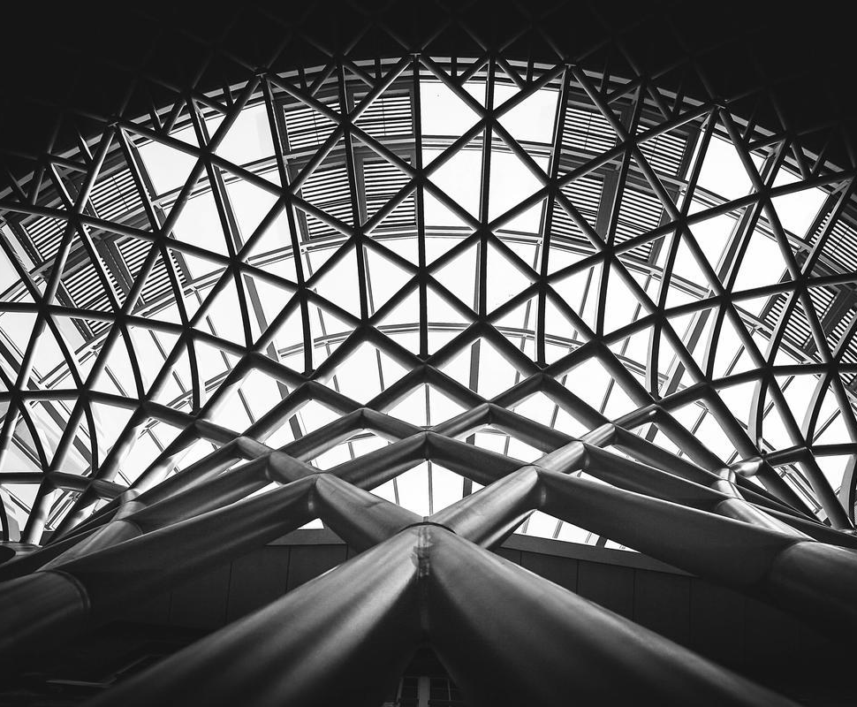
TILES
STEEL

Slide 6
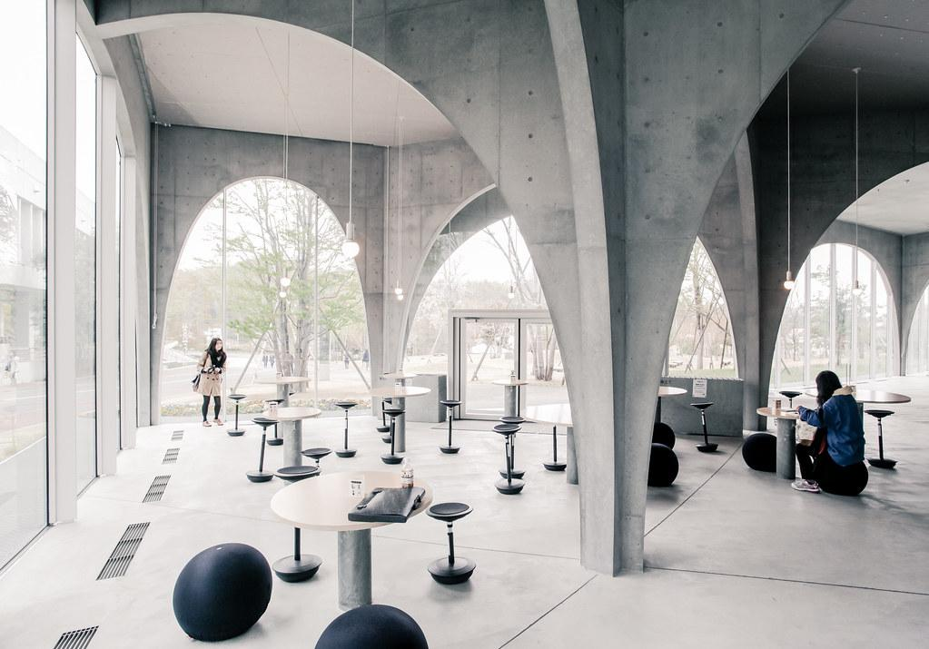
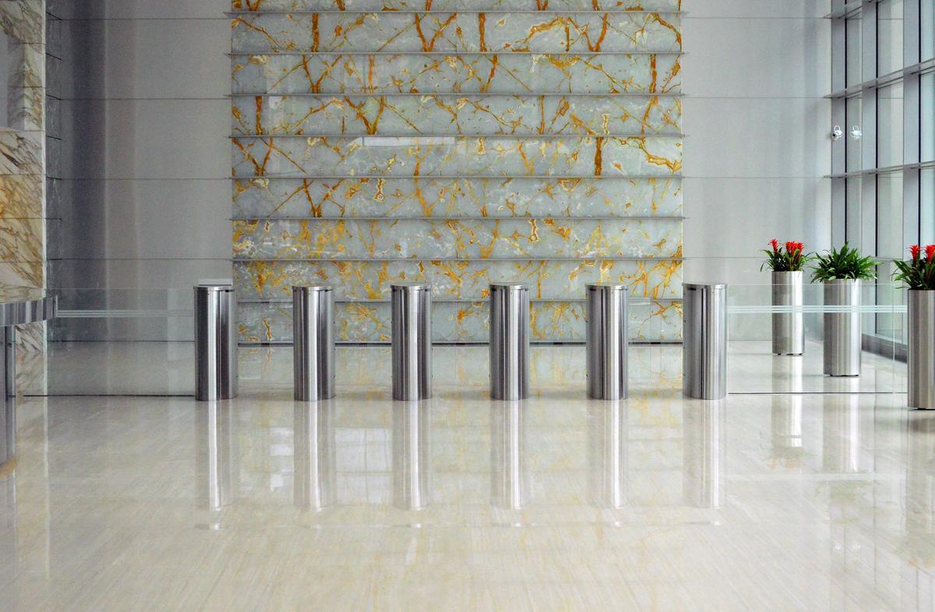
CONCRETE
STONE

Slide 7
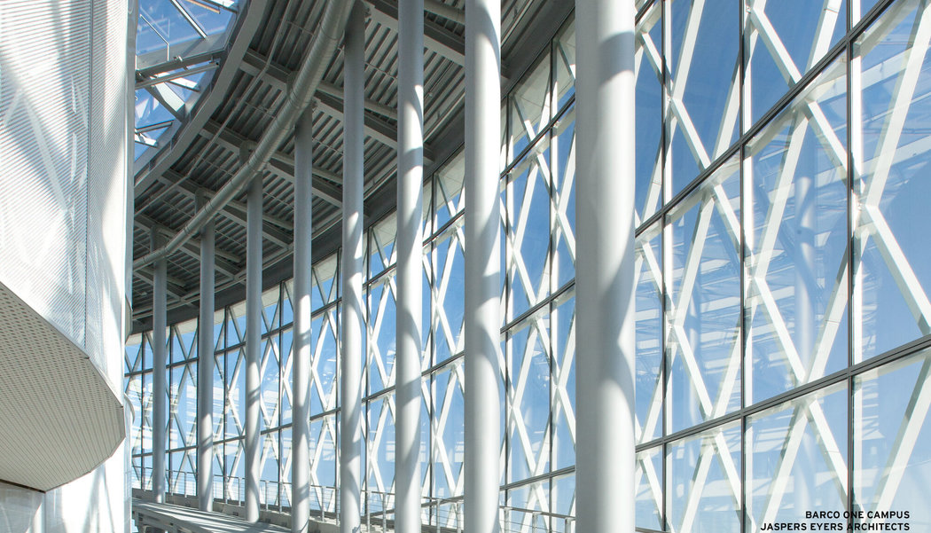
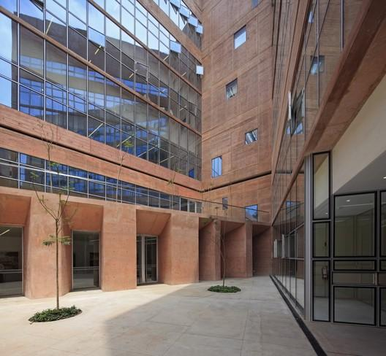
TRANSPARENT ALUMINIUM
PIGMENTED CONCRETE

Slide 8
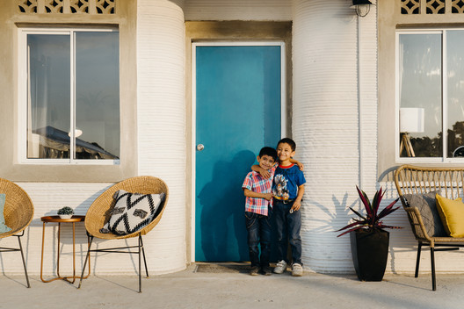
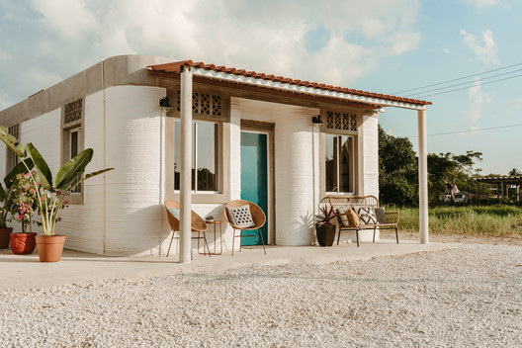
3D printing

Slide 9
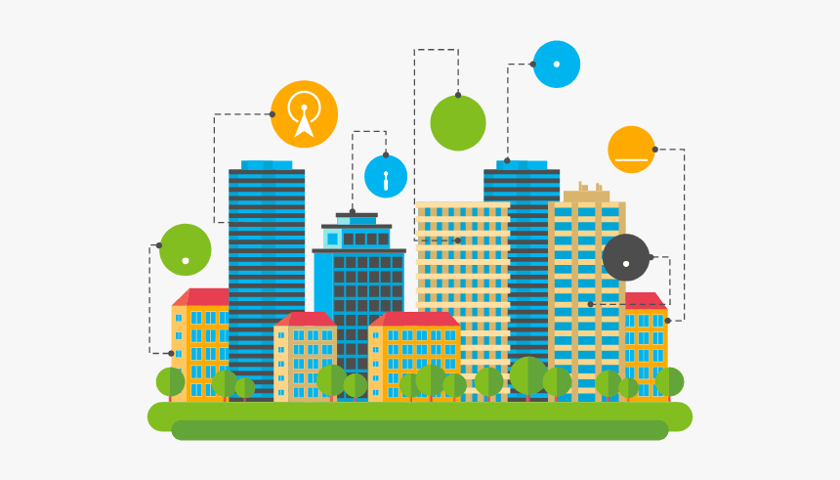
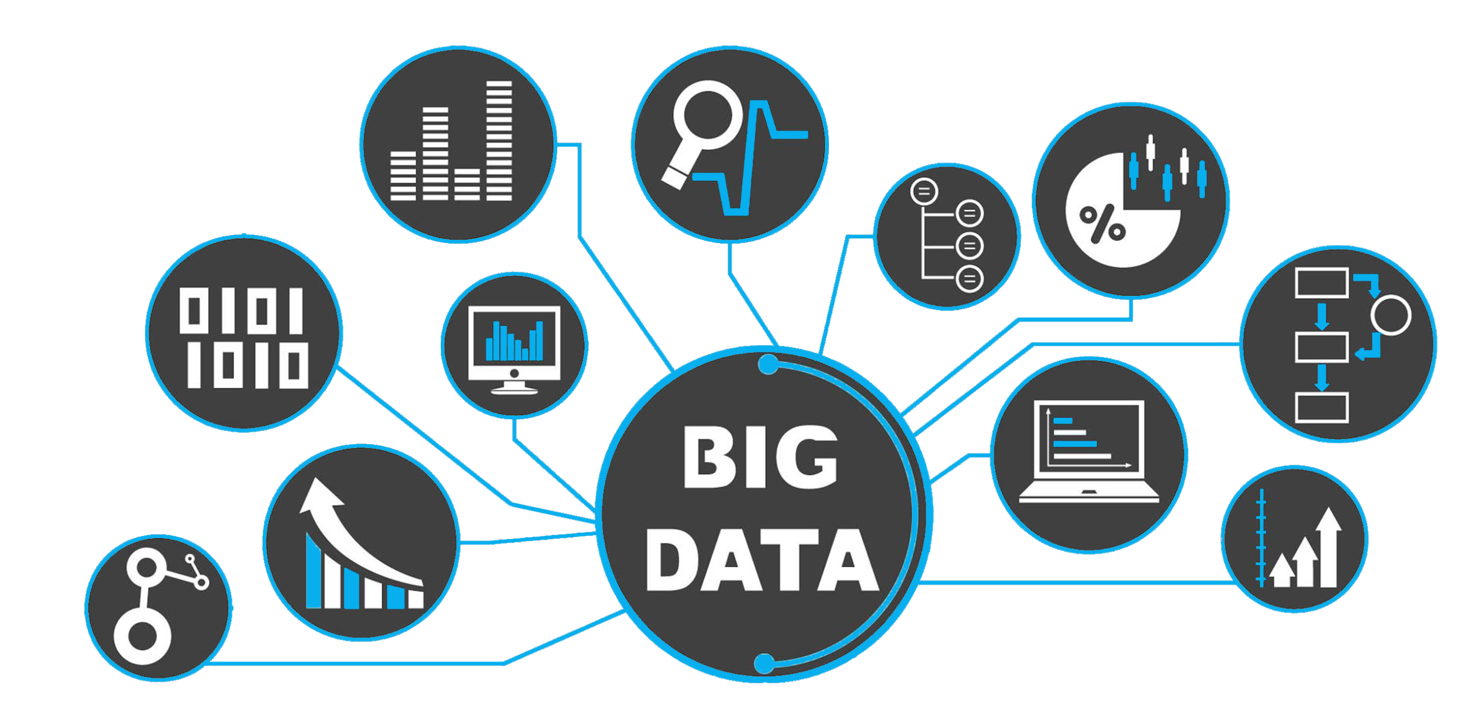
The future of cities
incorporate outskirt settlements
eco friendly/ sustainable architecture
big data - internet connection
smart city - integrates information and communication tech, faster production, less waste

Slide 10
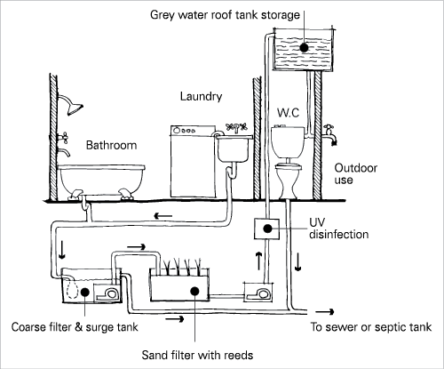
Green Homes
sustainable, locally sourced, non toxic material use
energy efficiency: reuse greywater, collect rainwater
installing skylights and more windows

Slide 11
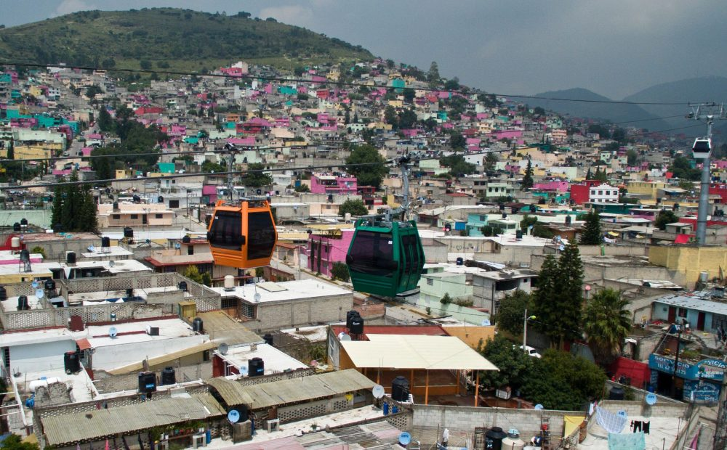
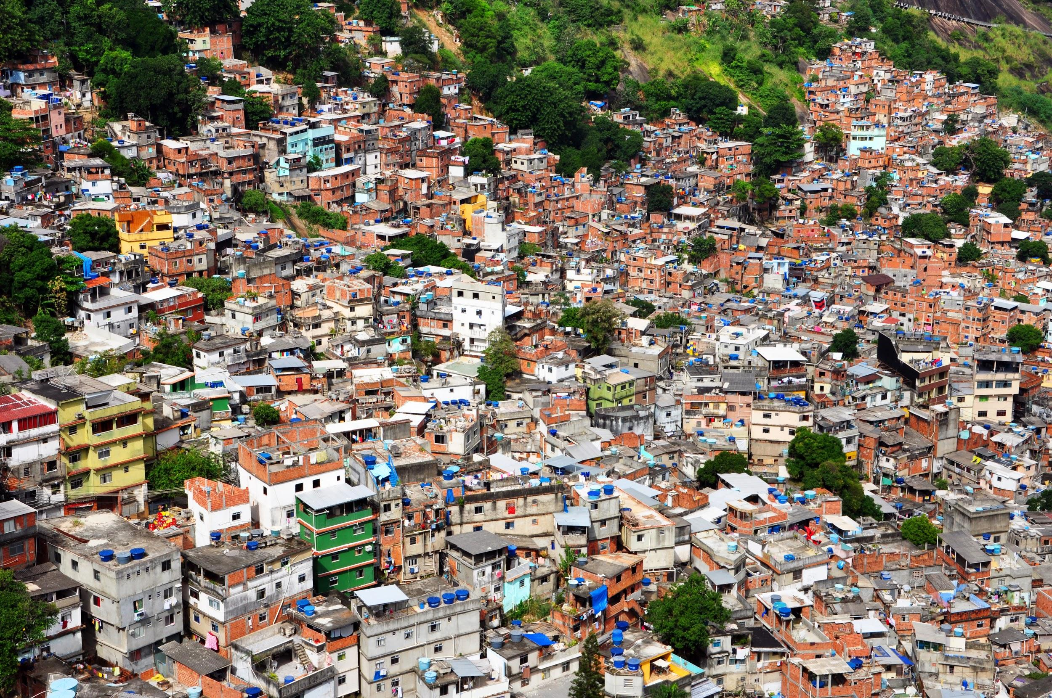
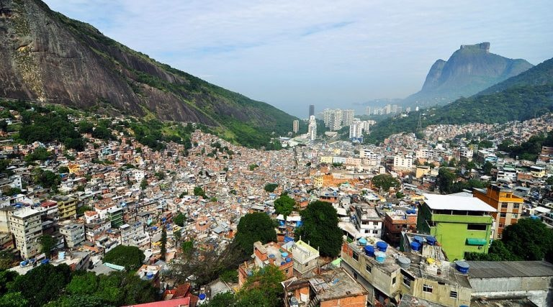
A not so distant example
Mexico and latin America - connect the city with poor outskirt districts

