Slide 1
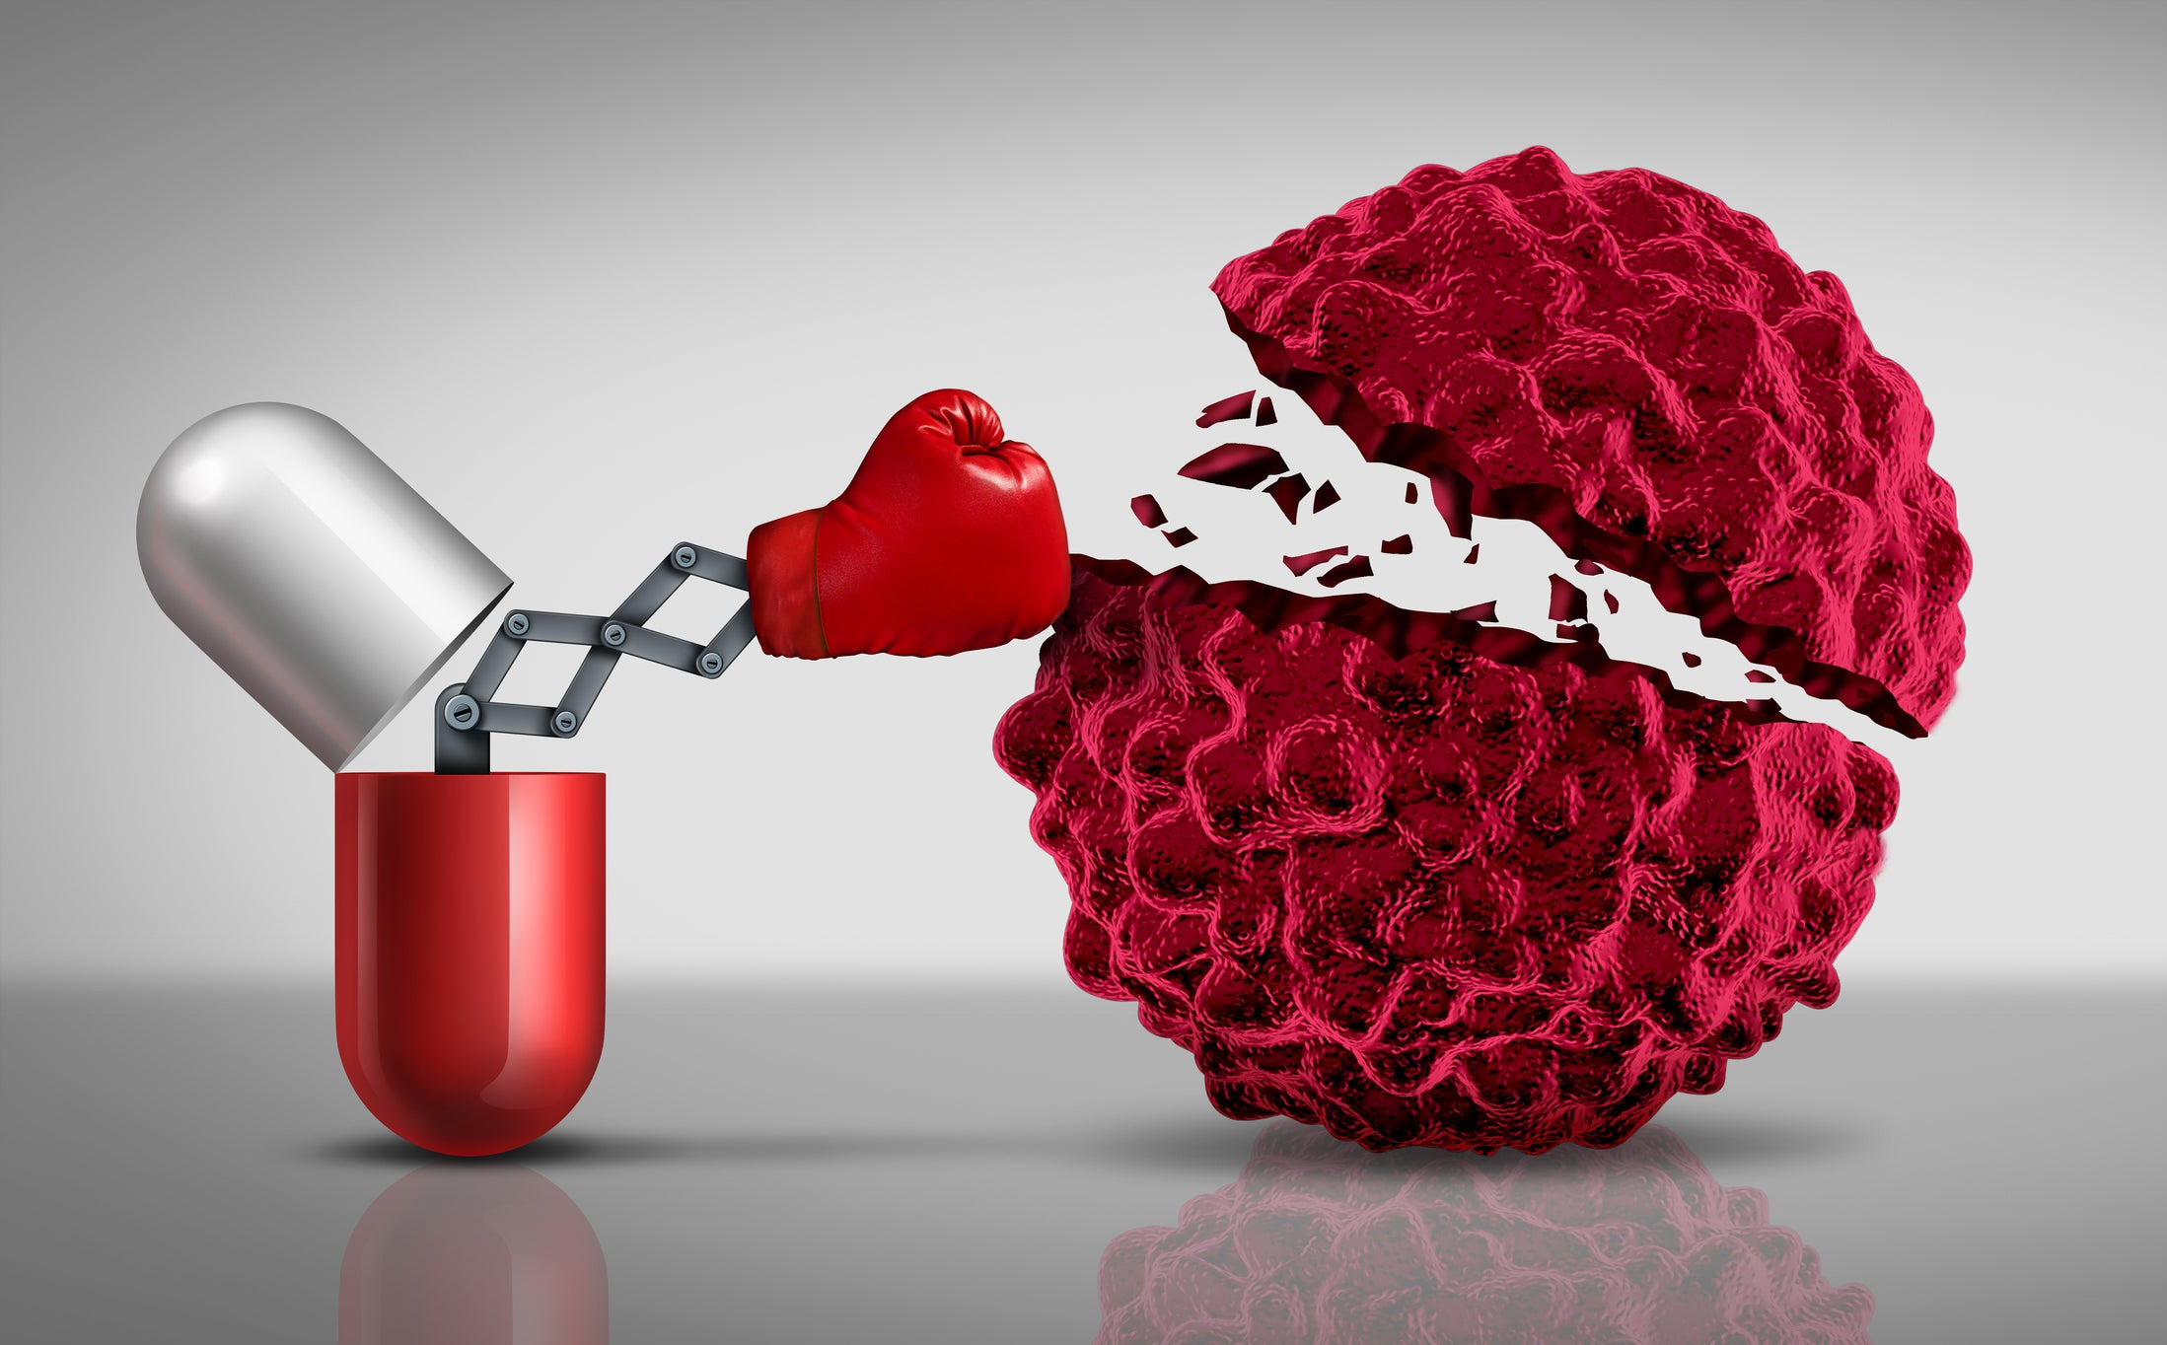
Fight against tumors

Slide 2
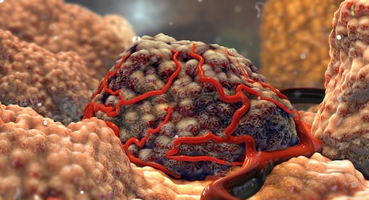
What is a tumor?
Problem with growing
Become immortal
Cleavage does not stop
Fabric grows
Problem with copying

Slide 4
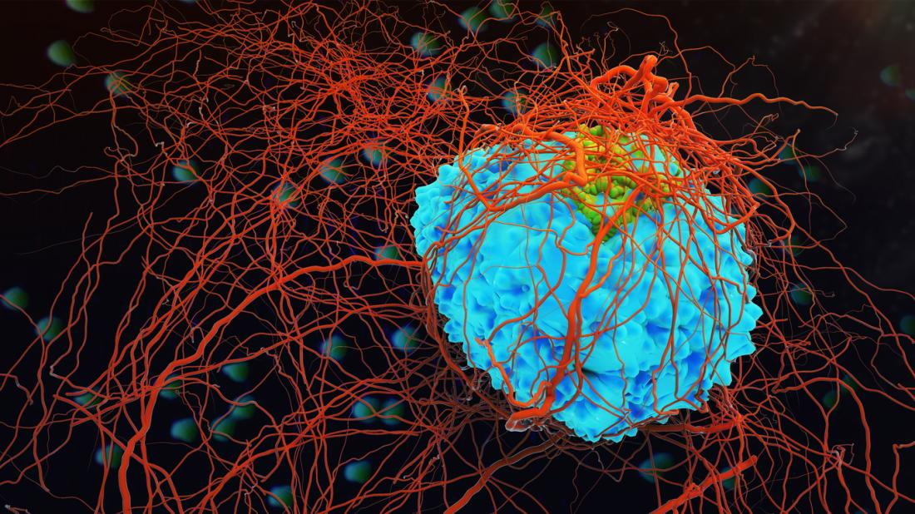
Cancer: epithelial tissue – origin; Malignant

Slide 5
Most common tumor types
Lung cancer – highest number of deaths
Mouth and gorge cancer
Breast cancer

Slide 6
PREVENTION
Don’t use tobacco
Eat a healthy diet (fruits, avoid obesity, maderate alchohol drinking)
Maintain healthy weight, be physically active
Protect yourself from sun
Get vaccined
Avoid risky behaviors
Get regular medical car

Slide 7
Symptoms
C: Change in bowel or bladder habits
A: A sore that does not heal
U: Unusual bleeding or discharge
T: Thickening or lump in the breast or elsewhere
I: Indigestion or difficulty in swallowing
O: Obvious change in a wart or mole
N: Nagging cough or hoarseness
75% of American cancer deaths can be prevented

Slide 8
Chemotherapy
The most common treatment
Drugs are used to kill cancer
Stops/slows the growth of cancer cells
Side effects: mouth sores, nausea, hair loss, fatigue
It can be given in many ways

Slide 9
Other Treatments
Immunotherapy (helps the immune system fight cancer)
Targeted Therapy (targets the changes in cancer cells that helps them geow, divide and spread)
Hormone Therapy (slows/stops the growth of breast or prostate cancers)
Stem Cell Transplant (restores blood forming stem cells)
Precision Medicine

