Slide 1
GENE TECHNIC
Treatment
Diseases
Progress
Cancer
Human
Nature
DNA
Clones
Dangers
Alterations
Reproduction
Future generation
Unethical
Health
The different cons of DNA ALTERATIONS: CLONING AND danger for future generations
the different pros for fight against diseases
The perspective of each of us on the subject

Slide 2
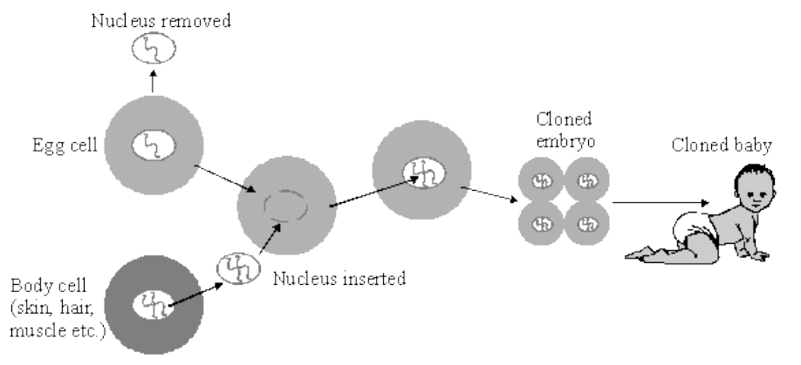
CLONING
Cloning is a process which produces genetically copies of a biological entity. This special procedure has been tested on animals as sheep. Human cloning is unethical but for some people it allows a social stability.
Click to listen :

Slide 3
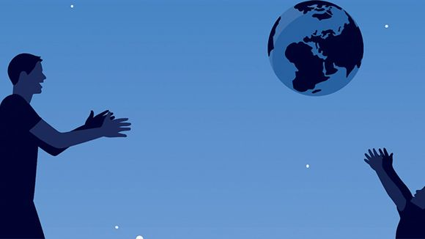
FUTURE GENERATIONS
We don’t know the real impact of GMO ( Genetically Modified Organism) and the manipulation of DNA on our world and the future generations.
Click to listen :

Slide 4
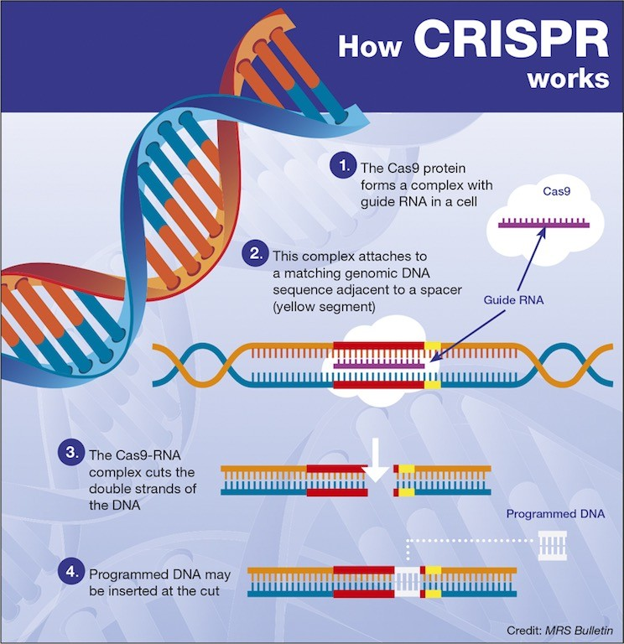
FIGHT AGAINST DISEASES
The alterations of DNA plays a role in the process of carcinogenesis. A potential exists for deriving comprehensive profiles of these alterations characterizing each form of human cancer. In addition the CRISPR ( Clustered Regularly Interspaced Short Palindromic Repeats) could be used to prevent genetic diseases of the embryo.
Click to listen :

Slide 5
THE PERSPECTIVE OF EACH OF US ON THE SUBJECT
« I’m not for these medical procedure because it’s not natural and it’s sometimes unethical »
Chloé
Alan
Maël
« I think that in the coming decades, DNA attenuation and crossovers could remedy many problems such as genetic diseases for example. But for the moment, the manipulation of DNA is not very precise and random enough, reaching certain cells but not others, which can dangerously
impact the genome. »
« I’m for the progresses against the development of diseases but in the same time against cloning. So, my opinion is mixed. »
Tiago
Maëlys
Vincent
« In my opinion genetic alteration is on the one hand an incredible way to fight heredity diseases like Cystic Fibrosis by removing the « sick » alleles. On the other hand it can be dangerous for someone with bad intentions. It must be used carefully. »
« For me the various progresses can be good to limit as much as possible diseases but they are also dangerous because we don’t know what they can cause in the future. »
« I think that the genetic alteration is a good thing for the future. Firstly for medical domain and secondly to improve humans. But we must be careful with that because it can fall in bad hands. »

