Slide 1
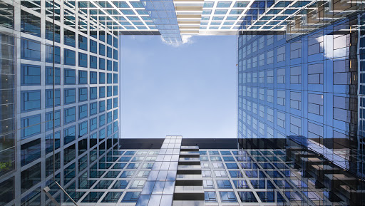
Architecture
Smart cities of the future

Slide 2
Table
1- History and evolution of Architecture
2-Regiously, culturally
3- Materials
4- Famous Architecture in the world
5- Smart cities
6- Our innovation of future house

Slide 3
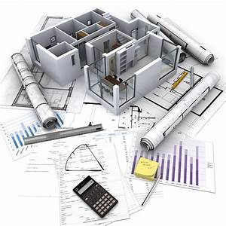
Architecture
Art
Conception
Infrastructures
Evolution
Reduce pollution

Slide 4
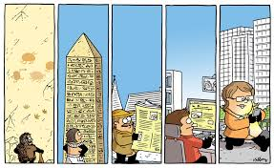
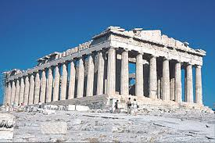
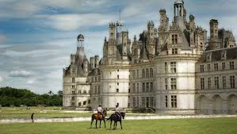
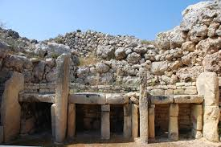
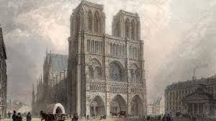
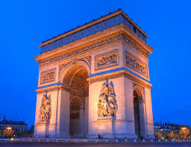
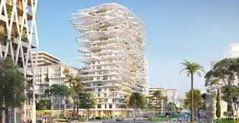
History of architecture
Prehistory Antiquity Middle Age Renaissance 19th 21st

Slide 5
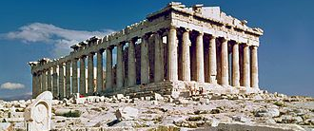
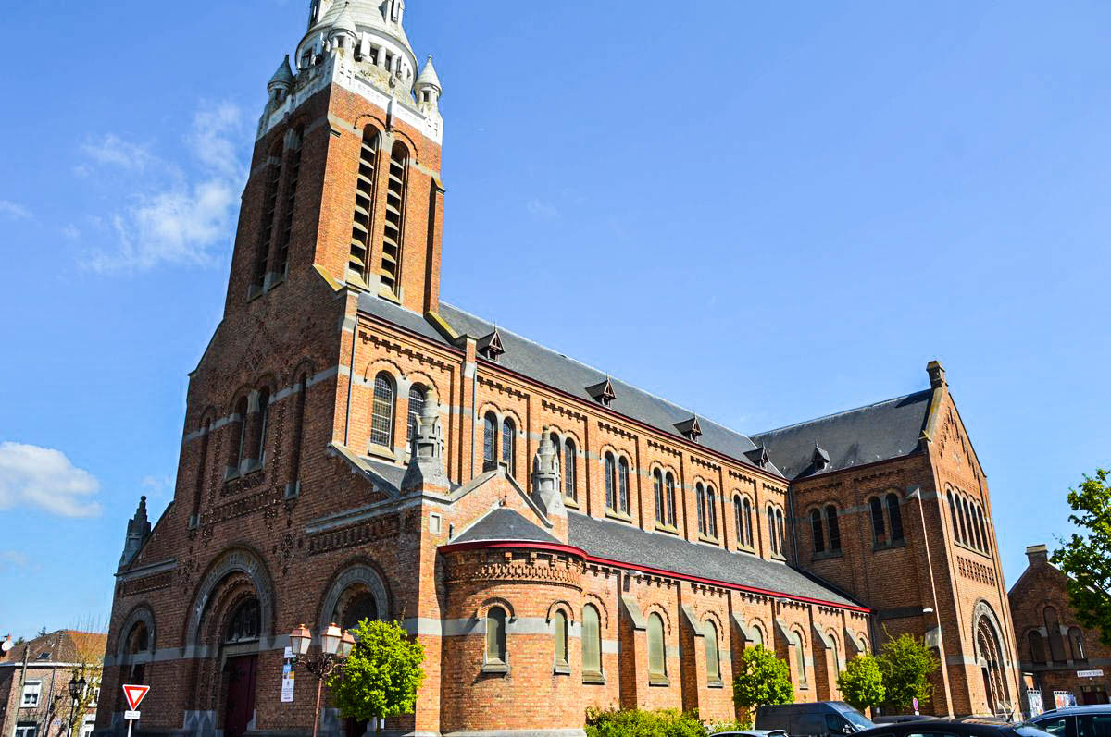
Religiously, culturally

Slide 6
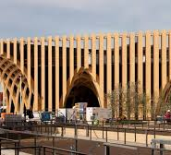
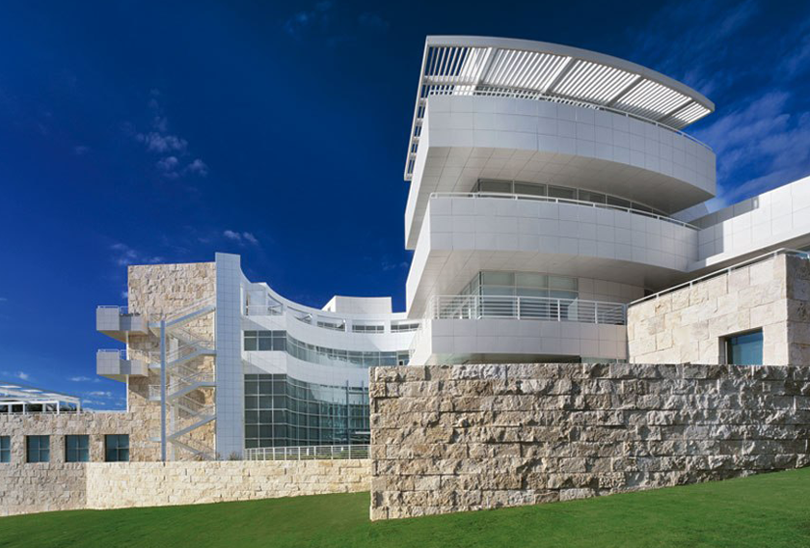
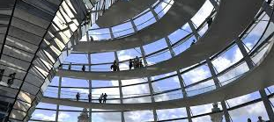
Materials
Wood
Rock
Brick
Glass
Steel
Concrete
Cement
Tile
Sealant
Aluminium
Terracotta
Iron and cast iron
Plastic
Slate

Slide 7
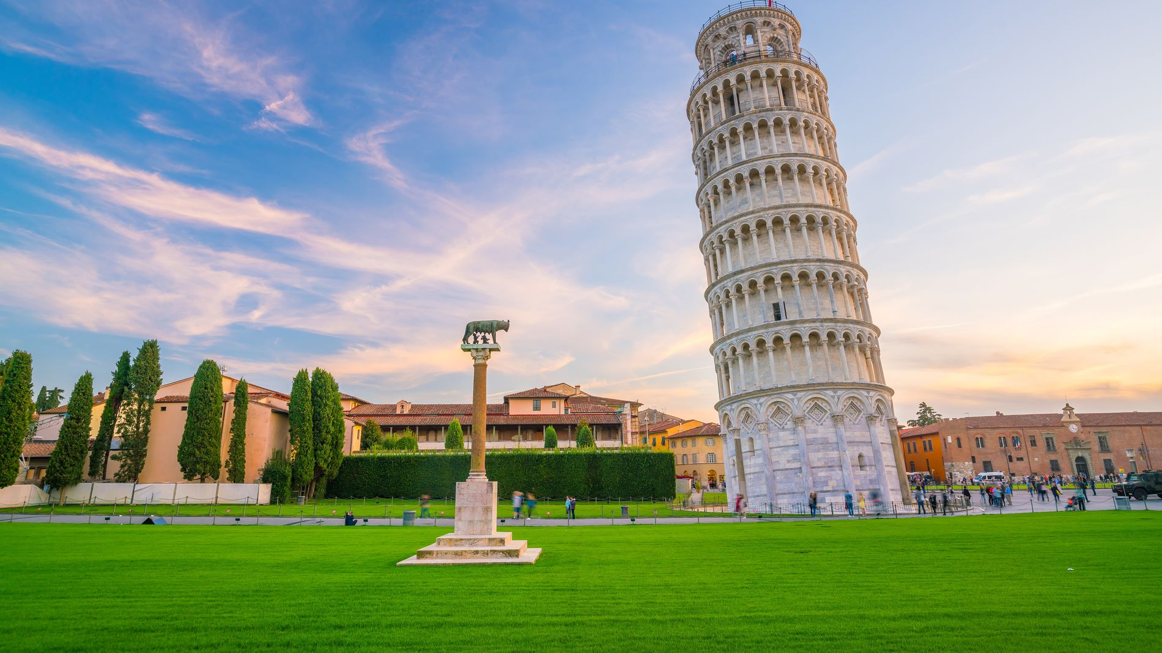
Pise tower
Marble

Slide 8
Taj Mahal
Marble, gemstones

Slide 9
Eiffel tower
Cast iron

Slide 10
Architecture of the future
"Smart cities"

Slide 11
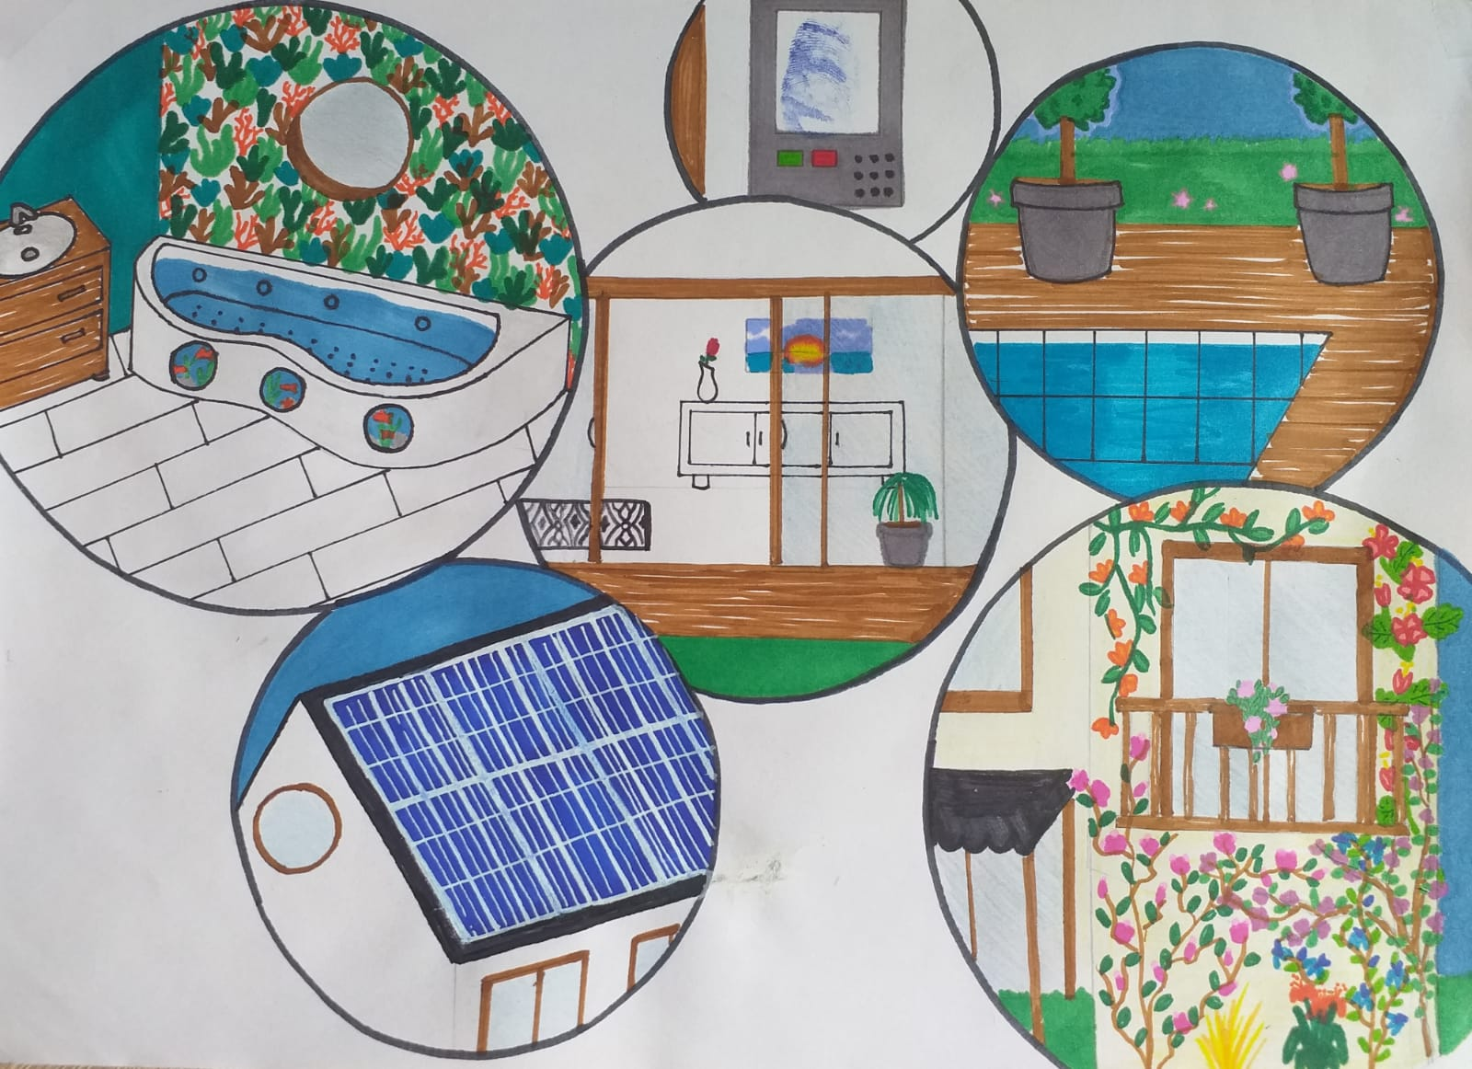
Ideal house of the future

