Slide 1
our high school and our city
students of 4th ESO C, Institut Jaume Callís, VIc.

Slide 2
THE HIGH SCHOOL
INSTITUT JAUME CALLÍS IN VIC

Slide 3
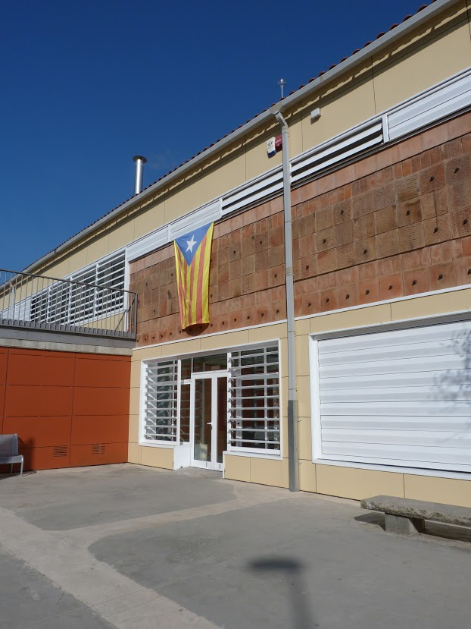
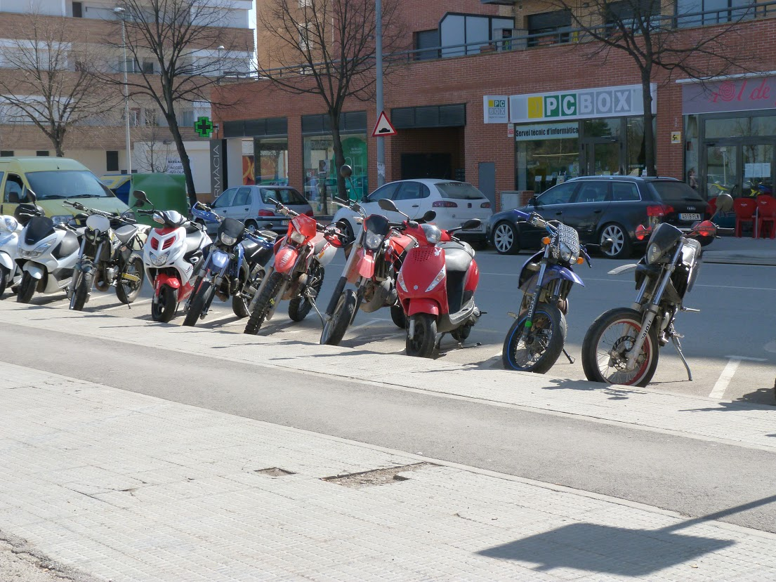
THE ENTRANCE
This is the entrance of our high school. We
have a parking lot for the motorbikes and a
“Estelada” flag waving above the main entrance.

Slide 4
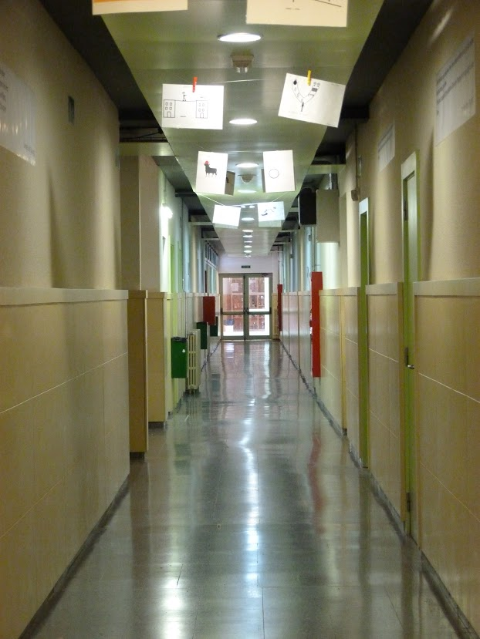
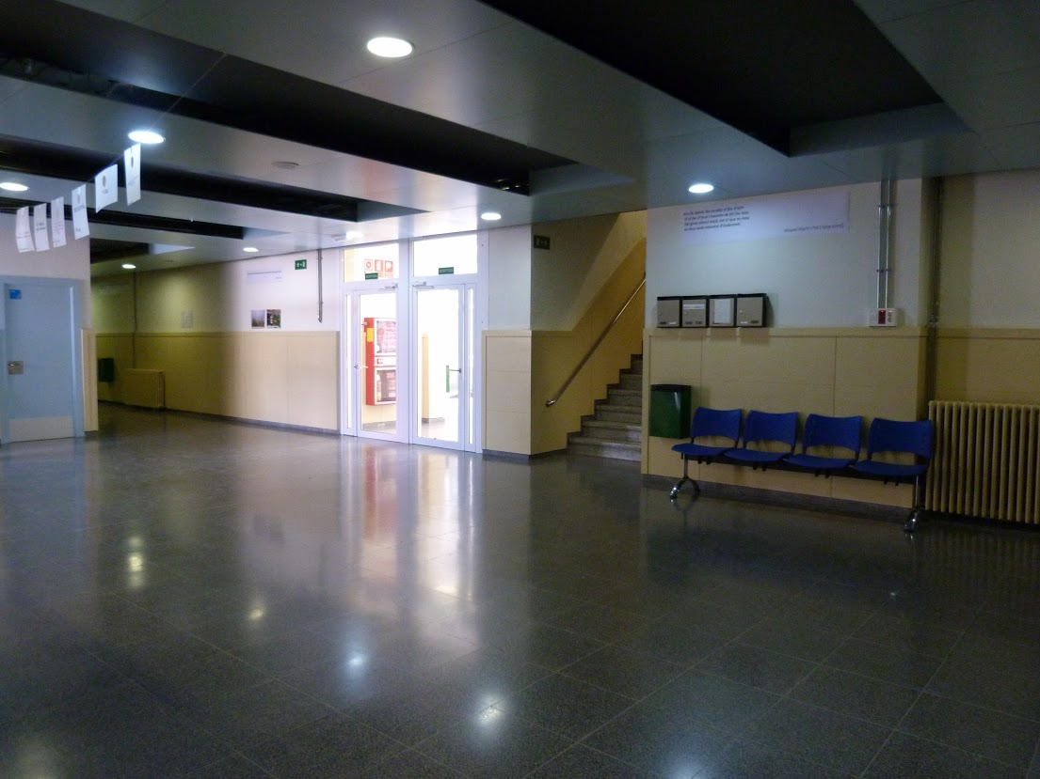
INSIDE
There is a lobby which connects to various
corridors and classrooms

Slide 5
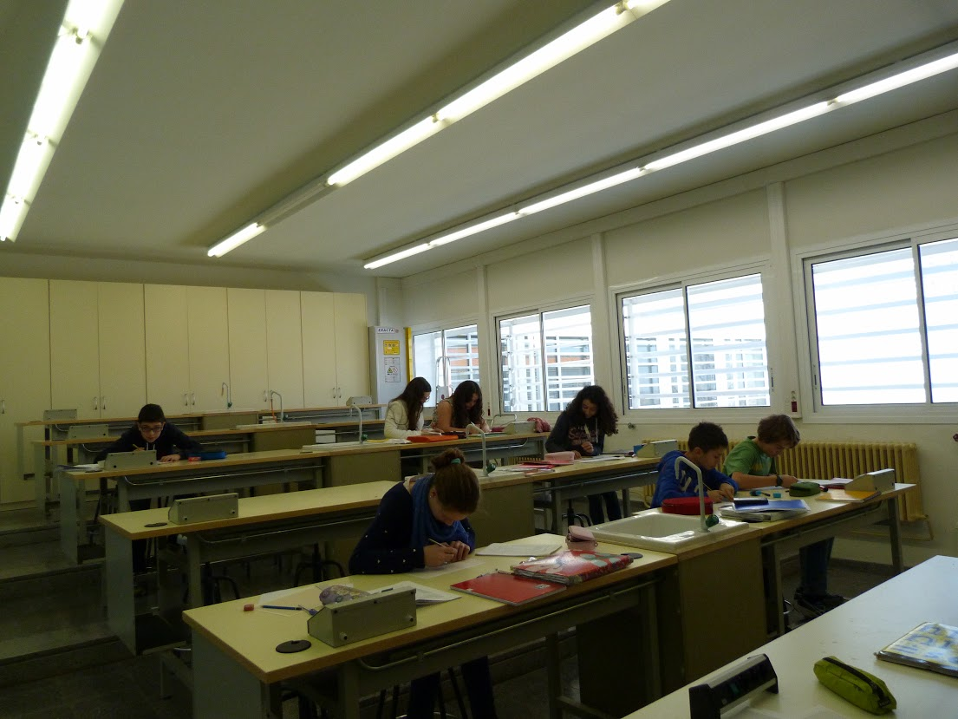
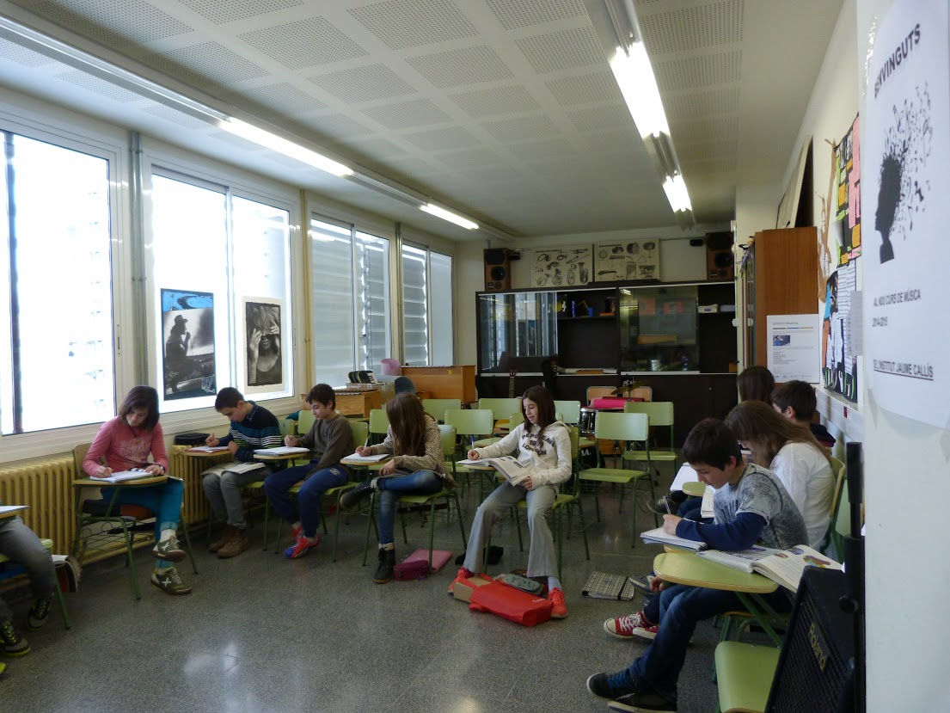
CLASSROOMS
On the left we can see on of the laboratories and on the right the music class.

Slide 6
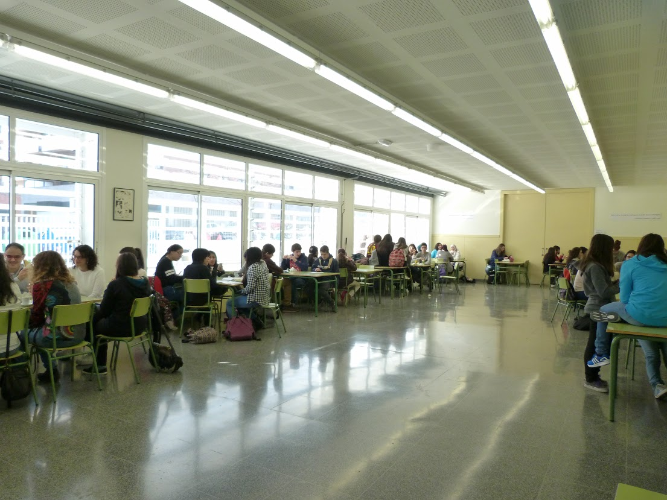
THE CANTEEN
Here we can see
the canteen where
students have
breakfast during the break
There is a bar
where you can buy
food.

Slide 7
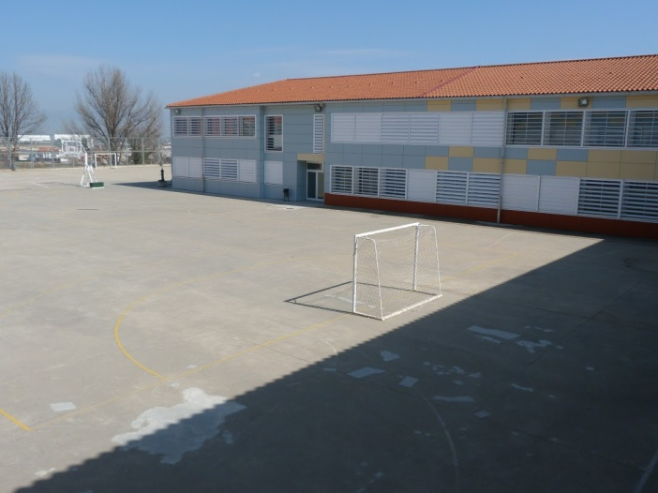
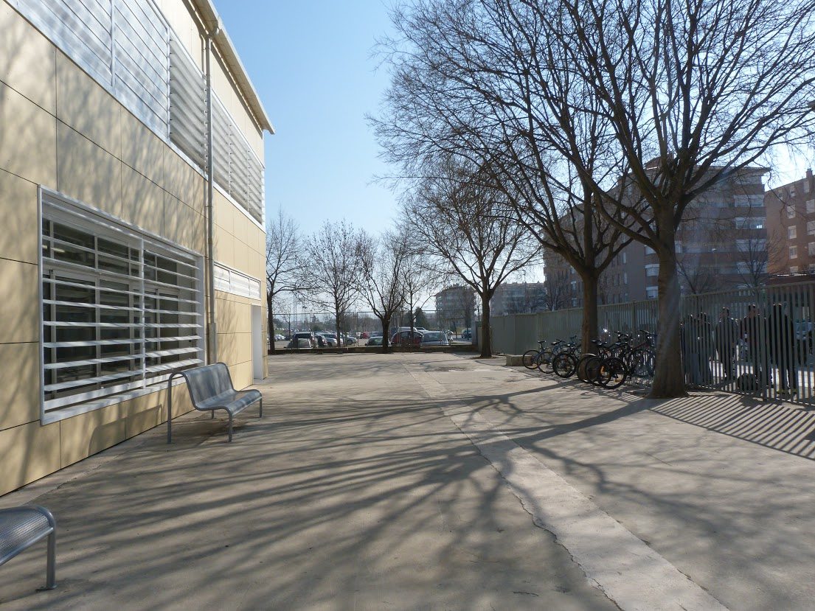
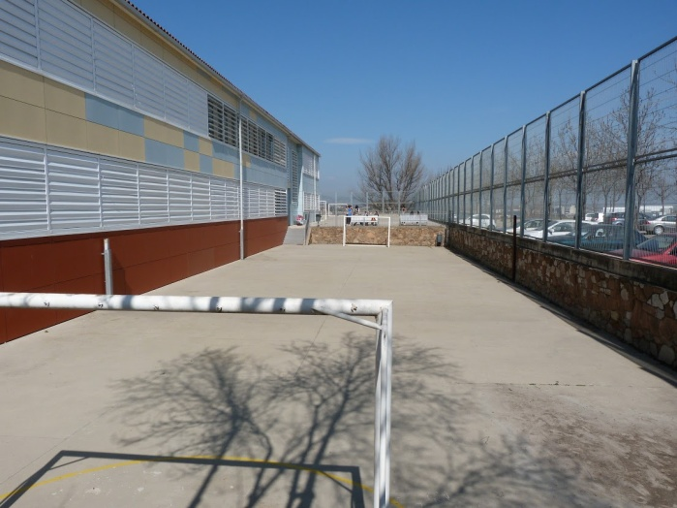
THE PLAYGROUND
Here we can see our playground. There are
two football pitches, one basketball pitch,
one volleyball pitch and a gym.

Slide 8
TIMETABLE
MONDAY | TUESDAY | WEDNESDAY | THRUSDAY | FRIDAY
Recerca Project/ Ethic | Mathematics | Spanish | Elective | Recerca Project /Ethic
English | Spanish | Elective | History | English
BREAK | BREAK | BREAK | BREAK | BREAK
Elective | English | Elective | Catalan | Mathematics
Mathematics | Catalan | Catalan | Mathematics | History
BREAK | BREAK | BREAK | BREAK | BREAK
History | Tutorial Sessions | Physical Education | Spanish | Elective
Elective | Elective | Physical Education | Elective | Elective
Electives are: Physics and Chemistry, Biology and Geology, Music, Computer, Plastic, Technical Drawing, Latin, French and technology

Slide 9
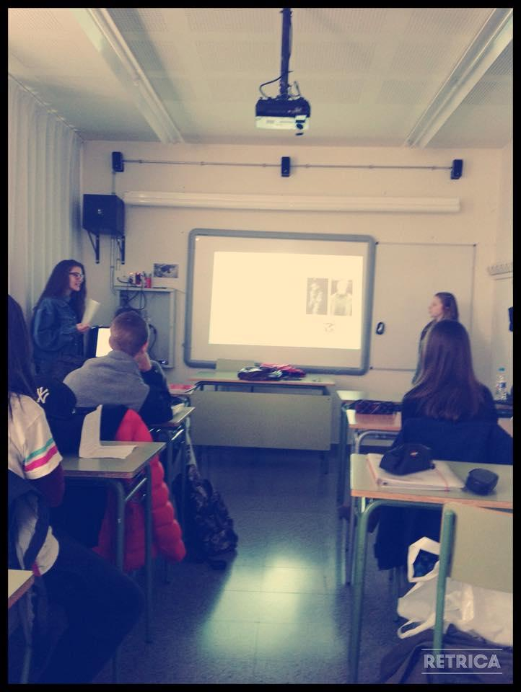
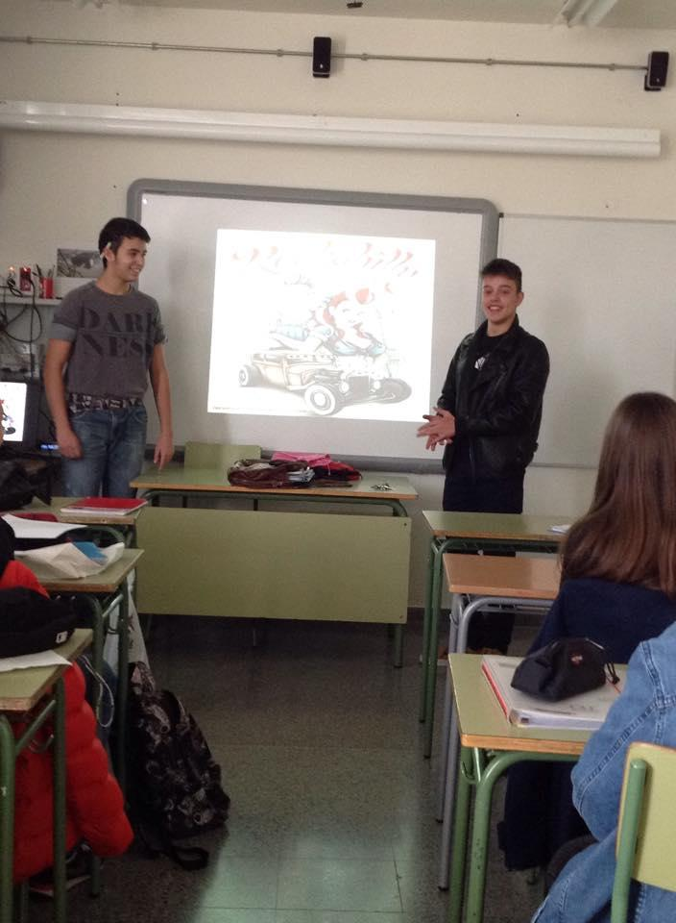
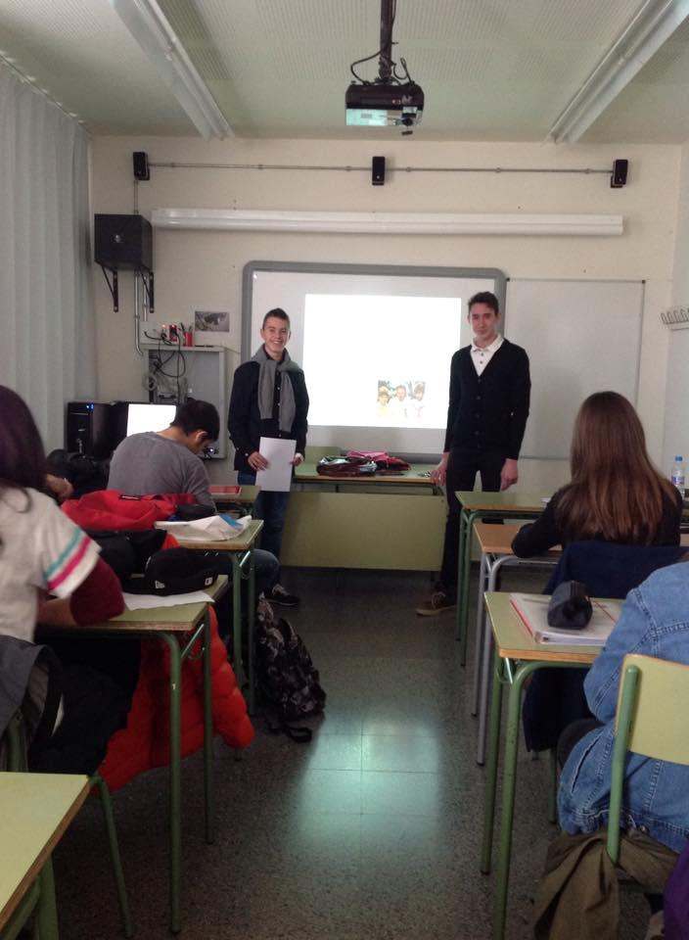
ORAL PRESENTATIONS
Sometimes we do oral presentations. In groups we prepare PowerPoints and then, we explain it in class.

Slide 10
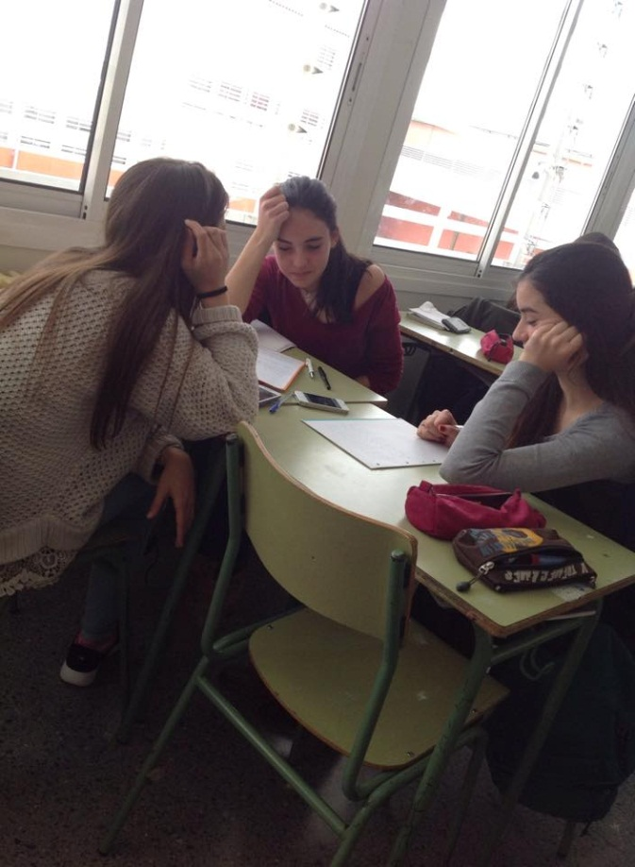
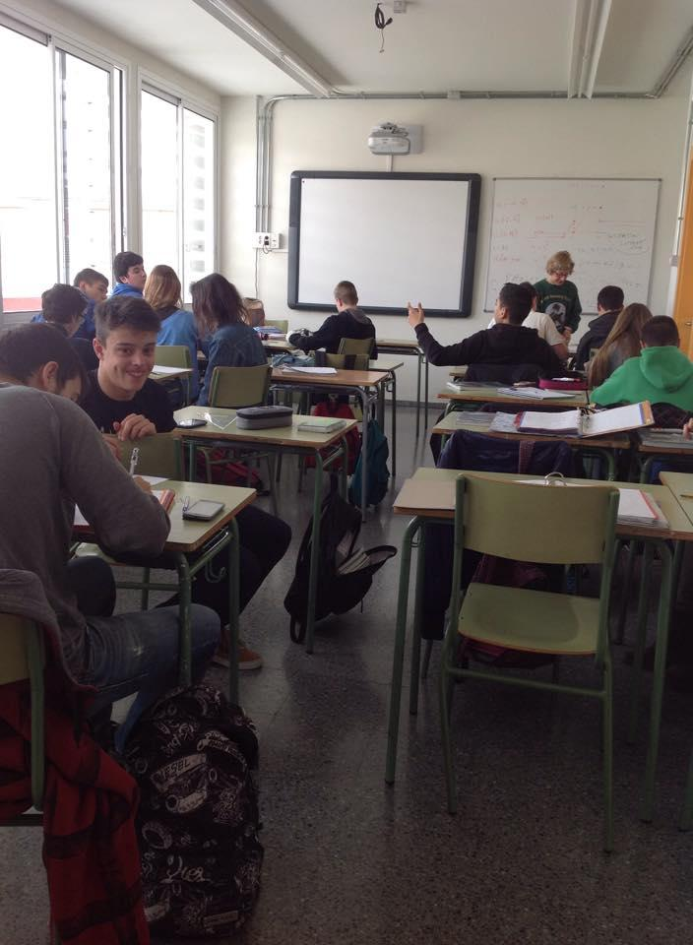
WORKING IN GROUPS
Usually we work in groups in some subjects to improve our teamwork skills

Slide 11
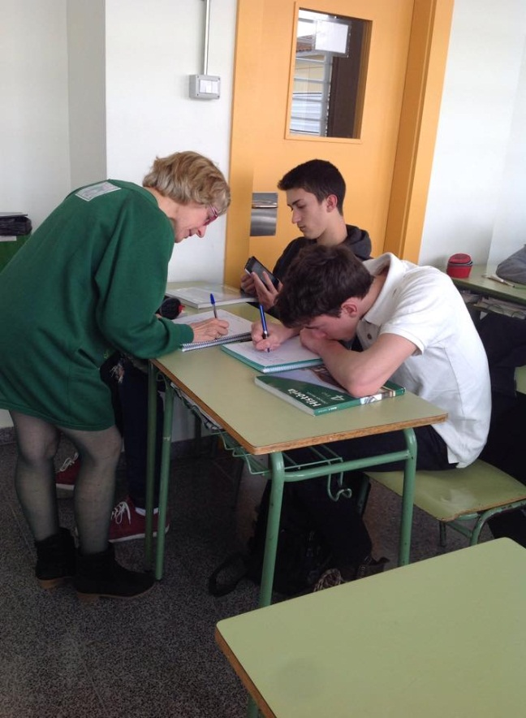
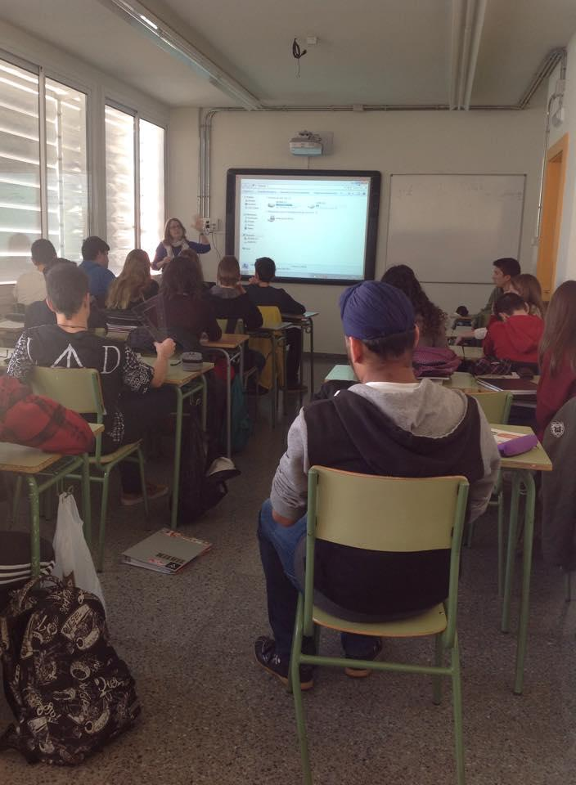
TYPICAL CLASS
The teacher explains the subject and we take notes. If we don’t understand something, the teacher helps us.

Slide 12
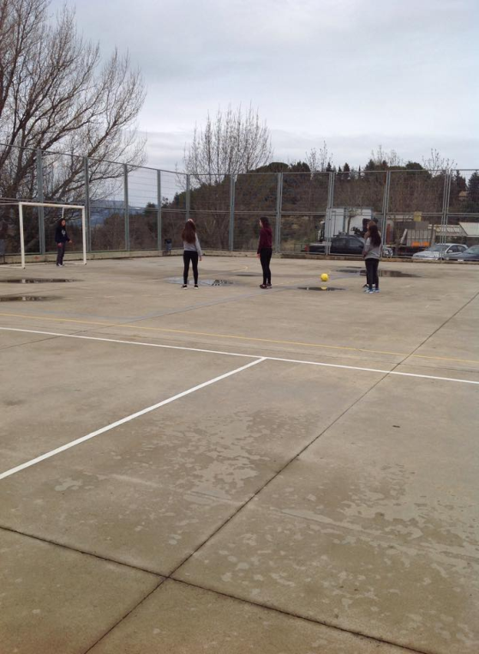
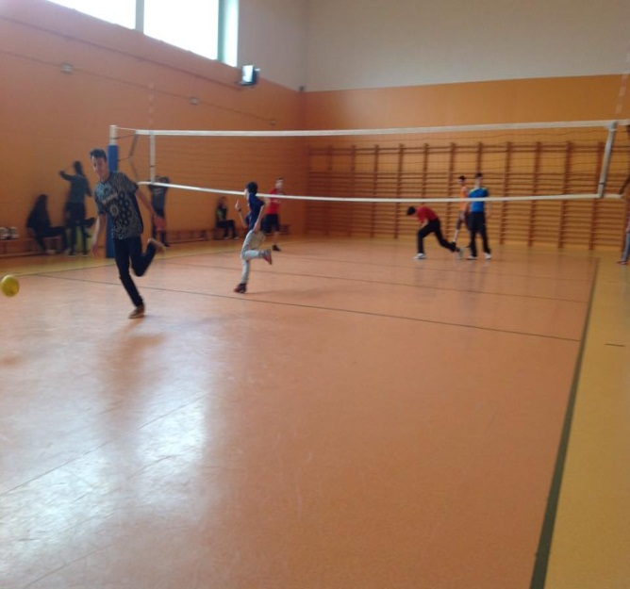
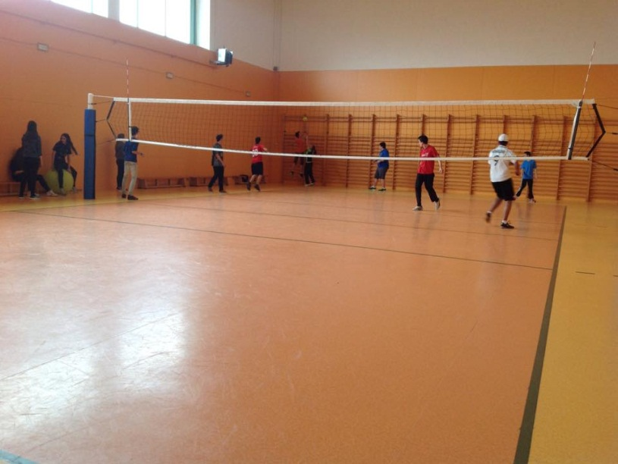
PHYSICAL EDUCATION
Every term we do a different sport.
We don’t do theorical classes.

Slide 13
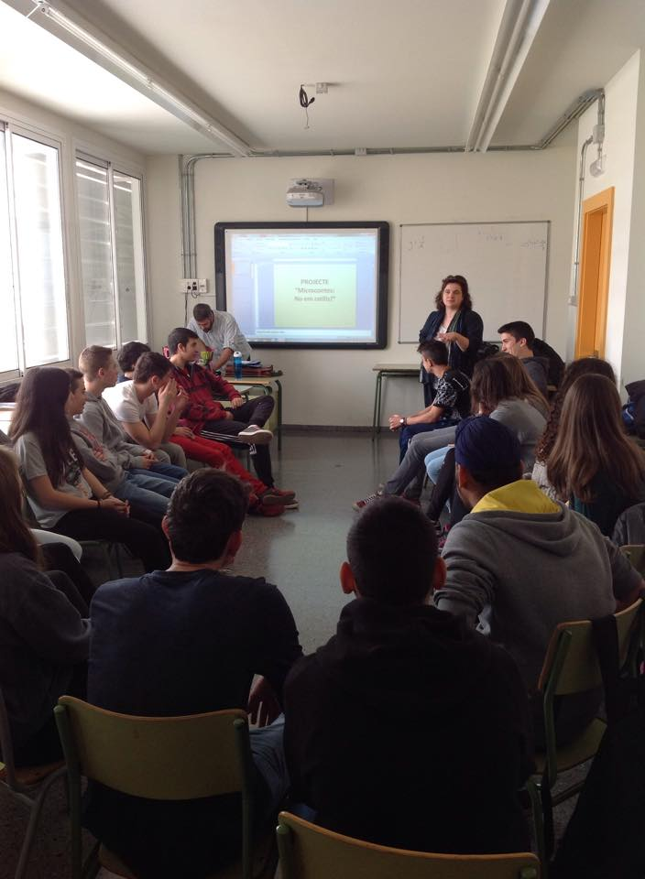
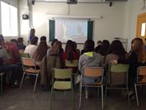
ACTIVITIES
At the end of the term, we usually have different activities as lectures on various topics and in some areas we watch films related to the lesson

Slide 14
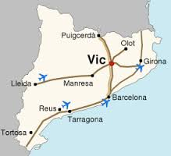
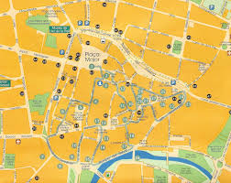
Our hometown, Vic

Slide 15
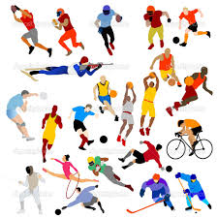
SPORTS FACILITIES

Slide 16
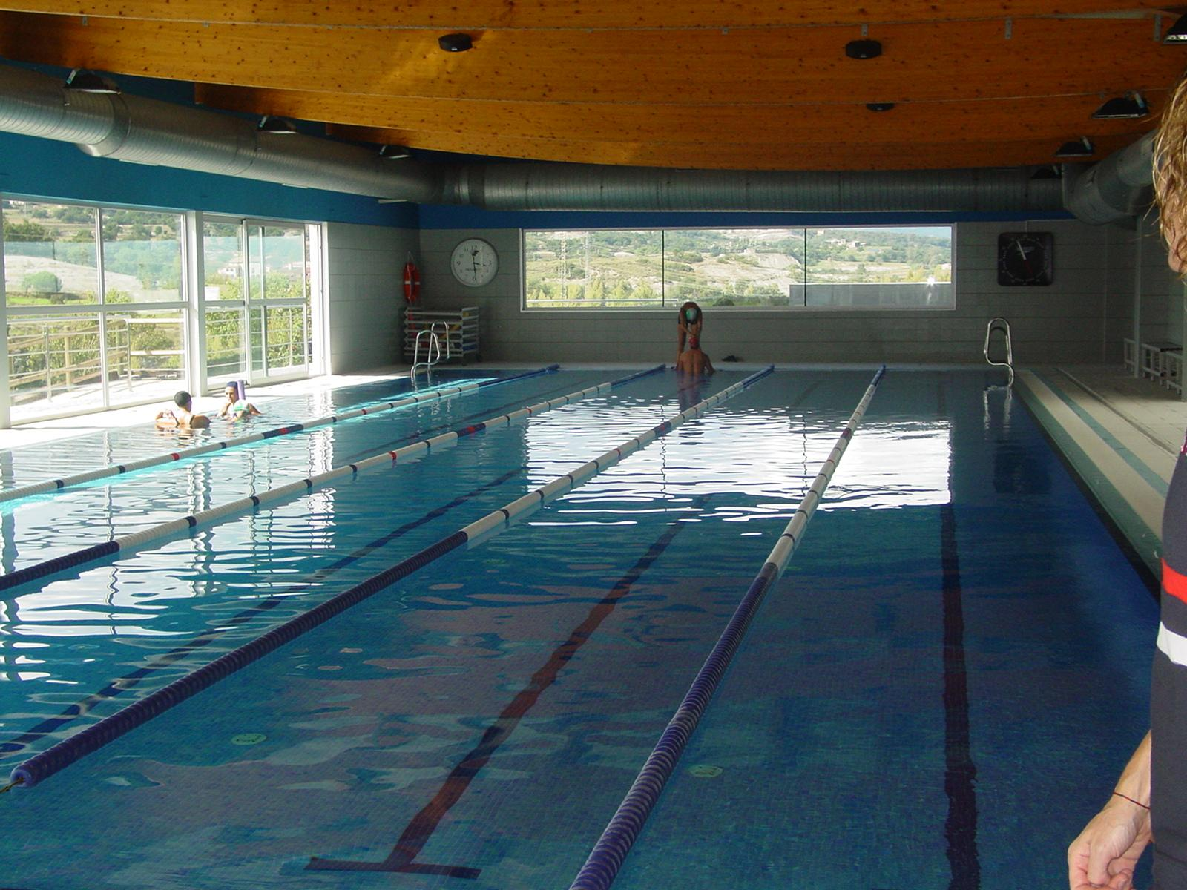
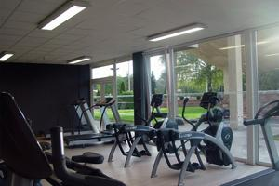
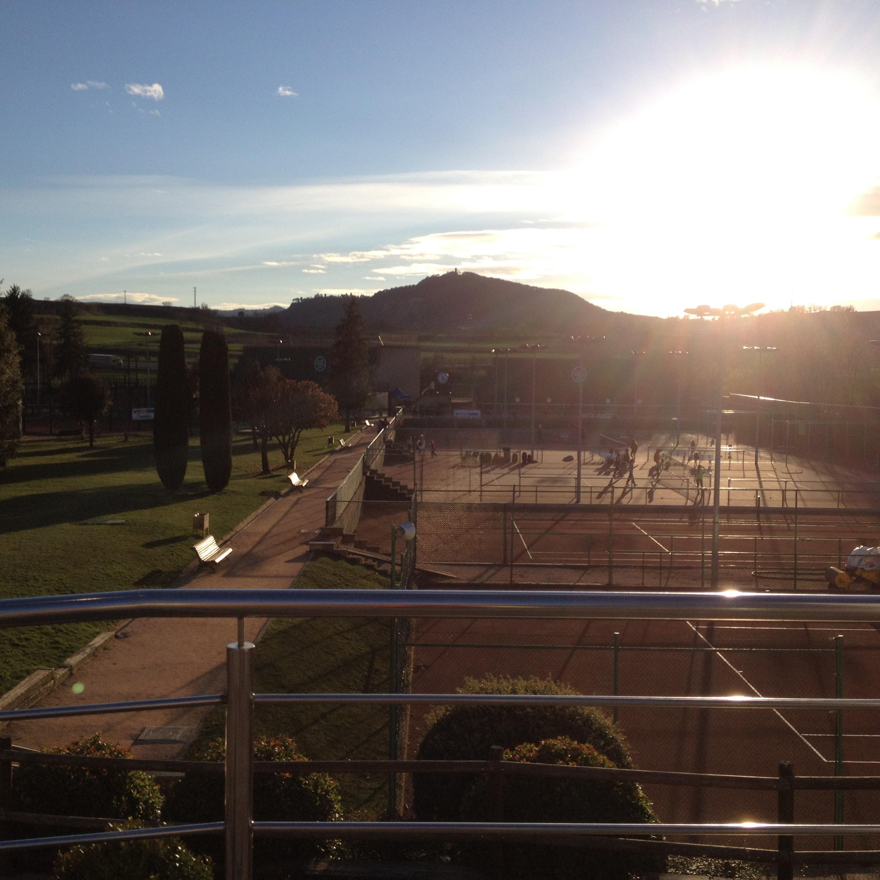
Club natació Vic - swimming club and gym
Founded in 1955
Club Tennis Vic - swimming club, gym and tennis court
Founded in 1948

Slide 17
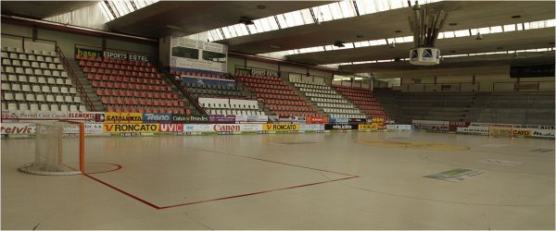
Club Patí Vic - swimming club, gym and tennis court
Founded in 1951
Club patí Vic - hockey club
Founded in 1951

Slide 18
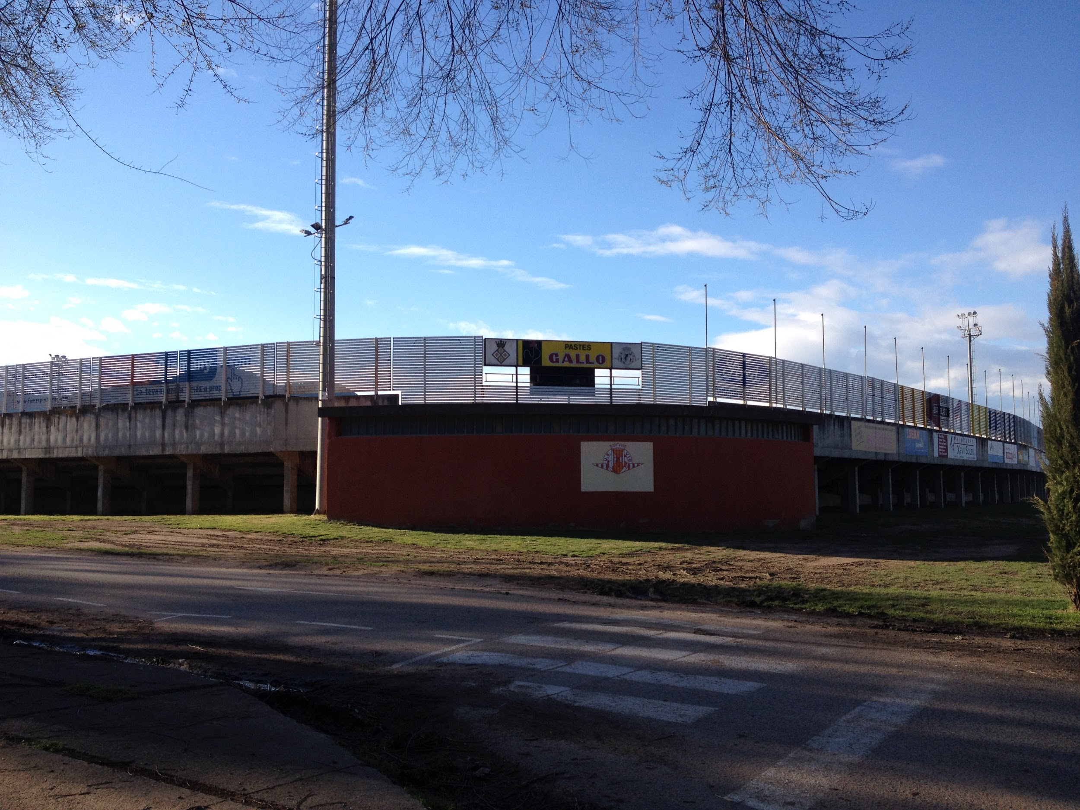
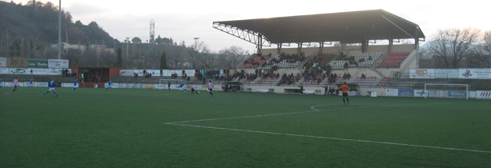
Unió Esportiva de Vic - soccer team and pitch
Founded in 1925

Slide 19
Club Atlètic Vic - Track and field and gym
Founded in 1929

Slide 20
HISTORICAL BUILDINGS

Slide 21
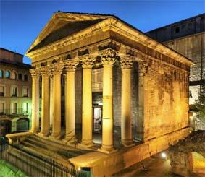
THE ROMAN TEMPLE OF VIC

Slide 22
ORIGINS
The temple was built in the second century a.c.
This building was found in 1882 when the Montcada Castle was demolished.
This castle was built in 897 for Guifré el Pilós.
This temple is well preserved.

Slide 23
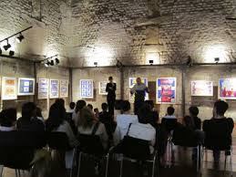
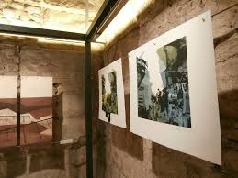
IS THE TEMPLE USED NOW?
The temple is used to
make lectures because the temple is a little small.
for art exhibitions
You can visit the temple and the entry is free

Slide 24
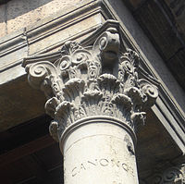
RESTORATION
The restorations of the 1930 and 1954 recovered most part of the monument.
Pere Puntí i Terra sculpted the letters of the columns.
·The whole temple it’s restoured except 1/3 of the seventh column and the capital of the second one.
Original part of the column
Original capital

Slide 25
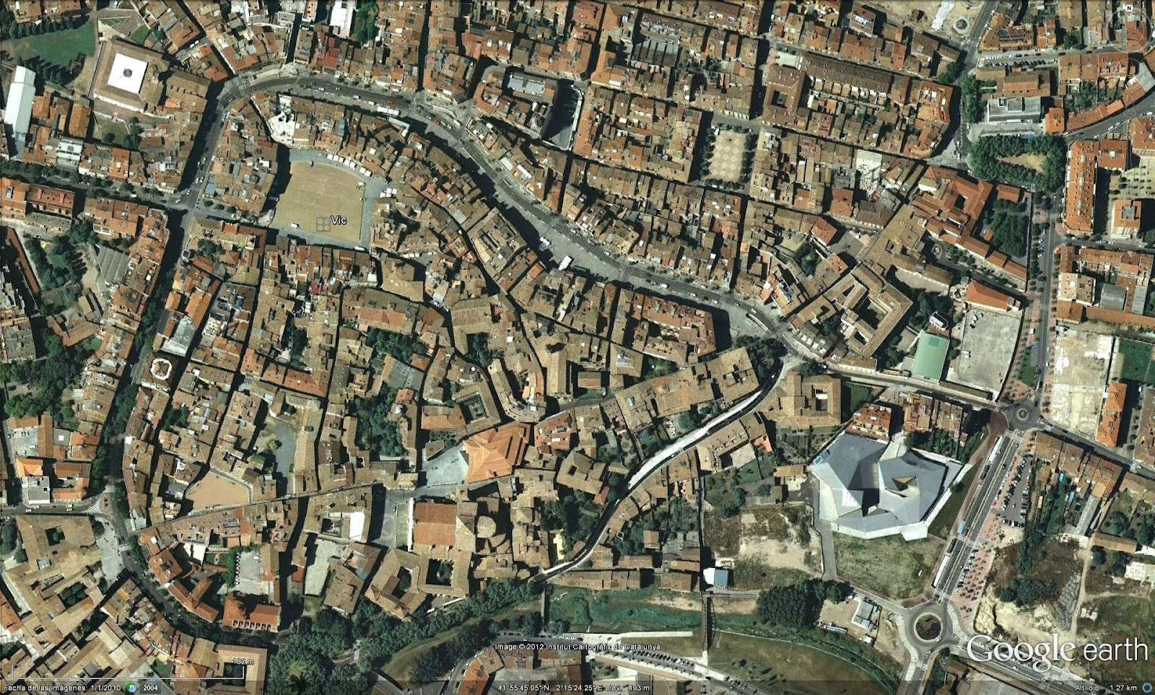
THE OLD QUARTER
Guifré el Pilós decided to re-populate Vic during the 9th century. From the 12th and 13th centuries the first walls were built in Vic and in 1386 they were renovated by Pere III. The population grew and they grouped around three centres: the bishopric, the Montcada castle and Market Square. As a result, the city grew too and then appeared new houses forming irregular streets and narrow.

Slide 26
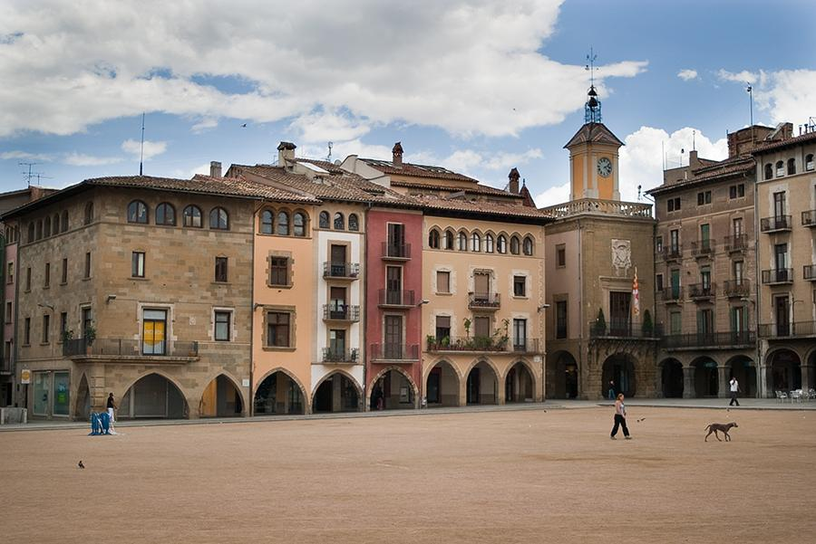
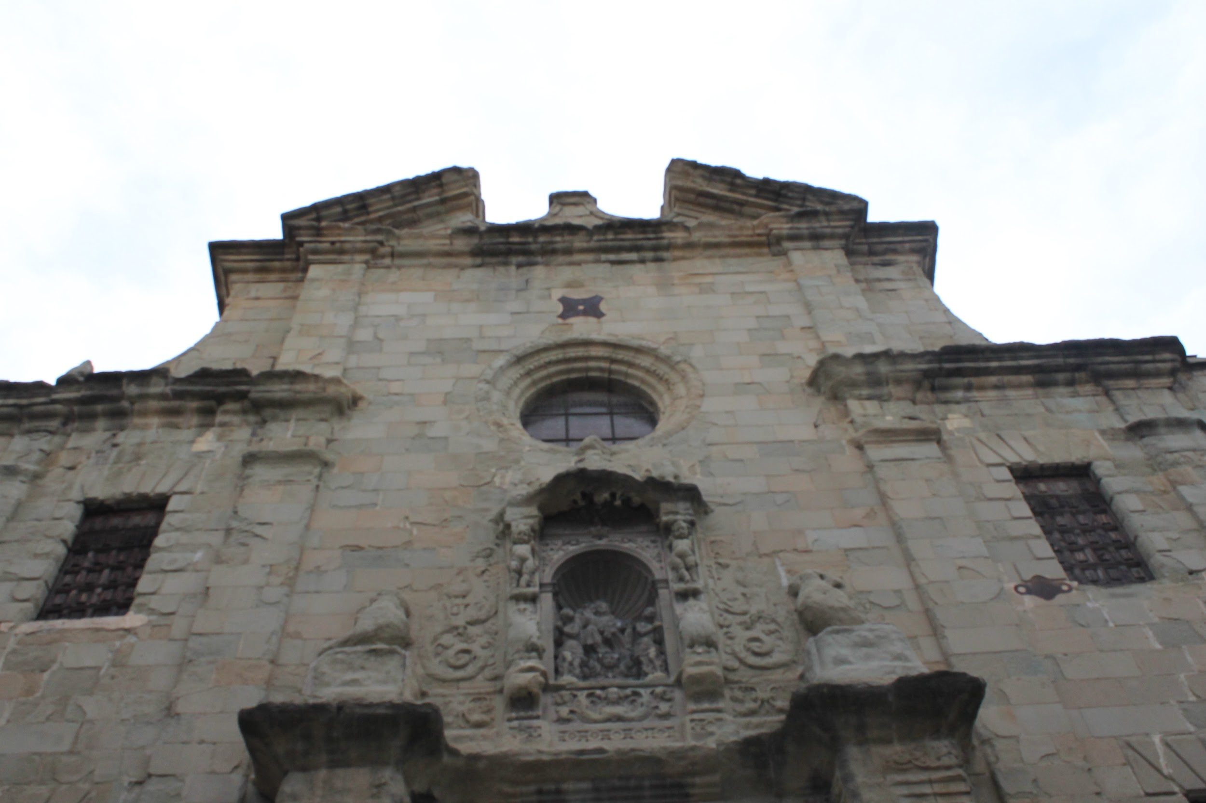
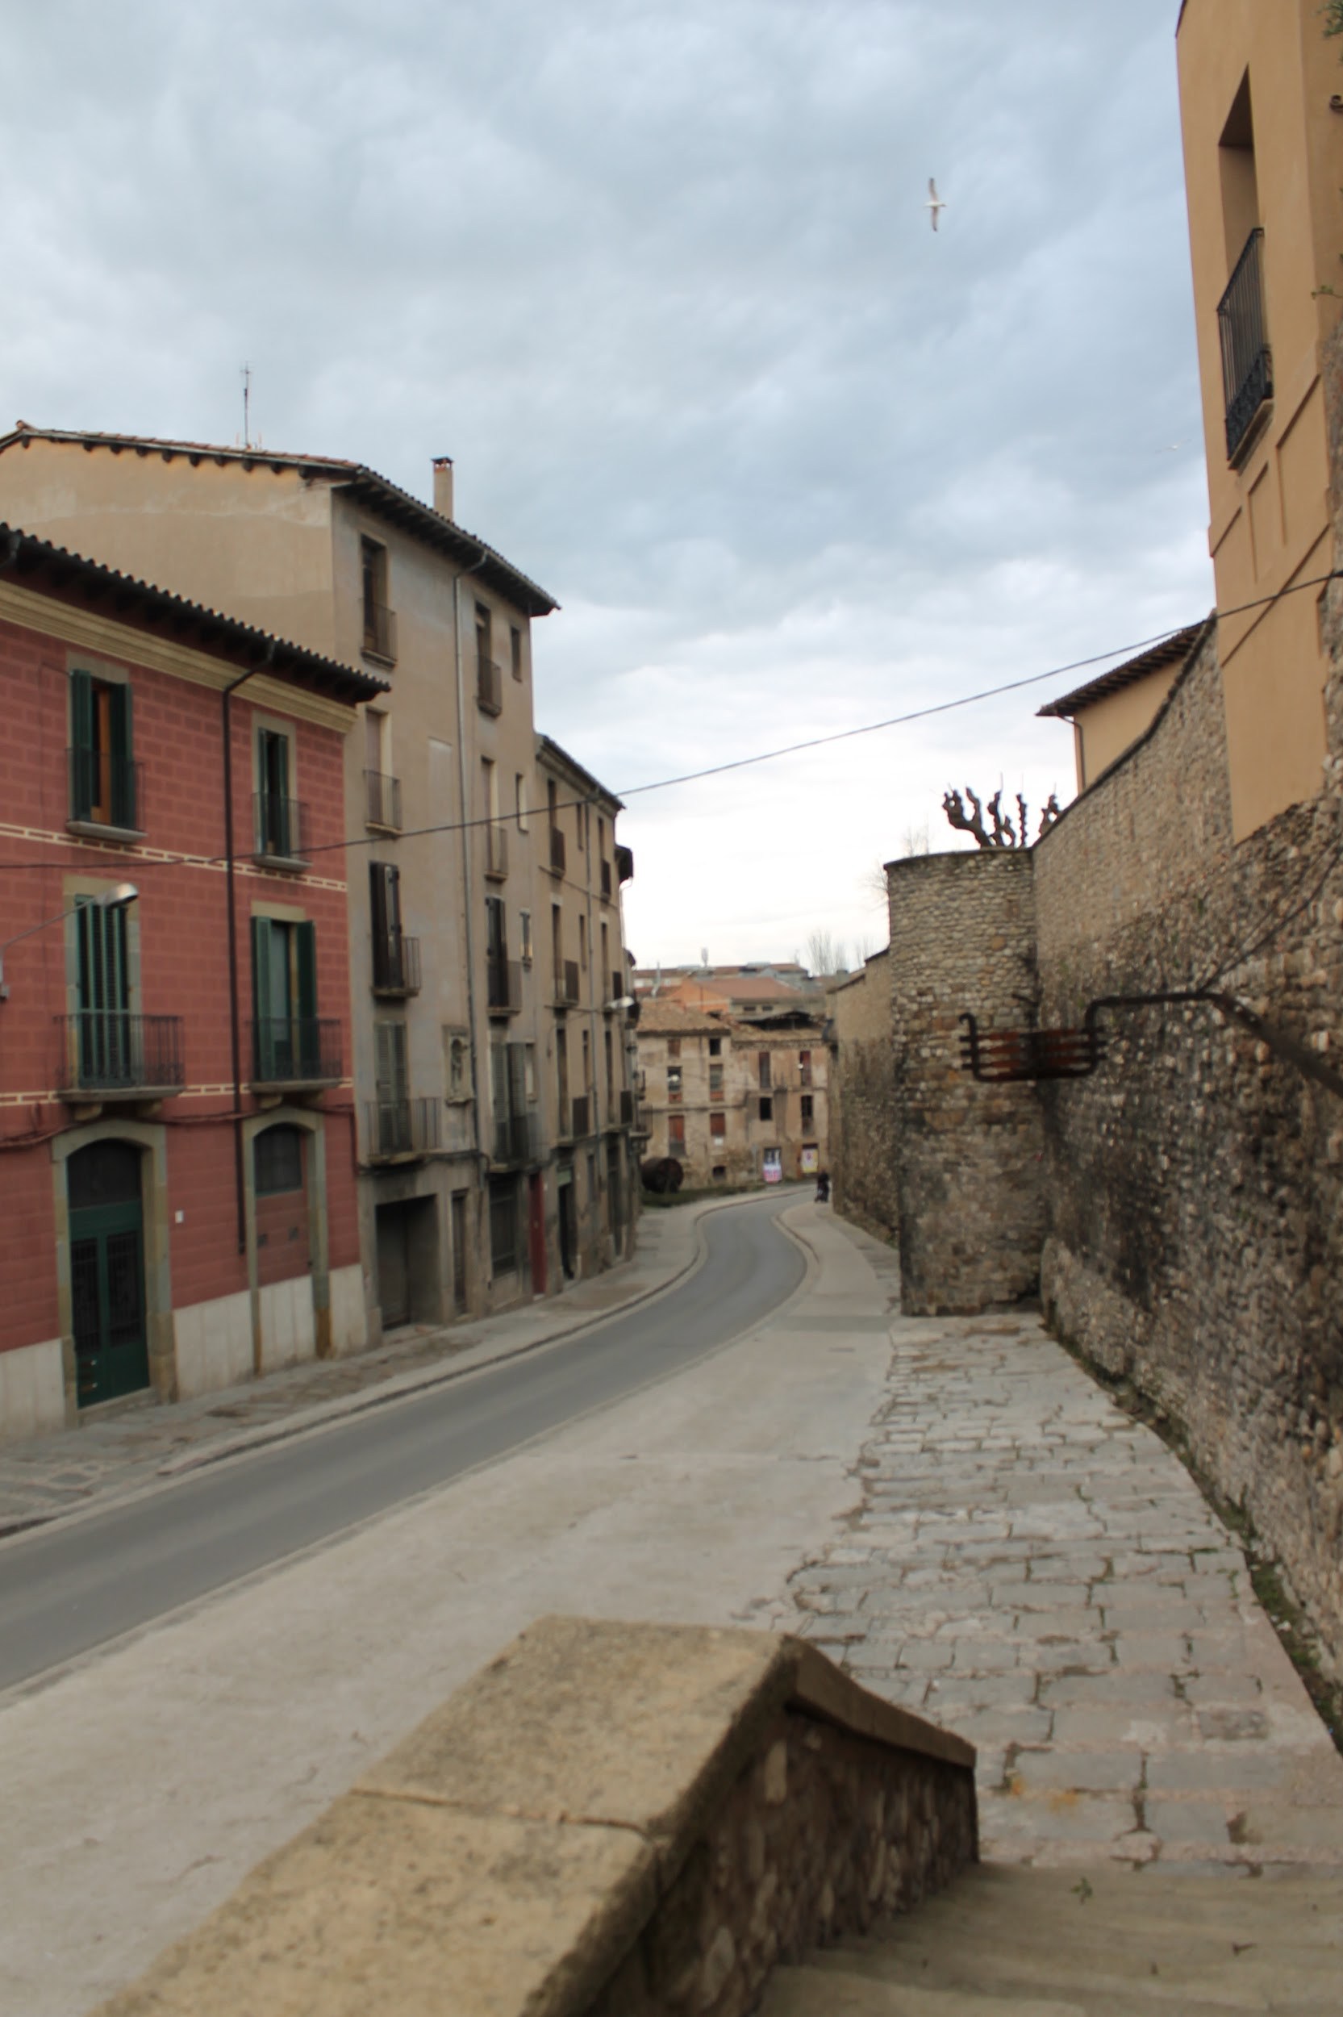
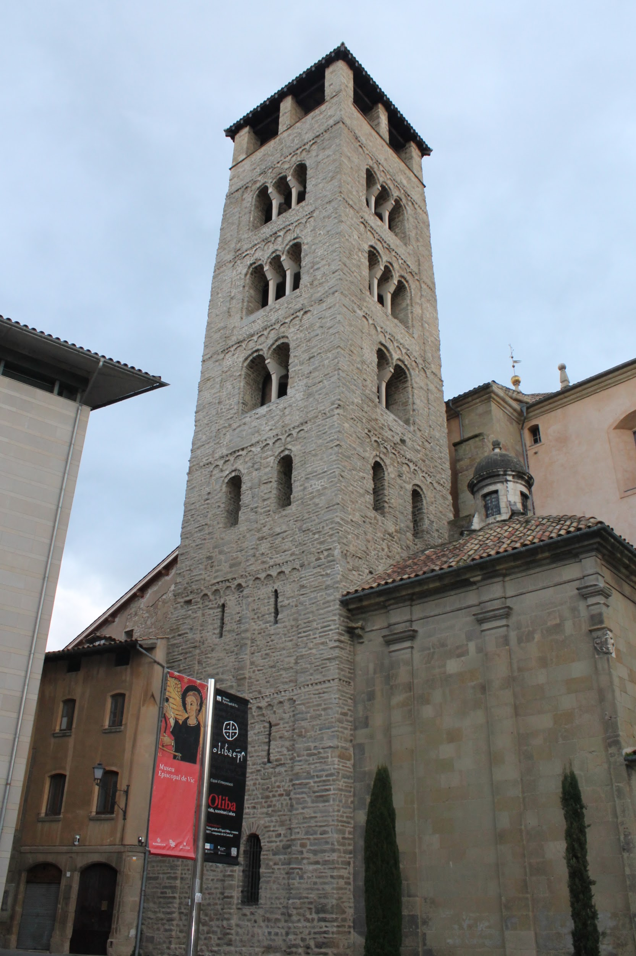
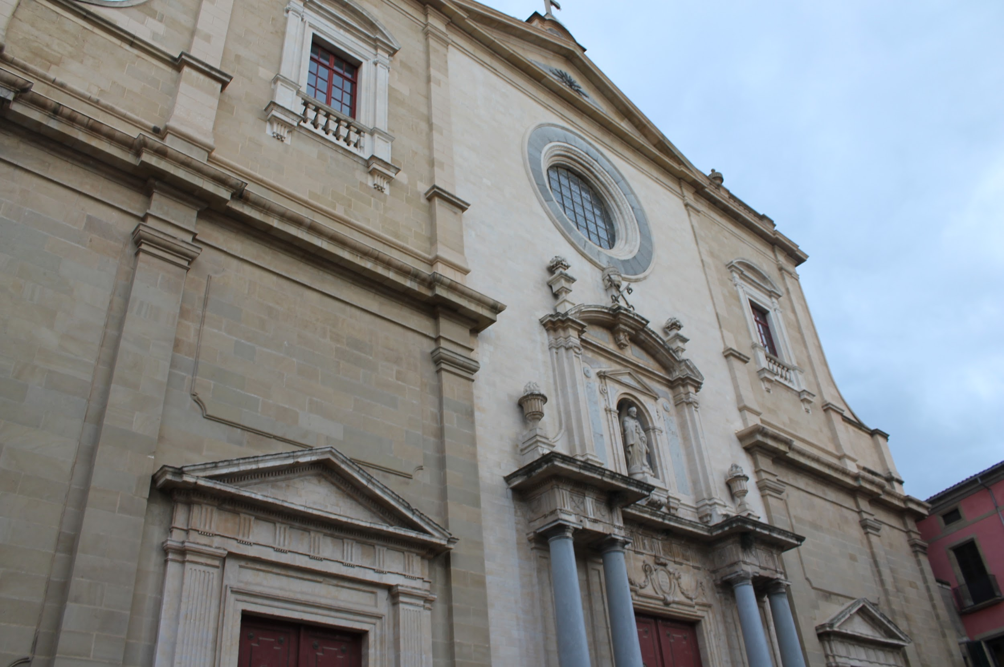
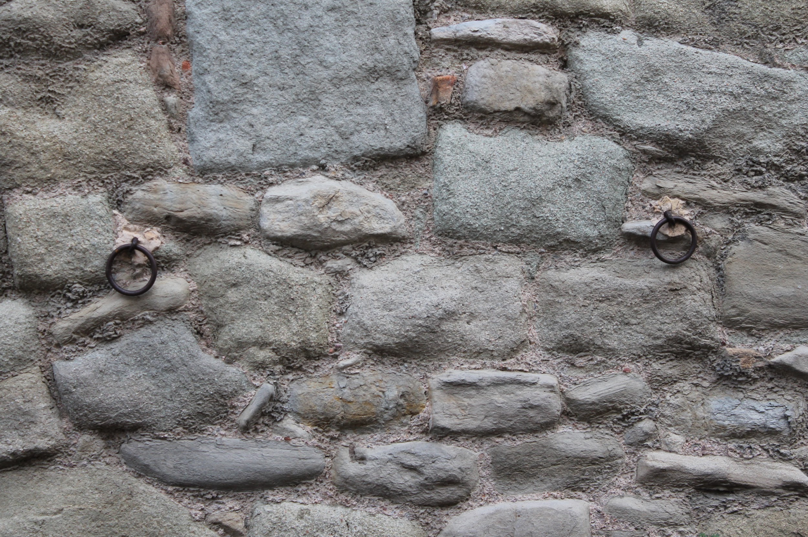
Ruins Of Sant Sadurní
The Market Square
City Walls Of Pere III
The Cathedral

Slide 27
ENTERTAINMENT

Slide 28
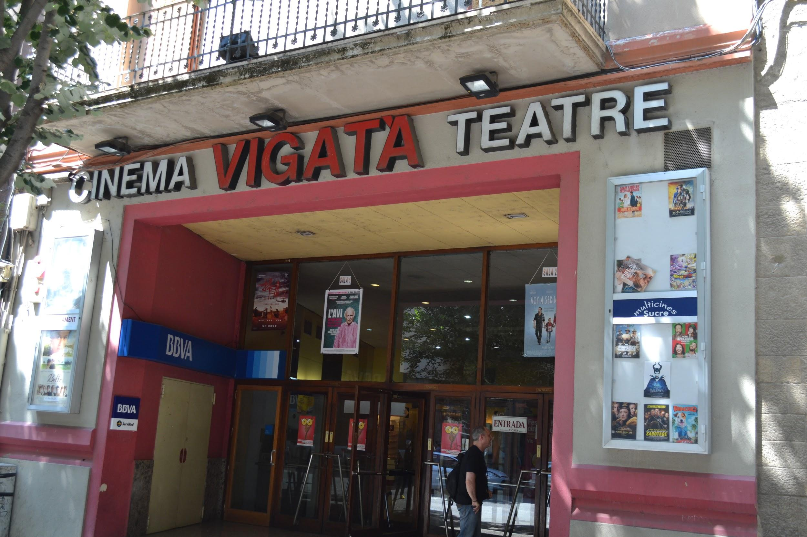
CINEMA VIGATÀ
The Cinema Vigatà was a theatre, but nowadays it’s mainly a cinema. It was built a long time ago.

Slide 29
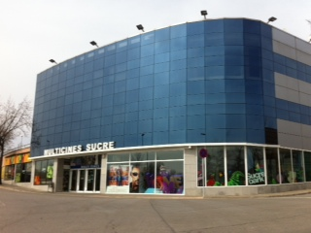
SUCRE
The Cinema Sucre is a place where you can watch films, go to fast food restaurants like “Pans and Company” or to an amusement arcade
There is a playpark for children.

Slide 30
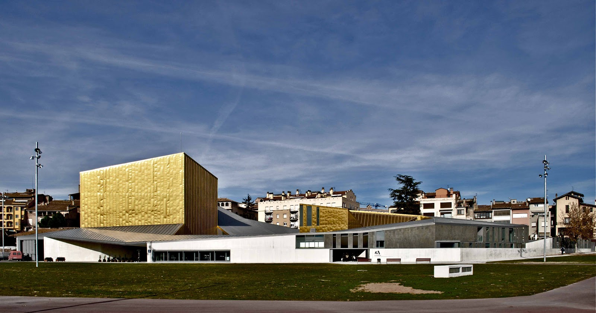
L’ATLÀNTIDA
The Atlàntida is a music school, a theatre and an auditorium, where you can see different plays or listen to live concerts. It was built a few years ago.

Slide 31
MUSEUMS

Slide 32
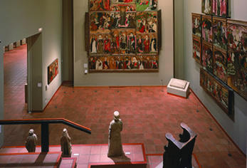
MUSEU EPISCOPAL
The museum was inaugurated in 1891 by the bishop Josep Morgades.
This museum takes action to preserve, document, study, exhibit and distribute funds that make up their collections to contribute to the safeguarding of cultural heritage.

Slide 33
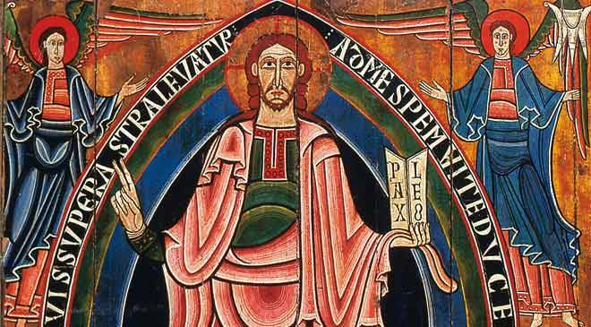
MUSEUM EPISCOPAL

