Slide 1
PORTUGAL
This work was made by the 3rd grade of the Crato School in Alentejo region – Portugal
February, 2019
Erasmus+Impact: Mini-Project Hello, Europe!

Slide 2
This is our flag

Slide 3
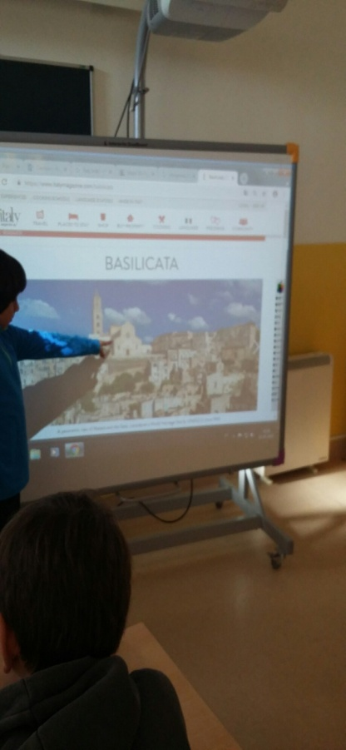
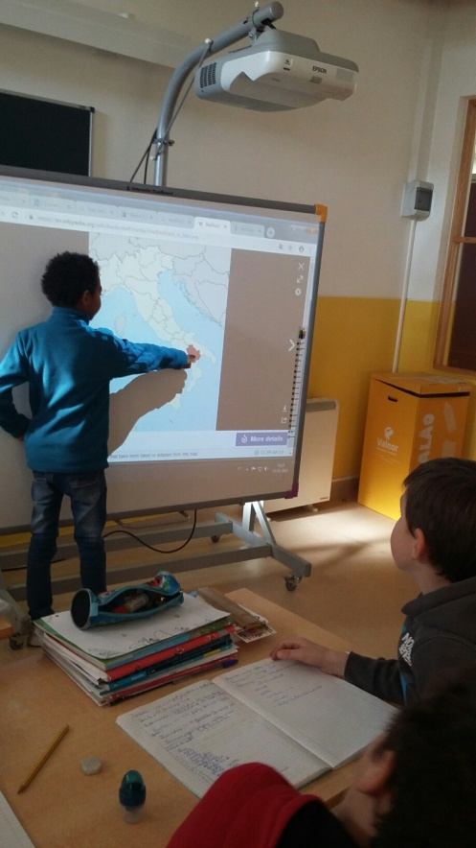
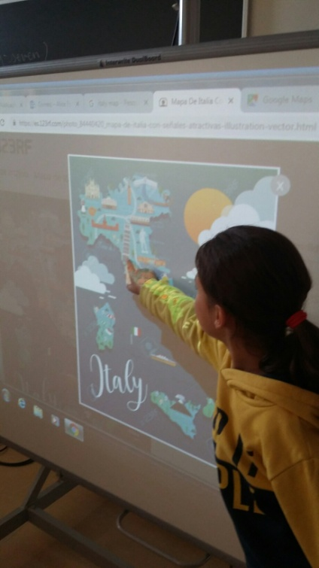
We made groups in our class and researched about the localization of your countries

Slide 4
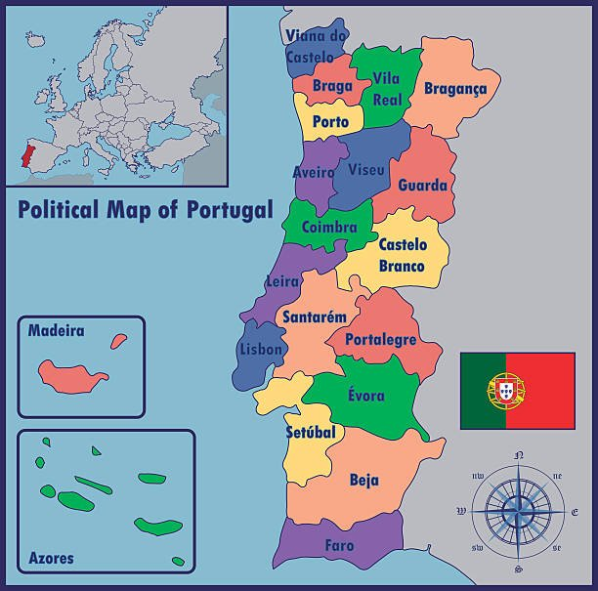
Our school is in the district of PORTALEGRE
The map of PORTUGAL

Slide 5
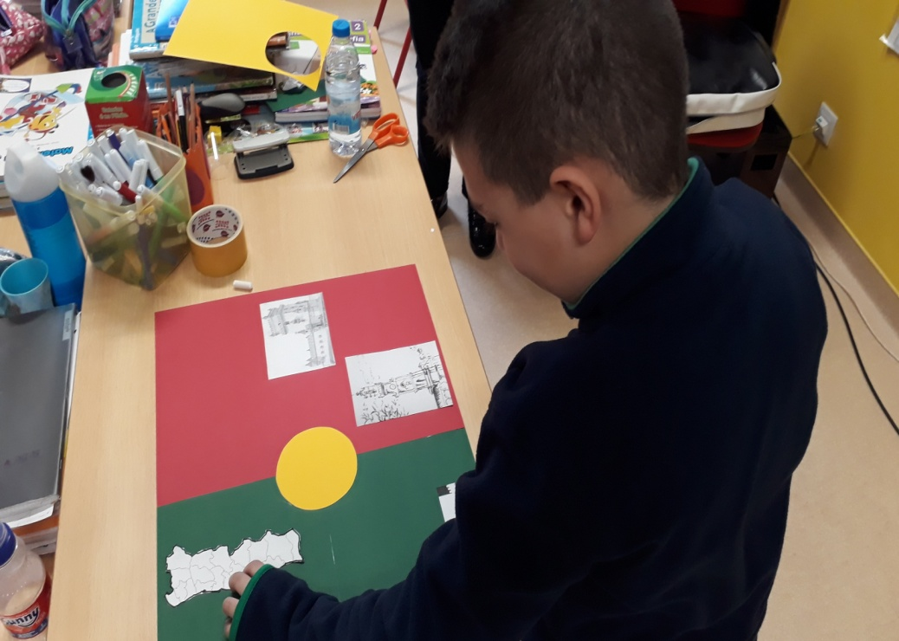
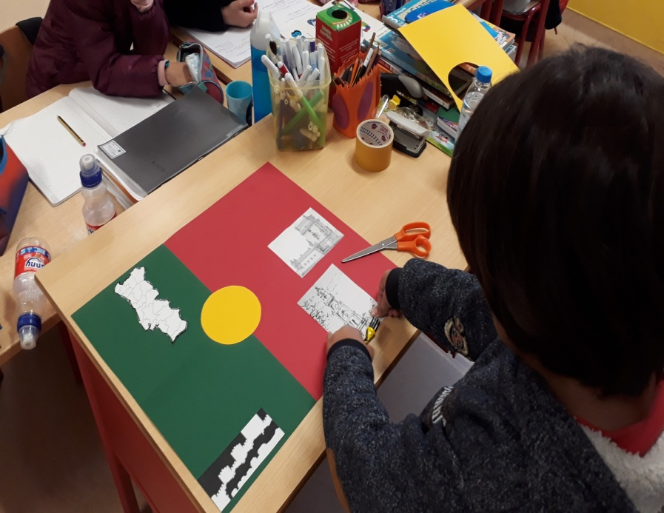
Now we are going to show you some photos of our Mini-Project Hello, Europe!

Slide 6
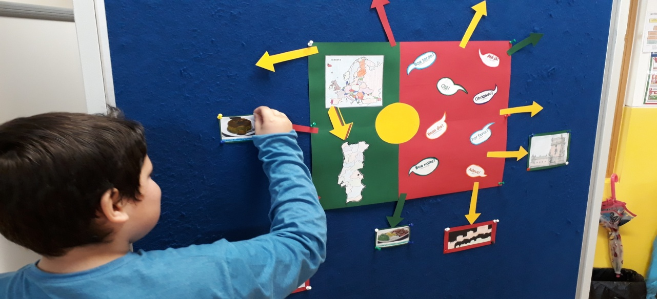

Slide 8
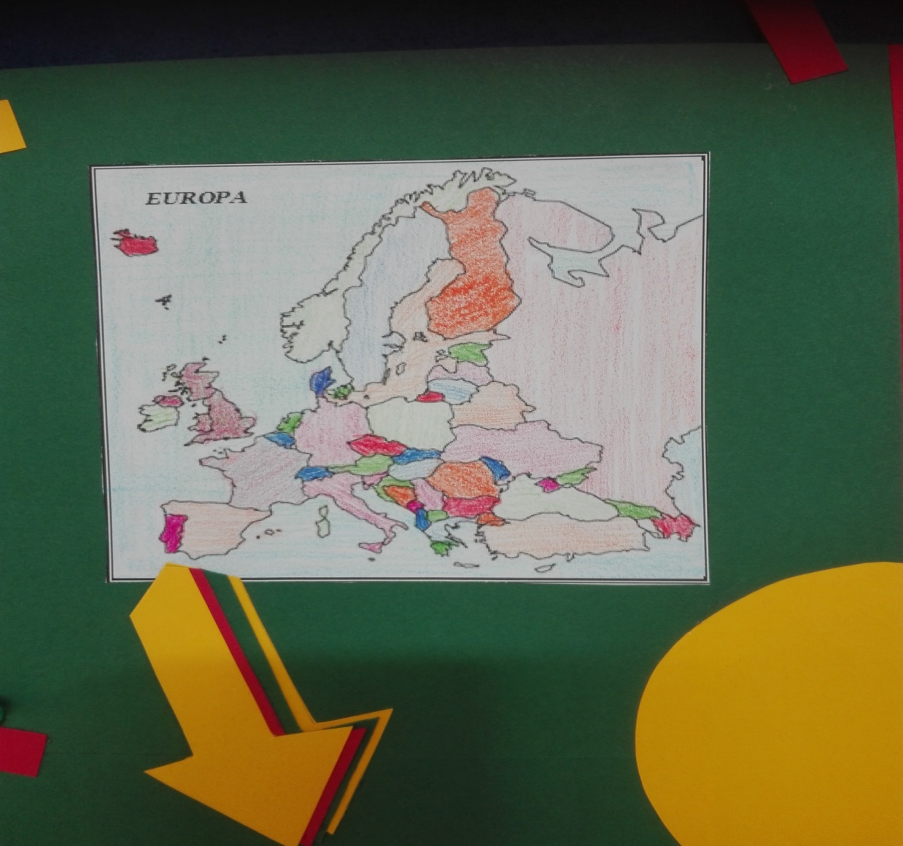

Slide 9
The map of Portugal

Slide 10
Greetings

Slide 11
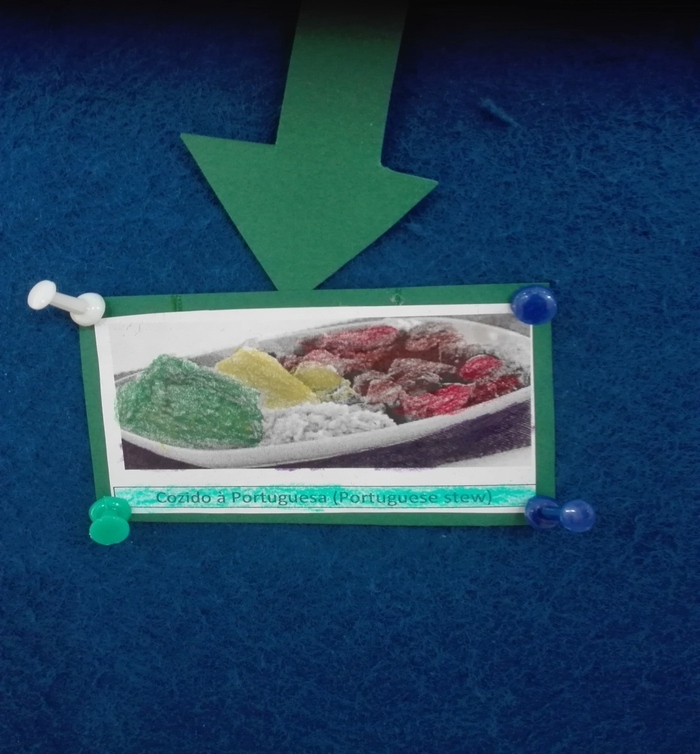
Typical food

Slide 12
Important monuments: Jerónimos`Monastery in Lisbon, the capital of Portugal

Slide 13
Another important monument: the Belém Tower, in Lisbon

Slide 14
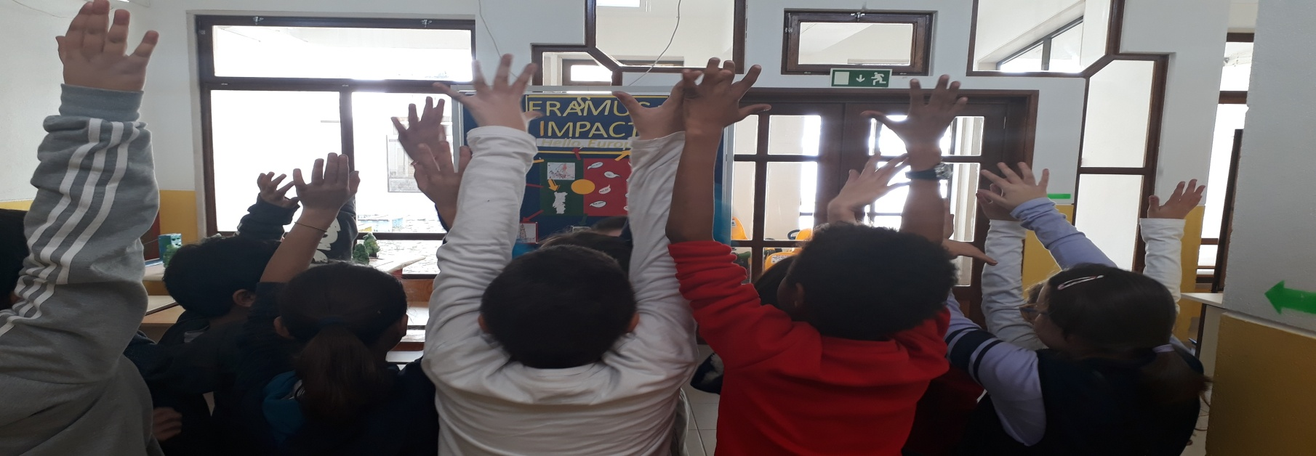
Thank you very much!!!!
Thanks a lot for your attention!
It was a pleasure to work with you!

