Slide 1
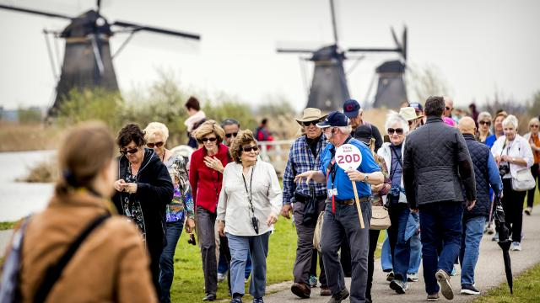
Touristic Attractions brochure
Amy – luis - filomena - mihirican

Slide 2
What are we going to do?
The students are going to make a brochure about 3 touristic attractions in their city.
Diepenheim, Bursa, Portalegre, ….
Work in groups
Make a brochure using different tools
Blogger.com to share them and communicate with the other countries.

Slide 3
Didactical approach
As a teacher, you have a coaching role.
We learn the children how to work together.
Social skills
ICT/technology (21’st century skills)

