Slide 1
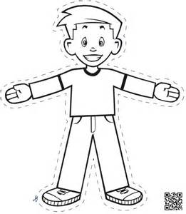
FLAT STANLEY
SERRA TURAMBERK (TURKEY), HANNEKE IN TRAA (THE NETHERLANDS),
ANNA MARIA RUBINO (ITALY), EMILIA MAIA & ALICE FERNANDES (PORTUGAL)

Slide 2
Goals
To use CLIL methodology in the project
To develop multilingualism by using different languages orally and in written form
To support collaboration among students and teachers

Slide 3
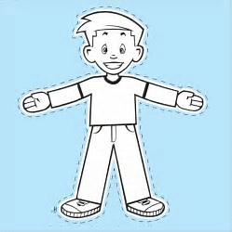
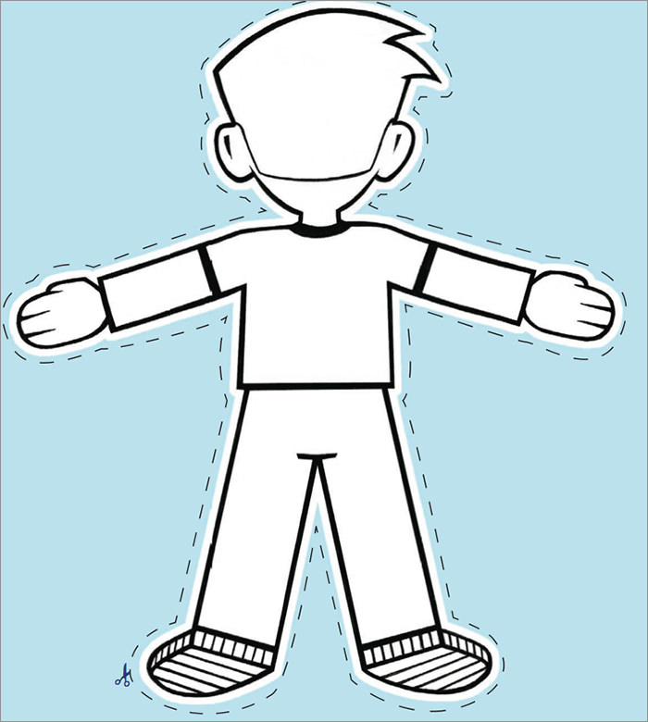
Didactical approach & organisation
Integrating English language education with Geography-CLIL
Flat Stanley template
Videos in groups
Preparing posters
Letter writing in groups
Pen friending

