Slide 1
February, 2019 Erasmus+Impact:
HELLO EUROPE!!!
This work is made by the 6th grade of the Roccanova School

Slide 2
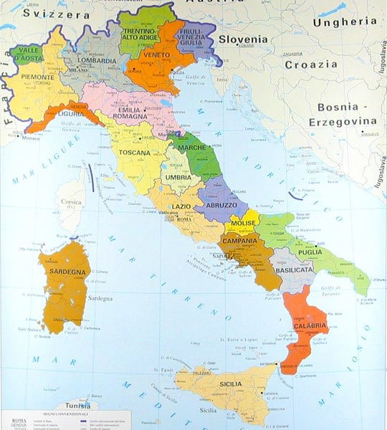
WE ARE FROM ITALY
WE ARE ITALIAN

Slide 3
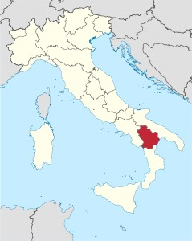
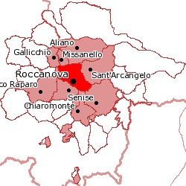
We live in Roccanova, a small village in the Basilicata region in the south of Italy.

Slide 4
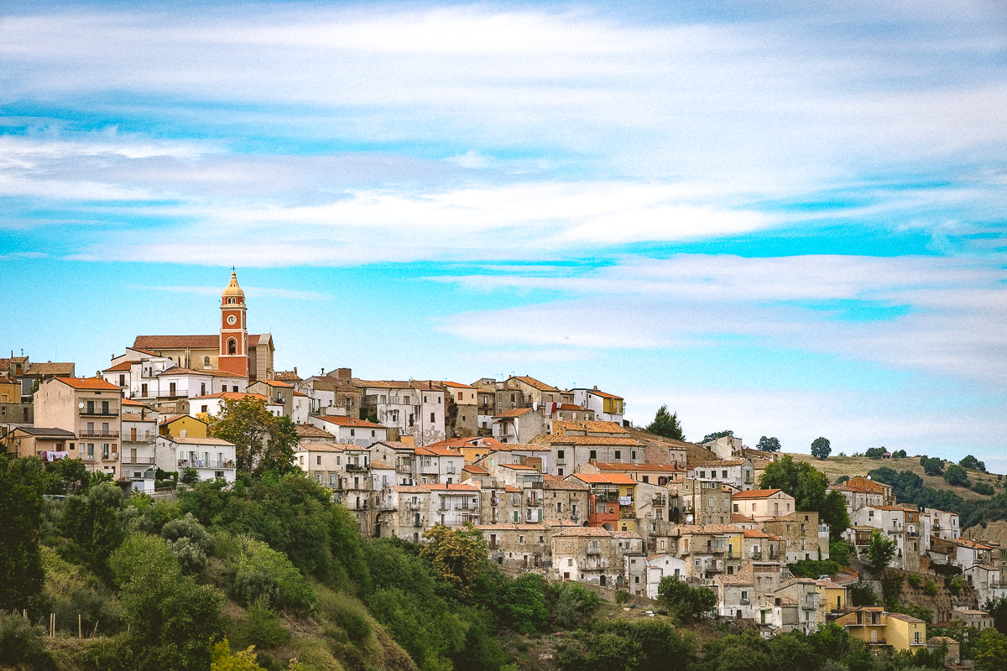
ROCCANOVA

Slide 5
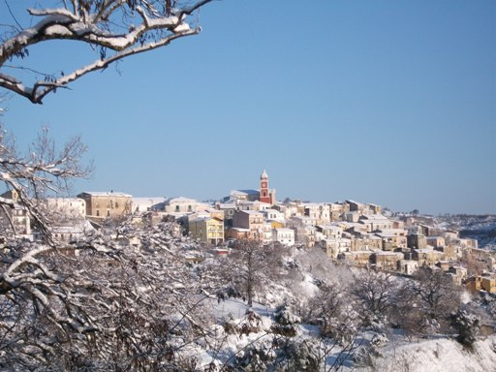
THE LANDSCAPE
Roccanova’s landscape is
mountainous. It’s about 650 m high.

Slide 6
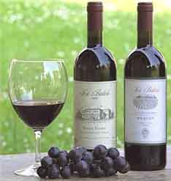
TYPICAL PRODUCTS
Roccanova is famous for its “Grottino”, a wine DOC produced in its wine cellars.

Slide 7
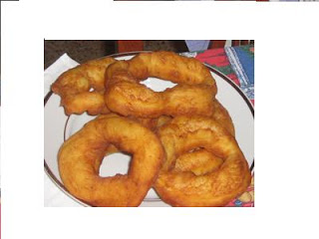
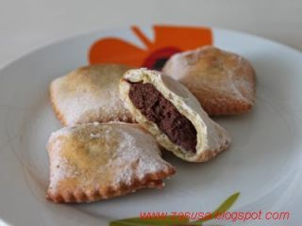
The typical dishes of Christmas time are: Calzoni with chestnut cream, Crispelle.

Slide 8
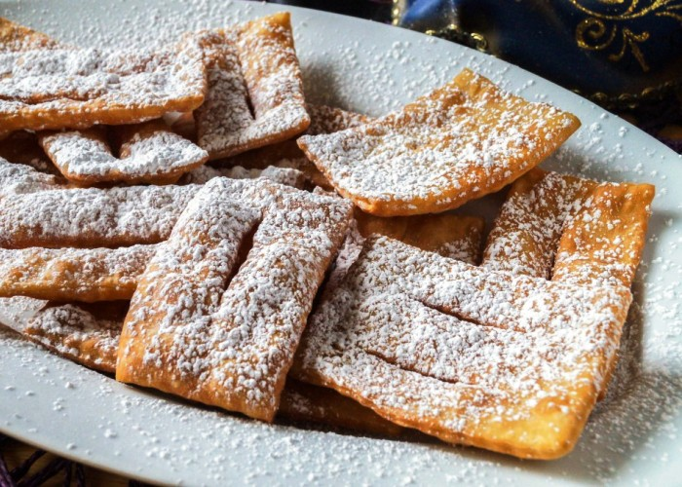
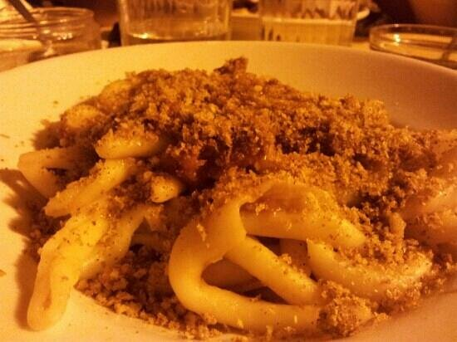
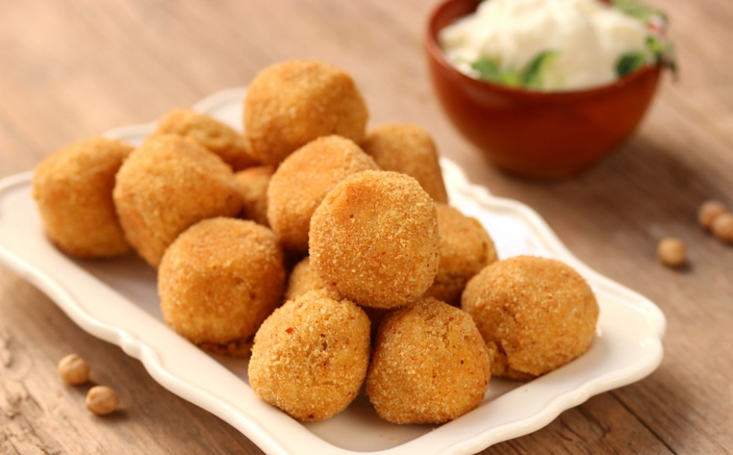
For Carneval, Polpette with bread and cheese and pasta handmade with bread. A typical dessert is Chiacchiere

Slide 9
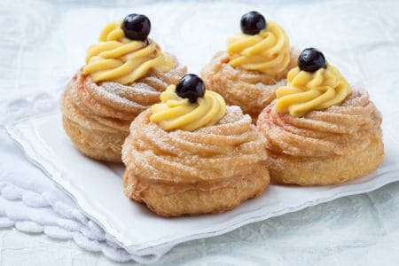
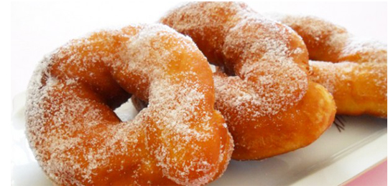
Another important party is Saint Giuseppe, celebrated in March 19°. A typical dessert is fried or baked Zeppole.

Slide 10
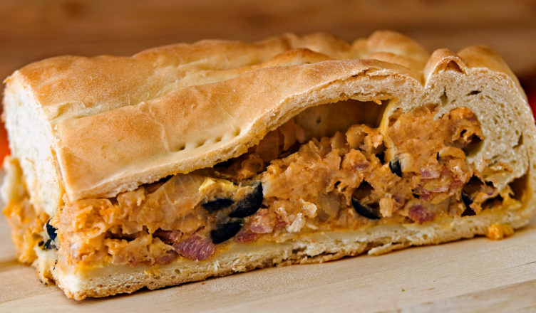
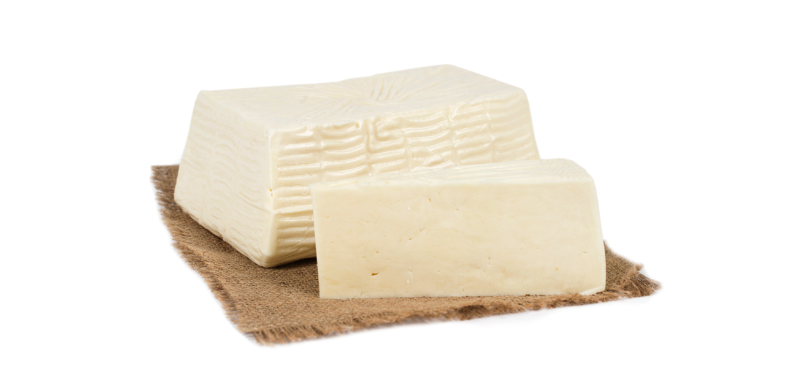
On Easter, the typical dish is Calzone full of sausages, eggs and tuma, such as a fresh cheese.

Slide 11
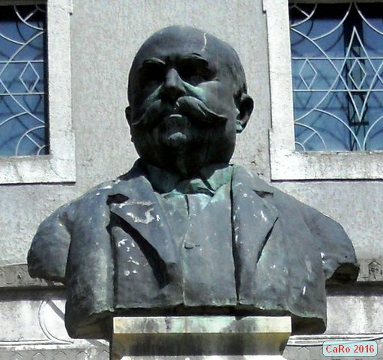
Roccanova’s buildings
Mendaia
Cinema
It’s a bulding in honour of Vincenzo Saverio Mendaia, a good citizen admired and respected by inhabitans for his professional, cultural and social dedication.
One of the most ancient building in Roccanova is the Cinema. It’s near G.Chiaradia’s amphiteatre.

Slide 12
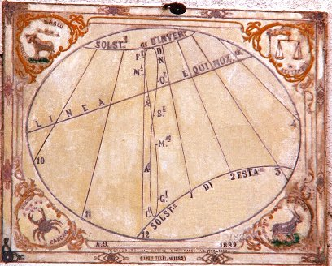
The MERIDIANA is of particular importance for the historical and artistic point of view. It’s a solar clock that is situated in a very old tower out “Piazza del Popolo”. The dial is rich of zodiac signs that mark the starting of season.
The Meridiana was arrived out in 1882 by an engineer who in 1864 was the captan of rifflemen that fought against bendtry.

Slide 13
Our students researched about the localization of your countries and prepared an European map pointing out your right position on it.

Slide 14
THE END
It was a really pleasure to work together!
THANK YOU!!!

