Slide 1
IMPACT of Literature on immigrant students and in diversity for learning environment

Slide 2
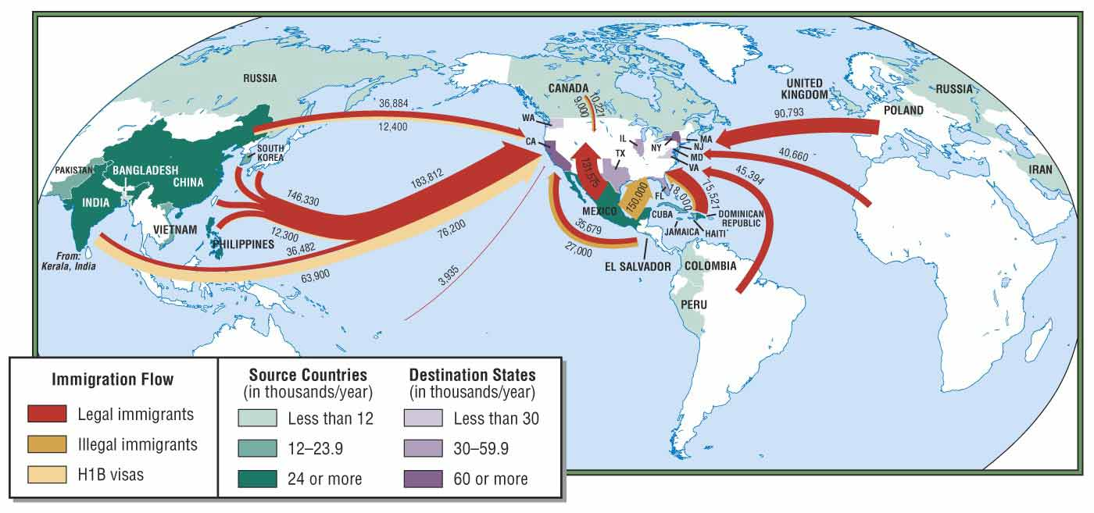
Immigration is a natural process throughout the world history.

Slide 3
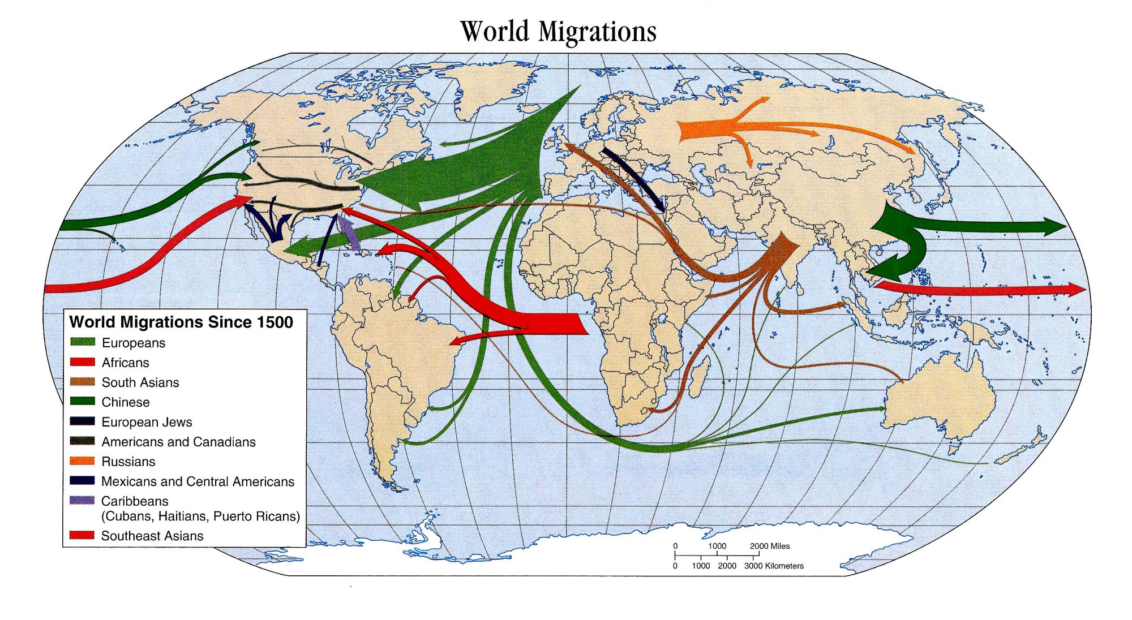
Reasons vary: political, economical, intellectual, etc..

Slide 4
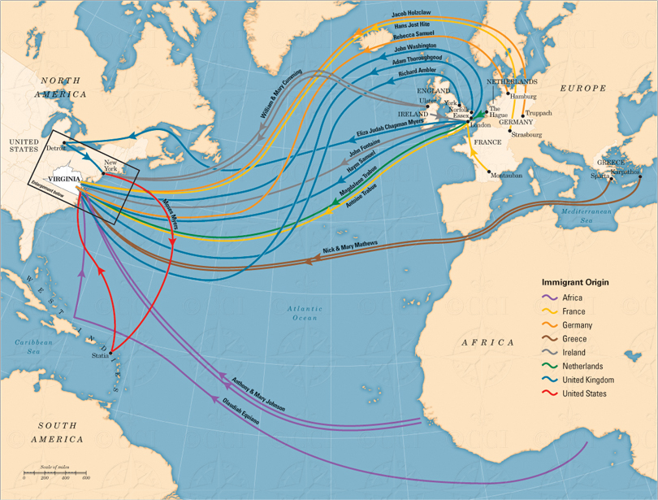

Slide 5
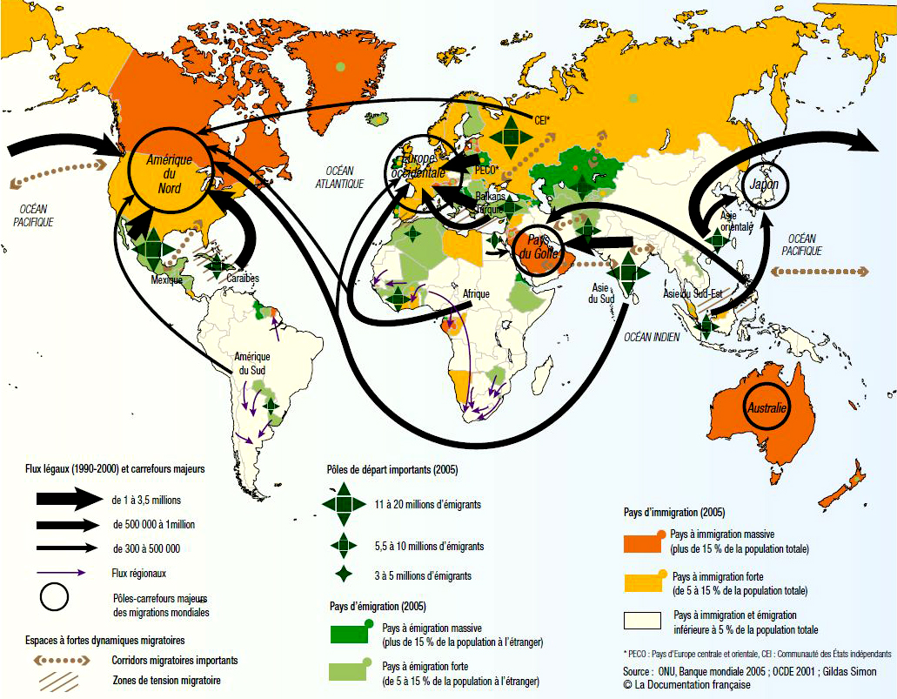

Slide 6
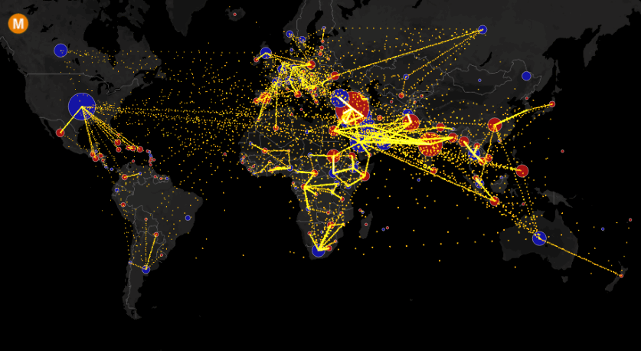

Slide 7
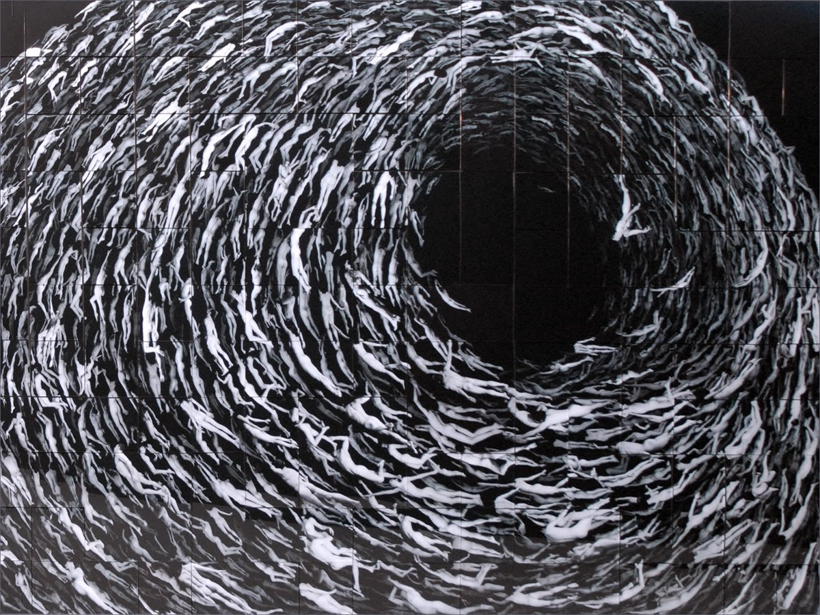
As migration is an inevitable nature of societies, does this necessarily mean children get lost in other cultures as if in a deadlock skein?

Slide 8
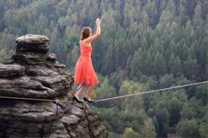
As teachers, what is our role in helping immigrant children discover their existing values and helping them adapt to the new culture?

Slide 9
How can we make use of literature in and beyond the classroom to help students blend in in the same environment?

Slide 10
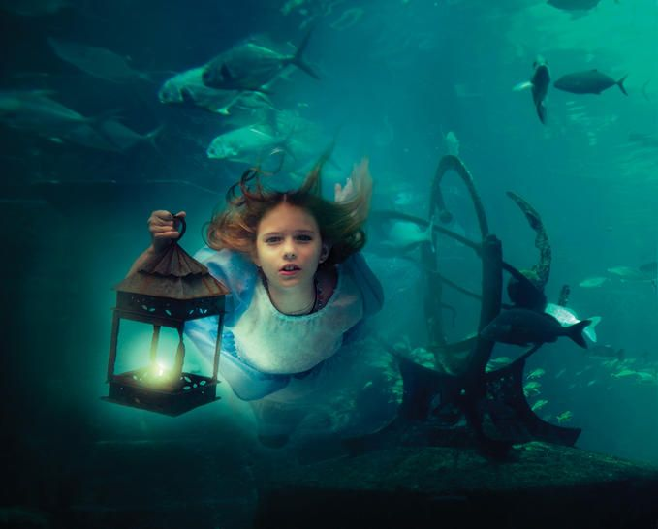
“A book must be the axe for the frozen sea within us.” -Franz Kafka

Slide 11
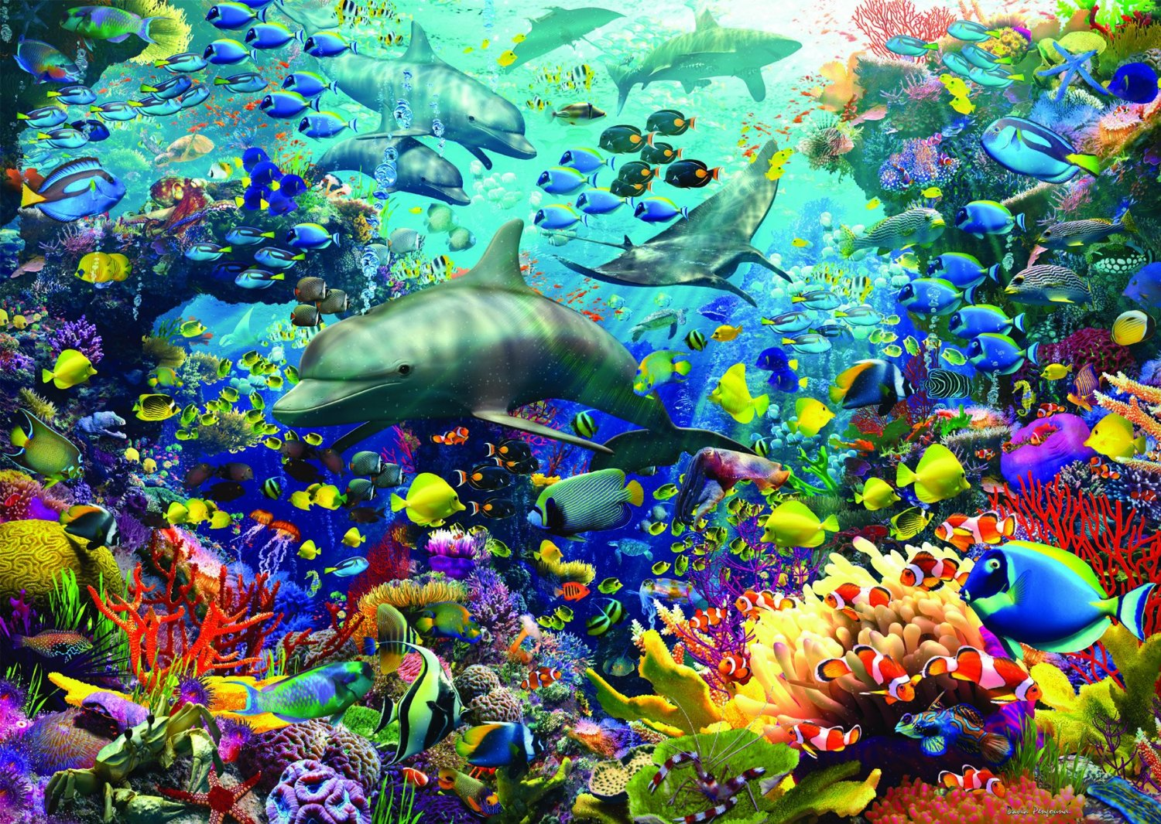

Slide 12
What are some ways to encourage students enjoy wealth of diversity?
Using different national fairy-tales,
Using national lullabies, nursey rhymes,
Making exhibitions of famous literature characters, costume parties, etc.
Using dramas,
Other?

Slide 13
Let’s have a quick look at some good examples…
NESET II ad hoc question 1 / 2016
By Dr. BARBARA HERZOG-PUNZENBERGER Institute for Pedagogy and Pedagogical Psychology, Johannes Kepler University of Linz
SUCCESSFUL INTEGRATION OF MIGRANT CHILDREN IN EU MEMBER STATES: EXAMPLES OF GOOD PRACTICE

Slide 14
“Gallery Walk”
Stand up
Take a colored marker
Go to posters on the wall
Read the handouts available & discuss within the group (10 minutes)
Write down your ideas explicitly so that it can be understood by other groups (15 minutes)
You may include following items:
How effective do you think the project is?
What are the positive sides?
What might be the difficulties?
Any other comments/ideas?
Visit the poster next to you and add any ideas/comments until you come back to the poster you created. (10 minutes at each poster)
Examine the points other groups have added to your poster.
Present the poster to the rest of the group. (5 minutes)
16/05/17
<número>
Notes:
<número>

Slide 15
Thank you!

