Slide 1
The Netherlands
Made by the 5th grade of The Wiekslagschool in the Netherlands.

Slide 2
Our team! We made groups in our class and we made presentations about your countries!

Slide 3
The Netherlands

Slide 4
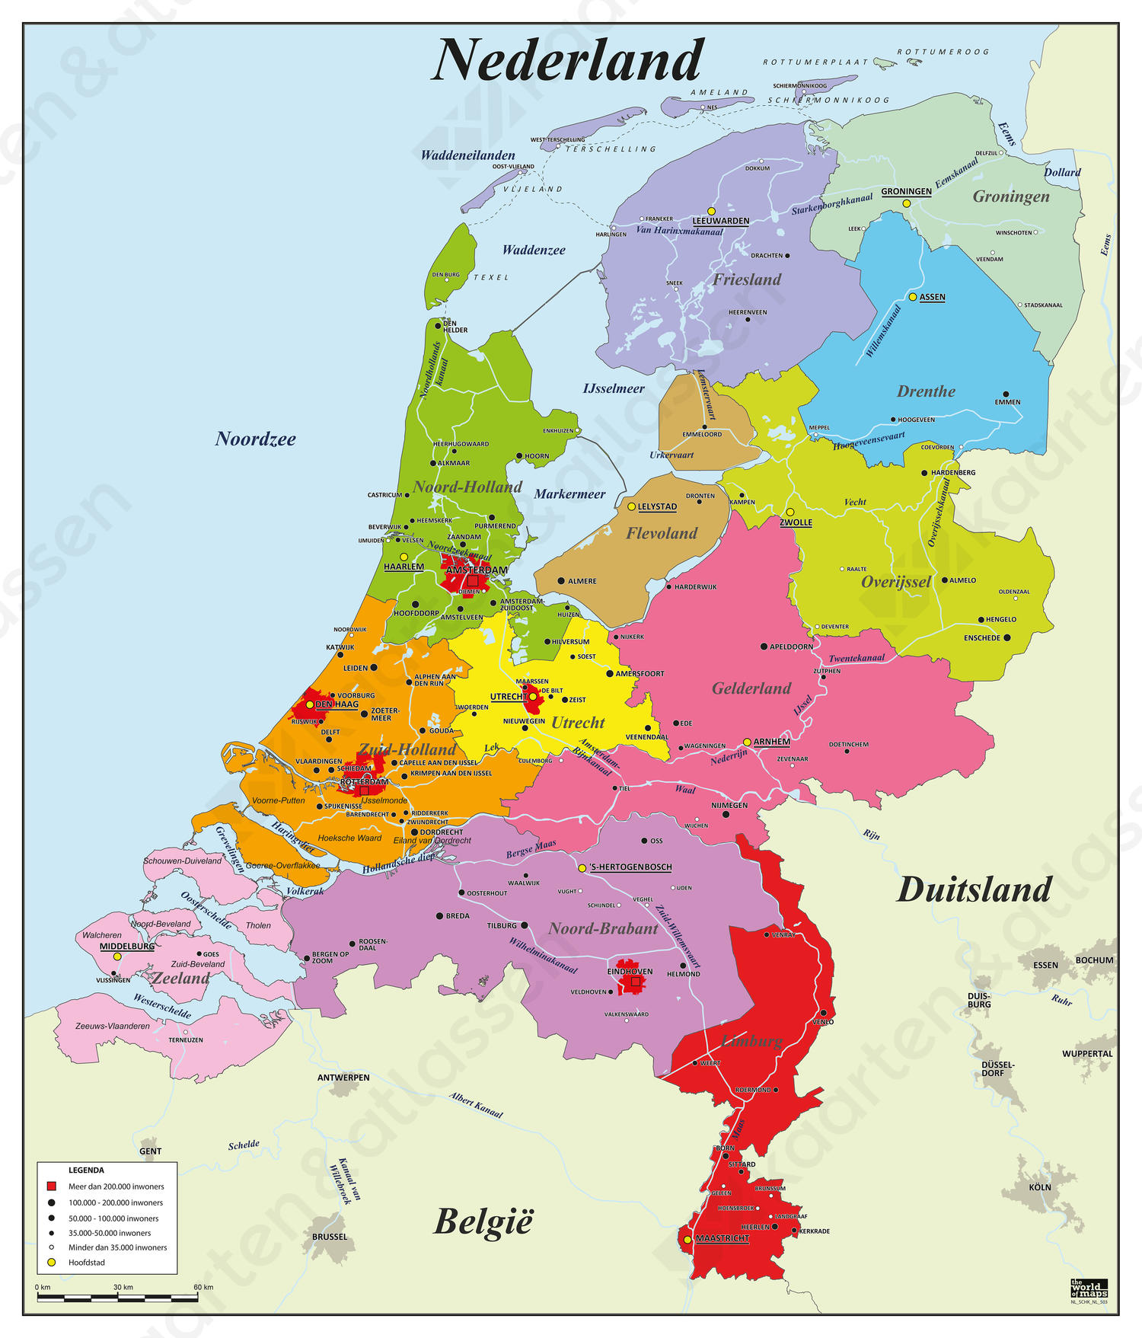
provinces
Zeeland
Utrecht
Gelderland
Noord-Holland
Zuid-Holland
Overijssel
Groningen
Drenthe
Noord-Brabant
Friesland
Limburg
Flevoland
We live here, in Goor.

Slide 5
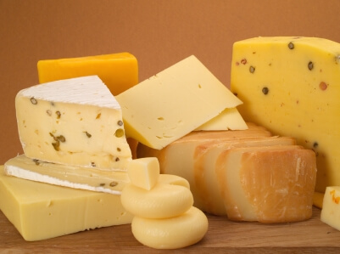
Stuff from the Netherlands
Bread
Syrup waffle
Potato
Sprinkles
Cheese
Clogs/wooden shoes
Stampot/Stew
Tulips
licorice

Slide 6
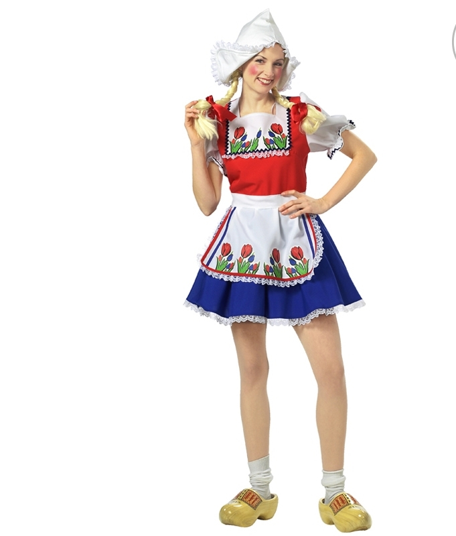
Clothes Netherlands
This is a joke! We don’t dress like this. But foreigners sometimes think we look like this.
Dress
Wooden shoes
Point hat

Slide 7
Greetings
Hey , how are you?
Hi , nice to meet you.

Slide 8
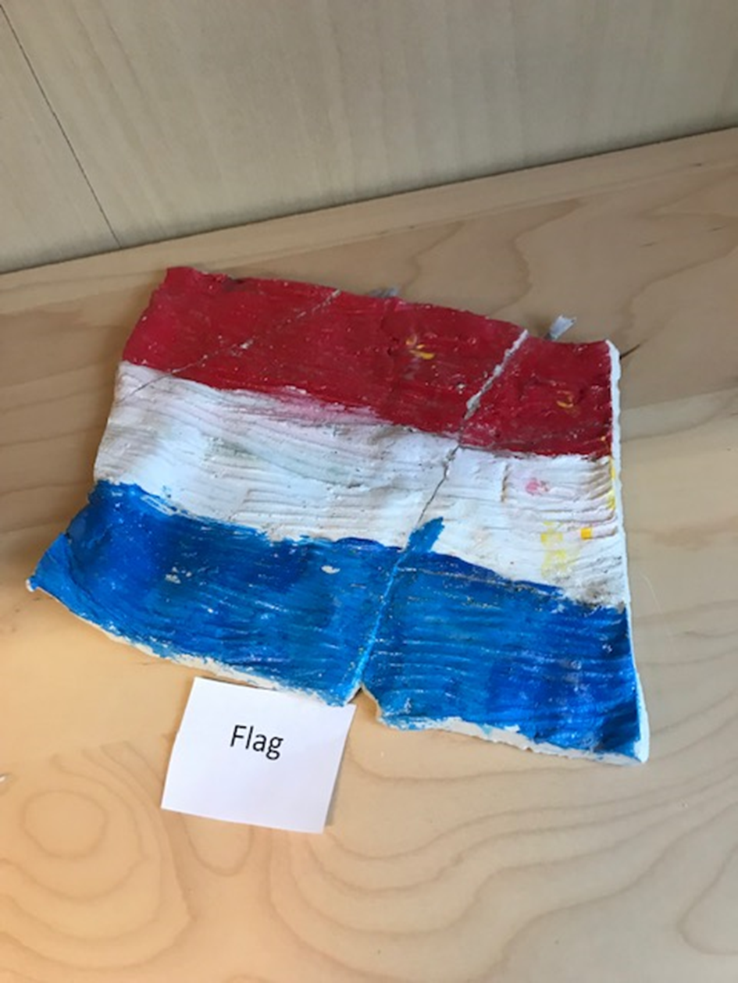
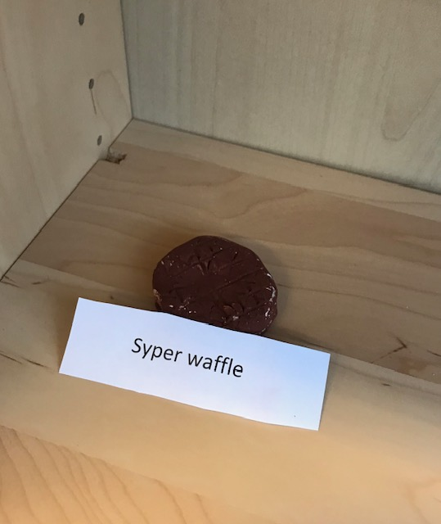
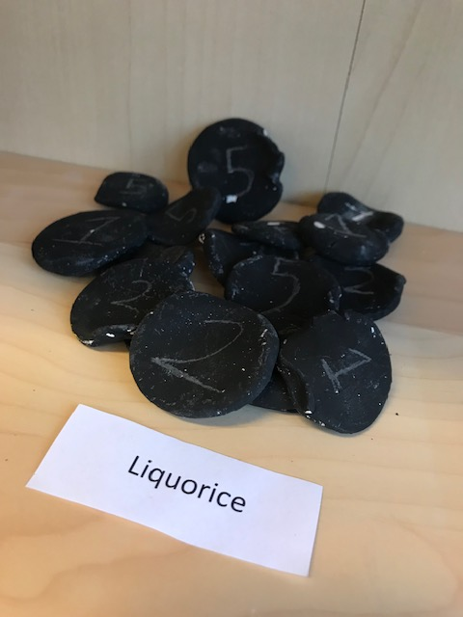
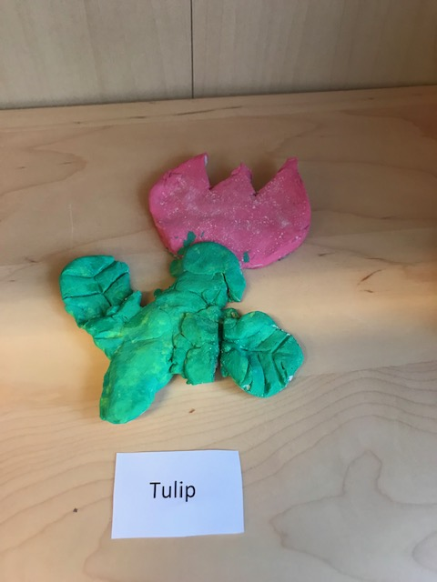
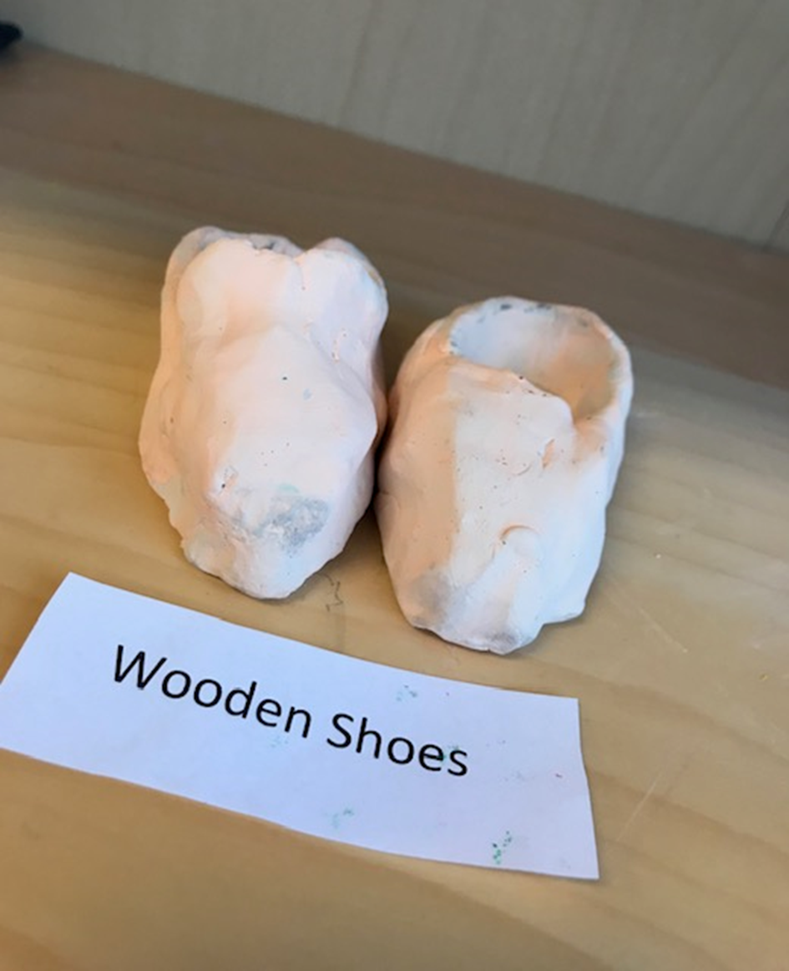
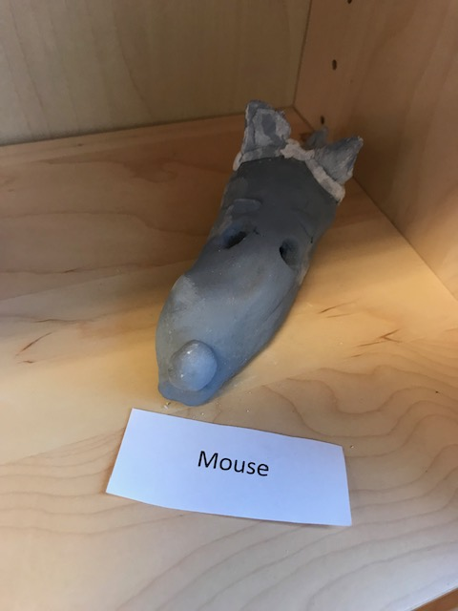
Pictures We made these things. They are made from clay.

Slide 9
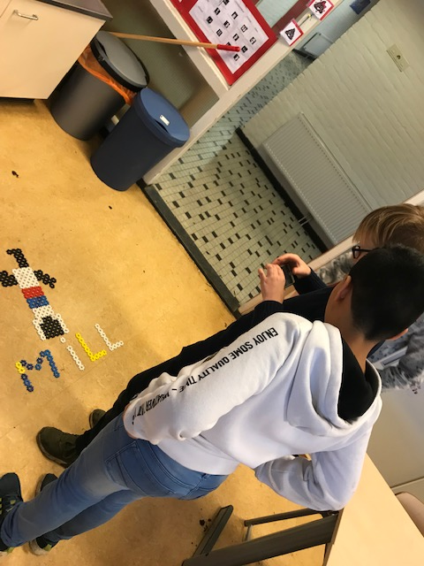
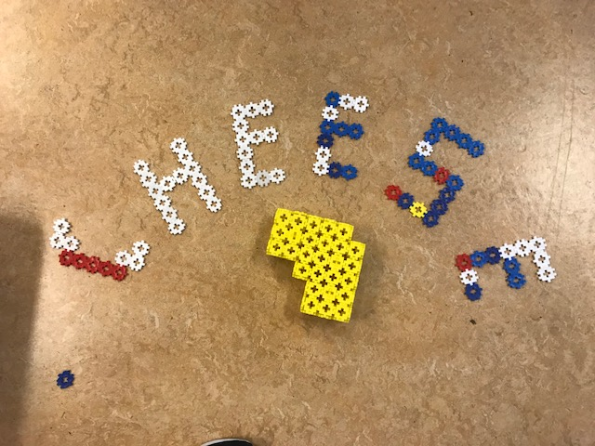
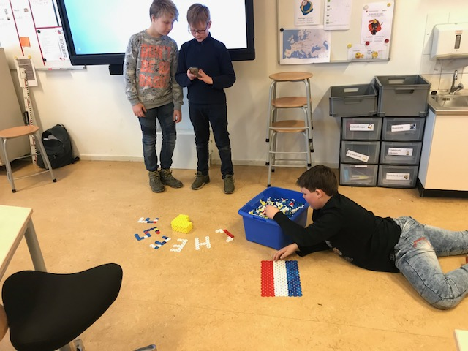
We made a mill, the flag and cheese.

Slide 10
Movies

Slide 12
These boys are named Gijs, Thijs and Sem. These are typical Dutch names

Slide 13
The End!
We hope you liked our presentation!
We hope you learned a lot about our country.
And we learned a lot about your countries!
Thank you so much!
We hope you liked it too!

