Slide 1
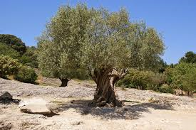
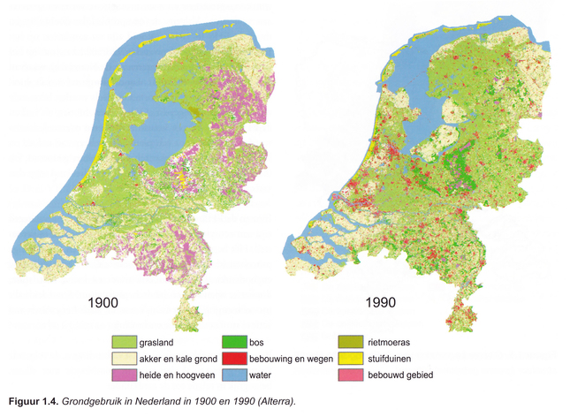
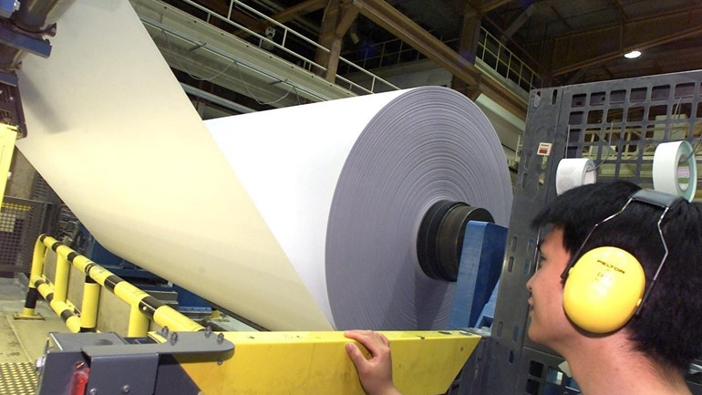
Mini-project land use
Finland, Turkey and The Netherlands

Slide 2
Goals
Introduce yourself in English
Learn about the land use in your own country and the aother countries (map-atlas)
Link the landuse to industry and learn the other countries about is
Learn words in Finnish, Turkish, Dutch and English by using Quizlet
Make and sent a postcard to the other schools to evaluate the project.

Slide 3
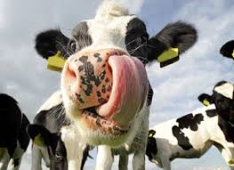
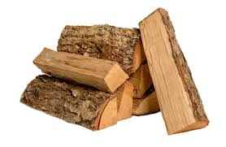
Project LANDUSE
Introducing your school, class and pupils in a short movie
Introducing yourself: name, age, country, hobbies. Present it in a way that fits your theme. (like spots on a cow, lemons in a tree of paperrolls)
Learn words related to the topic in English, Turkish, Finnish and Dutch in different ways
Look at landuse maps in the atlas: choose one. For example: grass in the Netherlands, Wood in Finland and Olives/lemons/oranges in Turkey.
Assignment for the pupils: tell what industry is related to the main landuse in your country. Present it in the way you want (draw, video, make a paper, make an artwork etc)
Evaluate the program by sending selfmade thematic postcards to the other participants and tell them what you likes, disliked and learned from the project.

