Slide 1
Welcome to PortAlegre
Teacher Training Week 2
6-10 November 2017

Slide 2

Getting to know each other (Monday)
Word of welcome
The road of IMPACT
Generates attention in the Netherlands
General introductions
Steering Group Members
Movieclips of each new school
Presentations of schools already in the project
Welcoming dinner (change seats after each course)

Slide 3
structure of the project
Children of the five primary schools
Teachers of five primary schools
Steering group members:
Jasper Kok (Content coördinator)
Anabel Borras (Evaluation)
Gizem Dincer & Savas Gencturk (TTW, Literature)
Antonio Mendez (PR)
Luciana Soldo (Twinspace)
Saxion University supporting staff:
Erica Staverman (Financial support)
Luke Klazema (Student, Social media expert)
Saxion University:
Paul Stuit (Project coördinator)

Slide 4
Goals of the Project
1. Five Teacher tRaining weeks
1. Improving education
2. Setting up small projects between primary school classes
3. Developing internationalisation policy
2. Expand
1. Number of schools (5 – 11)
2. Number of countries (Finland in March)
3. Number of teachers participating (spread the knowledge in the school)
4. Number of children reached

Slide 5
PROJECT SET-UP
Goals: | Input:
Improving education | Video’s schools | Presentations | Conversations | Info workshop
Setting up mini-projects | Key-notes: Multilingualism Professionalism | Presentations | Examples on Twinspace | Examples European teachers.eu
Developing internationalisation policy | Internationalisation scale | Presentations | Info workshop

Slide 6
Location: Instituto Politécnico de Portalegre – Central services
Address: Praça do Municipio - Portalegre
Monday November 6th
17.00 (Paul, Jasper, Antonio) Welcome and first session
Getting to know each other, introducing steering group members
Presentation of the goals of the IMPACT project
Ppt presentations of schools already in the project (presenting their progress on education, internationalisation and mini-projects)
Video presentations of all new schools
20.00 Welcoming dinner

Slide 7

Let’s get it started!
Movieclips of each new school
Introduction
Strenghts and challenges
Presentations of schools already in the project
Goals set on improving education +evaluation
Goals set on developing internationalisation policy +evaluation
Mini-projects
Suggestions new mini-projects

Slide 8
Tuesday November 7th
9.00 Keynote 1: Multilingualism: Mary Ashton - Content and Language Integrated Learning
Centro de Linguas e Culturas – Escola Superior de Educação de Portalegre
10.00 Coffeebreak
10.15 Developing international policy in school (Jasper)
Using internationalisation scale (Translated and sent to every steering group member (SGM))
PDCA model, long & short term goals and actions
11.45 Twinspace presentation (Luke & Luciana)
Using Twinspace during the IMPACT project
13.00 Lunch – Instituto Canteen
14.00 Mini-projects, guided by all SGM (Jasper, Paul)
Start with setting up the mini-projects between classes
Finding partners of different countries
Note: In theme of TTW (Multilingualism & Professionalism)
16.00 Summary of the day (Paul, Antonio, Jasper)
Short presentation of the start of the mini-project
Questions, answers, feedback of the group
16.30 Exploring cultural heritage (Antonio)
20.00 Dinner

Slide 9

3. Developing international Policy
Main question: How to integrate internationalisation in your school and teaching?
1. Assess your level through the internationalisation scale
2. Workshop during TTW:
- Discuss what you want to add short and long term
- Write a plan, with help of the PDCA structure (PDF presentation)
- Think of the different levels of the school it influences
1. Plan (Sabadell) 5. Plan (Portugal)
2. Do (Sabadell & own school) 6. Do (Portugal & own school)
3. Check (Presenting in Portugal) 7. Check (Presenting in the Netherlands)
4. Act (Portugal) 8. Act (the Netherlands)

Slide 10
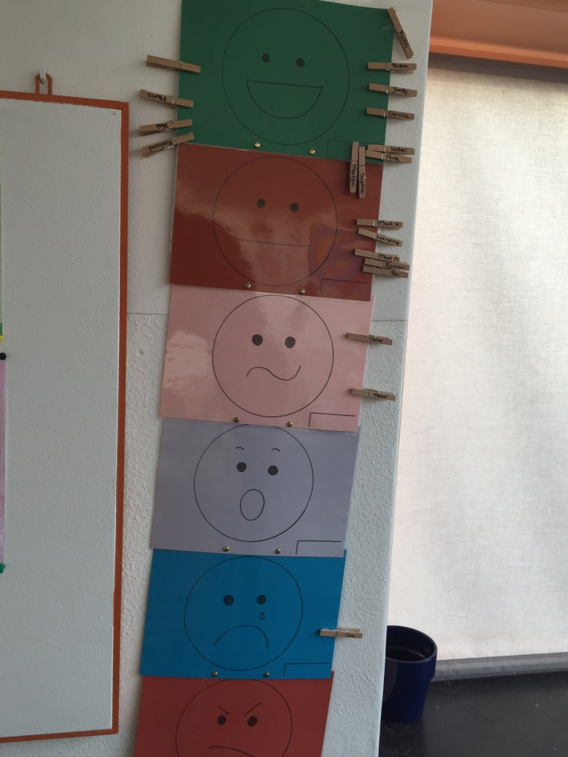
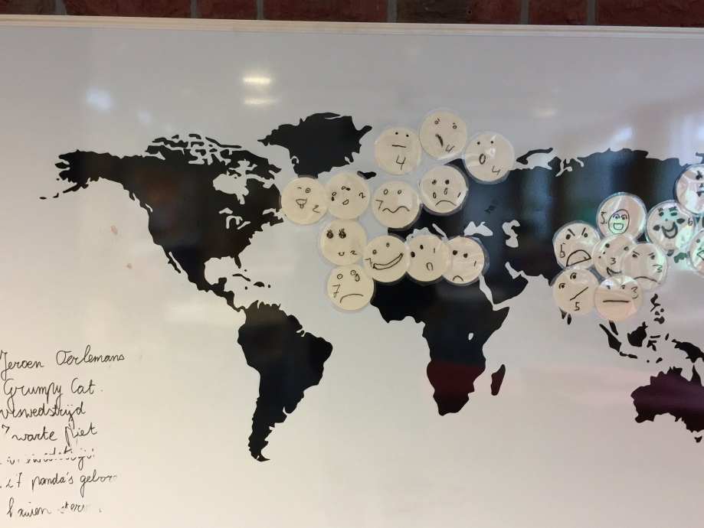
activities
International day
International students
Link internationalisation to school policy, results:
Advice
Product: Emotional barometer
Product: Emotional map of the world
Setting up concrete projects
Teachers (+ intern) will travel to:
Austria
England
Finland

Slide 11
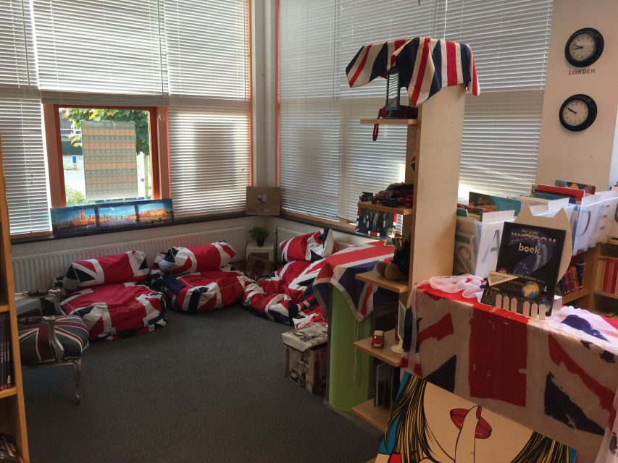
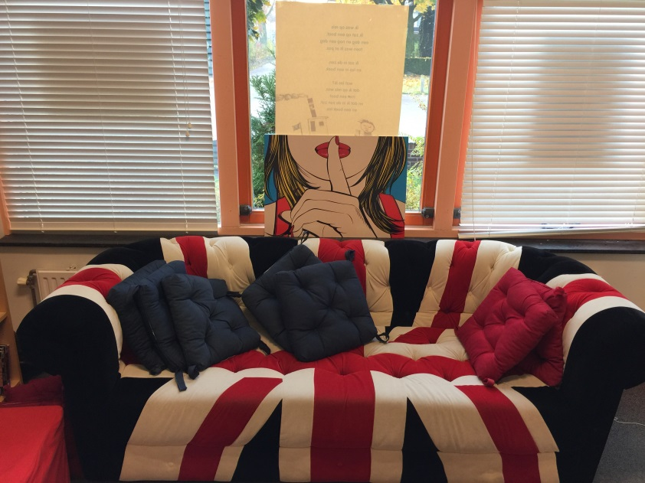
How is internationalisation integrated (1)
Organisation (OPO Hof van Twente):
All 11 schools of our organisation started with Early English
Three have started with undertaking international activities
Annemarie has become English coördinator for all 11 schools of our organisation
Obs Stedeke:
English Lessons
Materials in “the Beep”
Kindergarten (2-4) teaches English too

Slide 12
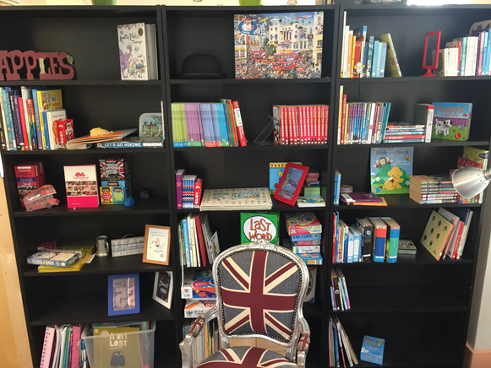

Slide 13
How is internationalisation integrated (2)
World oriëntation projects
Based on IPC
+ internationalisation
+ theme words
+ world map in every class
+ using eTwinning
Wonderwalls in every class
Workspace: Diepenheim & the world
When buying materials: Have Europe on your mind
- Testing English level in groep 7 & 8 (11 & 12 year olds)

Slide 14

How is internationalisation integrated (3)
International day
Tour with teachers from Kenya
Support Cambodja, Haïti, Peru
Children group 6,7 & 8 use “My Languages, A multilingual folder”.
Extra challenging
Enables differentiating
Stimulates creativity
Price: €12,50

Slide 15
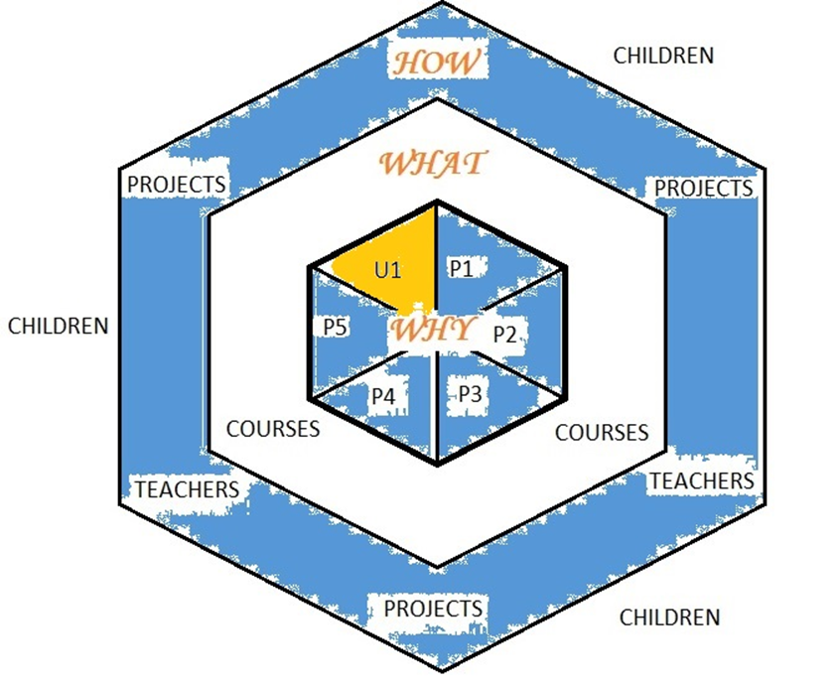
2. Setting up mini-projects

Slide 16
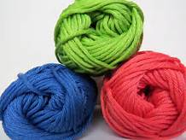
Finding PArtners
2-4 schools
Making a connection
Similar age groups
Everybody needs to be happy in a group

Slide 17
Practical information
Link the project to the themes of the TTW
Examples Keynote Paul, Maria and Andrea
Examples at http://www.european-teachers.eu/products/e-books
Set-up the project (Use the Word form in your e-mail)
Not to big, not to small
Upload on Twinspace (Luke)
Results on Facebook
Finished before the next TTW
New teachers present results in the Netherlands (spread the word)

Slide 18
Wednesday November 8th
8.30 Bus departure for Primary school visit (Antonio)
School: José Régio School
11.30 Literature session (Savas)
Read and discuss provided articles in small groups
Outcome upload on Twinspace
12.50 Bus departure for lunch at school for Tourism
14.00 Mini-projects
Continue developing your project
16.00 Summary of the day (Paul, Anabel, Jasper)
Short presentation of the start of the mini-project
Questions, answers, feedback of the group
16.30 Individual/free evening program

Slide 19
Thursday May 9th
9.00 Key-note 2: Professionalism
Luis Guerra
Teaching and Learning English as an International Language in Portugal: Policy, Practice and Perceptions
From Departamento de Linguística e Literatura – Universidade de Évora
10.00 Coffeebreak
10.15 Social media (Antonio, Luke)
Presenting Facebook page of IMPACT and social media
10.45 Improving education (Jasper)
Set up plans for improving education, With help of weak and strong points
Based on film presentations (good practices) of Monday, Inspired by the people (good ideas) you have met
12.15 Finishing mini-projects
13.00 Lunch – At Institute canteen
14.00 Finishing mini-projects
17.00 – Visiting other sections of the school
20.00 Farewel dinner: Tarro Restaurant

Slide 20
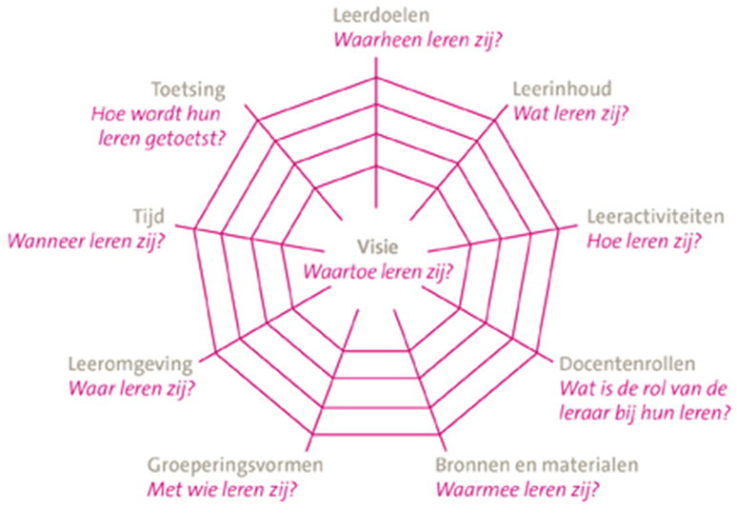
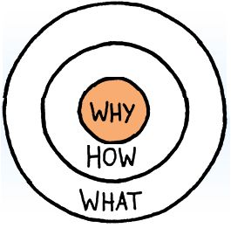
1. IMPROVING EDUCATION

Slide 21
Improving Education
Input:
1. Video presentations
Twinspace
New schools
Presenting strong points & challenges
2. Conversations with other teachers
3. Input before workshop
Inspiration to improve education in your schools, Thursday: Write a plan according to:
Golden circle (Sinek, 2009): Why, how, what?
Didactical Concept (van den Akker, 2003)

Slide 22
CuRrent educational developments
English
Early English from age 4 and up, work together with preschools and kindergarten
Use a practical application for English, for example eTwinning or mini-projects
The learning environment of a child is bigger than a classroom
Connect learning goals to internationalisation
Integrating subjects, for example English and music, social skills etc.
PARENTS
Involvement of parents in education and school organisation
Assist in learning, help decorate the school, use their talents

Slide 23

Differentiation
Teaching at different levels within a classroom
Depending on instructional needs of children
- Assess levels beforehand
No instruction, basic instruction, extra instruction
Mostly combined with system of postponed attention of the teacher
Program/activities for highly gifted children
Integrate children with special educational needs within regular primary schools
Fitting education/inclusive education

Slide 24
Talent focused learning
Put children in situations where they can discover/explore
- For example workshops in school
Start a dialogue with the child about the things they want to learn
Obtain resources, time
Make use of a portfolio to keep track
Use goalsetting theory
In class, for example use a wonderwall
Create time by integrating subjects, with help of projects. Each child can contribute to its strength.

Slide 25
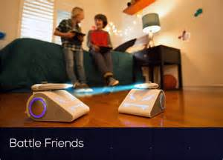

Digitalising education
Use of tablets, apps for added content
Programming for all ages
- Beebot, Cubetto, Coji for youngest learners (3+)
- Lego Boost en Mindstorms, Raspberry pi, Bendoo-box, Wink, Ozobot & Codeybot
Bring your own device projects
QR codes, augmented reality
Virtual Reality
3D-printing, doodle3D (4+) and drawing

Slide 26
Friday
10.00 – Welcoming word for the last day
11.00 Presentations (Jasper)
Mini projects (per mixed group)
Next step internationalisation policy (per school)
Plan for improving education (per school)
13.00 Evaluation (Anabel, Paul)
Making arrangements, Declarations, Certificates
Departure!

