Slide 1
Welcome to Stigliano
Teacher Training Week 4
5 – 9 November 2018
European Citizenship and New Teacher Education

Slide 2
Tuesday November 6th
08:30 Departure from hotels to school by Italian teachers’ cars
09:00 Official Headmistress welcome.
09.30 Welcome from the pupils in the school hall
10:30 Coffee break
11:00 (Paul, Bernardien) Welcome and first session
Getting to know each other
Presentation of the goals of the IMPACT project
Split into 2 groups, short presentations about:
improving education,
developing internationalisation policy
mini-projects (and 1 new school) per school.
(Luke, Luciana) Introducing Twinspace and eTwinning platform (Luke)
13.00 Introducing mini-projects
14:00 Lunch in the school canteen
15:00 Visit in the classes
16:30 (Ezgi) Literature presentation
20:30 Dinner Antico Pastificio Restaurant

Slide 3

Getting to know each other (Monday)
Word of welcome
The road of IMPACT
New schools, new country
General introductions
Steering Group Members
Divide into 2 groups
- Movieclips of each new school
- Presentations of schools already in the project
Welcoming dinner at Samos restaurant (20.00 h.)

Slide 4
MINGLE
What do you know about the project?
What are your expectations?
How is the project visible (or will it be) in your school?

Slide 5
structure of the project
Children of the sixteen primary schools
Teachers of sixteen primary schools
Steering group members:
Jasper Kok & Bernardien Nijhof (Project coördinator & content coördinator)
Anabel Borras (Evaluation)
Ezgi Ferek (TTW, Literature)
Antonio Mendez (PR)
Luciana Soldo, Rosaria Giglietta (Twinspace)
Saxion University supporting staff:
Erica Staverman (Financial support)
Luke Klazema (Student, Social media expert)
Saxion University:
Paul Stuit (Project coördinator)

Slide 6
Goals of the Project
1. Five Teacher tRaining weeks
1. Improving education
2. Setting up small projects between primary school classes
3. Developing internationalisation policy
2. Expand
1. Number of schools (5-16)
2. Number of countries (Finland)
3. Number of teachers participating (spread the knowledge in the school)
4. Number of children reached

Slide 7
PROJECT SET-UP
Goals: | Input:
Improving education | Video’s schools | Presentations | Conversations | Info workshop
Setting up mini-projects | Key-notes: European Citizenship New Teacher Education | Presentations | Examples on Twinspace | Examples European teachers.eu
Developing internationalisation policy | Internationalisation scale | Presentations | Info workshop

Slide 8

Let’s get it started!
Movieclips of each new school
Introduction
Strenghts and challenges
Presentations of schools already in the project in 2 groups
Goals set on improving education +evaluation
Goals set on developing internationalisation policy +evaluation
Mini-projects
Suggestions new mini-projects

Slide 9
Group Division
Group 1 (Paul Stuit)
Pontus school, Joan Salares i Pla,
Antalya Ted College, Antoni Brusi,
obs Wiekslag, Jose Regio,
Bonfim, Galicchio, Salandra
Group 2 (Jasper Kok):
Serraparera, Bursa Sinav College,
Bursa Tan College, Obs Stedeke,
obs Puntdak, Crato,
Brancato, Montano

Slide 10
Wednesday November 7th
09:00 Departure from hotels to school by Italian teachers’ cars
09:30 (Mrs. Debora Infante – Basilicata Director of Education Studies) Facing new global challenges in teachers education.
10:30 Coffee break
10.45 Start mini-projects, finding partners, guided by Steering Group Members (SGM) (Jasper, Paul) - Start with setting up the mini-projects between classes. Finding partners of different countries
Note: In themes of TTW: European Citizenship and New Teacher Education.
11:45 (Mrs. Margaret RASULO - Professor at the University of Naples L'Orientale) Sustaining language education through innovative methodologies.
Laboratory.
12.45 Continuing mini-projects
13:30 Lunch in the school canteen.
14:30 (Jasper, Bernardien) Developing internationalisation policy
16.30 Mini-projects
18:30 (optional) Visit to the CEA - Center for Environmental Education. Theater laboratory
21:00 Dinner Chiato di Luna restaurant

Slide 11
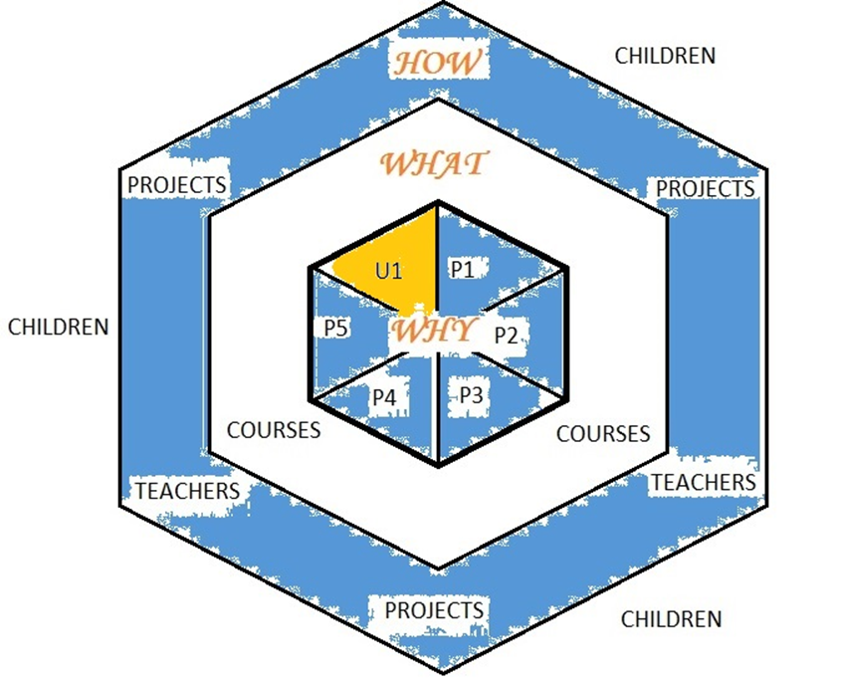

1. Setting up mini-projects www.european-teachers.eu

Slide 12

Cognitive learning
Meta cognitive skills

Slide 13
Theme 1: European Citizenship
European citizens: 1 self, many identities, some more primary
National or local stronger identity
Being a European Citizen = abstract categorising
Not sense of common identity and belonging
What circumstances are needed to let E.C. become an important part of one self?
We are agents, doing boundary work
But: National and local contexts provide many resources
With mini-projects: Take a step to let E.C. become a more important part of a child’s self

Slide 14
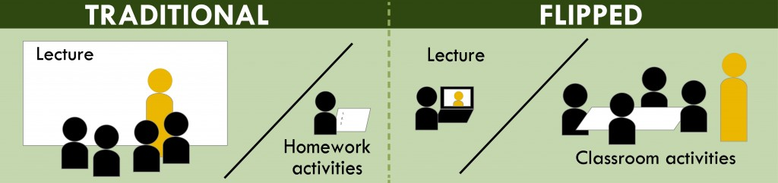
Theme 2: New Teacher education
Focused on learning by blended and rich media learning
Blended learning: a portion of the traditional face-to-face instruction is replaced by web-based online learning.
Flipping the classroom:
Focused on 21st century skills
What do we look for in a European teacher that makes a difference towards 2038?

Slide 15
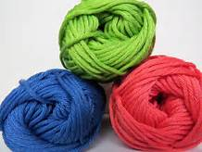
Finding PArtners
Groups of 3 or 4, separate countries in each group
Only 1 teacher of each school in 1 group
Making a connection
Similar age groups
Everybody needs to be happy in a group
Set-up the project (Use the Word form from Twinspace)

Slide 16
Practical information
Link the project to the themes of the TTW (European Citizenship and New Teacher Education)
Examples at http://www.european-teachers.eu/products/e-books
Include a planning with evaluation in it
Not to big, not to small
Upload on Twinspace (Luciana, Luke)
Results on Facebook, Twinspace
Finished before the final week of February
Evaluations (kids and teachers) ready and sent to Anabel at the latest in the first week of March.
New teachers present results in next TTW (spread the word)

Slide 17
2. Developing internationalisation Policy
Main question: How to integrate internationalisation in your school and teaching?
1. Assess your level through the internationalisation scale
2. Workshop during TTW:
- Discuss what you want to add short and long term
- Write a plan, with help of the PDCA structure (PDF presentation)
- Think of the different levels of the school it influences
1. Plan (Netherlands) 6. Do (Italy & own school)
2. Do (own school) 7. Check (Presenting next TTW)
3. Check (Presenting in Italy) 8. Final act: evaluation (next TTW)
4. Act (Italy) 9. Final plans for the future (next TTW)
5. Plan (Italy)

Slide 18
Materials availabe
New schools:
Internationalisaton scale (Twinspace)
Empty document to develop internationalisation policy (Twinspace)
Partner schools:
Internationalisaton scale (Twinspace)
Filled in documente to develop internationalisaton policy (Twinspace)
Evaluation of the goals (presentation from Monday evening)
Empty document to develop internationalisation policy (Twinspace)

Slide 19
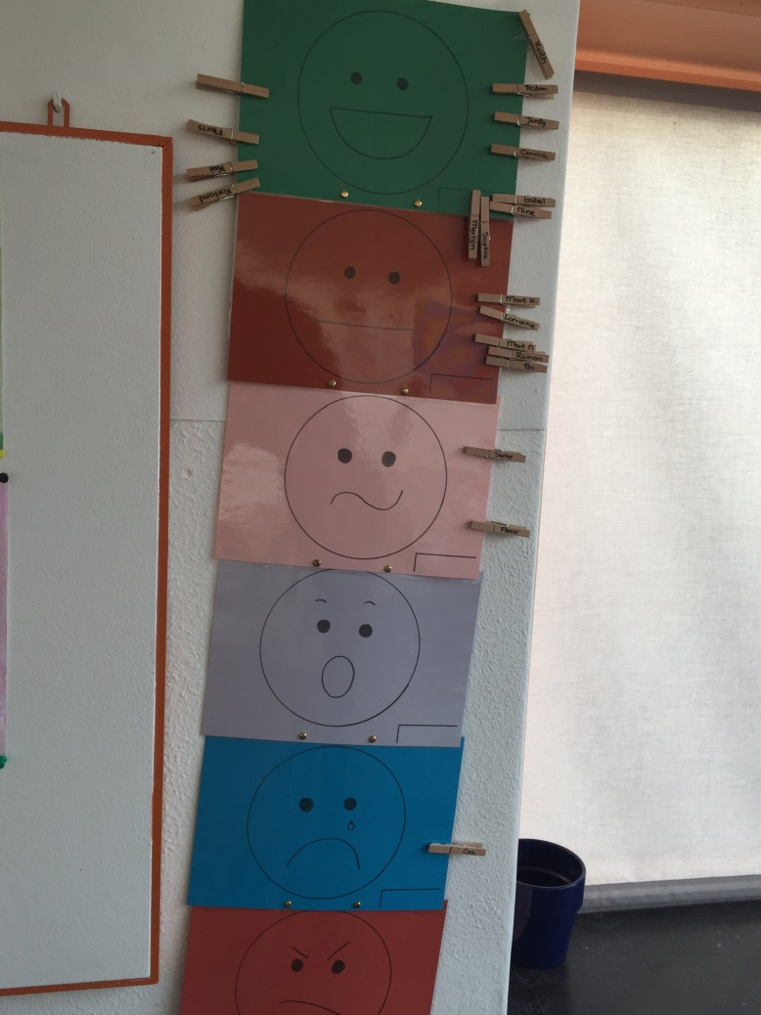
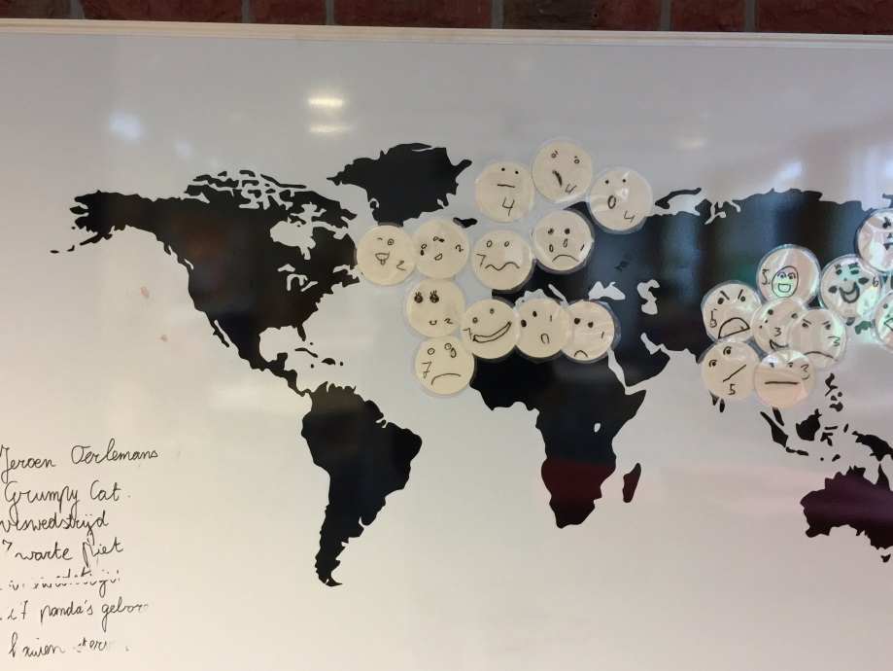
activities
International day
International students
Link internationalisation to school policy, results:
Advice
Product: Emotional barometer
Product: Emotional map of the world
Setting up concrete projects
Teachers (+ intern) will travel to:
Austria
England
Finland

Slide 20
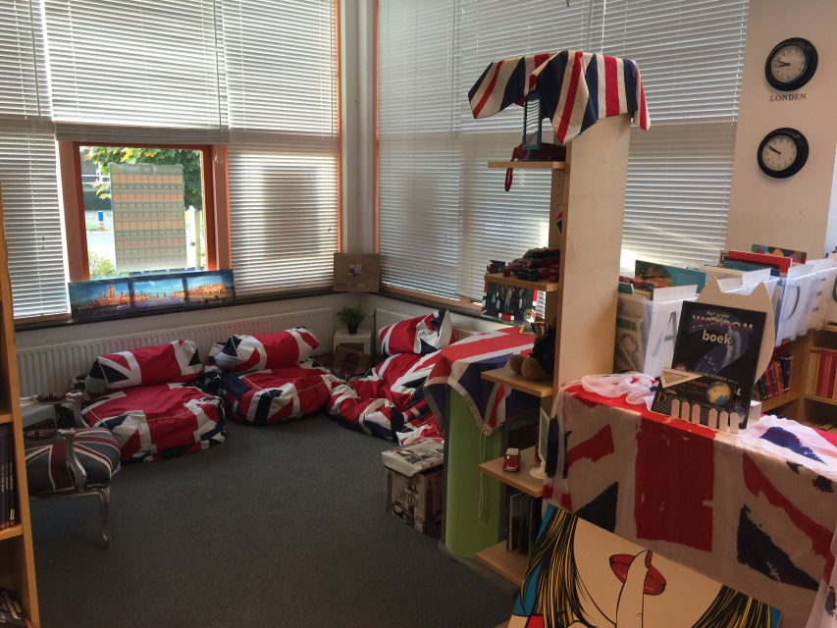
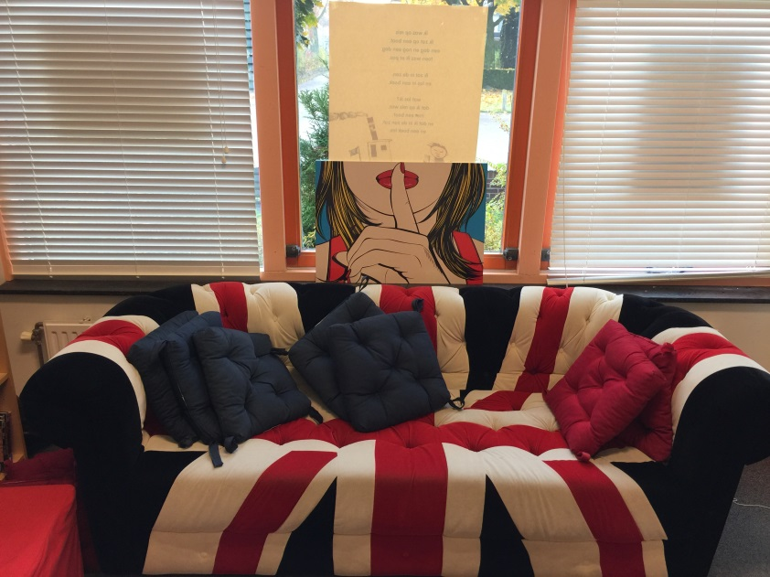
How is internationalisation integrated (1)
Organisation (OPO Hof van Twente):
All 11 schools of our organisation started with Early English
Three have started with undertaking international activities
Annemarie has become English coördinator for all 11 schools of our organisation
Obs Stedeke:
English Lessons
Materials in “the Beep”
Kindergarten (2-4) teaches English too

Slide 21
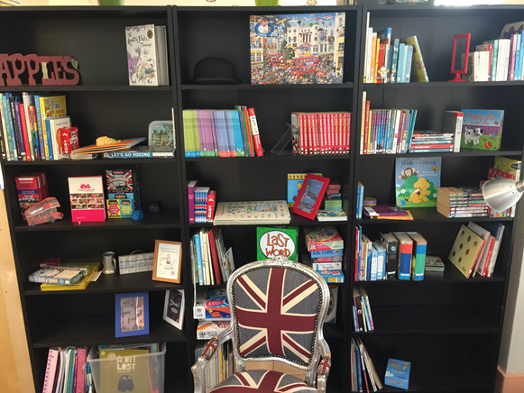

Slide 22
How is internationalisation integrated (2)
World oriëntation projects
Based on IPC
+ internationalisation
+ theme words
+ world map in every class
+ using eTwinning
Wonderwalls in every class
Workspace: Diepenheim & the world
When buying materials: Have Europe on your mind
- Testing English level in groep 7 & 8 (11 & 12 year olds)

Slide 23
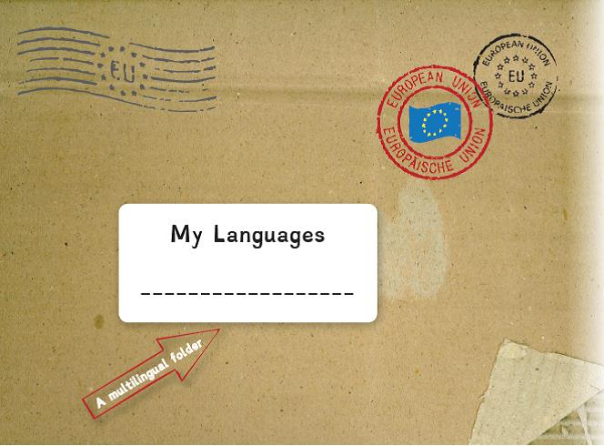
How is internationalisation integrated (3)
International day
Tour with teachers from Kenya
Support Cambodja, Haïti, Peru
Children group 6,7 & 8 use “My Languages, A multilingual folder”.
Extra challenging
Enables differentiating
Stimulates creativity
Price: €12,50

Slide 24
Points of Attention
Save your developing internationalisation plan on Twinspace.
Give it the name of your school!
There is a separate folder for it. Ask Luciana or Luke

Slide 25
Thursday November 8th
08:00 (Jasper & Bernardien) Improving education – writing the plan
10.00 Coffeebreak
10.15 (Anabel) Evaluation
11.00 Presentation of mini-projects
11.30 Presentation of improving education and developing internationalisation policy in 2 groups.
12.00 Handing out certificates
12.15 Tour to Matera. Visit to Matera’s Stone
14:00 Lunch L’Abbondanza Lucana” typical restaurant
15.30 Matera and visit to “Sassi di Matera”
18:00 Bus back to Stigliano
21:00 Dinner Mariano Restaurant

Slide 26
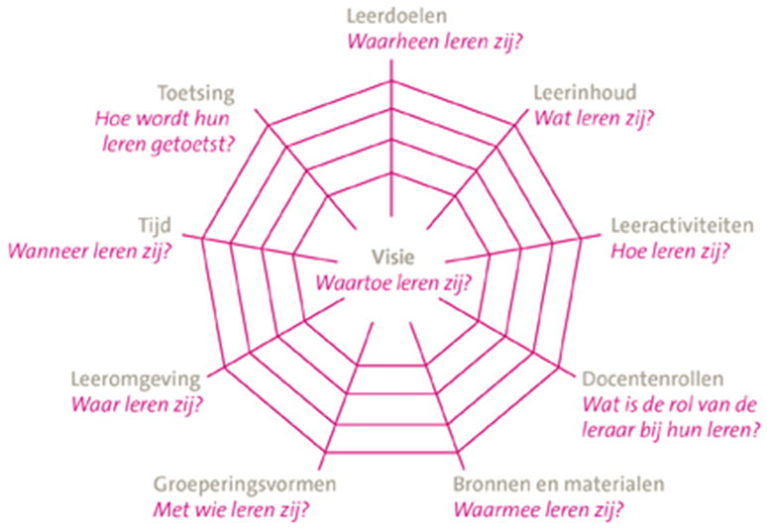
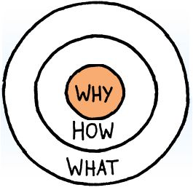
3. IMPROVING EDUCATION

Slide 27
Improving Education
Input:
1. Video presentations
Twinspace
New schools
Presenting strong points & challenges
2. Conversations with other teachers
3. Input before workshop
Inspiration to improve education in your schools, Thursday: Write a plan according to:
Golden circle (Sinek, 2009): Why, how, what?
Didactical Concept (van den Akker, 2003)

Slide 28
CuRrent educational developments
English
Early English from age 4 and up, work together with preschools and kindergarten
Use a practical application for English, for example eTwinning or mini-projects
The learning environment of a child is bigger than a classroom
Connect learning goals to internationalisation
Integrating subjects, for example English and music, social skills etc.
PARENTS
Involvement of parents in education and school organisation
Assist in learning, help decorate the school, use their talents

Slide 29

Differentiation
Teaching at different levels within a classroom
Depending on instructional needs of children
- Assess levels beforehand
No instruction, basic instruction, extra instruction
Mostly combined with system of postponed attention of the teacher
Program/activities for highly gifted children
Integrate children with special educational needs within regular primary schools
Fitting education/inclusive education
- Personalising education

Slide 30
Talent focused learning
Put children in situations where they can discover/explore
- For example workshops in school
Start a dialogue with the child about the things they want to learn
Obtain resources, time
Make use of a portfolio to keep track
Use goalsetting theory
In class, for example use a wonderwall
Create time by integrating subjects, with help of projects. Each child can contribute to its strength.

Slide 31
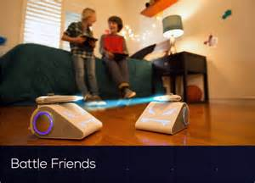
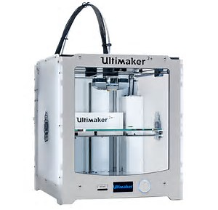
Digitalising education
Use of tablets, apps for added content
Programming for all ages
- Beebot, Cubetto, Coji for youngest learners (3+)
- Lego Boost en Mindstorms, Raspberry pi, Bendoo-box, Wink, Ozobot & Codeybot
Bring your own device projects
QR codes, augmented reality
Virtual Reality (ClassVR)
Drones
VLOG
3D-printing, doodle3D (4+) and drawing

