Slide 1
CLIL

Slide 2
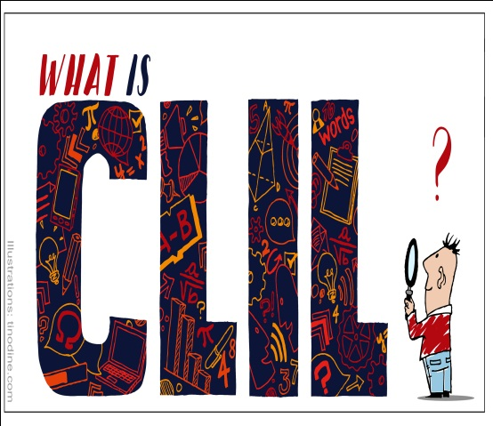
CLIL stands for Content and Language Integrated Learning and refers to teaching subjects such as science, history and geography to students through a foreign language.

Slide 3
The definition of CLIL has developed a lot in these last 10/15 years.
More and new definitions are adding to the old ones.

Slide 4
CLIL “a dual-focussed educational approach in which an additional language is used for learning and teaching of both content and language with the objective of promoting both content and language mastery to pre-defined levels” (Marsh, Mehisto, Wolff and Frigols Martin 2010: 11).
“CLIL is a developing, flexible concept where content (eg non-language subject/s, cross-curricular themes and holistic issues) and foreign languages - are integrated in some kind of mutually beneficial way so as to provide motivating, value-added experiences to educational outcomes for a wide range of students.”
Do Coyle (University of Nottingham

Slide 5
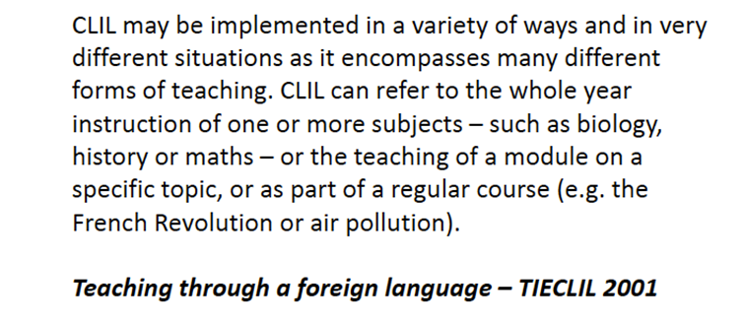
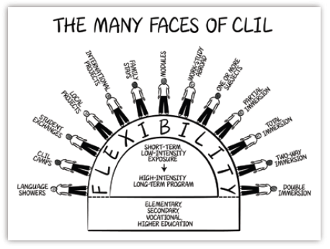
The many faces of CLIL

Slide 6
Five definitions of CLIL
CLIL is a member of the Curriculum Club.-"Content and Language Integrated Learning (CLIL), in which pupils learn a subject through the medium of a foreign language……“
CLIL has a dual focus.-CLIL refers to situations where subjects, or parts of subjects, are taught through a foreign language with dual-focused aims, namely the learning of content, and the simultaneous learning of a foreign language".
CLIL buys us time.-"It [CLIL] provides exposure to the language without requiring extra time in the curriculum".
CLIL causes change - and you don't need to be a genius to benefit from it.-"…an approach to bilingual education in which both curriculum content (such as science or geography) and English are taught together. It differs from simple English-medium education in that the learner is not necessarily expected to have the English proficiency required to cope with the subject before beginning study". (Graddol D. English Next, British Council Publications, 2006)
CLIL motivates-"CLIL is about using languages to learn………..It is about installing a 'hunger to learn' in the student. It gives opportunity for him/her to think about and develop how s/he communicates in general, even in the first language".
(Marsh, Marsland & Stenberg, 2001)

Slide 7
Why use CLIL?
It provides reasons for learning and improving the foreign language level, because the understanding of the subject content is compulsory.
It focuses on and assesses the subject content, so the learner is not being assessed on his/her mastery of the Past Simple (for example) but rather his/her ability to use it in the appropriate places.
It gives students a feeling of real achievement. They are coping with, and talking and writing about, complex material in the foreign language.
Because the teachers would have to adjust their methodology to ensure that the students were understanding the content.
Teachers would not be able to simply 'transmit' the content, assuming that their audience understood. They would have to think of other means (group work, tasks, etc) which would result in an increase of the skill-based focus of the learning.
The educational materials (textbooks) would also have to reflect this approach.
The pupils would be learning language that was more clearly focused on, and related to, the subject matter that they needed to learn.
CLIL is not confined to higher-achieving students. It is not an approach for the elite. It fits in perfectly with a mixed-ability philosophy.

Slide 8
CLIL in the District….
The Castelo Branco Polytechnic Institute (IPCB) is a public higher education institution in Portugal.
The Higher School of Education (Escola Superior de Educação – ESE) is one of IPCB’s faculties and some of its staff is to be directly involved in the CLIL4CHILDRENproject through its graduation and post-graduation programmes inteacher training, sports and social education and through the IPCB’s Interdisciplinary Language, Culture and Education Centre (CILCE).
ESE and CILCE are experienced in applied research in the areas of teacher education, intercultural education, foreign languages, reading promotion and children’s and young adult literature.
ESE has an extensive educational network in the Beira Baixa region, with Spanish institutions involved in teacher training and reading promotion, and with European education institutions through its many EU-funded projects in the above areas.

Slide 9
Fundão is located in a valley called “Cova da Beira” in Castelo Branco district between two mountains Gardunha and Estrela (the highest mountain in Portugal).
Its teaching levels rangesfrom Preschool to MiddleSchool (3 – 15 years of age),covering a total area of 700,20Km2, with 29 213 inhabitants.There are11 kindergartens, 13 primary schools, 1 Bilingual Primary school and 2 middle schools. It alsohas three Special Need Departments. Currently it has 1300 pupils, 135 teachers and 72 staff.
The pupils are given a solid grounding in the core subjects and they have the opportunity to be involved in a variety of activities including projects, clubs, debates, music, drama, sports, ICT, field work and educational trips. Parents always participate in school projects and activities.
Through the year the school library has several interesting activities for the pupilsin the different school levels. Authors, illustrators, journalists, politicians and othersoften cometo school and work with the pupils.
Since 2011/2012 EB1 NossaSenhora da Conceição has been a Bilingual Primary School. It has currently got 96 pupils enrolled, 8 teachers and 2 school helpers. English is taught through the Social Studies and Art/Craft curriculum using the CLIL methodology. All the teachers involved in this bilingual project have done teacher training courses in CLIL.

Slide 10
https://www.facebook.com/Kiitos-214500301903884/
PROJECT DESCRIPTION Kiitos@21st Century Preschools is an early second language learning (ESLL) project, which aims to promote a High-quality Early Childhood Education, in Portugal and in other European Countries, connecting different pedagogical approaches to support children’s global development, preparing and equipping them for the 21st century challenges. The project “Kiitos@21st Century Preschools” will be established as an “action research” project, where teachers and researchers from the partnership team will develop an integrated approach to improve ESLL (Early Second Language Learning), Music Learning and 21st Century Skills in Early Childhood Education..
PROJECT TITLE PARTNERSHIP Audiation Institute, Italy Cucurova University, Turkey Malopolska Wyzsza Szkola Ekonomiczna w Tarnowie (MWSE), Poland DGE/MEC Direção Geral de Educação – Ministério da Educação e Cultura Instituto Politécnico de Portalegre (IPP), Portugal Associação Portuguesa de Professores de Inglês (APPI), Portugal Agrupamento de Escolas de Ponte de Sor (AEPS), Portugal Associação de Pais e Encarregados de Educação do Agrupamento de Escolas de Ponte de Sor (APEEAEPS), Portugal COORDINATOR ORGANIZATION Município de Ponte de Sor, Portugal
Audiation Institute, Italy Cucurova University, Turkey Malopolska Wyzsza Szkola Ekonomiczna w Tarnowie (MWSE), Poland DGE/MEC Direção Geral de Educação – Ministério da Educação e Cultura Instituto Politécnico de Portalegre (IPP), Portugal Associação Portuguesa de Professores de Inglês (APPI), Portugal Agrupamento de Escolas de Ponte de Sor (AEPS), Portugal Associação de Pais e Encarregados de Educação do Agrupamento de Escolas de Ponte de Sor (APEEAEPS), Portugal.

Slide 11
https://www.youtube.com/watch?v=dFuCrxRobh0

Slide 12
Art Illusion Exercise
Feedback

