Slide 1
Mometta III
eTwinning project: On the Track of Our Recent Past
II. osnovna škola Čakovec, Croatia
Teacher: Iva Naranđa
Made by: Marko Mihoci
April 2016

Slide 2
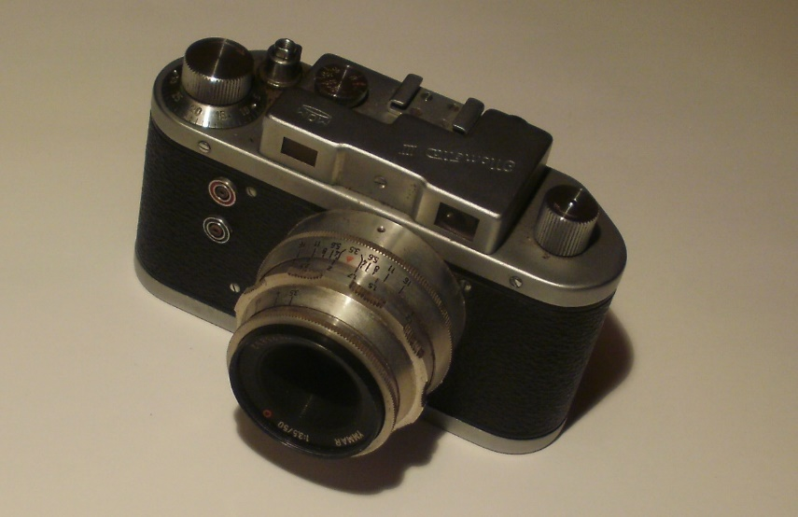
Mometta III
The Mometta is a camera made by MOM (Magyar Optikai Művek/Hungarian Optical Works) in Budapest.

Slide 3
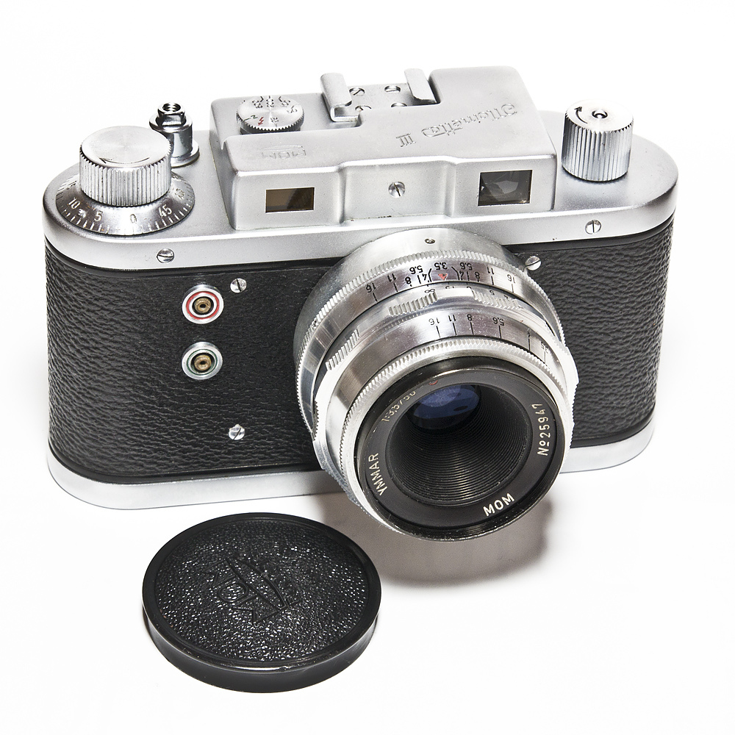
Mometta III
It is sometimes qualified as a Leica copy, even if its appearance is very different. It has a focal plane shutter from 1/25 to 1/500s, and takes pictures in 24×32mm format.

Slide 4
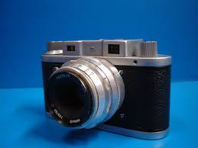
Mometta III
The Mometta III and Mometta Junior have an M42 interchangeable lens, although the Junior does not have a rangefinder.

Slide 5
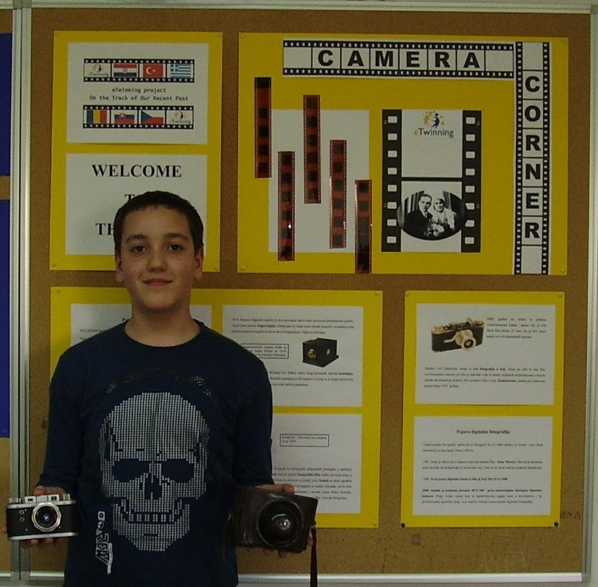
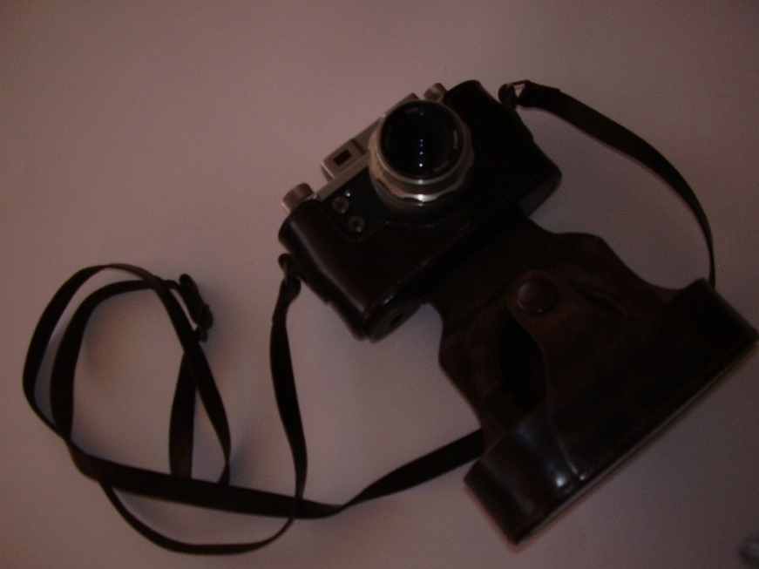
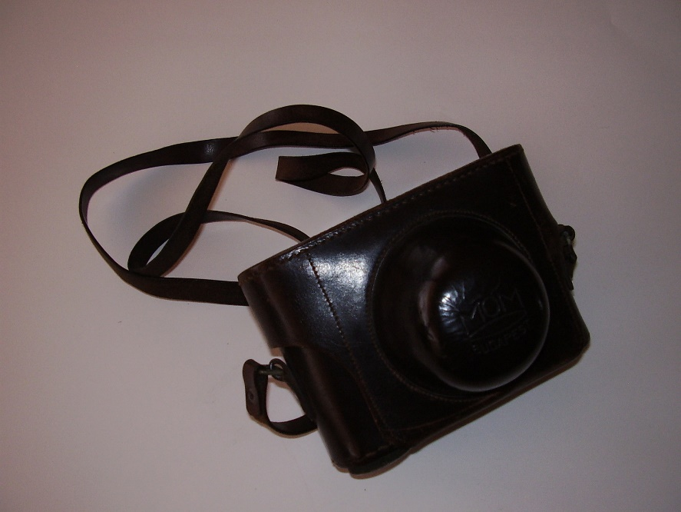
Source
http://camerapedia.wikia.com/wiki/Mometta

Slide 6
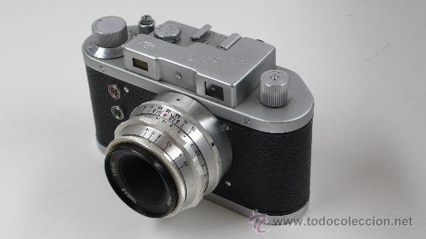
Thanks for your attention

