Slide 1
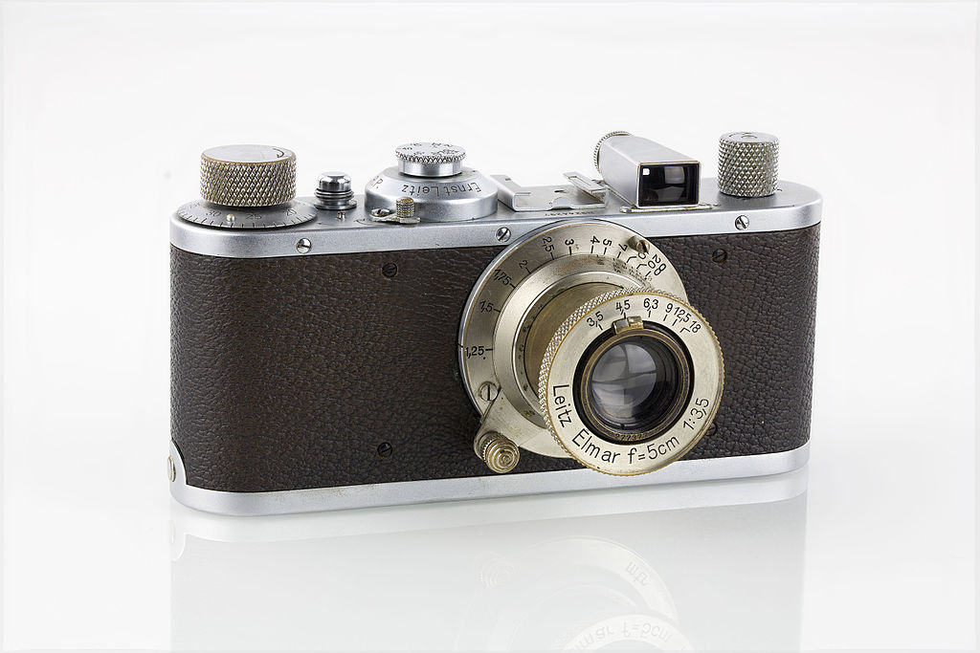
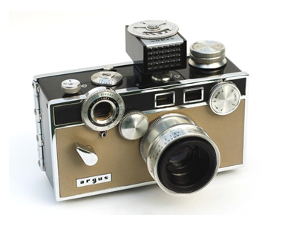
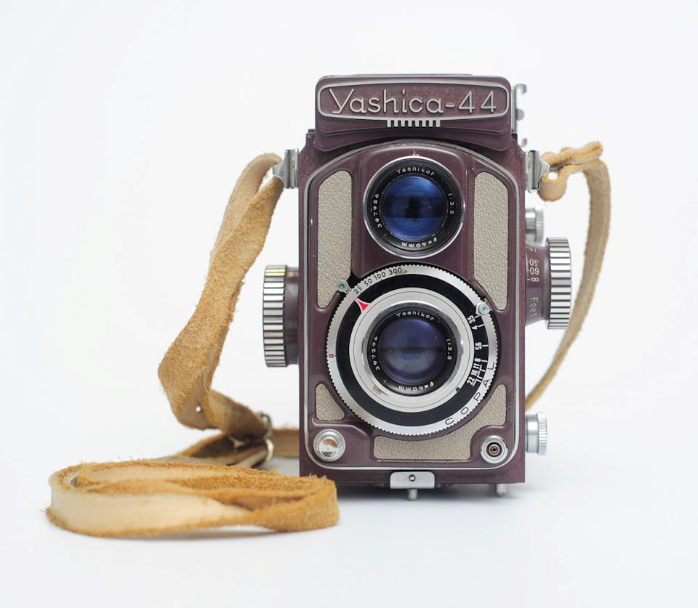
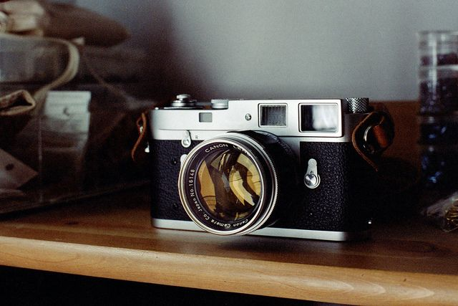
VINTAGE CAMERAS

Slide 2
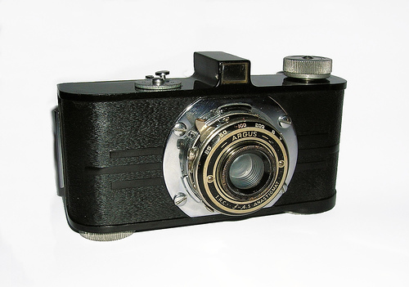
Argus A
Focus Type: 2 Position (6ft - 12ft and 12ft - Infinity, later 6ft - 18ft and 18ft - Infinity)
Years Manufactured: 1936 - 1941
Lens Speed: f/4.5 anastigmat
Aperture Settings: f/4.5, 5.6, 8, 11
Shutter Speeds: 1/200th sec, 1/100, 1/50, 1/25, B(ulb), T (imeExtinction)

Slide 3
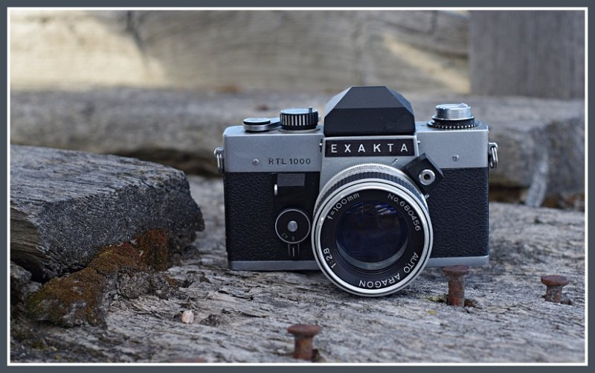
Exakta RTL 1000
TYPE: 35mm eye-level single lens reflex.
MANUFACTURER: Kombinat VEB Pentacon Dresden, former East Germany.
LENS: 50mm f/1.8 Meyer Optik with interchangeable bayonet mount, stops to f/16, focusing to 14 in.
HUTTER: Metal focal-plane with speeds from 8 to 1/1000 sec plus B, FPX sync, self-timer.

Slide 4
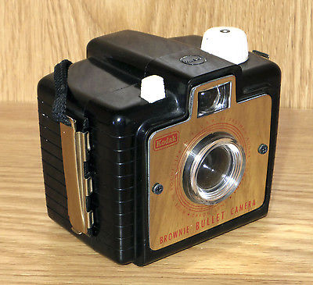
Kodak Brownie Bullet
Type: Solid body eyelevel rollfilm
Introduced: Sept 1957
Discontinued: 1964
Film size: 127
Picture size: 1 5/8 X 2 1/2"
Manufactured: US, Brazil
Lens: Dakon
Shutter: Rotary

Slide 5
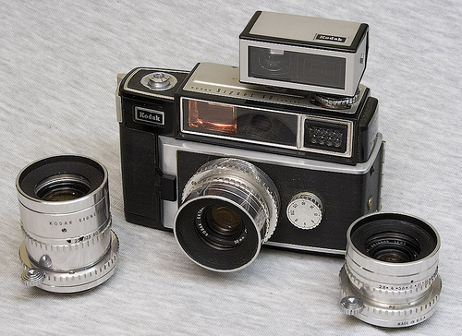
Kodak Signet 80
Lenses: 90mm, f/4.0 Kodak Ektanar, Lumenized.
SPECIAL SHUTTER-set as film is advanced
SPEEDS - 1/4, 1/8, 1/15, 1/30, 1/60, 1/125, 1/250 and "B"

Slide 6
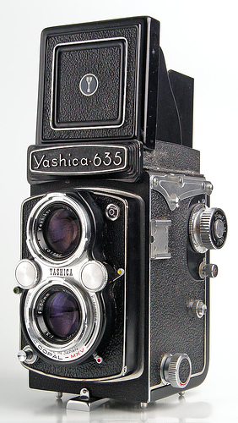
Yashica-635
Yashica-635 is a double format film TLR camera made by Yashica and introduced in 1958.
The lens is Yashikor 80mm f/3.5 in Copal-MXV shutter with speeds 1-1/500. Rewind knob for 35mm is on upper left side of the camera.
It is enhanced Yashica-D with the added ability to use 35mm film as an alternative to 120. To use 35mm requires an adaptor kit. This feature is very useful, effectively making two great cameras in one.

Slide 7
Yashica-44
The Yashica 44, 44A, and 44LM were a series of small twin-lens reflex cameras, designed to give 12 exposures of 4x4 cm on 127 roll film.
Yashica introduced the model 44 in 1958 as Japan's first 4x4 TLR. The camera was offered in several color options, but the gray version (no doubt inspired by the gray Baby Rolleiflex of 1957) proved to be the most popular.

Slide 8
Sources
http://camerapedia.wikia.com/wiki/Yashica-44
http://camerapedia.wikia.com/wiki/Yashica-635
http://camerapedia.wikia.com/wiki/Kodak_Signet_80
http://www.brownie-camera.com/13.shtml
http://camerapedia.wikia.com/wiki/Exakta_RTL_1000
http://camerapedia.wikia.com/wiki/Argus_A

Slide 9
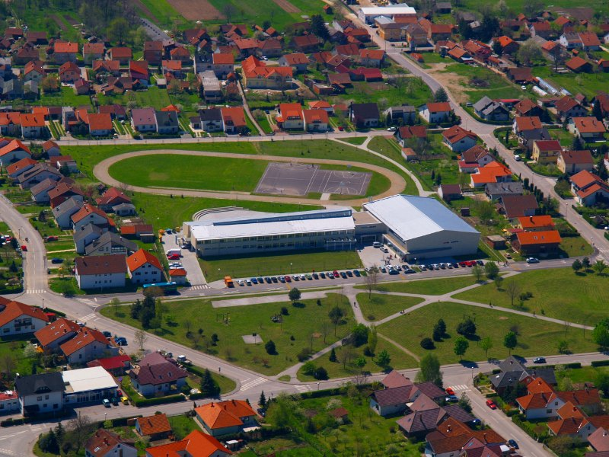
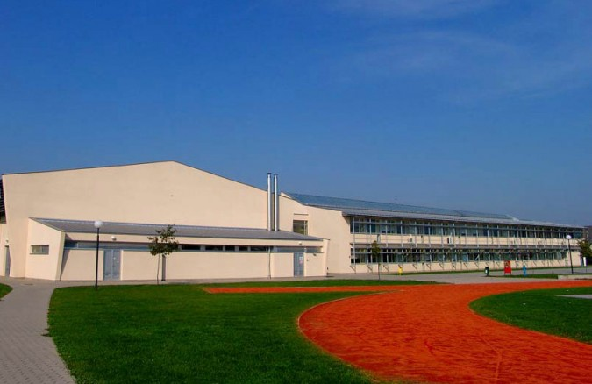
This presentation was made by:
Student: Mario Olčar
Teacher: Iva Naranđa
School: II. osnovna škola Čakovec, Croatia
eTwinning project: On the Track of Our Recent Past
Camera Week, April 2016
18.4.2016

Slide 10
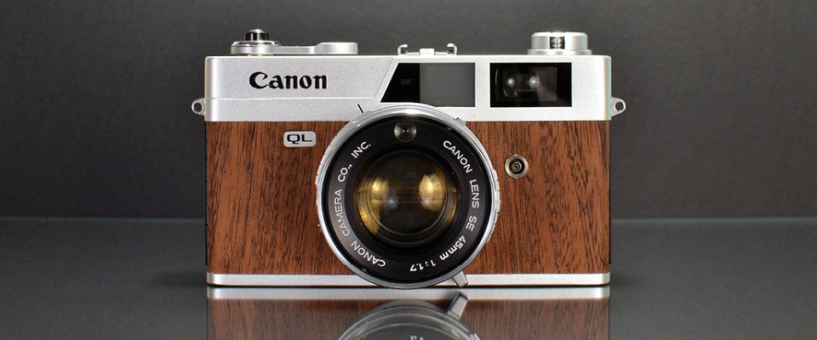
Thanks for watching!

